Slide 1
Application-Specific Logic-in-Memory for
Polar Format Synthetic Aperture Radar
Qiuling Zhu, Eric L. Turner, Christian R. Berger, Larry Pileggi, Franz Franchetti
September 22, 2011

Slide 2
Application-Specific Logic-in-Memory
Can we push some memory-intensive computational logic
into or close to the memory by constructing a smart and efficient “Logic in memory” block ?
Traditional:
Main
Memory
Local
Memory
CPU
Logic-in-memory:
Main
Memory
Local
Memory
CPU
logic
logic

Slide 3
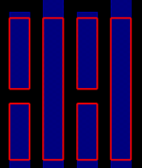

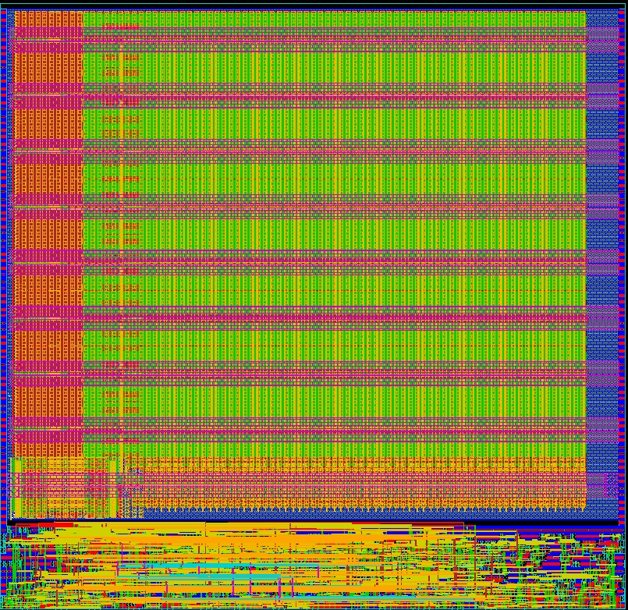

Enabling Technology: Regular Patterns
D. Morris, et. al, “Design of Embedded Memory and Logic Based On Pattern Constructs” , Symp.VLSI Technology, June 2011.
Implementing sub-22nm designs using a limited set of pattern constructs can enable robust compilation of smart memories
Regular
patterns
Application-specific
“Magic” memory
SRAM bitcell
Compatible Logic
Compatible logic cells

Slide 4
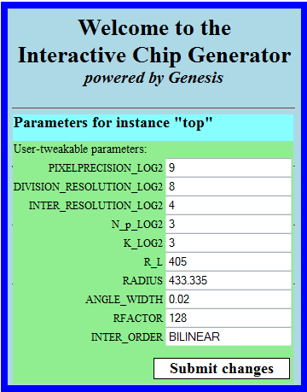
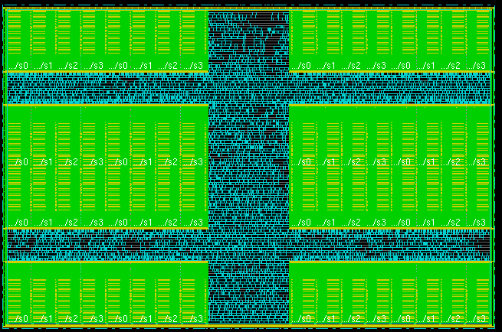
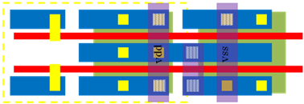

Tool Chain: Chip Generator and Memory Compiler
Chip Generator
Logic in Memory
Smart Memory Compiler
SRAM bitcell
Local
Memory
App-specific logic-in-memory
Compatible logic cells
Logic
logic
Chip Generator
Generates designs from high-level parameterization and specification
Utilizes Stanford’s chip generator platform (Genesis 2)
Smart Memory Compiler
Map memory and logic onto a set of pre-characterized pattern constructs
Allow flexible synthesis of logic and memory functionalities in place of hard IP

Slide 5
Big Question: Impact on Algorithms
Logic-in-memory changes the relative cost of operations, requiring new types of algorithms.
Traditional
Data storage and processing are logically and physically split
Algorithms are optimized w.r.t. cost measure as
Operation count, minimum number of memory accesses, reuse,…
eg. FFT: O(log n), Matrix Multiplication: O(n)
Logic-in-memory
Local data dependency
Regular memory access pattern
Simple computational logic
Cost measure changes
Notes:
Operations count, number of memory accesses, reuse,…
Algorithms are optimized w.r.t. this cost measure
Operations count: FFT: O(n log n), Matrix Multiplication: O(n³)
Minimum transfers: FFT: O(n), Matrix Multiplication: O(n²)
Reuse: FFT: O(log n), Matrix Multiplication: O(n)

Slide 6
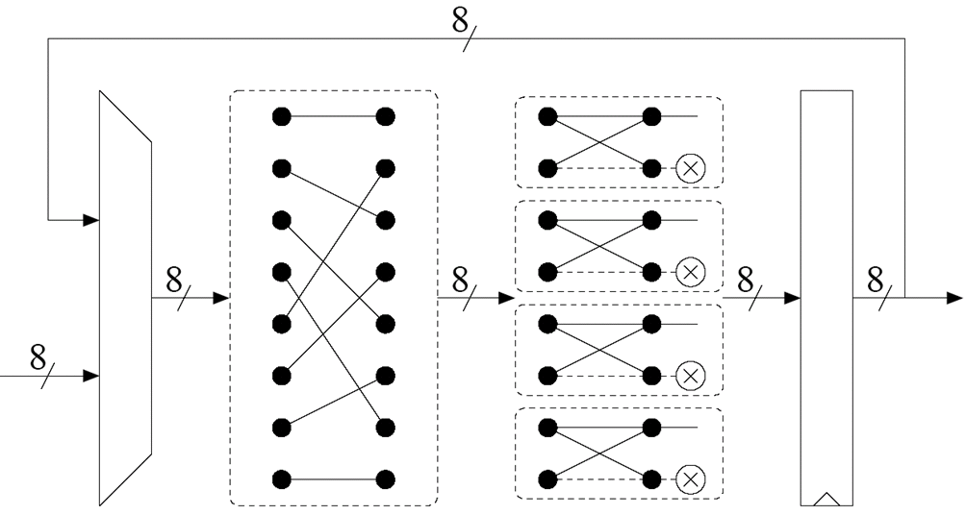

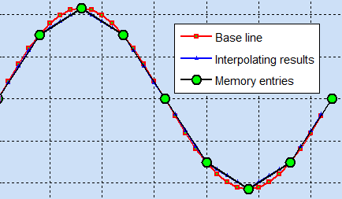

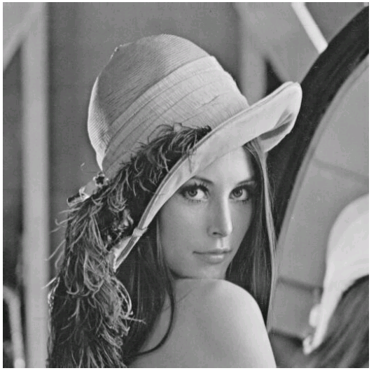



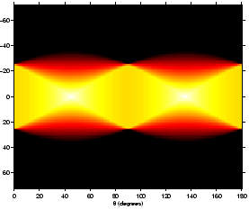
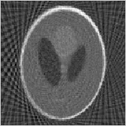
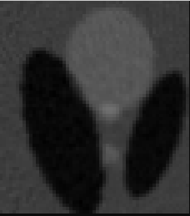
Case Study: Interpolation Memory
Ex 1: FFT Twiddle Factor
Ex 2: Image Pyramid Memory
level k
ALU
level k-1
ALU
level k-2
Ex 3: Geometry Transformation
Ex 4: Tomography Backprojection
x
Original Phantom image

Slide 7
Outline
SAR Polar Format Algorithms for Logic-in-Memory
Extension: Partial Reconstruction
Implementation and Design Automation
Experimental Results
Summary

Slide 8
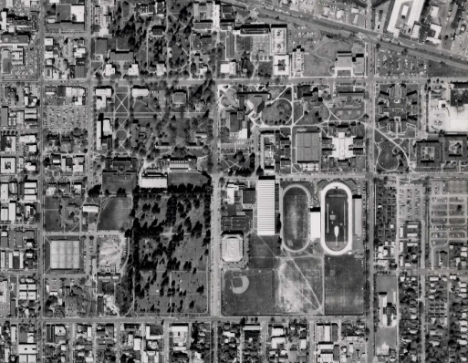
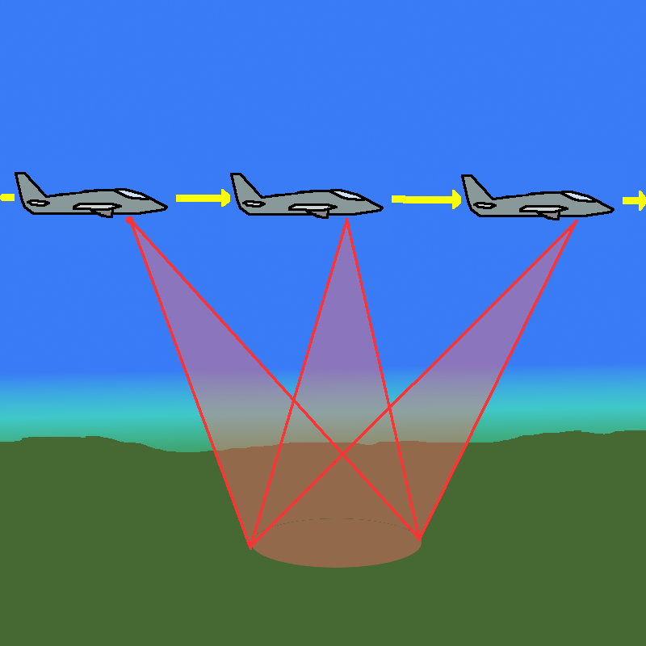
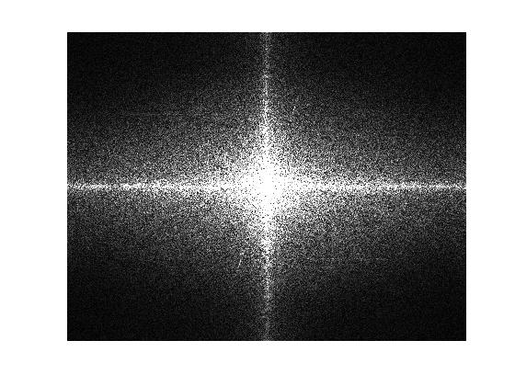
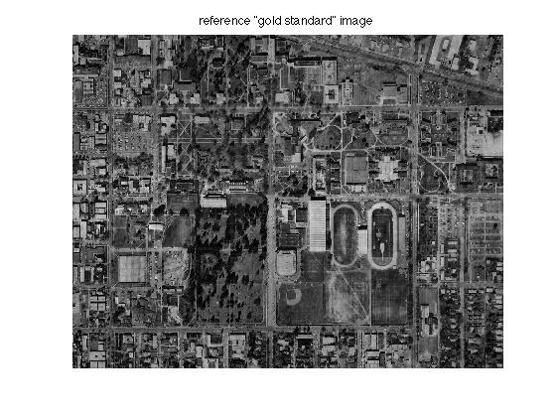
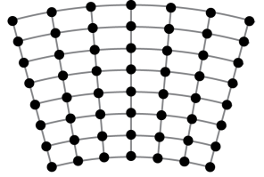
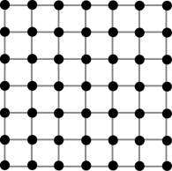
Synthetic Aperture Radar (SAR)
Data acquisition
Image formation
SAR image formation
Interpolation
2D FFT

Slide 9
FFT Upsampling Based Polar Reformatting
m1
n₂
n₂
Grid
Interpolation
n₂
m1
Inverse 2D FFT
n₂
SAR image formation:
Range interpolation
FFT upsampling based
Cross range interpolation
2D inverse FFT
Computational cost:
Interpolation: 10lm₁·(m·log₂(m) + n·log₂(n))
2D IFFT: 10·n₂²·log₂(n₂)
I is the number of segments per range line, m is the input segment size and n is the size of the upsampled output segment.
Data transferring cost:
Logic-in-Memory Interpolation
Needs new algorithm
Memory
CPU
Interpolation

Slide 10
Local Interpolation Based Polar Reformatting
Approach: direct local interpolation
P(x,y)
Finding neighbors is expensive
Grid points in Curvilinear grid (measurements)
Grid points in Cartesian space (outputs)
sqrt, atan operations are expensive in Logic-in-memory

Slide 11
Local Interpolation Based Polar Reformatting
dx
P(x,y)
dy
(+, -,×…)
sqrt, atan…
Grid points in Curvilinear grid (measurements)
Grid points in Cartesian space (outputs)
Steps:
Coordinate transformation
Four-corner image perspective geometric transformation
Avoid sqrt and atan
2D surface interpolation
Simple logic computation
bilinear, bicubic,…

Slide 12
2D Interpolation
dx
dx
i-1, j-1
i-1, j
i-1, j+1
i-1, j+2
i, j
i, j
i, j+1
i, j-1
i, j
dy
dy
i, j+1
i, j+2
P(x,y)
i+1, j+1
P(x,y)
i+1, j
i+1, j-1
i+1, j
i+1, j+1
i+1, j+2
Nearest Neighbor
Bilinear Interpolation
i+2, j+1
i+2, j-1
i+2, j
i+2, j+2
Bicubic Interpolation
Dividable 2D interpolation
Bilinear: (2 horizontal + 1 vertical) 1D interpolations
Bicubic: (4 horizontal + 1 vertical) 1D interpolations
1D interpolation: Newton divided difference form based polynomial interpolation
Suitable for Logic in Memory
Localized computation: Outputs are only decided by their neighbors
Regular memory access: Continuous or block data array access
Simple computational logic: Adders, subs, boolean operations …

Slide 13
Tiling: Accurate Geometry Approximation
error
Geometry approximation conditions:
K
delta_{width} is small enough
R_{L} is large enough
Solution: Image tiling
R_{L}
Tile1
Tile2
Tile in the Cartesian grid
Output oriented tiling
Easy to identify boundary
and tile overlap
Tile3
Tile4
delta_{width}

Slide 14
Outline
SAR Polar Format Algorithms for Logic-in-Memory
Extension: Partial Reconstruction
Implementation and Design Automation
Experimental Results
Summary

Slide 15
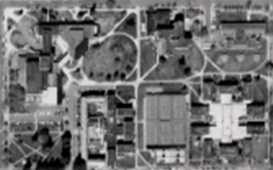
SAR Partial Reconstruction
Scenario: Big image, small screen, pan-and-zoom (e.g. handheld device)
Bad approach: reconstruct everything, display only region of interest
Better: reconstruct only what will be displayed
requires sophisticated filtering before reconstruction
Image data
10,000 × 10,000
Display
800× 600
Partial Image formation
Partial image formation
Interpolation + Filtering
2D FFT

Slide 16
Partial Reconstruction I
Reconstructs and displays low-resolution full-size image
Traditional: Interpolate all, full-size large IFFT then decimation
Alternative: Partial interpolation then smaller-size IFFT
Theory behind: Multiplication in the Frequency is identical to convolution in the spatial space.
cut off high frequencies
in Fourier space
only computes
the pixels that
are required!
Smaller-size
interpolation
Smaller-size
IFFT
Low pass filtering
In the spatial domain

Slide 17
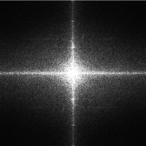
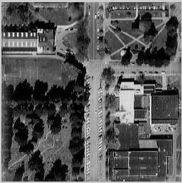
Partial Reconstruction II
Reconstructs and displays a high-resolution image portion
Traditional: Full-size large IFFT, reconstruct all then cut off unnecessary region
Alternative: Decimation filtering and then smaller-size IFFT
Theory behind: Multiplication in the space is identical to convolution in the Fourier domain.
Displacement in time is equivalent to phase shift
FFT
sample
ROI
interpolate
decimation
filter
smaller
IFFT
Logic in
Memory

Slide 18
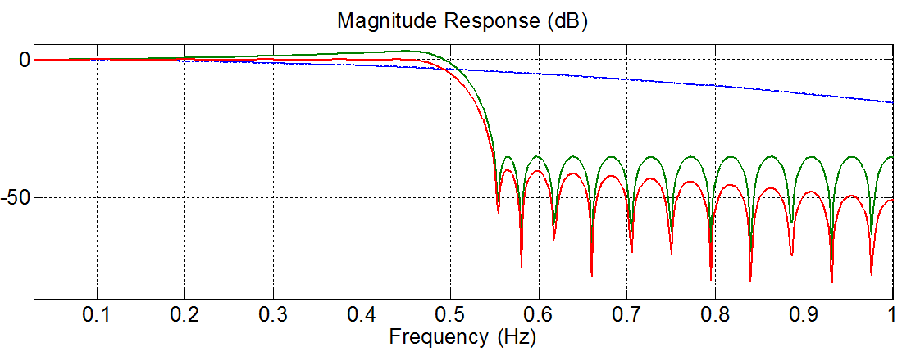
Decimation Filter Implementation
FIR Polyphase filter is expensive at high decimation factors
Cascaded Integrated Comb(CIC) filter is more economical
Large decimation factors
No multiplication
CIC compensation is required
inp
z⁻¹
z⁻¹
z⁻¹
z⁻¹
CIC filter structure
M=1
N=4
R
outp
z^{-M}
z^{-M}
z^{-M}
z^{-M}
Frequency Response:
CIC
ciccomp
cascade
CIC Spec: Decimation factor = 16; N = 4; M= 1
CIC Comp Spec:
Fp = 0.45; Fst = 0.55; Ap = 0.1dB, Ast = 35dB;
45 stages; downsample = 2 ; total decimation factor = 32 ;

Slide 19
Outline
SAR Polar Format Algorithms for Logic-in-Memory
Extension: Partial Reconstruction
Implementation and Design Automation
Experimental Results
Summary

Slide 20
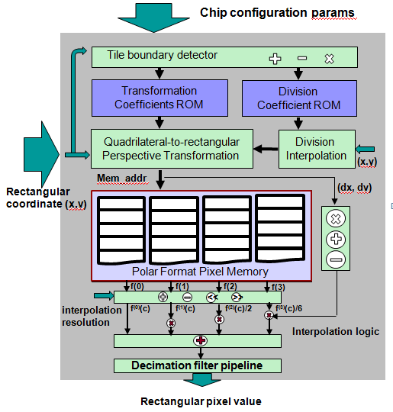
Design Automation and Optimization
Hardware Structure
Design Automation Flow:
Customized Parameters
Code
Generator
Target + Budget
Design Space
Exploration
Performance Model
RTL Design
(memory/logic
mixed)
Performance
/Cost Report
Smart memory
Compiler
Regular
Pattern

Slide 21

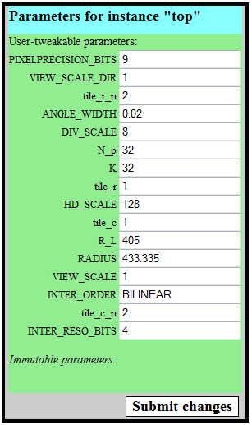
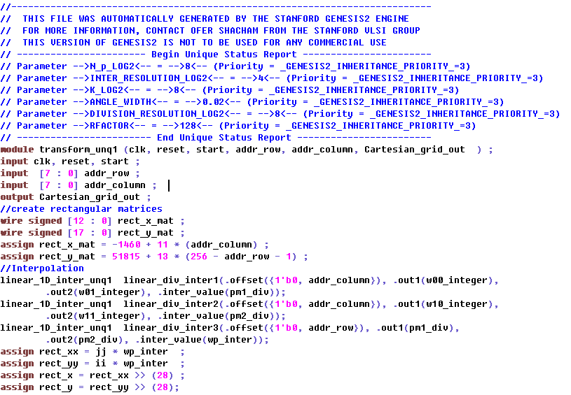

Chip Generator
http://genesis.web.ece.cmu.edu/gui/scratch/mydesign-10545.php
Reference: O. Shacham, O. Azizi, M. Wachs, et. al, "Rethinking
Digital Design: Why Design Must Change”, Micro, IEEE, Dec 2010.

Slide 22
Outline
SAR Polar Format Algorithms for Logic-in-Memory
Extension: Partial Reconstruction
Implementation and Design Automation
Experimental Results
Summary

Slide 23
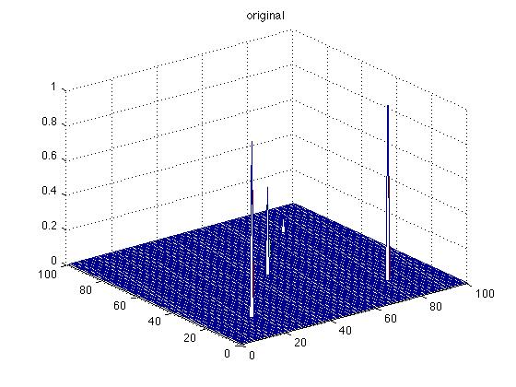
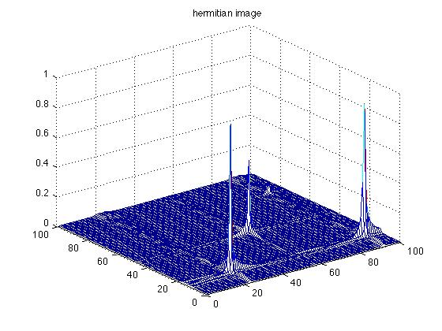
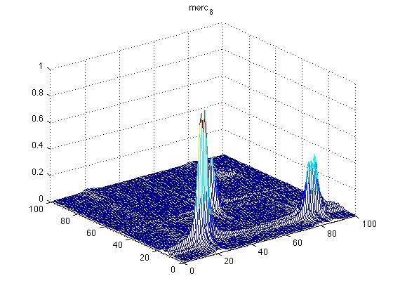
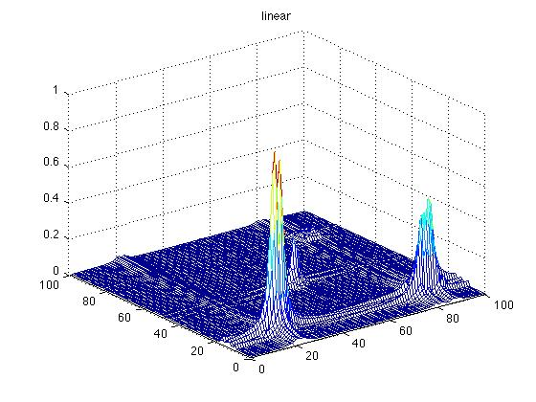
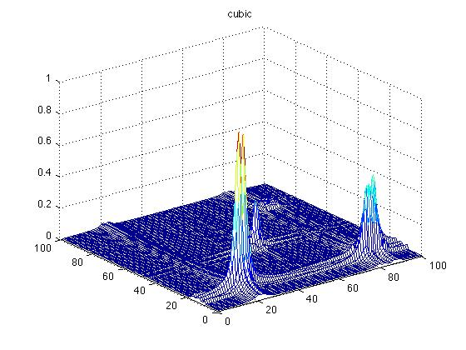
Reconstruction Quality vs. FFT SAR
Perfect reconstruction of point targets
original
hermitian image
Actual reconstruction algorithms
FFT-based
linear
cubic
Is FFT-based SAR better than interpolation-based SAR?

Slide 24
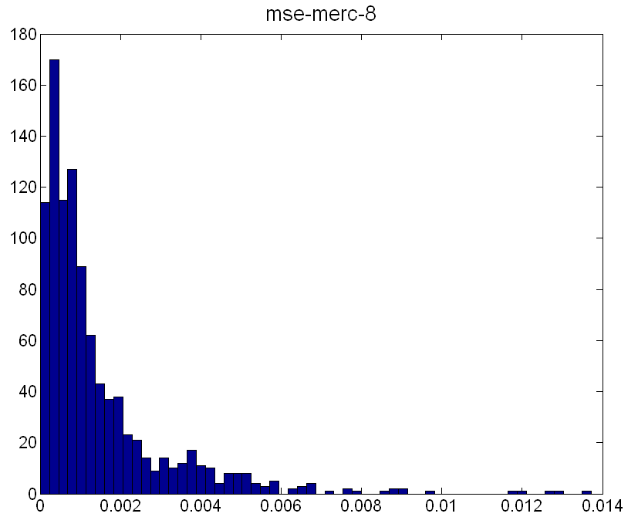
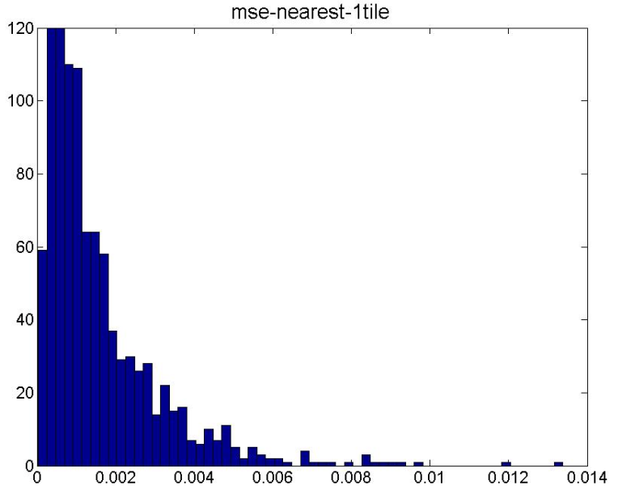
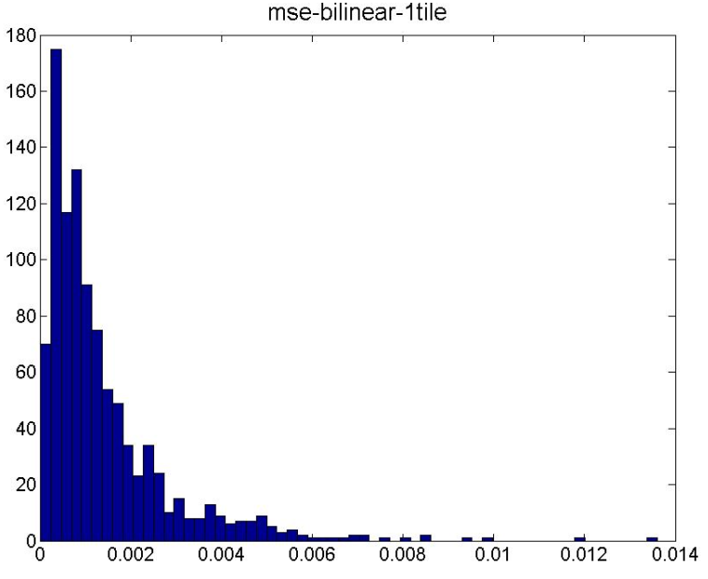
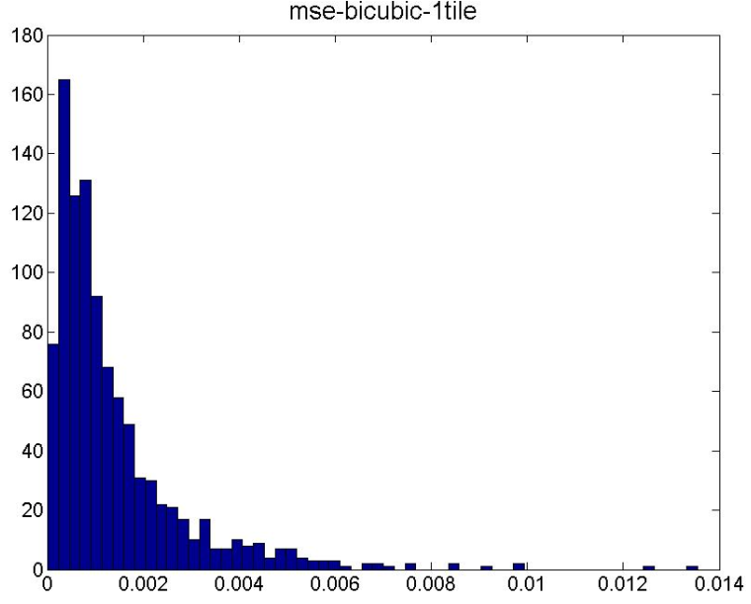
Can FFT and Interpolation Be Distinguished?
FFT interpolation
nearest neighbor interpolation
bilinear interpolation
bicubic interpolation
Answer: Hypothesis Testing
Hypothesis testing for linear and FFT: P(Error) = 0.495
Random guessing: P(Error) = 0.5
Results are statistically indistinguishable. Interpolation is as good as FFT

Slide 25
Accuracy Improvement Through Tiling
MSE decreases with more tiling and higher interpolation order

Slide 26
Energy Saving for Logic-in-Memory
Energy saving increases with the increasing of problem size

Slide 27
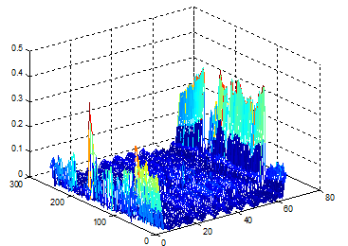
Accurate Region-of-Interest by Sacrificing Border
error
ast: decimation filter stopband attenuation (dB)
Imperfect image edge is resulting from non-steep filter transition region

Slide 28
Partial Reconstruction: Operation saving vs. Cost
Beta: filter rolloff factors ;
Ast: decimation filter stopband attenuation (dB)
IFFT operation counts decreases exponential with increasing decimation factors
Logic hardware cost is negligible compared with memory cost
Decimation filter cost slightly increases when increasing decimation factors

Slide 29
Outline
SAR Polar Format Algorithms For Logic-in-Memory
Extension: Partial Reconstruction
Implementation and Design Automation
Experimental Results
Summary

Slide 30

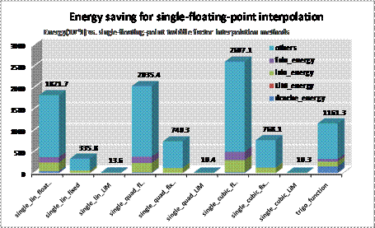
Summary
Logic in Memory and its applications for interpolation
Local
Memory
Logic in Memory for SAR FPA and partial reconstruction
inp
Tile1
Tile2
z⁻¹
z⁻¹
z⁻¹
z⁻¹
R
Tile3
Tile4
z^{-M}
z^{-M}
z^{-M}
z^{-M}
outp
Evaluation and integration with Genesis2

