Slide 1

3D Systems with On-Chip DRAM for Enabling
Low-Power High-Performance Computing
Jie Meng, Daniel Rossell, and Ayse K. Coskun
Performance and Energy Aware Computing Lab (PEAC-Lab)
Electrical and Computer Engineering Department
Boston University
HPEC’11 – September 22, 2011

Slide 2
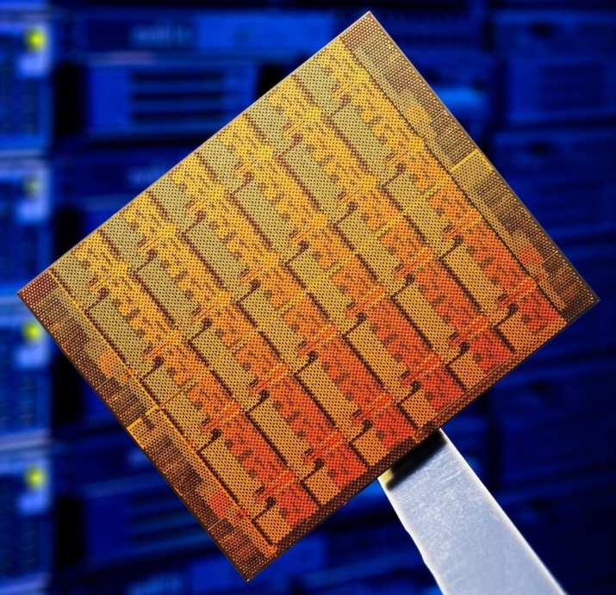
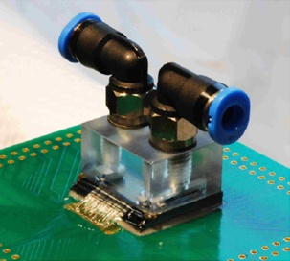
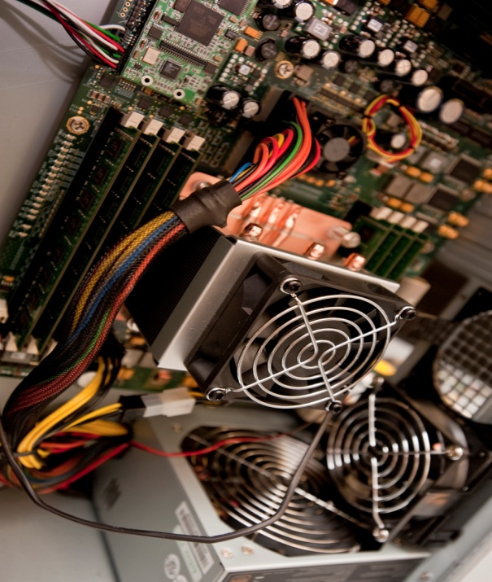
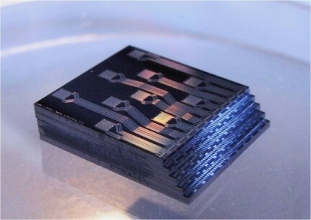
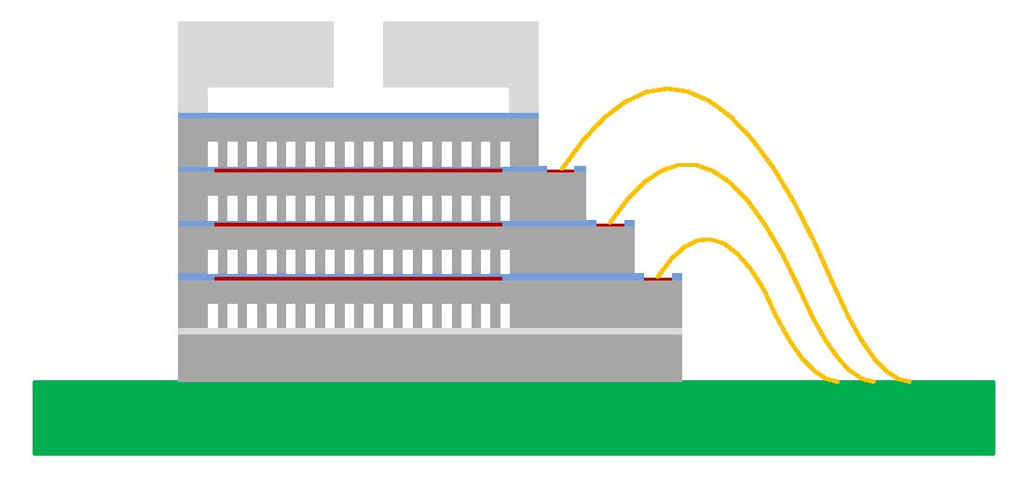
Performance and Energy Aware Computing Laboratory
Figure: IBM Zurich & EPFL
Energy and thermal management of manycore systems:
Scheduling
Memory architecture
Message passing / shared memory
…
3D stacked architectures:
Performance modeling, thermal verification, heterogeneous integration (e.g., DRAM stacking), …

Slide 3
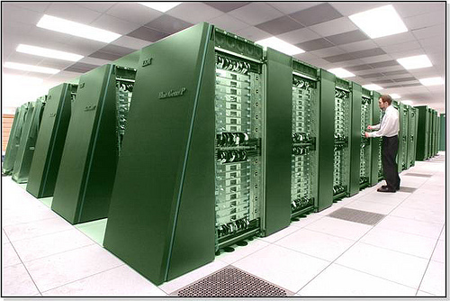
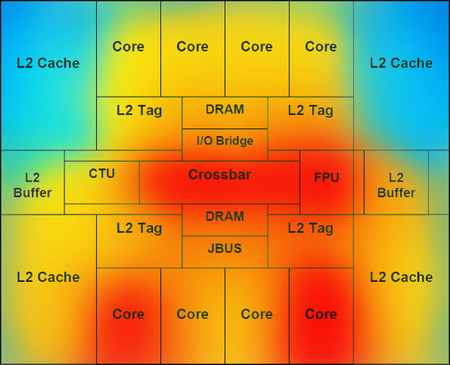
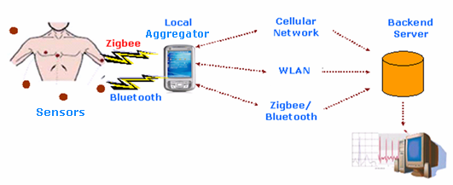
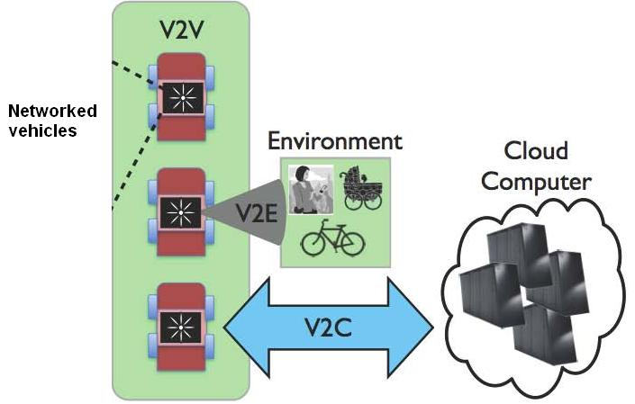
Performance and Energy Aware Computing Laboratory
Green software:
Software optimization, parallel workloads, scientific & modeling applications, …
Figure: Argonne's Blue Gene/P supercomputer
Energy Efficiency and Real-Time Design in Cyber-Physical Systems

Slide 4

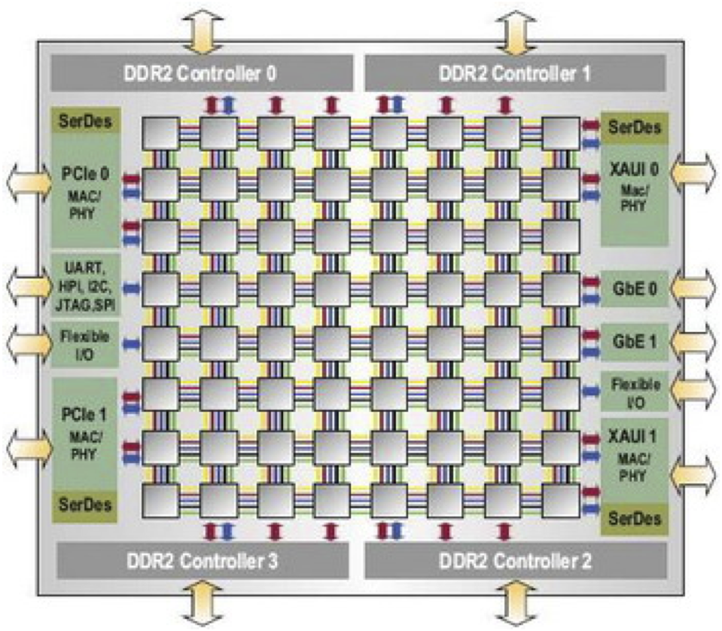
Multi-core to Many-core Architectures
Challenges in many-core systems
Memory access latency
Interconnect delay & power
Yield
Chip power & temperature
Intel’s
48-core
Single-Chip
Cloud Computer
Tilera
TILEPro 64-core Processor
Notes:
In addition to interconnect delay reduction -> speed gap between chip and memory.

Slide 5
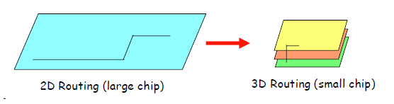
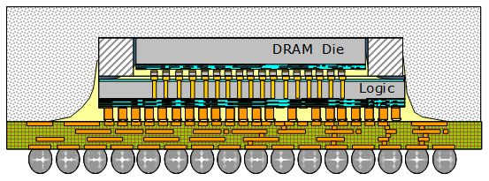
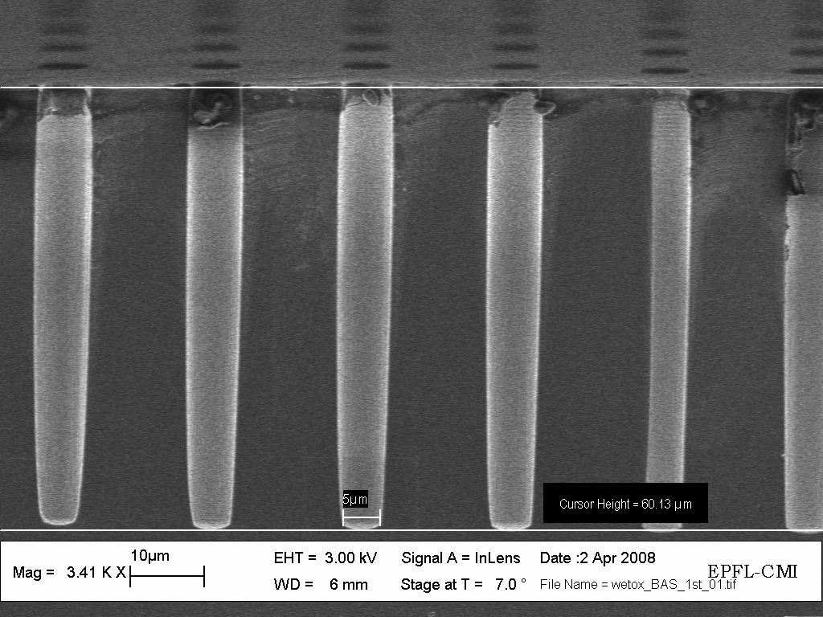
3D Stacking
Shorter interconnects → Low power and high speed
Figure: Ray Yarema, Fermilab
Ability to integrate different technologies in a single chip
Figure: IMEC
Figure: LSM, EPFL

Slide 6
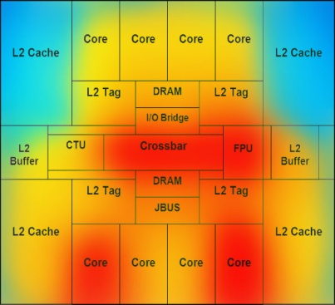
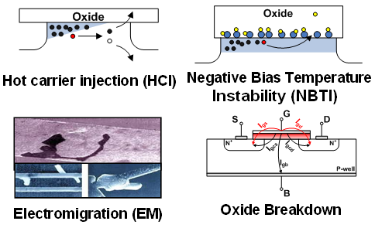
Energy Efficiency and Temperature
Temperature-induced challenges
Energy problem
High cost: a 10MW data center spends millions of dollars per year for operational and cooling costs
Adverse effects on the environment
Cooling Cost
Leakage
Performance
Reliability
Thermal challenges accelerate in high-performance systems!
Notes:
Mention dram stacking can boost the performance.

Slide 7
Contributions
Model for estimating memory access latency in 3D systems with on-chip DRAM
Novel methodology to jointly evaluate performance, power, and temperature of 3D systems
Analysis of 3D multicore systems and comparisons with equivalent 2D systems demonstrating:
  Up to 3X improvement in throughput, resulting in up to 76% higher power consumption per core
  Temperature ranges area within safe margins for high-end systems. Embedded 3D systems are subject to severe thermal problems.
Performance
Power
Thermal
Thermal management policies
3D systems with on-chip DRAM
running parallel applications
Notes:
Prior 3d work looks into perf or temp only.

Slide 8
Outline
System description:
  2D baseline vs. 3D target systems configuration
Methodology:
  Performance, power, and thermal modeling
  Thread allocation policy
Evaluation:
  Exploring performance, power, and thermal behavior of 2D baseline vs. 3D system with DRAM stacking

Slide 9
Target System
16-core processor, cores based on the cores in Intel SCC [Howard, ISSCC’10]
Manufactured at 45nm, has a die area of 128.7mm²
Core architecture
CPU clock | 1.0GHz
Branch Predictor | Tournament predictor
Issue Width | 2-way out-of-order
Functional Units | 2 IntAlu, 1 IntMult, 1 FPALU, 1 FPMultDiv
Physical Registers | 128 Int, 128 FP
Instruction Queue | 64 entries
L1 ICache / DCache | 16 KB @2 ns (2 cyc)
L2 Cache(s) | 16 private L2 Caches Each L2: 4-way set-associative, 64B blocks 512 KB @5 ns (5 cyc)

Slide 10
3D System with On-chip DRAM
11.7mm
System Interface + I/O
Core
L2
Core
L2
Core
L2
Core
L2
Core
L2
Core
L2
Core
L2
Core
L2
HeatSink
11mm
Memory Controller
core + L2s
Core
L2
Core
L2
Core
L2
Core
L2
pad
Core
L2
Core
L2
Core
L2
Core
L2
pad
2-layer 8Gb DRAM
(4Gb each layer)
11.7 mm
pad
1.625mm
1.3mm
DRAM
Layer
Core
L2
11mm
9 mm
2.4mm
11.5 mm

Slide 11
Memory Access Latency: 2D vs. 3D
Memory access latency
 | 2D-baseline design | 3D system with on-chip DRAM
memory controller (MC) | 4 cycles controller-to-core delay, 116 cycles queuing delay, 5 cycles MC processing time | 4 cycles controller-to-core delay, 50 cycles queuing delay, 5 cycles MC processing time
main memory | off-chip 1GB SDRAM, t_{RAS} = 40ns, t_{RP} = 15ns, 10ns chipset request/return | on-chip 1GB SDRAM, t_{RAS} = 30ns, t_{RP} = 15ns, no chipset request/return
memory bus | off-chip memory bus, 200MHz, 8Byte bus width | on-chip memory bus, 2GHz, 128Byte bus width

Slide 12
Outline
System description:
  2D baseline vs. 3D target systems configuration
Methodology:
  Performance, power, and thermal modeling
  Thread allocation policy
Evaluation:
  Exploring performance, power, and thermal behavior of 2D baseline vs. 3D system with DRAM stacking

Slide 13
Performance Model
Performance metric: Application IPC
Full-system simulator:
  M5 (gem5) simulator [Binkert, IEEE Micro’06]
  Thread-binding in an unmodified Linux 2.6 operating system
Parallel benchmarks:
  PARSEC parallel benchmark suite [Bienia, Princeton 2011]
  Sim-large input sets in region of interest (ROI)

Slide 14
Power Model
Processor power:
    McPAT simulator [Li, MICRO’ 06]
    Calibration step to match the average power values of the Intel SCC cores
M5
McPAT
IPC
Cache misses
......
Dynamic power
Leakage power
L2 cache power:
  CACTI 5.3 [HPLabs 2008]
  Dynamic power computed using L2 cache access rate
3D DRAM power:
  MICRON’s DRAM power calculator [www.micron.com]
  Takes the memory read and write access rates as inputs

Slide 15
Thermal Model
Hotspot 5.0 [Skadron, ISCA’ 03]
Includes basic 3D features
Thermal simulation parameters
Chip thickness | 0.1mm
Silicon thermal conductivity | 100 W/mK
Silicon specific heat | 1750 kJ/m³K
Sampling interval | 0.01s
Spreader thickness | 1mm
Spreader thermal conductivity | 400 W/mK
DRAM thickness | 0.02mm
DRAM thermal conductivity | 100 W/mK
Interface material thickness | 0.02mm
Interface material conductivity | 4 W/mK

Slide 16
Thermal Model (Cont’d)
We consider two additional packages representing smaller size and lower cost embedded packages.
M5
McPAT
Hotspot
IPC
Cache misses
……..
Dynamic power
Leakage power
Temperature
Heat sink parameters for three different packages
Package | Thickness | Resistance
High Performance | 6.9 mm | 0.1 K/W
No Heatsink (Embedded A) | 10 μm | 0.1 K/W
Medium Cost (Embedded B) | 6.9 mm | 1.0 K/W

Slide 17
Outline
System description:
  2D baseline vs. 3D target systems configuration
Methodology:
  Performance, power, and thermal modeling
  Thread allocation policy
Evaluation:
  Exploring performance, power, and thermal behavior of 2D baseline vs. 3D system with DRAM stacking

Slide 18
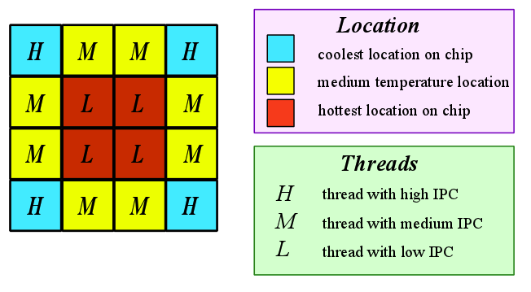
Thread Allocation Policy
Based on the balance_location policy [Coskun, SIGMETRICS ’09]
Assigns threads with the highest IPCs to the cores at the coolest locations on the die

Slide 19
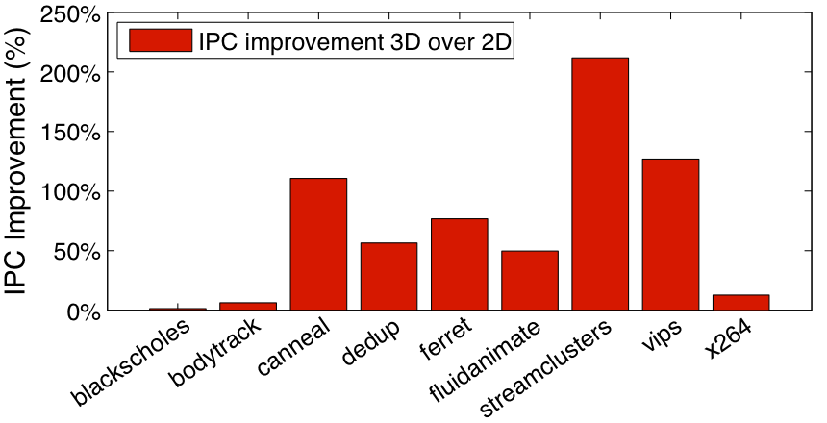
  Performance Evaluation
3D DRAM stacking achieves an average IPC improvement of 72.55% compared to 2D.

Slide 20
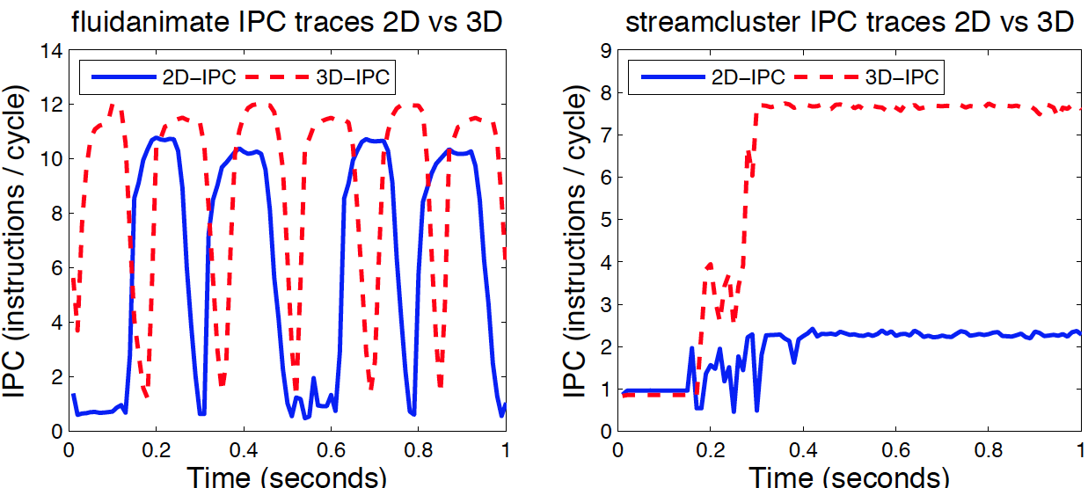
Temporal Performance Behavior
streamcluster and fluidanimate improve their average IPC by 211.8% and 49.8%, respectively.

Slide 21
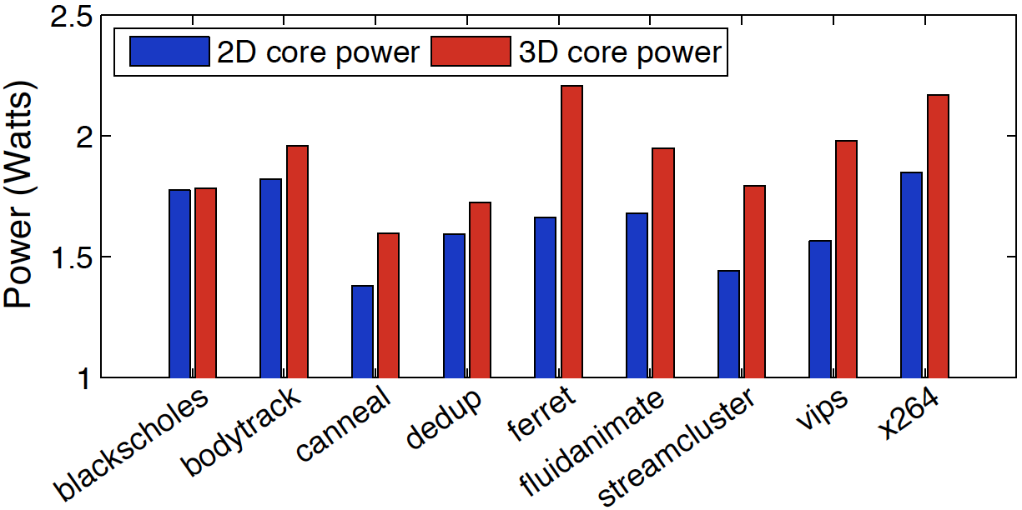
Power Evaluation
Per-core power increases by 16.6% on average for the 3D system.
Power of the 3D system and 2D-baseline running PARSEC benchmarks

Slide 22
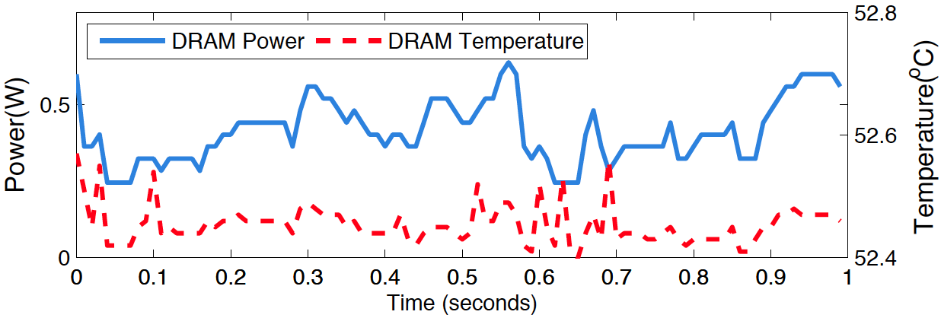
DRAM Power and Temperature
DRAM power changes following the variations in memory access rate.
DRAM layer power and temperature traces for dedup benchmark
Notes:
Discuss impact of low mem access versus high mem access (e.g., parallel access case).

Slide 23
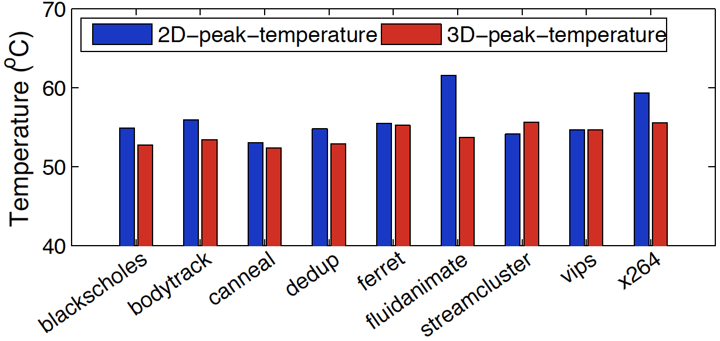
Temperature Analysis
Temperature decreases because the lower power DRAM layer shares the heat of the hotter cores.
Peak core temperature for the default high-performance package

Slide 24
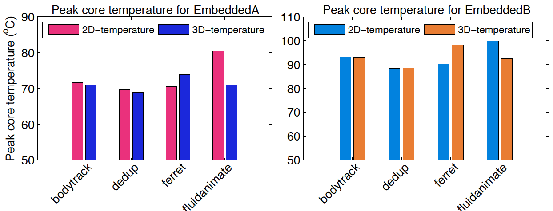
Temperature Analysis (Cont’d)
Temperatures increase more noticeably in 3D systems with small-size and low-cost embedded packages
small-size embedded package
low-cost embedded package

Slide 25
Conclusion
We provide a comprehensive simulation framework for 3D systems with on-chip DRAM.
We explore the performance, power, and temperature characteristics of a 3D multi-core system running parallel applications.
Average IPC increase is 72.6% and average core power increase is 16.6% compared to the equivalent 2D system.
We demonstrate limited temperature changes in the 3D systems with DRAM stacking with respect to the 2D baseline.
Future work: Detailed DRAM power models, higher bandwidth memory access, new 3D system architectures, new thermal/energy management policies.

Slide 26
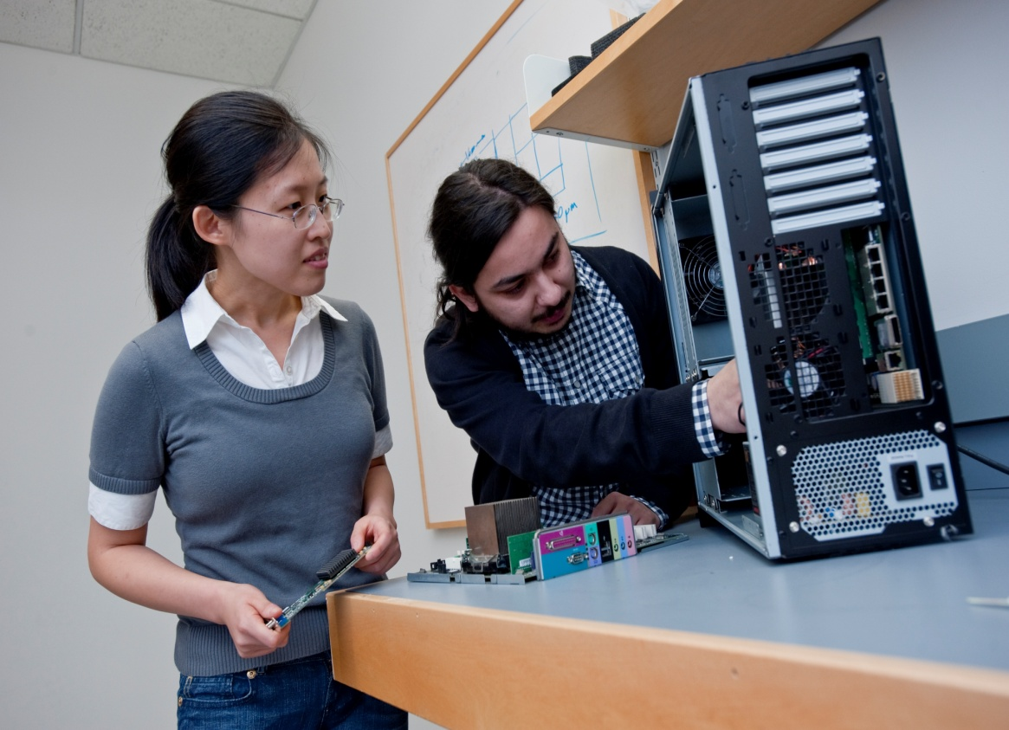

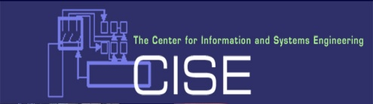

Performance and Energy Aware Computing Laboratory
Collaborators
  EPFL, Switzerland
  IBM
  Oracle
  Intel
  Brown University
  University of Bologna, Italy
Funding:
  DAC, Richard Newton Award
  Dean’s Catalyst Award, BU
  Oracle
  VMware
Contact:
http://www.bu.edu/peaclab
http://people.bu.edu/acoskun
acoskun@bu.edu

