Slide 1
Performance Portable Tracking of Evolving Surfaces
Wei Yu
Citadel Investment Group
Franz Franchetti, James C. Hoe, José M. F. Moura
Carnegie Mellon University
Tsuhan Chen
Cornell University
This work was supported by DARPA, ONR, NSF, Intel, Mercury, and ITRI

Slide 2
The Future is Parallel and Heterogeneous
2012 and later
?
Sun Niagara
32 threads
2009
Intel Larrabee
Intel Sandy Bridge
8-way float vectors
Cell BE
8+1 cores
Virtex 5
FPGA+ 4 CPUs
Intel Haswell
vector coprocessors
before 2000
Xtreme DATA
Opteron + FPGA
CPU platforms
multicore
IBM POWER7
2x8 cores
IBM Cyclops64
80 cores
SGI RASC
Itanium + FPGA
BlueGene/Q
Core2 Duo
Core2 Extreme
Tilera TILEPro
64 cores
ClearSpeed
192 cores
Nvidia GPUs
240 streaming cores
Nvidia Fermi
AMD Fusion
Programmability?
Performance portability?
Rapid prototyping?

Slide 3
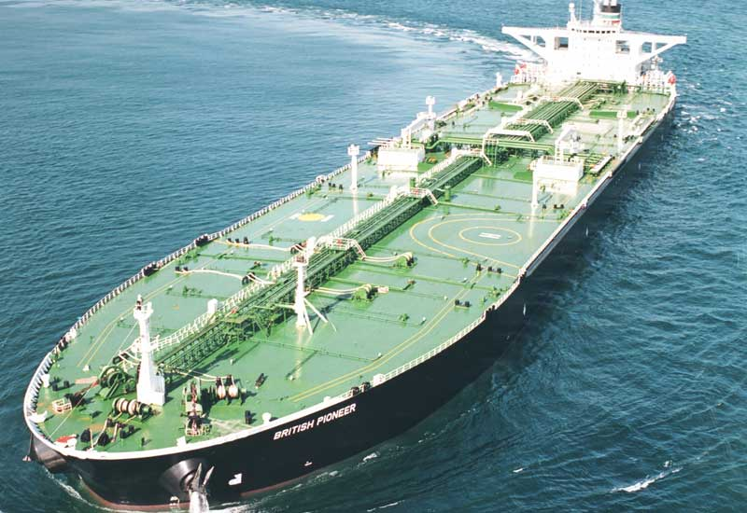
Software’s Slow Pace of Change
Popular performance programming languages
1953: Fortran
1973: C
1985: C++
1997: OpenMP
2007: CUDA
Popular performance libraries
1979: BLAS
1992: LAPACK
1994: MPI
1995: ScaLAPACK
1995: PETSc
1997: FFTW
Popular productivity/scripting languages
1987: Perl
1989: Python
1993: Ruby
1995: Java
2000: C#
Notes:
3

Slide 4
Compilers: The Fundamental Problem
Matrix-matrix multiplication
for i=1:N
for j=1:N
for k=1:N
C[i,j] += A[i,k]*B[k,j]
+=

Tiled+unrolled+parallelized+SIMDized+prefetching matrix-matrix multiplication
#pragma omp parallel for
for i=1:NB:N
for j=1:NB:N
for k=1:NB:N
for i0=i:NU:i+NB
#pragma prefetch B
for j0=j:NU:j+NB
for k0=k:NU:k+NB
#pragma unroll
for k00=k0:1:k0+NU
for j00=j0:1:j0+NU
#pragma vector always
for i00=i0:1:i0+NU
C[i00,j00] += A[i00,k00]*B[k00,j00];
+=

Problem: which transformation order? What parameter values?
Notes:
4

Slide 5
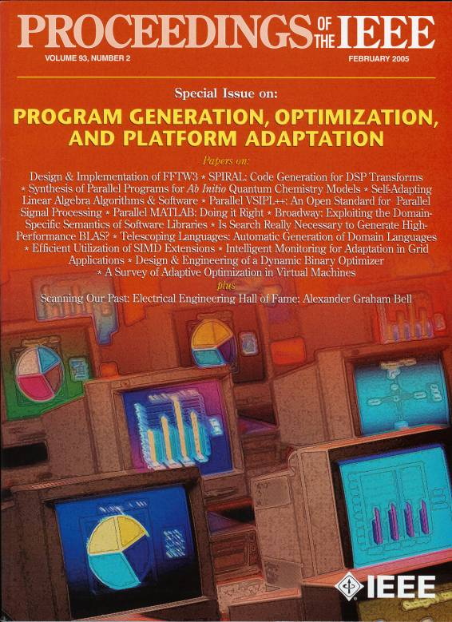
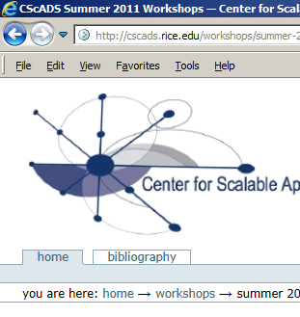
Autotuning and Program Synthesis
Synthesis from Domain Math
Compiler-Based Autotuning
Spiral
Signal and image processing, SDR
Tensor Contraction Engine
Quantum Chemistry Code Synthesizer
FLAME
Numerical linear algebra (LAPACK)
Polyhedral framework
IBM XL, Pluto, CHiLL
Transformation prescription
CHiLL, POET
Profile guided optimization
Intel C, IBM XL
Autotuning Numerical Libraries
Autotuning Primer
ATLAS
BLAS generator
FFTW
kernel generator
Vendor math libraries
Code generation scripts

Slide 6
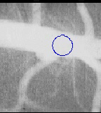
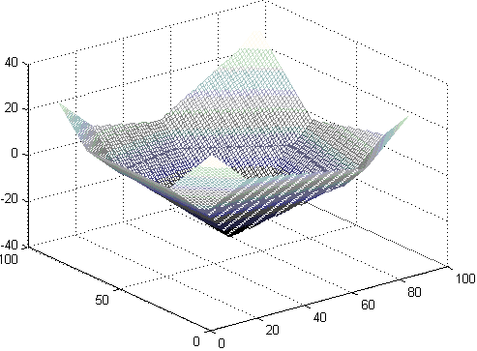
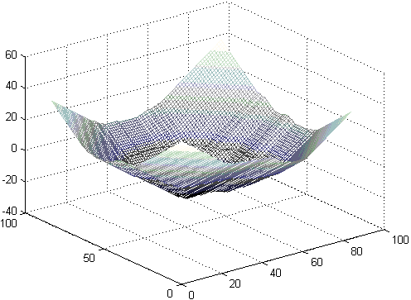
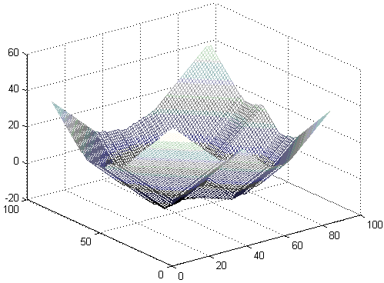
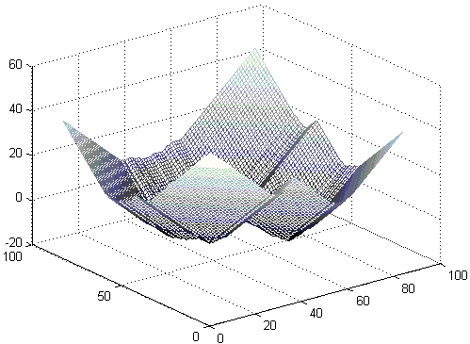
Level-Set Image Segmentation
Level Set Algorithm
PDE-based image segmentation method
Image produces force field on moving contour
Embeds contour into n+1 dimensional level-set function
Narrow Band Level Set Algorithm
Compute only in neighborhood of boundary
Makes algorithm computationally tractable but complicated
Notes:
Round edge
Regular data cube
Surface
Force field (PDE)
A simple 3-D evolving surface example
Region of interest
Stencil
evolution

Slide 7
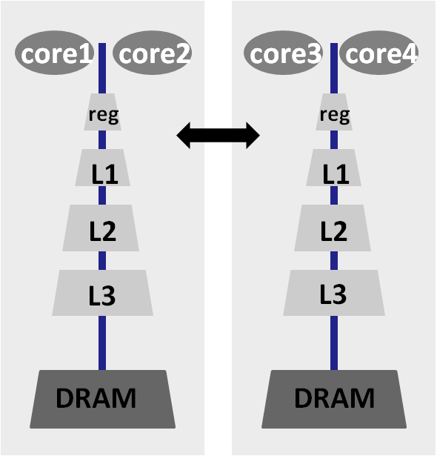
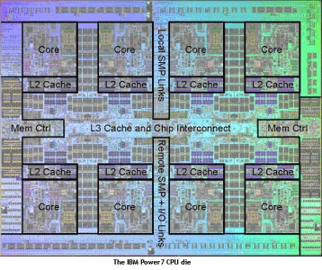
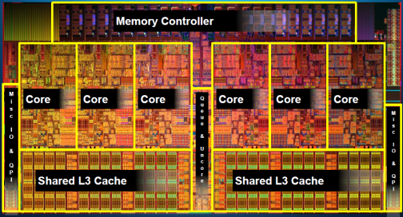
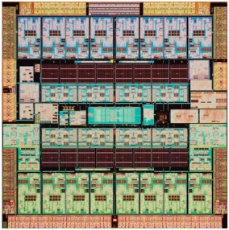
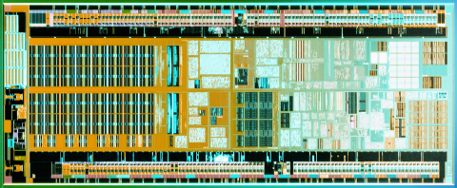
Target: Cache-Based Multicores
COTS Multicore
Shared memory (SMP or NUMA)
Cache-based memory (L1, L2, L3)
SIMD vector instructions (SSE, AltiVec,…)
IBM POWER7
8 cores, 4-way SMT
Intel Core i7
8 cores, 2-way SMT
UltarSPARC T3
16 cores, 8-way SMT
Intel Atom
1 cores, 2-way SMT
Notes:
ALU symbols

Slide 8
Why A Challenging Problem?
SparseMV
Narrow Band Level Set
Stencil
r iter
N iter
Memory bound
compute bound
O(1)
O(N)
sparse & irregular data structure
sparse data with dense substructure
dense & regular data structure
Notes:
Aspects from both worlds, but solutions don’t compose

Slide 9
Approach
Understand algorithmic trade-offs
  Cheaper iterations vs. fewer iterations
  Computation load vs. algorithm regularity
Understand the target hardware
  What are the costs and trade-offs?
  What are good implementation choices and tricks?
Develop optimized parameterized implementation
  Parameters should expose machine/algorithm interaction
  Parameterization may require macros or program generation
Autotune the algorithm and implementation parameters
  Parameter choice is unclear because of algorithm/architecture interaction
  Autotuning is the last step in aggressive performance tuning
100x gain: Optimized parameterized program: 50x, autotuning: 2x
Notes:
9

Slide 10
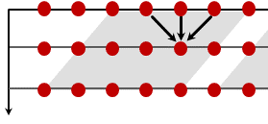
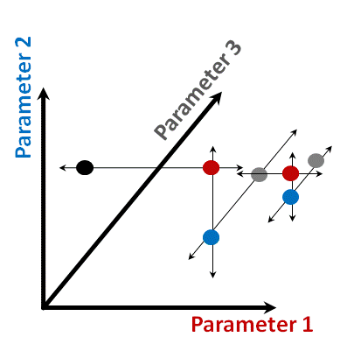
How to Get Level Set Up To Speed?
Sparse Linear Algebra
Time Skewing
A
x
y
Code generation
Auto-tuning
switch (case) {
case (…):
BI[j-1][i-1]=1;
…
BI[j+1][i+1]=1;
break;
case (…):
…
}
for (int j=lj; j<=hj; j++)
for (int i=li; i<=hi; i++)
BI[j][i]=1;
Notes:
Sparse on the left, Plus, a major question mark.
They don’t combine
That’s the problem
Question mark disappear.
Framework that integrates all these

Slide 11
How Far Did We Go?
Level 0: simple C program
implements the algorithm cleanly
Level 1: C macros plus autotuning search script
use C preprocessor for meta-programming
Level 2: autotuning + scripting for code specialization
text-based program generation, specialization
Level 3: add compiler technology, synthesize parts
internal code representation, standard compiler passes
Level 4: synthesize the whole program from scratch
high level representation, domain-specific synthesis
Notes:
Productive code when port to another machine
Search mechanism
Better sol than trying out all
Framwork first
Can do through search
But more smart ones
Arch is not exact
Extract degree of freedom
Interaction of parameters is non-trivial
Can guess, but not scale to new arch..
How to automate search space of auto-tunig
Heavily parameterized framework
Parameter space? stability?
Happy that space is not too different

Slide 12
Narrow Band Level Set in a Nutshell
zero level set at t
update the level set
zero level set at t+1
update the band
converge
no
narrow band
yes
narrow band
Autotuning parameter: narrow band width
Notes:
Animation
Level set moves..
Band moves..
Easy if implemented naively, but code runs slow

Slide 13
Projection of Manifold into Dense Stencil
Autotuning parameter: tile size
Notes:
Better word of optimization
Neighbors
Two-stage dag, reuse pattern
Shrink graph, more normals…

Slide 14
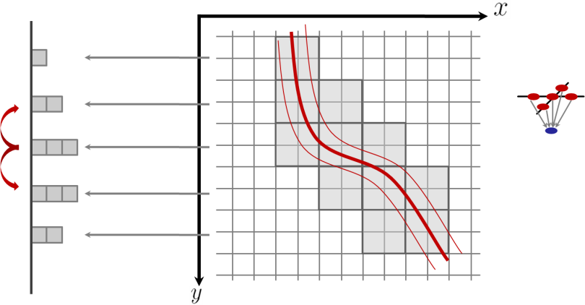
Projective Time Skewing
Standard 1-D dense time-skewing
Polyhedral width
Height
Time iteration
Projective time-skewing
2D row number
r0
r1
r2
r3
r6
r5
r6
t₀
r4
t₀+1
r0
r1
r2
r3
r4
r5
r6
t₀+2
r0
r1
r2
r3
r4
r5
r6
t₀+3
r0
r1
r2
r3
r4
r5
r6
Autotuning parameter: polyhedral tile size
Notes:
Standard 1-D polyhedral…
Nice things of polyhedral apply
Differ in details
My thing…

Slide 15
In-Core Stencil Optimization
left
right
up
down
4x4 tile
Compute norm
Compute
level set function
store
load
and
add/sub
cmple/cmpge
mul
rsqrt
shuffle
xmm0
vector register
xmm1
1
2
4
4
5
1
1
3
Optimizations
Common subexpression elimination
Transcendental function approximation (cos by polynomial)
SIMD vectorization
Instruction scheduling (intra and inter stencil)
+
+
+
+
vector operation
addps xmm0, xmm1
xmm0
6
3
5
7
Autotuning parameter: tile instruction schedule
Notes:
Better word of optimization
Neighbors
Two-stage dag, reuse pattern
Shrink graph, more normals…

Slide 16
Multicore Optimization: Software Pipeline
Prologue
Core 1
Core 2
Steady state
Data transfer between cores
requires a memory fence
Epilogue
Autotuning parameter: prologue/epilogue vs. steady state
Notes:
Naïve plot shown here please????

Slide 17
Narrow Band Update: Program Generation
2x4 rubber
stamp
Rubber
stamp
// TILE=4x4, BAND=+/-1
// unroll: 2x4
for (i=0;i<4;i+=2) {
b0=&band[Ti+i-1][Tj-1];
b1=&band[Ti+i][Tj-1];
b2=&band[Ti+i+1][Tj-1];
b3=&band[Ti+i+2][Tj-1];
switch (zeropat(Ti+i,Tj)) {
...
case PAT(0,1,1,0
0,0,1,0):
b0[1]=1;b0[2]=1;b0[3]=1;b0[4]=1;
b1[1]=1;b1[2]=1;b1[3]=1;b1[4]=1;
b2[1]=1;b2[2]=1;b2[3]=1;b2[4]=1;
b3[2]=1;b3[3]=1;b2[4]=1;
break;
case PAT(...):
}
// rubber stamp zero level set
for (i=0;i<TILE;i++)
for (j=0;j<TILE;j++)
if (!is_zero(Ti+i,Tj+j)) {
for (k=-BAND;k<=BAND;k++)
for (m=-BAND;m<=BAND;m++)
band[Ti+i+k][Tj+j+m]=1;
}
Autotuning parameter: rubber stamp unrolling

Slide 18
A Fundamental Tradeoff
runtime
total
total
Level set update
Band update
Level set update
Band update
Narrow band radius
Notes:
Colors
Animation
Before opt. then after opt
minimum point
Arrows -> between minimum points
Hard to figure out moves

Slide 19
Parameter Space
Tuning Parameters | Range
Tile size | {1,2,4,8}x{4,8,16}
Band radius | {1,2,3,4,5,6,7,8}
Polytope size height | {2, 4, 8, 16, 24, 32, 48, 64, 80, 96, 128, 160, 192}
Polytope size height | {2, 4, 8, 12, 16, 32}
Enable/disable | SIMD, instruction scheduling, approx. cos(), padding, large pages,…
Notes:
Framework
Parameterize Algorithm
On hardware

Slide 20
Autotuning: Iterative Line Search
Iterative Line search
Search parameters one by one
hold others fixed
Multiple refinement iterations
Search space is well-behaved
Heuristics
Cut search space
For instance: DAG scheduling
Parameter 3
Parameter 2
Parameter 1
Notes:
Colors
Animation
Before opt. then after opt
minimum point
Arrows -> between minimum points
Hard to figure out moves

Slide 21
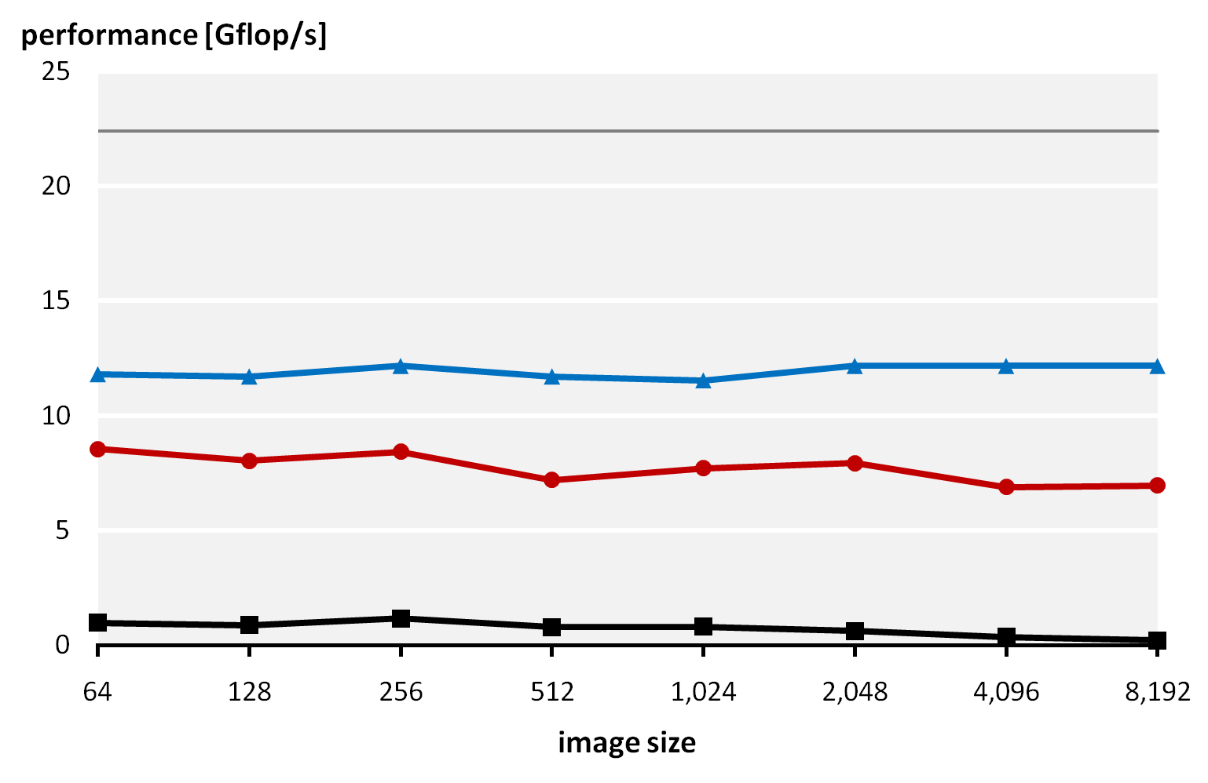
Efficiency on Single Core 2.8 GHz Xeon 5560
Peak performance (single core)
In-core kernel
upper bound
Full program
8x
33x
C base line=best 3rd party code
Notes:
Third line
Cycles/pixel

Slide 22
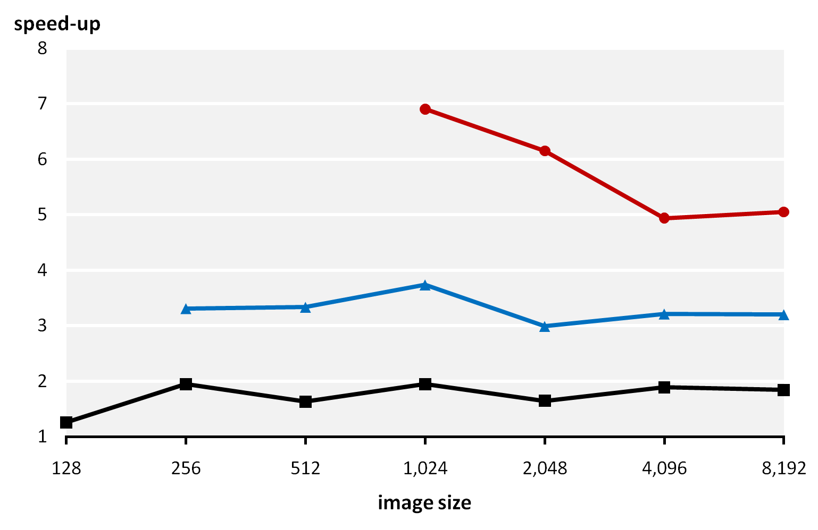
Speed-Up On 2x 2.8 GHz Quad Xeon 5560
8 threads
4 threads
2 threads
Notes:
Fixed parameter what is?

Slide 23
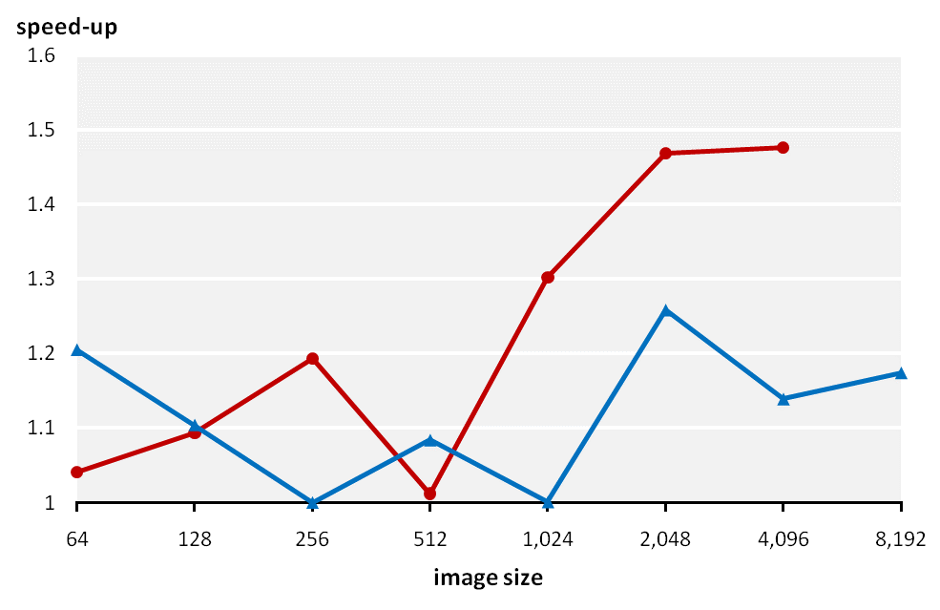
Performance Gain Through Autotuning
Atom N270 @ 1.6 GHz
2x Quad Xeon 5560 @2.8 GHz
Notes:
Fixed parameter what is?

Slide 24
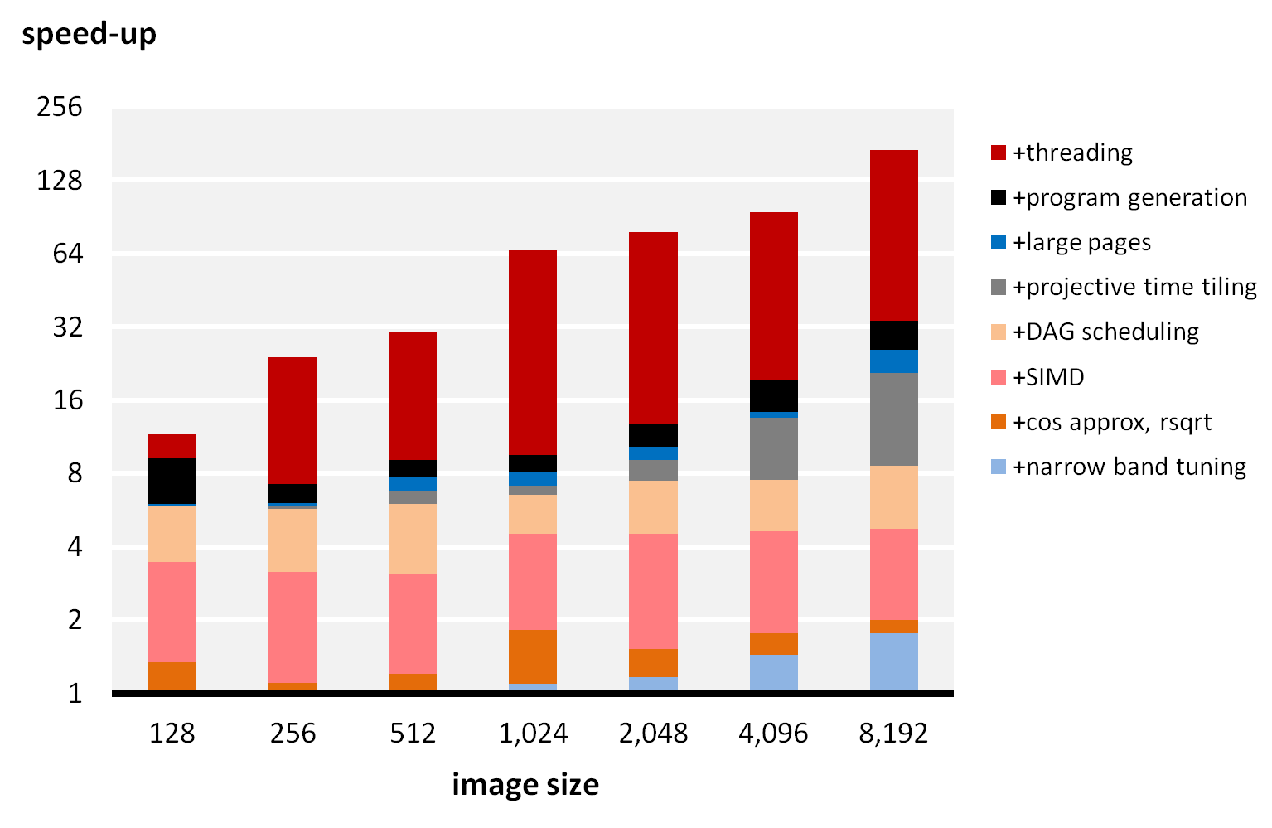
Speedup Breakdown on 2x Xeon 5560
Notes:
Mention baseline

Slide 25
Lessons From Optimizing Level Set
10x to 100x speed-up is often possible
really hard work, specific to the problem
Doable with standard tools
C compiler, autotuning, and program generation scripts
Crucial: extract meaningful parameters
capture machine/algorithm interaction, one algorithm a time
Many things must be done right
SIMD, threading, low-level tricks, specialization, tuning
Autotuning gives the last 50% to 2x speed-up
the remaining 5x to 50x come from standard optimization
Notes:
25

Slide 26
More Information: www.spiral.net www.spiralgen.com

