Slide 1
High-Dynamic-Range, Real-Time Architecture for Robust Space-Time Synchronization Algorithm
Vitaliy Gleyzer*, Tom Baillio, Adam Margetts
{vgleyzer, tom.baillio, margetts} @ll.mit.edu
MIT Lincoln Laboratory
HPEC Workshop 2011
Notes:
1
1
Title

Slide 2





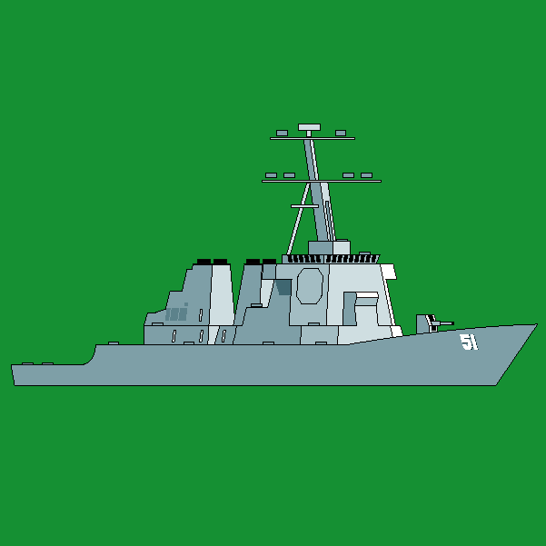


Adaptive System Building Blocks
Space-Time adaptive signal processing
Ideal for dynamic environments
Numerous real-time applications
Radar
Object of Interest
Common signal processing building blocks:
C = AB
Matrix Multiplication
Jammer
Radar Array
Z = QR
QR Decomposition
C = A / B
Back/Forward Substitution
…
Sonar
Communications
Jammer
Object of Interest
Ad-Hoc Network
Notes:
Space-Time adaptive signal processing is an important part of operating in dynamic environments. This presentation’s focus is the application of STAP for communications.

Slide 3
Interference in Ad-hoc Networks
Node A
Node B
Node D
TX Range of Node C
Node C
Wireless nodes compete for channel resources and
interfere with each other
Notes:
Typical communication scenario – ad-hoc nodes attempting to communicate in an urban environment with interference from other network nodes.

Slide 4
Outline
Time Synchronization
Overview
Algorithm comparison
Implementation Details
Performance results
Architecture overview
Notes:
Outline

Slide 5


Synchronization in Time
Interfering link
Interfering link
Synchronization sequence
Synchronization statistic
Φ_{n} > 0.5?
Node A
Node B
threshold
Φ
time
Time synchronization is a fundamental requirement for communication
Notes:
The receiver is running open loop, waiting for a known sequence to be sent by the transmitter. Once the sequence is detected, the receiver can synchronize with the transmitter

Slide 6
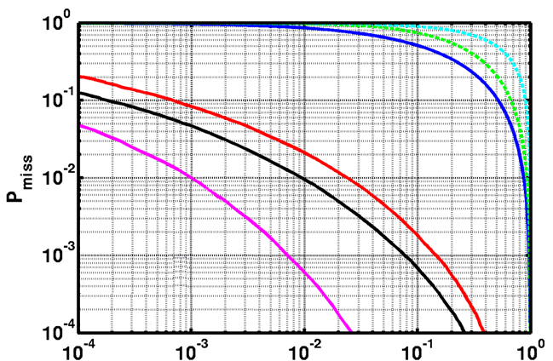
Sync Statistic Performance in Presence of Interference
Statistic Comparison
Performance Bounds
Rand – Random guess
NP – Theoretical bound
Traditional Techniques
Cor – Correlator
LSE – Least Squared Channel Estimator
Advanced Techniques
MMSE – Minimum Mean Squared Error
GLRT – Generalized Likelihood Ratio Test
Traditional
Advanced
Theoretical
Better
System Parameter | Value
Interference-To-Noise Ratio | 10 dB
Signal-To-Noise Ratio | 2 dB
# of Interferers | 1
P_{false-alarm}
TX₁
TX₂
Interfering link
Φ_{n} > 0.5?
Φ
A
B
time
Notes:
Different metrics can be used to identify the presence of a known sequence. The plot shows the advantage of using different advanced MIMO techniques compared to other traditional solutions

Slide 7

GLRT Synchronization Metric
Synchronization Metric
Expected Sequence
(Normalized )
Sample Matrix
Reference
D. W. Bliss and P. A. Parker, “Temporal synchronization of MIMO wireless communication in the presence of interference,” IEEE Trans. on Signal Processing Mar. 2010
TX₁
TX₂
Interfering link
Φ_{n} > 0.5?
Φ
A
B
time
Notes:
One of the advanced metrics is the GLRT (Generalized Likelihood Ratio Test). It consists of several critical terms, including the projection of the observed sample matrix onto the hyperplane formed by the known sequence.

Slide 8
Sample Matrix Formation
TX₁
Environment
ADC
ADC
N_{receivers} x M_{samples}
ADC
TX₂
ADC
Spatial diversity is captured via multiple receive antennas
TX₁
TX₂
Interfering link
Φ_{n} > 0.5?
Φ
A
B
time
Notes:
The sample matrix is constructed using the same number of observations as the length of the known sequence. The samples are gathered from the Analog to Digital Converters which are sampling the environment from spatially separated receive antennas.

Slide 9
Outline
Time Synchronization Overview
Implementation Details
Performance results
Architecture overview
Notes:
Outline

Slide 10
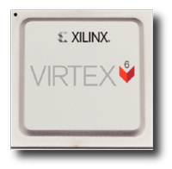
Implementation Challenges and Strategy
Challenge | Approach
Dynamic Environment | Single-Precision Floating Point
Real-Time Processing | Highly Parallel Computational Platform
Mobile Profile | Embedded Form Factor
Xilinx Virtex 6 FPGA
Virtex6 LX550 Resources | Quantity
6-input LUTs | 343,680
DSP Blocks | 864
BRAM | 22 Mbits
Registers | 687,360

Slide 11


Algorithm Reformulation
Z^{H} = QR, where Q is a unitary matrix,
and R is upper triangular
TX₁
TX₂
Interfering link
Φ_{n} > 0.5?
Φ
A
B
time
Notes:
In order to address the dynamic range requirements of the inverse computation, the inverse covariance term can be simplified using QR decomposition. This provides better dynamic range since the covariance does not need to be computed directly.

Slide 12
Data Flow Overview
S
Matrix
Conjugate
Matrix
Multiply
Matrix
Conjugate
Forward
Substitution
Matrix
Multiply
I-X
Determinant
Φ_{n}
Z
QR
Notes:
This diagram is showing the data flow required to compute the synchronization metric. The sample matrix Z is conjugated and is multiplied by the normalized known sequence S.

Slide 13
Data Flow Overview
S
Matrix
Conjugate
Matrix
Multiply
Matrix
Conjugate
Forward
Substitution
Matrix
Multiply
I-X
Determinant
Φ_{n}
Z
QR
Notes:
The Z hermitian term is then decomposed using QR decomposition to produce the upper triangular R which is subsequently used for forward substitution.

Slide 14

Data Flow Overview
S
Matrix
Conjugate
Matrix
Multiply
Matrix
Conjugate
Forward
Substitution
Matrix
Multiply
I-X
Determinant
Φ_{n}
Z
QR
Notes:
The two terms in parenthesis are conjugates; therefore the second term doesn’t need to be re-computed explicitly. The output of the forward substitution can be multiplied by its conjugate.

Slide 15

Data Flow Overview
S
Matrix
Conjugate
Matrix
Multiply
Matrix
Conjugate
Forward
Substitution
Matrix
Multiply
I-X
Determinant
Φ_{n}
Z
QR
Notes:
The metric is then computed using a simple determinant

Slide 16
Operation Complexity
Realistic Configuration:
Operation Breakdown:
Parameter | Value
Observation Size (N_{samples}) | 50 samples
Number of Receivers(N_{receivers}) | 4
Number of Transmitters(N_{transmitters}) | 2
Computation | Operations (MUL/ADD)
QR Decomposition (50x4) | 9200
Matrix Multiply (2x50 * 50x4) | 2800
Matrix Multiply (2x4 * 4x2) | 120
Forward Substitution (4x4) | 34
Other | 32
2x50
S
2x4
Matrix
Conjugate
50x4
Matrix
Multiply
2x4
Matrix
Conjugate
Forward
Substitution
Matrix
Multiply
I-X
Determinant
Φ_{n}
~12,000 arithmetic OPs
Z
QR
4x50
50x4
4x4
2x2
2x2
Complexity dominated by QR Decomposition
Notes:
This slide shows the computational complexity of each of the operations given an example configuration

Slide 17
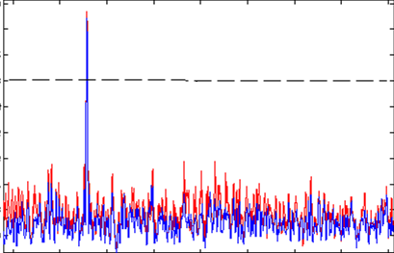
Implementation Performance
Realistic Configuration:
Resource Utilization:
Parameter | Value
Observation Size (N_{samples}) | 50 samples
Number of Receivers(N_{receivers}) | 4
Number of Transmitters(N_{transmitters}) | 2
Resource Name | Utilization (%)
LUTs | 45%
DSP Blocks | 6%
BRAM | 3%
Registers | 6%
Performance of Virtex6 LX550 Implementation:
Computation Throughput | 36 GFLOPS
Computation Throughput / Watt | 2.4 GFLOPS/W
Example Output
1.0
Model
FPGA
0.7
Metric
Embedded Synch
Synchronization Rate | 2.5 MHz
0.3
0.0
Time
Feasible rates for networks that can stream multimedia content
Notes:
The performance of the implementation is compared to the correlation metric, which is a common technique for synchronization in communication systems. The slides show the utilization requirements as well the achieved computational throughput with the FPGA implementation for an example instantiation of a communication link.

Slide 18
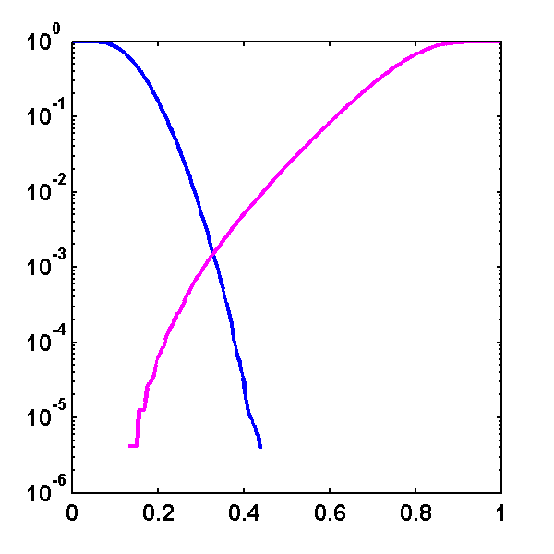
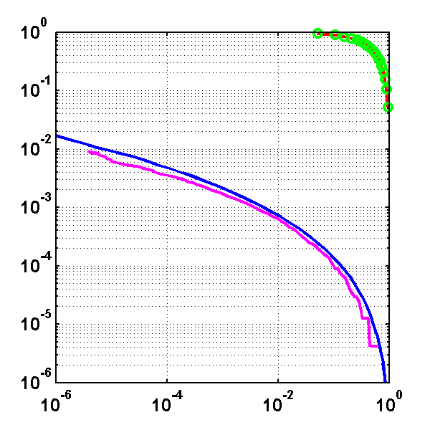
Performance Plots
Environment:
Parameter | Value
Interference-To-Noise Ratio | 80 dB
Signal-To-Noise Ration | 0 dB
Number of Interferers | 2
Threshold Trade-Off
Algorithm Comparison
False Alarm
Miss
Correlation
MATLAB Model
Random
Probability
P_{miss}
FPGA Implementation
Threshold
P_{false-alarm}
Vastly outperforms traditional techniques in presence of interference

Slide 19
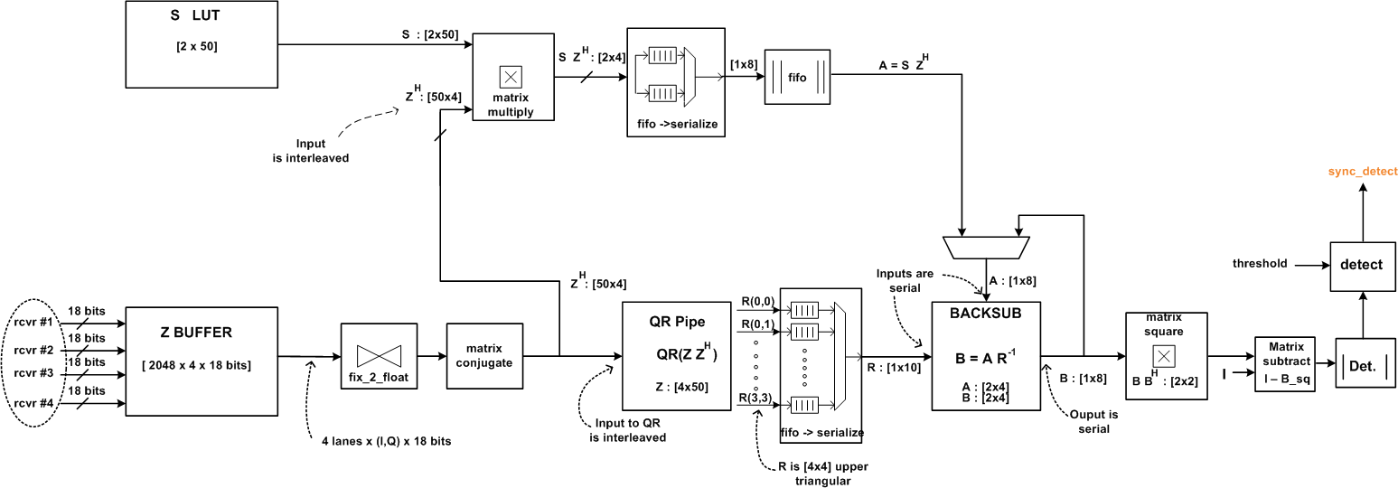
Initial Sync Architecture
Three main component: QR, Matrix Multiply, and Forward Substitution
Notes:
The overall detailed architecture of the design. The highlighted blocks are further discussed in detail on the follow-on slides

Slide 20

Systolic Matrix Multiplier
Operation
Processing Element(PE)
Z
A
B
b_{i,j}
nd
=
ready
a_{i,j}
a_{i,j}
Architecture
B_{KxN}
C_{KxN}
E_{KxN}
G_{KxN}
b_{i,j}
b_{1,0}
Single precision floating-point
Parameterized result matrix size
Fully pipelined
Accepts new data row every clock cycle
Multiple interleave windows
Allows overlapping multiple, simultaneous matrix multiplication
A_{MxK}
b_{1,0}
b_{0,1}
b_{0,0}
D_{MxK}
a_{0,1}
PE
PE
a_{0,0}
F_{MxK}
a_{1,1}
a_{1,0}
PE
PE
H_{MxK}
a_{2,1}
PE
PE
a_{2,0}
Notes:
Matrix multiplication is implemented as a systolic array of processing elements shown in the upper right corner. Each PE is a multiply accumulate unit responsible for a single value in the result matrix. The implementation allows the interleaving of multiple independent matrix multiplication in order to increase utilization of the floating point operations.

Slide 21

Systolic QR Decomposition
Operation
Processing Elements(PE)
Q
R
A
=
(Unitary matrix Q is not explicitly computed)
Architecture
A_{NxM}
B_{NxM}
C_{NxM}
D_{NxM}
x_{0,0}(n)
x_{0,1}(n)
x_{0,2}(n)
x_{0,M}(n)
McWhirter/Givens array
Single precision floating-point
Parameterized result matrix size
Fully pipelined
Accepts new data row every clock cycle
Multiple interleave windows
Allows overlapping multiple, simultaneous QR computations
r_{0,0}
c₀(n)
s₀(n)
r_{0,1}
r_{0,2}
r_{0,M}
x_{1,1}(n)
x_{1,2}(n)
x_{1,M}(n)
c₁(n)
r_{1,1}
s₁(n)
r_{1,2}
r_{1,M}
x_{2,2}(n)
x_{2,M}(n)
c₂(n)
r_{2,2}
s₂(n)
r_{2,M}
x_{M,M}(n)
c_{M}(n)
r_{M,M}
s_{M}(n)
Notes:
The QR is computed using a systolic structure known as the McWhirter array. It is comprised of two element types: boundary and internal.

Slide 22
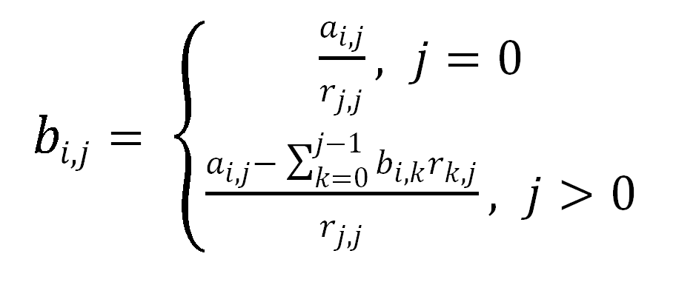
Forward Substitution
Operation
B
A
R
=
Architecture
Single precision floating-point
Parameterized size of input matrices
Interleaves multiple rows for greater throughput
Notes:
The back/forward substitution is computed serially. The data is streamed through a single multiplication and subtraction block.

Slide 23
Summary and Future Work
Successfully implemented real-time space-time adaptive synchronization algorithm in FPGA
Performance verified to be vastly superior to less sophisticated techniques
Implemented high-performance blocks to be utilized for other integral communication components
Future Work:
Implementing other components of the communication sub-system:
Channel capacity estimation
Frequency offset estimation
Beamforming
Constructing complete ad-hoc network node environment
Algorithm Comparison
Correlation
MATLAB Model
Random
P_{miss}
FPGA Implementation
Better
P_{false-alarm}
Notes:
Summary

Slide 24
Acknowledgements
Dan Bliss
Huy Nguyen
Notes:
Acknowledgements

