Slide 1
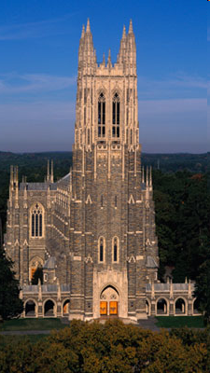
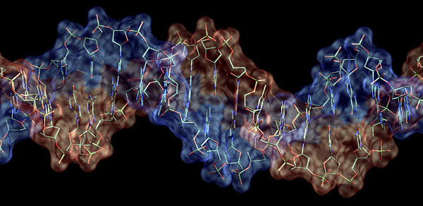

Self-assembled Materials for Computer Architectures
Chris Dwyer
Associate Professor
Department of Electrical and Computer Engineering,
Department of Computer Science
HPEC, 2011

Slide 2
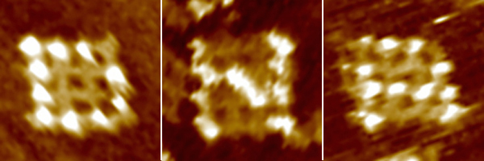
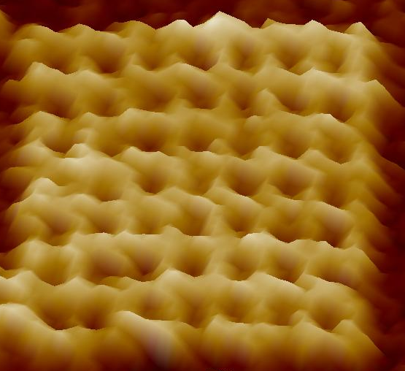
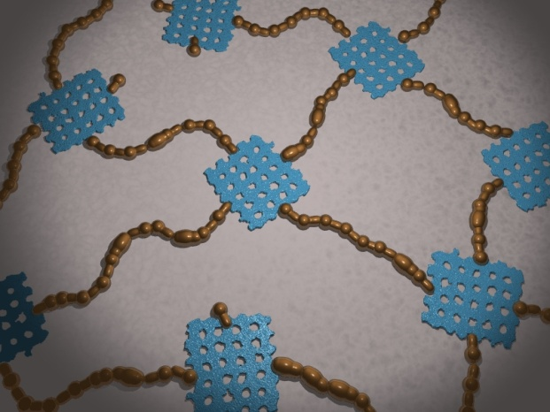
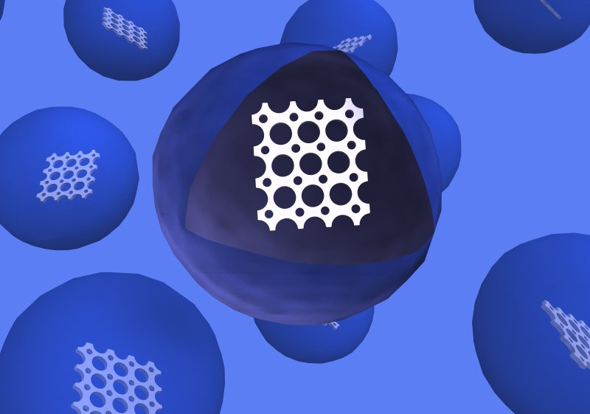
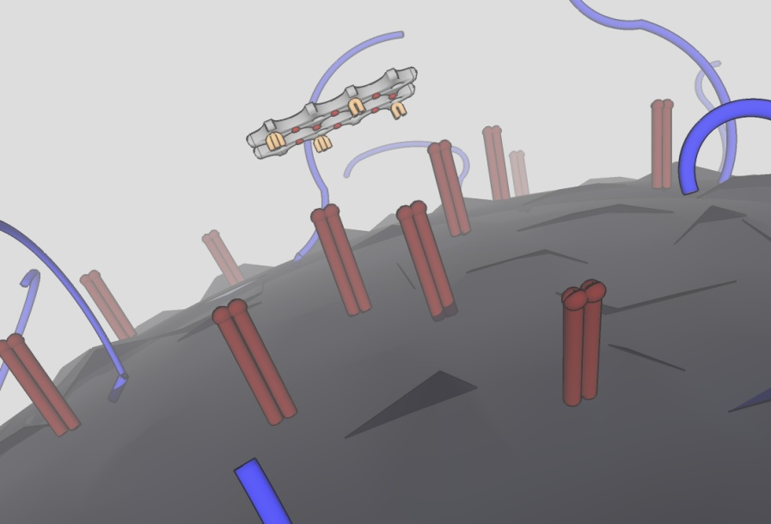
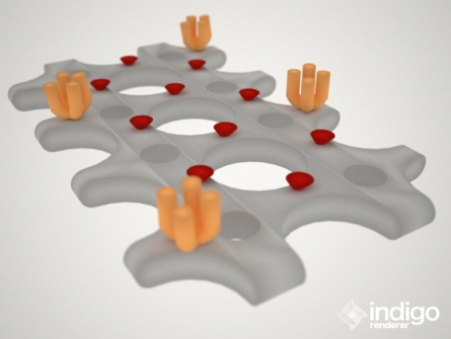
Lab Overview
Precise chemical patterning
Sensors
“Taggants” and
Devices
Self-organizing computer
architectures
Targeted Chemotherapies
[DNA] self-assembly is a technology that enables next-
generation materials, computers, sensors, and systems

Slide 3
Outline
Architectural Drivers
Economics of Performance
New Computational Domains
Disruptive Technology
DNA Self-assembly
Devices & Logic Elements
Self-organizing Architectures
Multiplexed Sensing
Design study: SOSA

Slide 4
Economics of CMOS vs. DNA
Conven.
Value of goods sold†
Year
Fab. Cost*
Semiconductors
~$75B
(180 nm)
2000
~$1B
(Non-petrol.) Chemical mfg.
~$400B
2002
Δ=$1.6B
(90 nm)
2004
Δ=$2B
…
…
(65 nm)
2006
Δ=$3B
Market Capitalization‡
…
…
Semiconductors
$ 260B
(32 nm)
2009
Δ=$4B
Microelectronics
(22 nm)
2010
Δ=$6-8B
Drug Manufacturing
$1,170B
…
…
Specialized Chemical Mfg.
$ 247B
(14 nm)
2013
Δ=$5B+?
Biotechnology
$ 349B
(<10 nm)
2014+
Δ=?
+
DNA self-assembly
$1,766B
*EE Times, †2004 U.S. Census, ‡ Yahoo! Finance
(<1 nm)

Slide 5
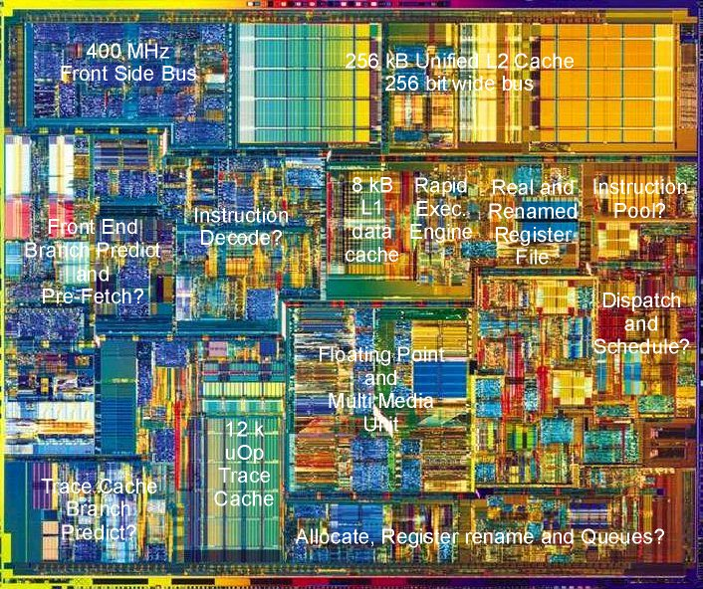
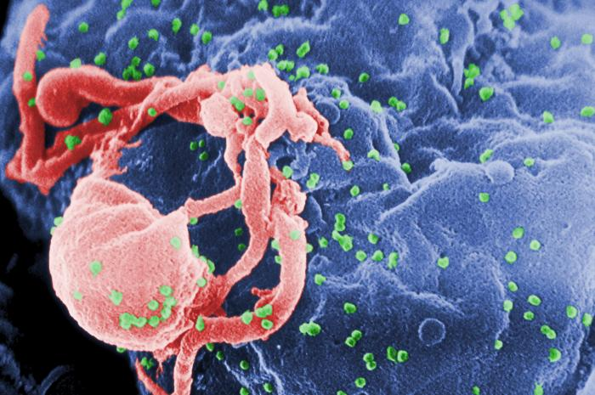
Why? To Enable New Domains for Computation
Intel 8088
HIV-1 budding from lymphocyte (CDC)
New Systems
Novel materials to introduce computing to entirely new domains
Hybrid Systems
Novel materials to enhance existing CMOS
Augmented optical computing on chip (e.g., w/ optical NOCs)

Slide 6
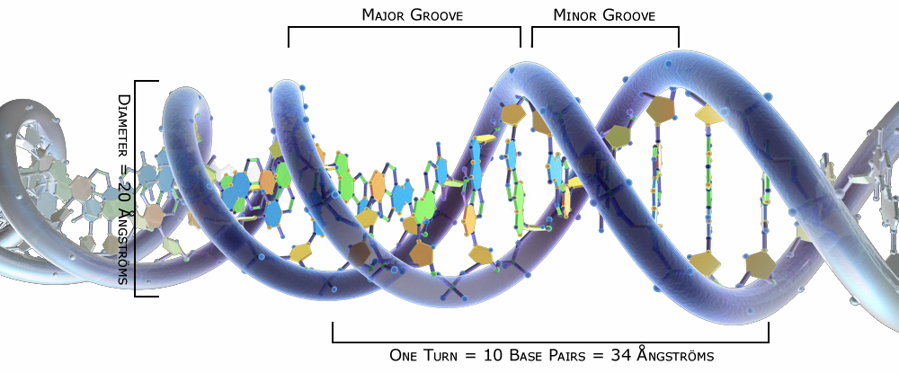
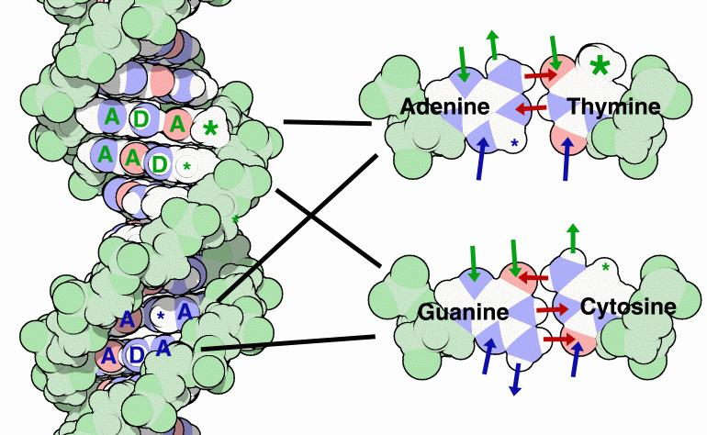
Source credit: Wikipedia
A
T
T
G
C
C
G
A
T
A
A
C
G
G
C
T
Source credit: Wikipedia

Slide 7
DNA Scaffolds - Geometry
The geometric properties of double strands can form specific, controlled self-assembled nanostructures:
ΔT
3.4 Å

Slide 8
DNA Motifs
“Sticky-ends” sequences
can be unique
9 strands
ΔT
A strand “crosses-over”
to another at a “junction”
Two double-helices
per arm

Slide 9
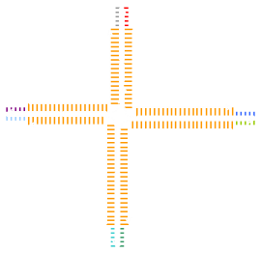
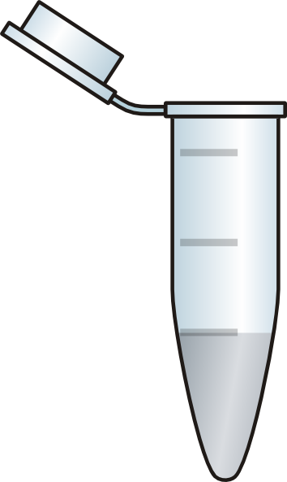
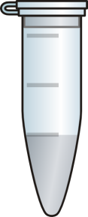
DNA Motifs
9 strands
ΔT
2
3
4
5 - 16
1

Slide 10
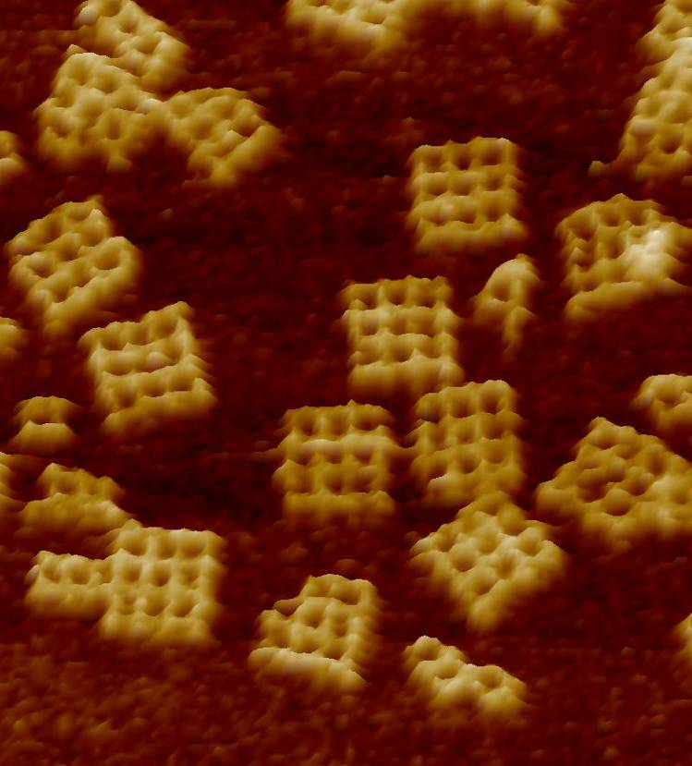
DNA Motifs
1
2
3
4
5
6
7
8
9
10
11
12
13
14
15
16
20.0 nm
Atomic Force Microscopy (AFM) Image
(360nm X 360nm)

Slide 11
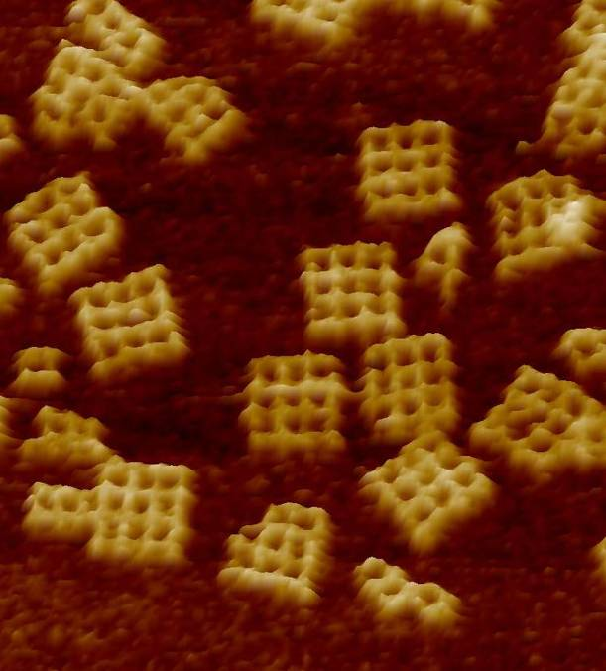
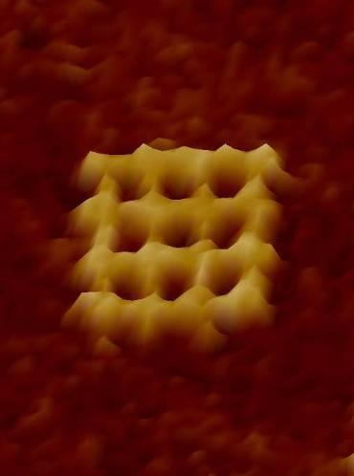
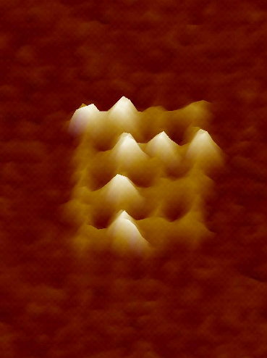
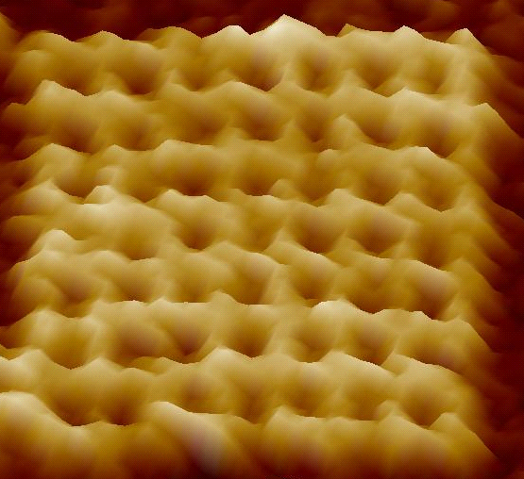
DNA Nano-grids
Self-assembled grids with sub-nm resolution (3.4 Å)
60nm
16-tiles
Patterned grid
Multiple DNA grids deposited on flat mica plane
64-tiles
Manufacturing scale: >10¹⁵ grids/mL
(< 8 hours)

Slide 12
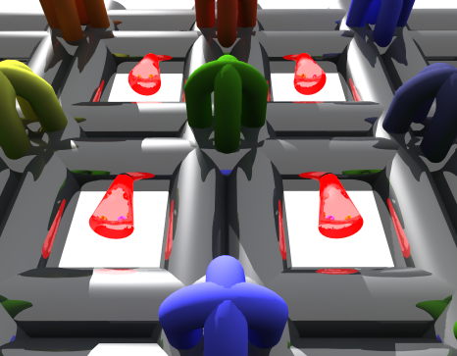
Next-step: Add active, functional components

Slide 13
Outline
Architectural Drivers
Economics of Performance
New Computational Domains
Disruptive Technology
DNA Self-assembly
Devices & Logic Elements
Self-organizing Architectures
Multiplexed Sensing
Design study: SOSA

Slide 14
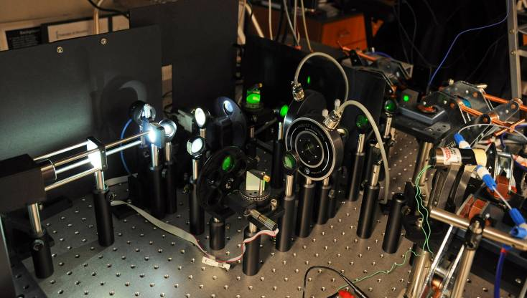
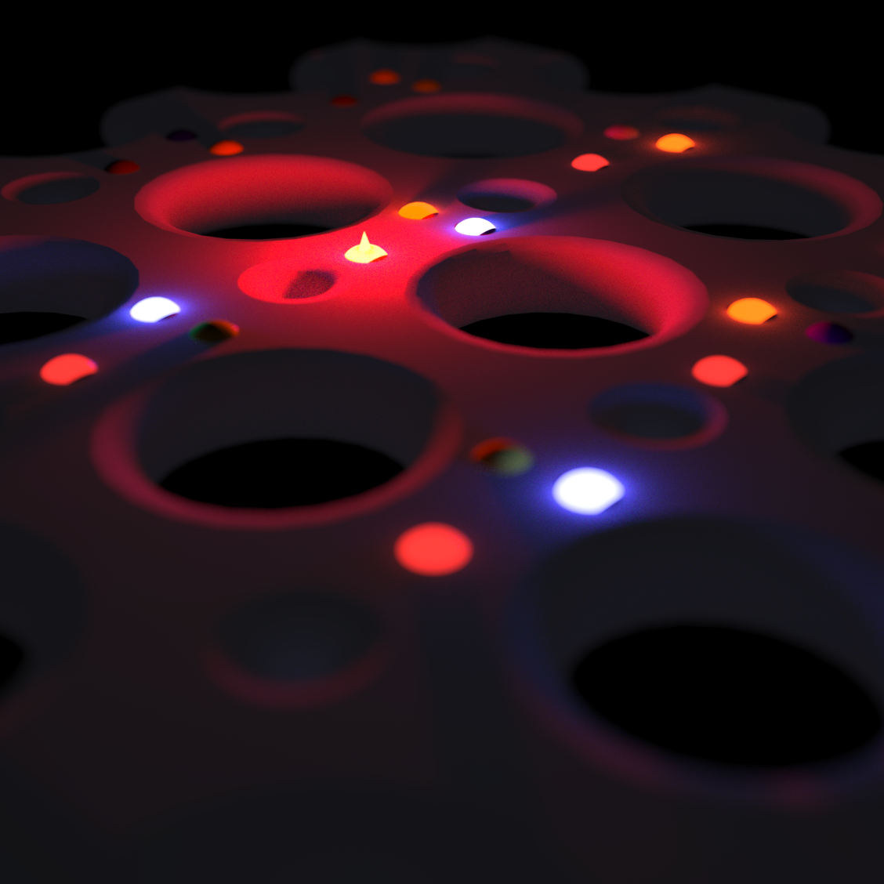
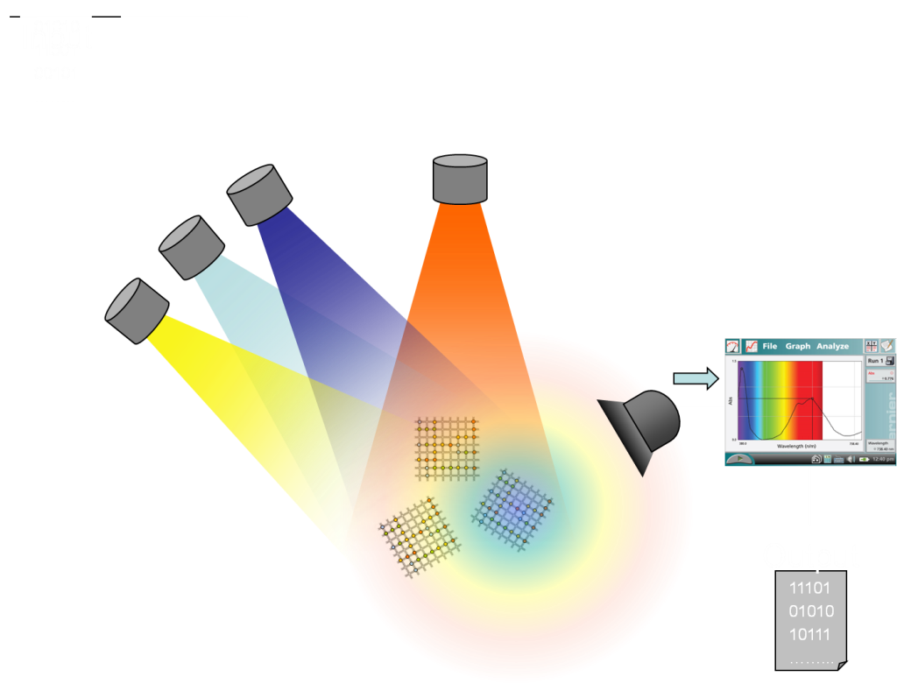
Operational Overview for RET Logic
C. Pistol, et al., Small, 2010.

Slide 15
RET Circuit Theory
OR
AND
X
X
Y
X + Y
Y
X ⋅ Y
R
OR / AND primitives, good but…
Inversion by dual-rail encoding OR new devices
New opportunity to integrate logic into molecular scale processes

Slide 16
RET-Logic: Resonance Energy Transfer
hv₁
D₀+A₀
D*+A₀
D₀+A₀+hv_{D}
RET
D₀+A*
D₀+A₀+hv_{A}
hv₁
D
A
hv_{D}
D
A
D
A
hv_{A}
RET
D
A
D
A
Φ_{T}

Slide 17
RET Efficiency
hv₁
RET
D₀+A₀
D*+A₀
D₀+A*
D₀+A₀+hv_{A}
Energy transfer efficiency
QM + EM derivation
R₀ : Förster Radius
r : D – A distance
κ : D – A alignment
η : index of refraction
Q_{D} : Donor quant. yield
J(λ) : Overlap integral
T. Förster, "Intermolecular energy migration and fluorescence," Annals of Physics, vol. 2, pp. 55-75, 1948.
Notes:
[1] T. Forster, "Intermolecular energy migration and fluorescence," Annals of Physics, vol. 2, pp. 55-75, 1948.

Slide 18
RET Circuit Theory
(1)
X
Z
(energy migration)
(2)
RET Cascades
I₁
V_{F} < V_{FT}
I₀
I₂
X
Z
(3)
V_{F} > V_{FT}
R_{T}
+
Other elements
I_{E}=V_{F0}/(R₁+R₂)
R₁
R_{NR}
V_{F}=V_{F0}·R₂/(R₁+R₂)
V_{F0}
R_{Cross-Ex.}
C_{P}
R₂
-

Slide 19
Simple Application: Logic + Sensors
Receptor #1
Receptor #2
DECODER
X Y Z “address”
0 0 0 N/A
0 0 1 Z
0 1 0 Y
0 1 1 YZ
1 0 0 X
1 0 1 XZ (#2)
1 1 0 XY (#1)
1 1 1 XY,XZ,YZ
Z
Y
X
X
X
R₁
Y
X ⋅ Y ⋅ R₂/(R₁+R₂)
R_{L}
R₂
XY forms a distinct “address”
Output depends on R₂/(R₁+R₂)
R_{H}

Slide 20
Logic and Sensors
XY
XZ
R₂/(R₁+R₂)
L1+/L2+
L1-/L2+
L1+/L2-
L1-/L2-

Slide 21
Design Study: SOSA and New Constraints
Self-assembly introduces chaos at the microscale:
(>1-10 μm)
DNA hybridization restores order at the nanoscale:
(< 1 μm) sub-nm resolution
Three fundamental assumptions must change:
Availability of long-range interconnect (toward none!)
No large-scale interconnect networks / limited local comm.
Area vs. cost tradeoff (toward an even worse exponential!)
Large (> ~5 μm on a side) circuit footprints are impractical
Reliable devices (toward error prone!)
The substrate can have defects
The devices can have defects

Slide 22
Self-Organizing Architectures
Conventional architectures do not self-assemble
Several new architectures can exploit self-assembly:
Oracles: DNA computing with a device twist that enables rapid (electrical) re-use of a DNA computation
DAMP: Distributed Array Multi-processor, SIMD without an interconnection network for embarrassingly parallel codes.
NANA: Nanoscale Active Network Architecture, general purpose but imbalanced due to a large communication / execution ratio- under utilized resources.
SOSA: Self-organizing SIMD Architecture, a SIMD model on a reconfigurable network topology. Utilization is high due to a depth first network traversal.

Slide 23
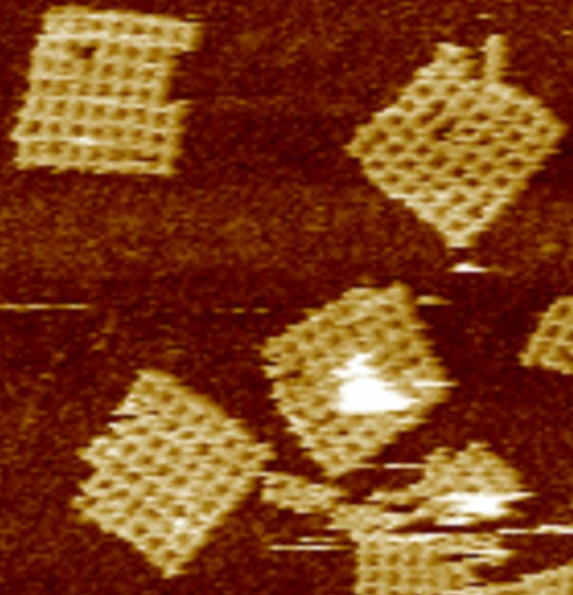
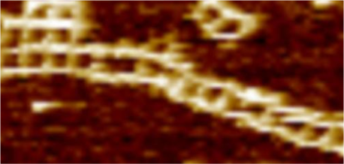
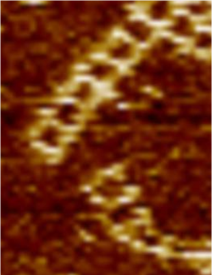
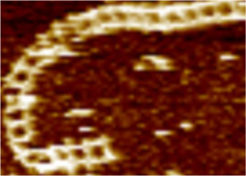
Tangent: Interconnect, even if limited…
1
Self-assemble grids, ... , randomly deposit on smooth surface.
Self-assemble nanotracks between grids on surface.
2
3
Metallize tracks...

Slide 24

Self-Organizing Architectures
Self-assembled
Computational nodes
(minimal computational power
& defect-prone)
Self-assembled
Interconnect
(defect-prone)
Distant micro-scale
I/O contact
(low bandwidth)
Defect model includes:
Rotation, position
Connectivity
Defective devices on nodes

Slide 25
Strategy
Map out both topology and defective links and nodes in the network (i.e., configure)
Group nodes together to form more powerful computational elements
Provide a convenient programming abstraction

Slide 26
Major Design Challenges (w/ Self-assembly)
Conventional approaches to defect tolerance fail
Global defect maps are impractical if:
System is large (>10¹² nodes),
Nodes are weak
I/O bandwidth is limited
The network topology is unknown and random
Every system instance is different!
Nodes will have defective pieces
Functional and performance binning impractical

Slide 27
Design Solution
Use the reverse path forwarding (RPF) algorithm to create a tree
Use Euler paths (EP) to create an abstract ring
Use lightweight built-in self-test per node to protect connectivity
Asynchronous! (no global clock)
Instructions and data are broadcast to all nodes in network-order, down the RPF tree.

Slide 28
SOSA Configuration: RPF
Micro-scale Via

Slide 29
SOSA Configuration: EP
Micro-scale Via
1
2
12
3
11
1,3,11
4
10
2
4,6,8,10
12
5
9
6
8
7
5
7
9
(DFS visit time)

Slide 30
SOSA Configuration: the ring
Microscale Contact
Ring abstraction
Random and dis-ordered
RPF & EP
Head
Bit 0
...
Bit N-1
Tail

Slide 31
SOSA Execution Model Overview
Head
Bit 0
...
Bit N-1
Tail
Instructions are broadcast to all PEs from the microscale I/O contact
Partial instruction re-use is permitted to reduce instruction broadcast overhead
Predicated instructions serialize through a synchronization signal sent from the head node of the PE (the head node holds predicate flags)
Why? out-of-order inst. arrival at nodes within a PE
PESHIFT operations (left, right) enable PE communications on the ring

Slide 32
Performance Comparison
We compare SOSA against:
P4 at 3GHz
Ideal SOSA
Ideal Superscalar
Ideal 16-way CMP
SOSA Configuration
Parameter | Value
Register File | 16 entry, 2-bits per node (32 bits wide)
Time Quantum | 1 ns (Synchronous equivalent: 1GHz)
ALU Latency | 1 time quanta
Inst. buffer size | 1 entry
Link type | Full duplex with 3 virtual channels
Ideal SOSA (I-SOSA):
1 time quanta instruction execution latency
No communication overhead

Slide 33
Performance Comparison
Ideal Superscalar (I-SS) Configuration
Parameter | Value | Parameter | Value
Width | 128 (Fetch/Dec./Iss./Commit) | Branch prediction | Perfect
Inst. Fetch Queue | 1024 Entries | Memory latency | 1 cycle
ROB/LSQ | 8192 entries, 1 cycle access | Memory ports | 128
Integer ALU | 128 Add, 128 Mult. | Frequency | 10 GHz
FP ALU | 128 Add, 128 Mult.
Ideal 16-way CMP (16CMP):
Linear scaling of I-SS performance

Slide 34
Benchmark Highlights
Application Class | Description
Scientific | Multiply integer NxN matrices (N² PEs)
Image Processing (Filters) | Generic 3x3 filter Separable Gaussian filter Median noise reduction filter Each over an NxN image (N² PEs)
General Purpose | Odd-Even transposition sort. Parallel sort with nearest neighbor communication (N PEs for sorting N keys)
Cryptography | Tiny Encryption Algorithm (TEA) used in XBox IP security.
Search | Search a database for a match with an input 32 bit string. O(N) PEs for N strings.
Bin-Packing | Pipelined version of bin-packing with first-fit heuristic (N PEs for N bins)

Slide 35
Highlight 1 of 2 – Matrix Multiply

Slide 36
Highlight 2 of 2– Gaussian Filter

Slide 37
Conclusions
Early days of self-assembled computing and the devices are nascent
However, we have demonstrated the fundamental building blocks and are moving toward more powerful devices
Self-assembly disrupts the conventional paradigm for computer architecture
Fortunately, self-organization as a principle can be applied in a defect-prone, distributed setting
Despite significantly higher defect rates higher-performance self-organizing architectures are possible

Slide 38







Students and Sponsors
Thank you!
Jaidev Patwardhan
Costantin Pistol
Vincent Mao
Viresh Thusu
Mohammad Mottaghi
Jun Pang
Vishwa Nellore
Siyang Wang
Heather Duschl
Arjun Rallipalli
Craig LaBoda
Dr. Perumal Ramasamy
Dr. Wanqiu Shen

