Slide 1
The Dark Silicon Implications for Microprocessors
Karu Sankaralingam
University of Wisconsin-Madison Collaborators: Hadi Esmaeilzadeh, Emily Blem, Renee St. Amant, and Doug Burger

Slide 2
Multicore Decade?
We have relied on multicore scaling for over five years.
?
2000 2005 2010 2015
Pentium
Extreme
Dual-Core
i7 980x
Hex-Core
Core 2
Quad-Core
How much longer will it be our primary performance scaling technique?

Slide 3
Finding Optimal Multicore Designs
Comprehensive design space:
Fixed area budget
Fixed power budget
Two sets of CMOS scaling projections
Optimal core and diverse multicore organizations
Parallel benchmarks
For next 5 technology generations, we find the best performing multicore from a comprehensive design space search for each of the PARSEC benchmarks

Slide 4
Symmetric Multicore Projections
18x
3.4x
in 10 years
Symmetric multicores alone will not sustain the multicore era.

Slide 5
Multicore Solutions
Asymmetric Topologies
3.5x

Slide 6
Multicore Solutions
Dynamic Topologies
3.5x
[Chakraborty (2008), Suleman et al (2009)]

Slide 7
Multicore Solutions
Composed/Fused Topologies
3.7x
[Ipek et al (2007), Kim et al (2007)]

Slide 8
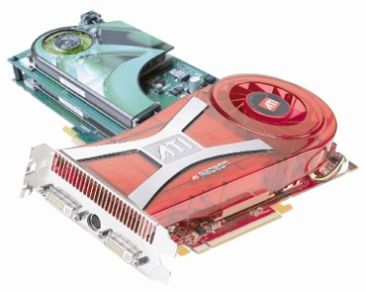
Multicore Solutions
GPU-Style Cores
2.7x

Slide 9
Multicore Era Projections
18x
3.7x
The best designs speed up 14% per year
rather than the recent trend of 34% per year

Slide 10
Why Diminishing Returns?
Transistor area is still scaling
Voltage and capacitance scaling have slowed
Result: designs are power, not area, limited

Slide 11
Overview
Notes:
PAUSES
Using this process, we cover the key levels of the design scaling process to get a complete picutre of the future of multicore scaling.

Slide 12
Device Scaling Projections
From 45 nm to 8 nm:
 | Conservative | Optimistic
Area | 32x | 32x
Power | 4.5x | 8.3x
Frequency | 1.3x | 3.9x
 | [Borkar 2007] | [ITRS 2010]

Slide 13
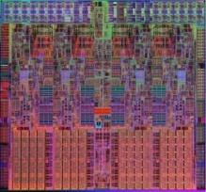
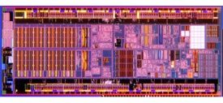
Modeling Ideal Core Power/Perf.
Nehalem
Pareto Frontier includes all optimal power/performance points
Repeat using core area for optimal area/performance points
Atom

Slide 14
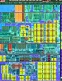
Combining Device and Core Models
45 nm Frontier
Device Scaling
32 nm Frontier

Slide 15
Overview

Slide 16




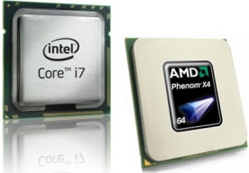



What belongs in multicore model?
Styles
Topologies
Pareto Frontiers
Number of Threads,
Cache Sizes
Area & Power Budget
Area & Power /
Performance Tradeoffs
Architectures
Applications
Cache & memory latencies, memory bandwidth
PARSEC f_{parallel},
Data Use

Slide 17
Multicore Speedup Model
Multicore
Speedup
1
=
1-f_{parallel}
Serial Speedup
f_{parallel}
Parallel Speedup
+

Slide 18
Multicore Performance Model
Performance is limited by:
and
Memory bandwidth
BW_{max} / (instructions per byte from memory)
Computation
N_{cores} × (core frequency/CPI_{exe}) × core utilization
[Guz et al, 2009]

Slide 19
Core Utilization Model
Core utilization is limited by:
Fraction of Time Core is Ready to Issue
Number of Threads in Core / Number of Threads to Keep Busy
[Guz et al, 2009]

Slide 20
Multicore Model & Pareto Frontiers
100 points
A(q), P(q)
q

Slide 21
Translating from SPECmark
From q, find core’s SPECmark speedup
Frequency linearly distributed from Atom to Nehalem
Recall: model predicts benchmark performance as f(benchmark chars, frequency, CPI_{exe})
Compute CPI_{exe} such that
Benchmark Speedup = SPECmark Speedup

Slide 22
Area and Power Constraints
N_{cores} x A(q) ≤ Area Budget
N_{cores} x P(q) ≤ Power Budget
Dark silicon = N_{cores} / # of cores that fit in chip area

Slide 23
Overview

Slide 24
Dark Silicon
At 8 nm:
At 22 nm:
71%
51%
26%
Sources of Dark Silicon:
Power + Limited Parallelism
17%

Slide 25
Overall Performance
Target
18x
16x
f_{parallel} = 0.99
8x
6x
3x

Slide 26
Conclusions
Multicore performance gains are limited
Need at least 18%-40% per generation from architecture alone without additional power
?
Unicore Era
Multicore Era

Slide 27
Specialization
Shrinking chips Pervasive
Efficiency

