Slide 1
Creating Chip Generators for Efficient Computing at Low NRE Design Costs
Chip Genesis
Ofer Shacham (Stanford University / Chip Genesis Inc.)
Professor Mark Horowitz’s VLSI Group At Stanford

Slide 2
My Goal Today Is…
Explain what a ‘Chip Generator’ design methodology is
  Why it is needed
  Why it solves many problems
Get you all to download and experiment with Genesis2 – a prototype tool for creating chip generators
  It’s a “generator for generators”
  http://genesis2.stanford.edu/

Slide 3
Disruptive Forces Changing The IC Industry
Power is today’s greatest design constraint
  Power no longer scales with technology
  Hand-held/embedded devices drive the market
  At a fixed power budget: more ops/sec requires less energy/op !
Complexity is growing
  Number of devices/chip still scaling
  Algorithmic complexity grows
  NRE costs are out of control
The need for customization has never been greater
Fewer and fewer applications have markets big enough to justify the effort

Slide 4
The Biggest Issue
The biggest issue is NOT design
  And also not masks
The biggest issues are:
  System firmware (i.e., software)
  System validation
  System optimization
Our systems are so complex that they are very hard to reason about
  Building complex systems is… complicated. And we need to face that fact!
  We need not to encode the system, we need to encode the reasoning
How the system works
We’ll get back to this a little later
Notes:
To move to the next slide: So how do we deal with complexity? How have we historically dealt with it?

Slide 5

A Wise Man Once Said…
Platform-based Design – Alberto Sangiovanni Vincentelli, 2001
Integrated circuits … will most likely be developed as an instance of a particular (micro-) architecture platform. …they will be derived from a specific “family” of micro-architectures, possibly oriented toward a particular class of problems, that can be modified… by the system developer. (pg 6)
RTL
Architecture Configuration
Netlist
“top” platform
Mapping tools
Synthesis
???
Place & Route
Sticking to an architecture family enables:
Software consistency/reuse
Verification consistency/reuse
While we search the sub architectural space for an optimal configuration
Circuit Lib
?? Lib
Cell Lib
Optimiser
Opti… ?
An architecture platform instance is derived from an architecture platform by choosing a set of components from the … library and/or by setting parameters of re-configurable components of the library. (pg 7)
Optimiser
“Bottom” platform
Physical Layout

Slide 6
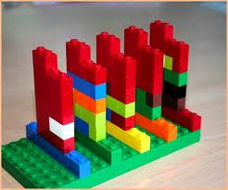

Industry Went Down Two Roads
System-on-Chip
Re-configurable System
‘Random’ configuration of pre-defined, pre-verified, and fixed in Verilog cement, IP blocks
Fixed configuration of run-time flexible IP blocks
Does not solve the problem:
“How the system works”

Slide 7


Why Reconfiguration Is Not Efficient?
A reconfigurable system can be modified / tailored to specific application
  At runtime (i.e., via software)
  Using the same set of resources
For example, we created Stanford’s Smart Memories
  (Probably) the most reconfigurable CMP ever created
Fixed architecture w/ mushy (programmable) blocks
  Does help / amortize the system complexity and reasoning problem!
Alas… BIG problem:
  The resource-mix is never optimal (un-utilized resources / missing resources)
  The configuration itself adds inefficiencies (registers, muxes, etc.)
DAC’09/ISSCC’10 Student Design Contest
Notes:
Summary:
We have two huge problems: power and complexity
SoC does not solve these problems
Reconfigurable designs solve the complexity but not the power
But all that this is saying is that we need to put the configuration in a different location in the abstractions stack!

Slide 8
Need to Rethink Our Ways Again:
Move The Configuration Step To Design Time
Parameters and Constraints
The right way to create an
Architecture Platform
is not in RTL, but in something that compiles into RTL
“top” platform
Architectural Template & Generator
Mapping tools
“Bottom” platform
RTL & Verification Collateral

Slide 9
Need to Rethink Our Ways Again:
Move The Configuration Step To Design Time
So this is a “virtually” reconfigurable chip
Parameters and Constraints
Fixed architecture with mushy (programmable) blocks
“top” platform
Architectural Template & Generator
Mapping tools
“Bottom” platform
Description that encodes system dependencies & trade-offs
RTL & Verification Collateral

Slide 10
Put Our Understanding of The System In A Tool – Chip Generator
Unlike logic/high-level synthesis, generators are domain specific
Each design group likely want to create their own generator
  But also use other’s, lower level, generators
Need a consistent way for building generators
(we’ll get back to this a little later)
Parameters and Constraints
  Defines how software handles the system
Architectural Template & Generator
  Encodes how components work together
  Enables optimization across the entire system
RTL & Verification Collateral

Slide 11
One Generator Template Encapsulates Systems
High Performance Configuration
App. Specific Configuration
Low Power Configuration
Architectural Template & Generator
Heterogeneous RTL
Aggressive RTL
“Simple” RTL
Notes:
Reuse systems, not components! By compiling different architectural programs.

Slide 12
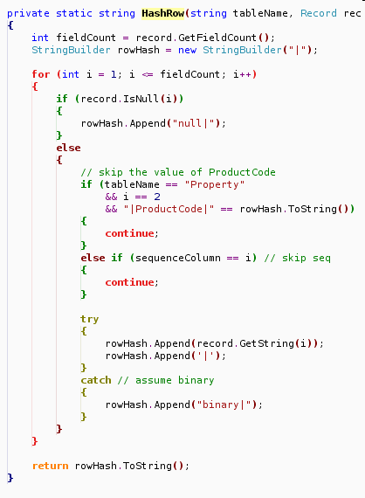
So We Can Explore The Design Space
Architectural Description
Energy Budget
Simulator
Hardware Optimization & Generation
Tradeoff Lib
E
D
Performance
Power Usage

Slide 13
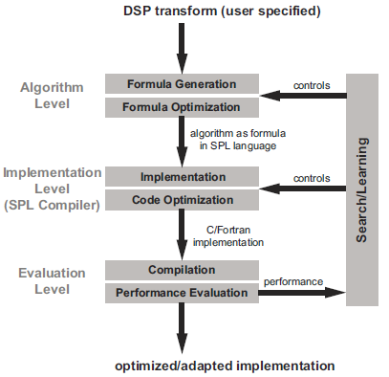
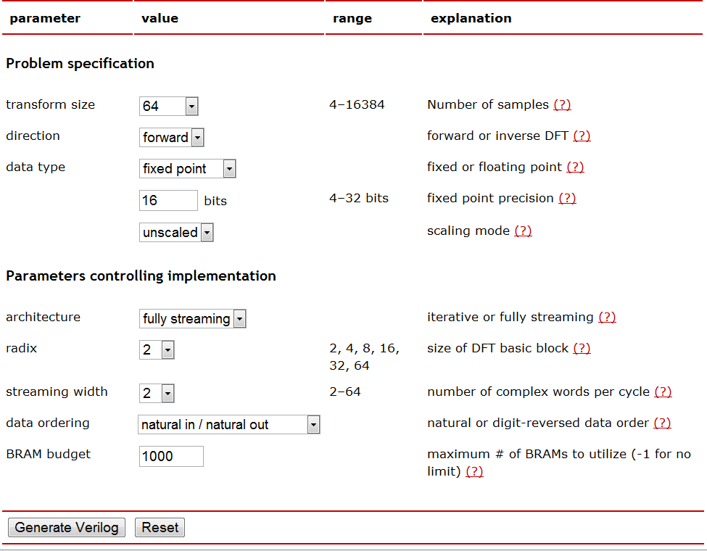
Example: CMU’s Spiral FFT Generator
Hardware and software co-optimization framework for DSP applications
  Given a transformation, Spiral can easily explore the implementation space
  Final result is optimal hardware and software for a given algorithm + constraints
Software Generation
Hardware Generation
D’Alberto, Milder et. al., IEEE Comp. Soc., 2007
Milder, Franchetti, Hoe and Püschel, DAC, 2008 http://www.spiral.net/hardware/dftgen.html

Slide 14

Generalizing Hardware Optimization & Generation
Programmatic System Description
Per-Application Configuration
Feedback
XML Program
Circuit / Micro-architecture Optimization
Synthesis
PNR
GDS2
(Semi) Automatic
Keep flexibility in sub modules
Encode cross-module dependencies
Encode validation and software dependencies
Encode physical / backend dependencies
Standardize interfacing with configuration tools
Formal interface for architect / application designer / end client
Repeat until target reached
Repeat for different chips
Notes:
Moving to the next slide: In an effort to standardize the creation of generators, we created a tool for making them. A Generators’ generator.

Slide 15
Standardizing The Creation Of Generators
We Created Genesis2
  So we (and you!) can build generators
Premise: Keep it simple – Genesis2 is just an extension for SystemVerilog
  Works like a pre-processor (* but actually is doing a little more)
  Remove artificial “synthesizability” limitations from the elaboration code
  Make elaboration explicit; software-like
Expressive: Encapsulate design trade-offs in blocks (make generators!)
  Goal is for each block to have a small elaboration program – a “constructor”
  Enable late, externally driven, tweaking of knobs
Instead of coding modules, we write programs that produce modules

Slide 16
Genesis2 Code Snippets
File: BitReverse.vp
module `mname` (
//; my $width=parameter(Name=>’WIDTH’,
//; List=>[1,2,4,8],
//; Val=>4);
input [`$width-1`:0] data_in,
input [`$width-1`:0] data_out
);
//; foreach my $idx (0 .. $width-1){
assign data_out[`$idx`] =
data_in[`$width-$idx-1`];
//; }
endmodule
File: OneHotMux.vp
module `mname` (
//; my $signal_width=parameter(Name=>’SIGWIDTH’, Val=>4);
//; my $mux_width=parameter(Name=>’MUXWIDTH’, Val=>4);
input logic [`$signal_width-1`:0] in [`$mux_width-1`:0],
input logic [`$mux_width-1`:0] sel,
output logic [`$signal_width-1`:0] out
);
always_comb begin
out = in[0]; // default
unique case (1’b1)
//; foreach my $idx (0 .. $mux_width-1){
sel[`$idx`]: out = in [`$idx`];
//; }
endcase
assert ($onehot(sel)) else $error(“Select sig is not one-hot”);
end // always_comb begin
endmodule
my $assoc = parameter(Name=>’CACHE_ASSOC’,
List=>[1,2,4,8],
Val=>4);
my $func = parameter(Name=>’TWID_FUNC’,
List=>[‘cos’, ‘sin’],
Val=>’cos’);
my $width = parameter(Name=>’BIT_WIDTH’,
Min=>4, Max=>16, Step=>2
Val=>6);
my $init_arr= parameter(Name=>’ROM_CONTENT’,
Val=>[ ] );
Initial param value is an empty list!

Slide 17
Example: Our Chip Multiprocessor Generator
What would adding a processor require?
  More MB’s; Bigger PC; More fabric
Changing a proc (e.g., scalar to vliw)?
  Change the word width of the bus and the relevant memory block
What about changing the protocol? Or adding a new memory operation?
Conclusion:
  Meaningful changes are not just local. They require system-wide modifications
  Need to encode the system reasoning.
Protocol Controller (PC)
P₀
MB₀
N Processors
K Memory Blocks
Custom Connectivity Fabric
MB_{K}
P_{N}
Work done with Andrew Danowitz and Megan Wachs

Slide 18
Grow Beyond The Per-Module Scope
Hierarchical: Build bigger generators out of smaller generators
  Remember: each generator is the encoding of its designer’s thought process and the encapsulation of many design trade-offs
  So instantiate the generator; Not just one instance of “cemented” Verilog
Scope: Open the system scope to the individual generators
  To resolve structural constraints between modules
Still need to control the internal knobs of the cache from the outside world
  E.g., way size, associativity, etc.
my $CacheObj = generate(‘Cache’, ‘Dcache’,
PROCESSOR => $ProcObj);
Sub-Generator name
Instance name
pointer to relevant processor

Slide 19
Standardized Parameter I/O Through XML
Genesis2
Elaboration Program
XML Input
XML Output
Refinement of the architectural parameters by application designer and/or optimization tools

Slide 20
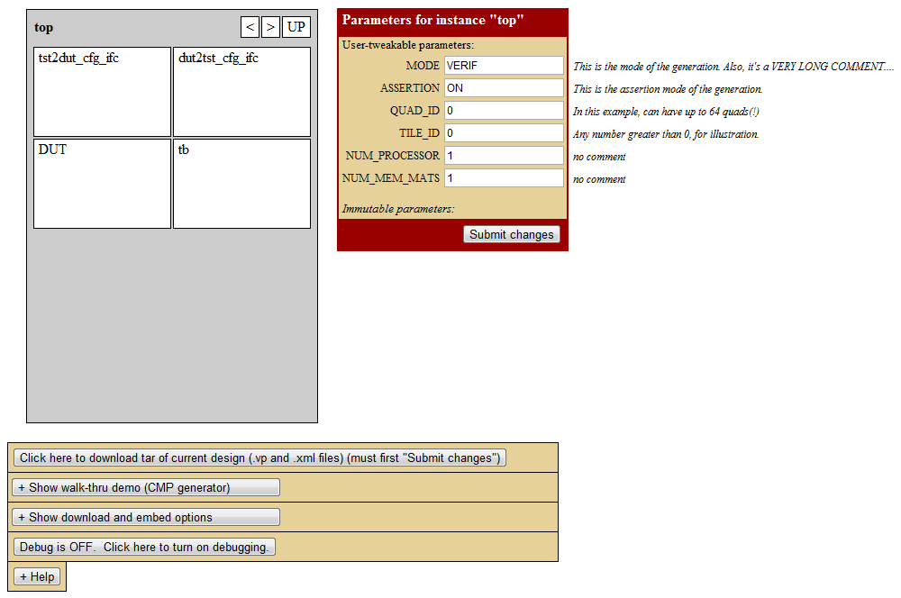
Standard Graphical User Interface
Work done with Steve Richardson, Megan Wachs, and Andrew Danowitz

Slide 21

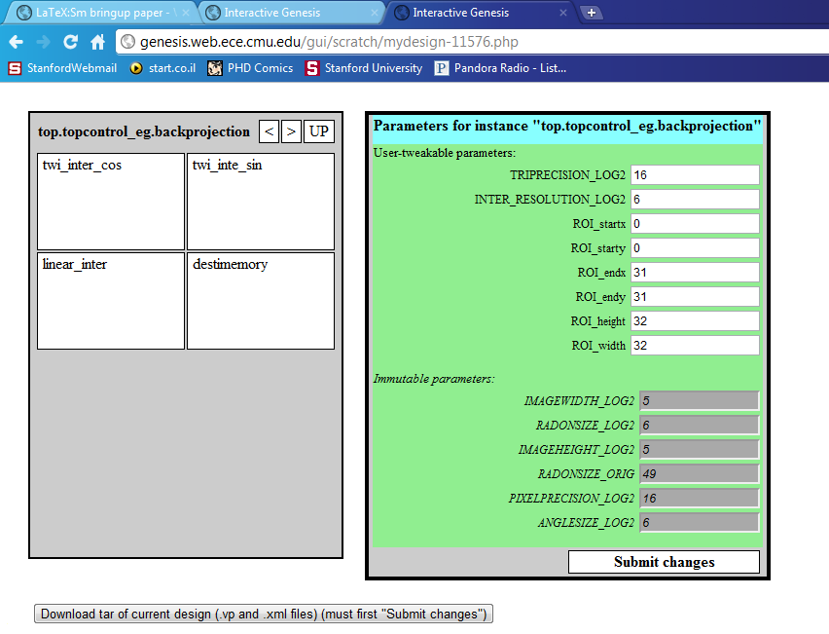
Genesis2 Now Also Used For CMU Generators
cmu.edu/g
Designed by Qiuling Zhu, Carnegie Mellon University

Slide 22
Summary / Conclusions
Power is today’s greatest design constrain → Calls for customization
Costs of creating new systems prohibitive → Due to system complexity
Chip Generators encapsulate the designer’s understanding of the system, as well as the design trade-offs
  Constrained architecture built off (design-time) flexible blocks
  The artifact produce is the process of making a chip, not a design instance
Genesis2 is a simple extension to SystemVerilog that enables and standardize the creation of hierarchical chip generators
Genesis2 can be downloaded from http://genesis2.stanford.edu/

Slide 23
Thank you!

Slide 24
Backup slides

Slide 25
Why SoC Costs Are Out Of Control?
Pool of fixed IP blocks
System Integration
Synthesis
PNR
GDS2
System definition
No sense of system
Each optimized for different power, perf., and area targets
Custom glue logic
Custom verification
Custom software
$$$
(Semi) Automatic
The focus of the entire EDA industry
Too late to make any change
(customize/optimize)
Not reusable
Growing costs
Time

Slide 26
End Result 1:
Better Amortized Cost Structure

Slide 27
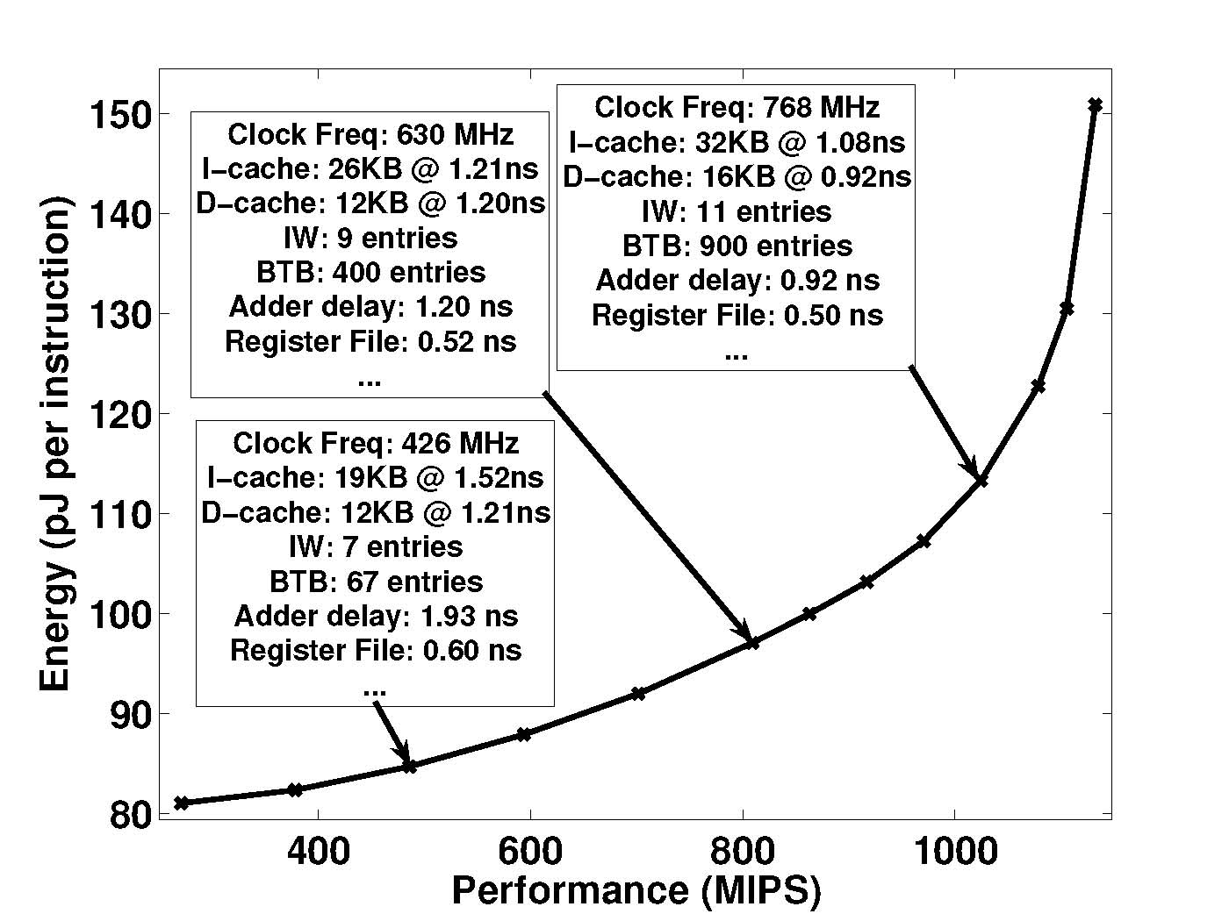
End Result 2:
Optimization At The System Level
Example: Best processor architecture configuration at various power / performance budgets
Source: Omid J. Azizi,
PhD Thesis, Stanford 2010

Slide 28
End Result 3:
Verification Team Also Leverages The Generator
Enhanced Design Process
Architectural Description
Architectural Template
(Chip Generator)
Target Design
(Semi-Random) Architectural Descriptions
Verif-only Design #1
Enhanced Verification Process
  Make corner cases into common cases
  Concept already used for concurrent software verif.
Shorten the long verification tail
Verif-only Design #2
Verif-only Design #n
Notes:
Similar to the sw verif tools:
Corensic Concurrency Debugger and Thread Debugger for Parallel Applications and Multicore Software (Jinx)
A randomized scheduler with probabilistic guarantees of finding bugs (ASPLOS '10)

Slide 29
The End Of Dennard Scaling

Slide 30
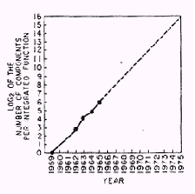
Historical Technology Scaling

Slide 31
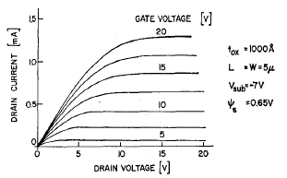
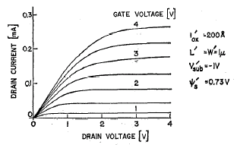
Dennard’s MOS Scaling (1974)
JSSC Oct 74, pg 256
In this ideal scaling (α < 1)
  V scales to αV, L scales to αL, W scales to αW
  So: C scales to αC,
  E = V/L is constant, so i scales to αi (i/m is stable)

Slide 32
The Triple Play of Historical Scaling
Over three decades of constant field (Dennard) scaling
  V scales to αV, L scales to αL, W scales to αW (α<1)
Everybody wins:
  Get more transistors, more gates 1/α²
  Gates get faster, delay scales as α
  Energy per switch is reduced α³
For the same power and area as the previous design
  Compute grows as 1/α³
Architects use this to improve computer performance

Slide 33
Random Backup Slides

Slide 34
Turn The Design Process Inside Out
Conventional System-on-Chip Design:
  Designer creates system from complex components
    IP components are designed in advance
    End with a new connection of fixed components
  SoC designer has to connect multiple IP blocks:
    Interface adapters between different blocks
    Complex verification
Chip Generator:
  Designer tunes parts in a “fixed” system architecture
    Fixed design of squashy components
  Functional interfaces remain constant
    Reusable validation

Slide 35
Silicon Compilers Again?
Well, yes and no
  No: I don’t expect it will take application code and “compile” it
  Yes: Each time we create a generator we essentially define a “language” that accepts an architectural “description,” and “compiles” it to silicon
Designers today encode results; We don’t encode our knowledge
  We think of many alternatives in a design; then choose one
      For the next application perhaps another alternative is best
  We optimize designs at each level, but then freeze them
      What happens if we let the design remain flexible?
Instead, embed explicit elaboration instructions into modules
  Same function that constructors provide for classes
Notes:
In some sense we are creating a silicon compiler, it is just that we ask the most knowledgable person how to compile---the rtl designer

Slide 36
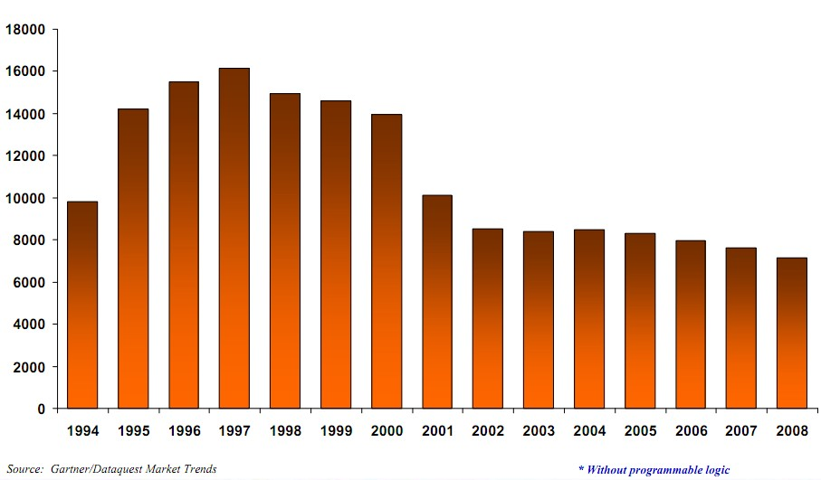
Semiconductors Logic Design Starts
Compiled by Walden C. Rhines, CEO, Mento Graphics

Slide 37

Semiconductor Market Size

Slide 38
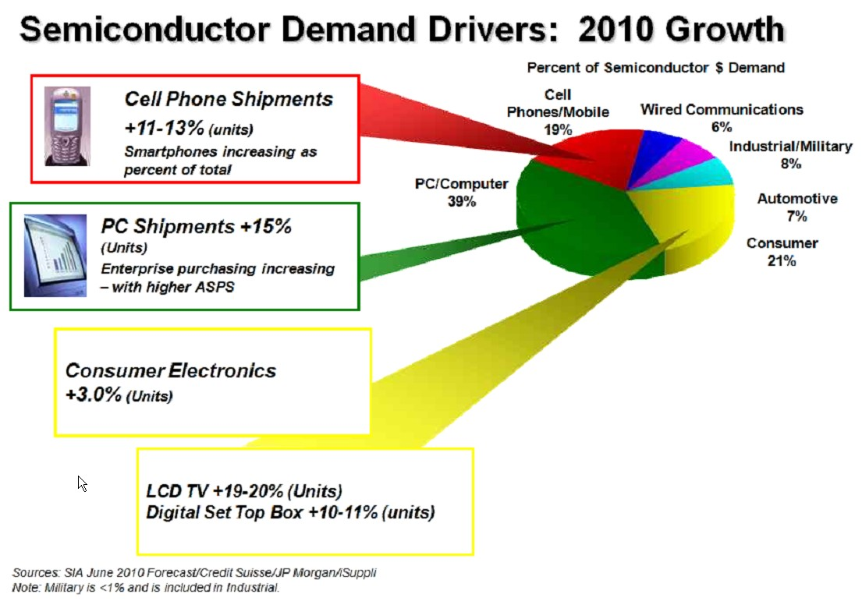
Semiconductor Market Breakdown (2010)

