Slide 1
The TILE-Gx Processor: Enabling HPC through Massive-Scale Manycore
Bob Doud
Director of Processor Strategy, Tilera Corp.
HPEC, September 2011

Slide 2
Tilera TILE-Gx Family
Manycore Processors with up to 100 Cores
© 2011 Tilera Corporation

Slide 3
The TILE-Gx8100™ Processor:
System-on-a-Chip with 100 64-bit cores
MiCA
Memory Controller (DDR3)
Memory Controller (DDR3)
Interlaken
4x GbE
SGMII
SerDes
10 GbE
XAUI
450 BOPS
32MBytes
Coherent
Cache
~60 Watts
USB x2,
UART x2,
JTAG, I²C,
SPI, GPIO
4x GbE
SGMII
SerDes
10 GbE
XAUI
4x GbE
SGMII
SerDes
SerDes
PCIe 2.0
8-lane
10 GbE
XAUI
4x GbE
SGMII
SerDes
10 GbE
XAUI
SerDes
PCIe 2.0
8-lane
mPIPE
4x GbE
SGMII
SerDes
10 GbE
XAUI
Interlaken
4x GbE
SGMII
SerDes
SerDes
PCIe 2.0
8-lane
10 GbE
XAUI
4x GbE
SGMII
SerDes
10 GbE
XAUI
Runs SMP
Linux
MiCA
4x GbE
SGMII
SerDes
Memory Controller (DDR3)
Memory Controller (DDR3)
10 GbE
XAUI
3
© 2011 Tilera Corporation

Slide 4
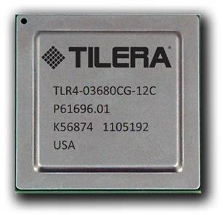
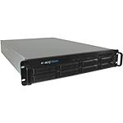

Peta-Op Integer Compute at <500KW
2250 Tile Processors = 1.012 Peta-Ops
TILE-Gx100 Processor:
3-way core, 1.5GHz, 100 cores = 450 BOPS per chip
1 Tilera Server Shelf:
3U rack space; 12 blades, 3 processors/blade
1 Tilera Rack;
13 Shelves, 468 processors, 46,800 cores
5 Tilera Racks;
2250 processors, 225,000 cores; ~450 Kilowatts
3600 cores
Up to 180 Tbps of I/O
288 TBytes DDR3 Memory
5 Racks
© 2011 Tilera Corporation

Slide 5
TILE-Gx Enables a Range of HPC Applications
© 2011 Tilera Corporation

Slide 6
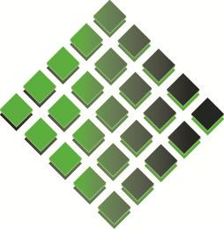
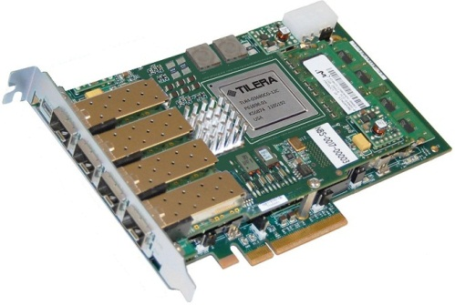
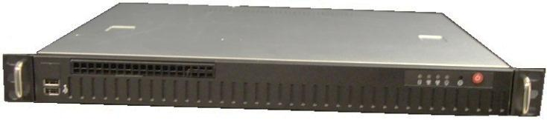
Thank You
Please stop by our table outside the auditorium
TILE-Gx processor solutions on display
We’ll be happy to discuss your HPC requirements
© 2011 Tilera Corporation

