Slide 1
VXFabric: PCI-Express
Switch Fabric for HPEC
Poster B.7, Technologies and Systems
Robert Negre,
Business Technology Director
Kontron Modular Computers SAS
France

Slide 2
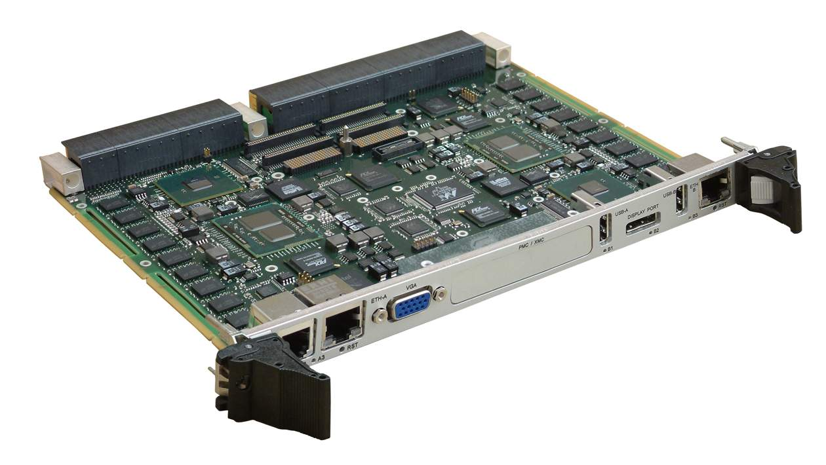
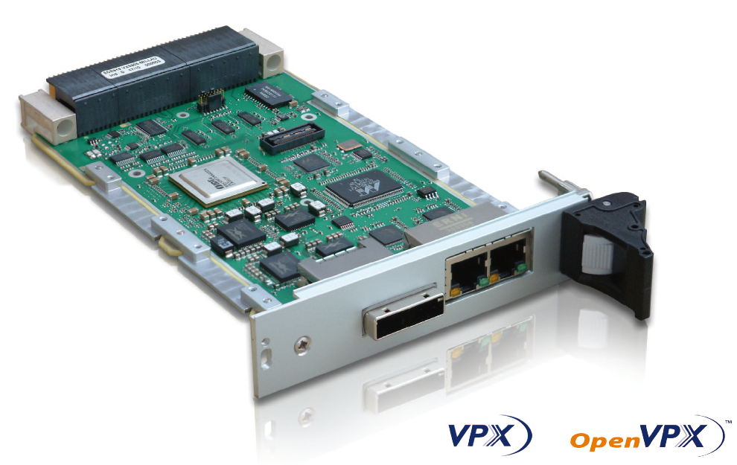
VXFabric: PCI-Express
Switch Fabric for HPEC
VXFabric is a new PCIe interconnect between multiple processor nodes
VXFabric is based on Internet Protocol over PCI-Express
  At the hardware level, it is built on PCIe Gen2/Gen3 links using non transparent PCIe bridges, allowing peer-to-peer DMAs. Implemented on Open VPX computers & PCIe switch boards
  At the software level, VXFabric provides a socket API giving access to TCP/IP or UDP/IP protocols, Low latency, Light weight protocol, Plug & play thanks to IP sockets
12 PCIe Links
12
    PCIe centralized
    switch
Six VX6060 =
12 processors = 24 cores

Slide 3
VXFabric Software API
  VXFabric user programming model is based on a socket Internet Protocol allowing direct use of TCP/IP or UDP/IP
  A low level protocol takes care of data transfers between processor nodes
User
VXFabric CLI
Socket Application
Operating System
Lightweight Protocol
Kernel Network Layer
“vxeth”
“vxdma”
“vxfabric”
Allocator
Hardware PCIe links and PCIe switch
  “vxfabric” deals with the mappings, status and low level protocol of the fabric
  “vxdma” implements the DMA API used by other modules to read/write data over PCIe
  “vxeth” creates the Ethernet emulation of VXFabric

Slide 4
VXFabric Performances under TCP/IP
VXFabric measured sustained performance, per PCIe x2 Gen2 link
The VXFabric software lightweight protocol frees up more of the CPUs bandwidth for processing data
  Aggregate performance for a 12-node VXFabric exceeds 51 Gb/s for unidirectional transfers, and 102 Gb/s for bidirectional PCIe transfers
  Latency for each packet is low: order of magnitude is a few µseconds
VXFabric is scalable
32 Gb/s
Gen3
16 Gb/s
Gen2
8 Gb/s
Gen1
PCIe x4 bandwitdh
per link

Slide 5
VXFabric
Conclusion
  VXFabric high performance switch fabric running on the Kontron VPX Computers
  The VXFabric API, based on IP Socket, is plug & play for most applications, and does not require any long integration/troubleshooting phase: moving from an Ethernet switch topology to VXFabric is straight forward
Have a look to our VXFabric poster and materials at Poster B.7, Demo B:Technologies and Systems
THANKS !

