Slide 1

HPEC 2011 Implementation of 2DFFT Processing and Large Dense Matrix Multiply on the TMS320C6678 Processor
www.gedae.com
Kerry Barnes (kbarnes@gedae.com),
William Lundgren (wlundgren@gedae.com),
James Steed (jsteed@gedae.com),
Amon Arnon Friedmann, Ph.D. (TI, arnon@ti.com),
Hector Rivera (TI, hrivera@ti.com)

Slide 2
HPEC Presentation History
Graphical Programming and Autocoding for Multiprocessor Systems - 1998
The Expressiveness of the GEDAE Graph Language – 1999
Implementation of the Intelligent Detector-Tracker Algorithm on Embedded Hardware Connected to a Local Area Network – 2002
Gedae Runtime Kernel Performance Characterization – 2004
Gedae: Auto Coding to a Virtual Machine – 2005
How Code Generation Will Save Moore’s Law – 2006
The Impact of Programming Difficulty on Hardware Obsolescence – 2007
Programming Examples that Expose Efficiency Issues for the Cell Broadband Engine Architecture – 2008
Simple, Efficient, Portable Decomposition of Large Data Sets – 2009
Implementation of 2-D FFT on the Cell Broadband Engine Architecture – 2010
Automated Software Cache Management – 2010

Slide 3
"When we start talking about parallelism and ease of use of truly parallel computers, we're talking about a problem that's as hard as any that computer science has faced. I would be panicked if I were in industry."
John Hennessy, Stanford President, Computing Pioneer
“A Conversation with Hennessy & Patterson,” ACM Queue Magazine, 4:10, 1/07
Gedae's technology was developed from first principles to target parallel computers. The effort spanned a quarter century.

Slide 4
The Concept is Familiar
von Neumann
Gedae
FORTRAN & Others
Idea™
Compiler
Compiler
von Neumann Architecture
Gedae Architecture Class

Slide 5
The Language Enables the Compiler
The schedule of distributed execution is important because it dramatically effects resource use and ultimately throughput and power consumption.
Idea™
Gedae’s Idea language allows the compiler to reason about concurrency, resource use and the schedule of execution to produce efficient parallel code that runs on architectures with N CPUs, M memories, K interconnects
Compiler
Gedae Architecture Class

Slide 6
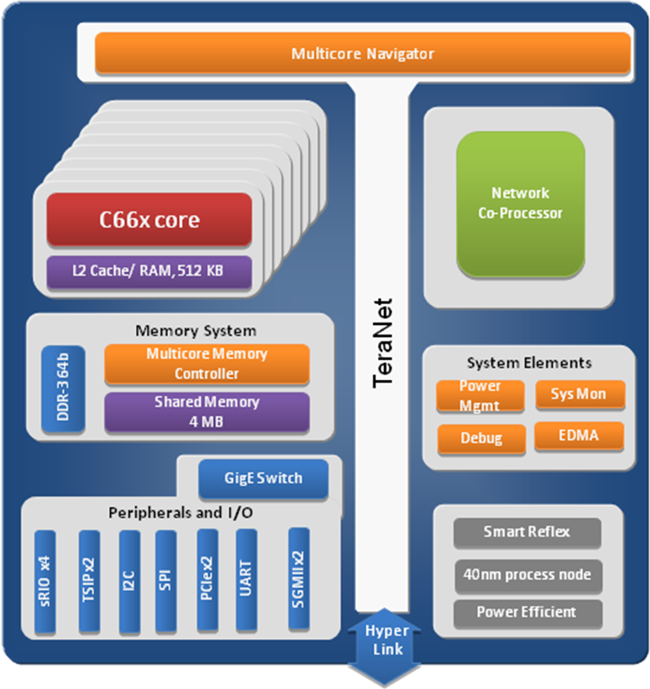
TMS320C6678 Architecture
Key Characteristics:
Maximum of 160 gflops
Maximum memory IO of 16 gB/s
Power consumption about 10 watts

Slide 7
Summary of Results
Summary of Processing and IOTimes
 | Theoretical† |  | Practical† |  | Measured
 | CPU | Memory | CPU | Memory | CPU | Memory
2D FFT (512x512) | 1.48e-4 | 6.55e-4 | 3.58e-4 | 7.28e-4 | TBD | TBD
Matrix Mult (4K x 4K) | 8.56e-1 | 1.57e-2 | 1.64 | 1.75e-2 | TBD | TBD
Summary of GFLOP Sustained
 | Theoretical | Practical | Measured
2D FFT (512x512) | 100 | 36.0 | TBD
Matrix Mult (4K x 4K) | 160 | 82.5 | TBD
†practical is the rate achievable based on available optimized vector functions theoretical is the rate achievable based on the balance between adds and multiplies

