Slide 1
Optical Interconnects for
Computing Applications
Mitchell Fields, Ph. D.
mitch.h.fields@avagotech.com

Slide 2
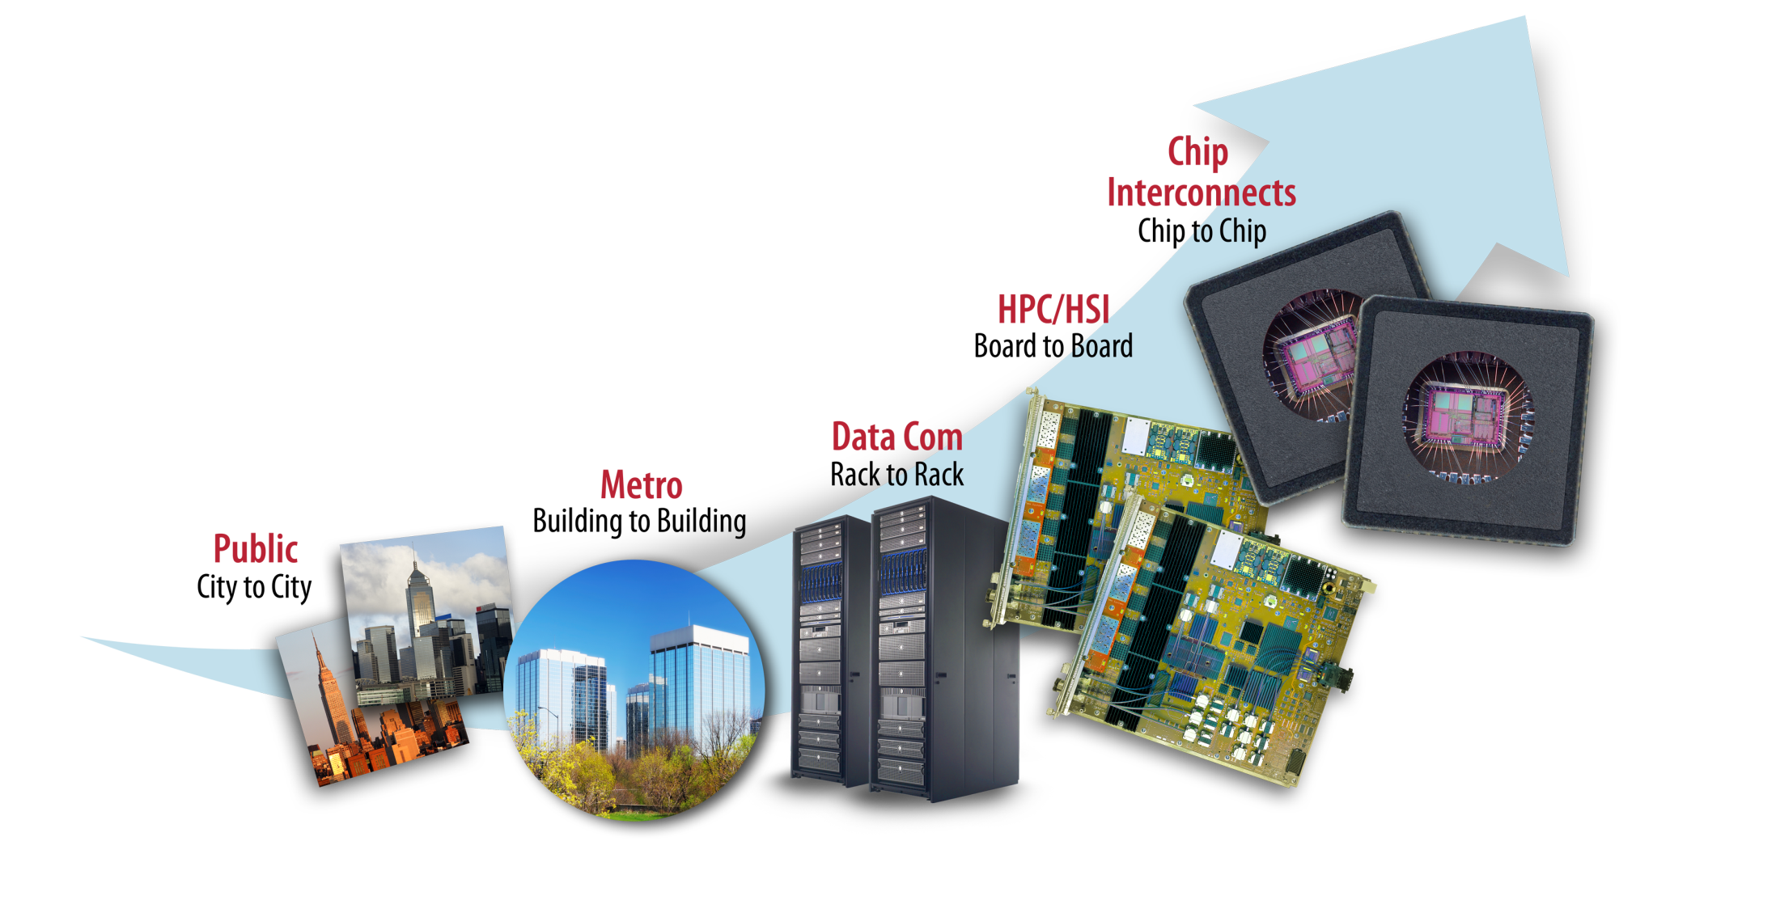
Evolution of high-bandwidth interconnects
Throughout history, optical interconnects were adopted when they overcame limitations of electrical signaling:
Distance / Bandwidth / Density / Power
Computing
For optical interconnects in computing environments,
COST and POWER are the most critical metrics.

Slide 3
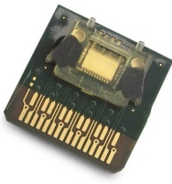
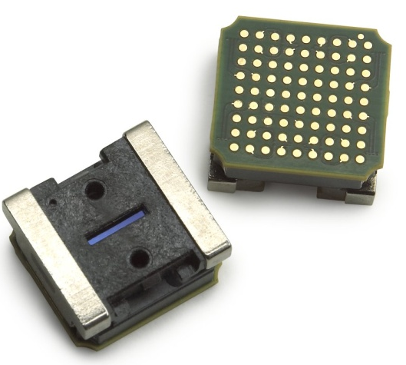
Modules targeted at different design points
Platform | AFBR-75 | MicroPOD
Application range | Consumer and low-BW computer interconnects | HPC and high-BW system interconnects
Aggregate bandwidth | 20G | 120G
IC technology | CMOS | BiCMOS
Laser source | 2xVCSEL array | 12xVCSEL array
Receiver | 2xPiN array | 12xPiN array
Electrical socket | Socket | μLGA
Optical connector | J-cable | Prizm
Footprint (with and w/o socket and optical connector) | 12x12x2 16x16x2.3 | 7.8x8.2x3.9 10.7x11.1x7.1
Power (mW/Gbps) | 14 | 25
Nominal reach (m) | 30 | 100
Diagnostic capability | ID and basic alarms | Full diagnostics
Signal integrity features | None | Equalization and de-emphasis

Slide 4
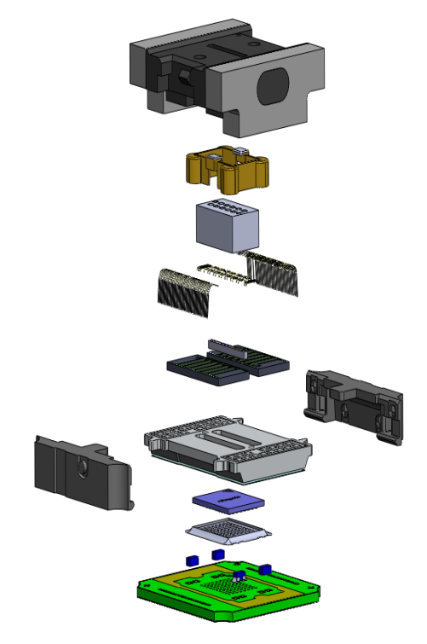
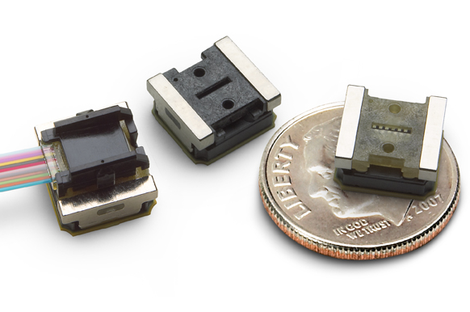




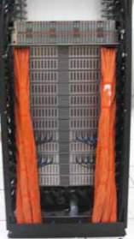

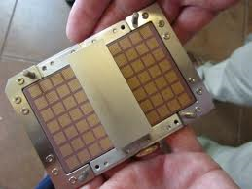
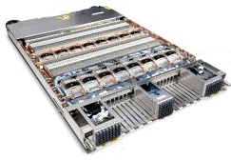
MicroPOD: Driven by high-performance computing
MicroPOD:
8.2mmx7.8mm 12-channel 10G Tx and Rx modules
HPC Challenge:
Unprecedented sustained computing power
Partnership for differentiation
IBM Hub Module:
28 Tx/Rx MicroPOD pairs (~6 Tbps I/O!)
IBM Power775 drawer: 8 Hub modules
IBM Power775 Datacenter in a rack:
12 drawers / ~100TF
To build the world’s most powerful computing system, IBM required a novel optical interconnect. MicroPOD was designed for low cost and high performance.

Slide 5
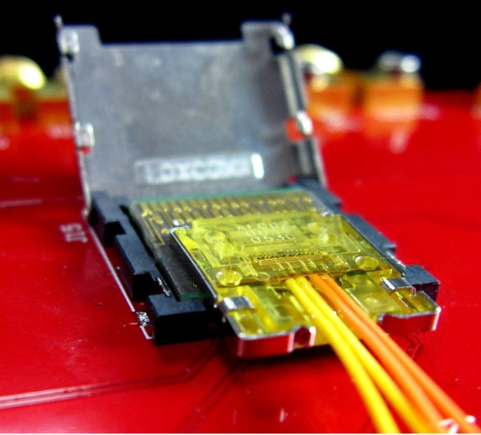
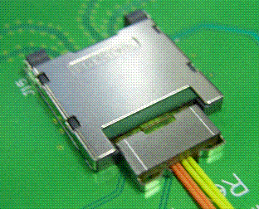
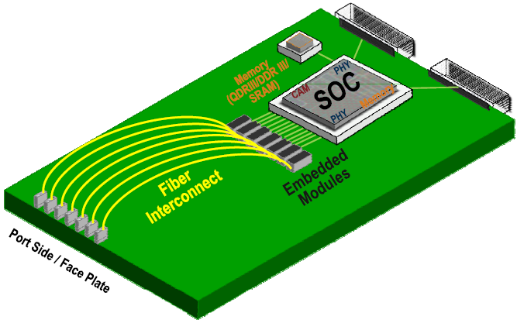
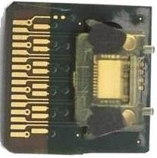
AFBR-75 Optical Module detailed overview
2 Photo-detectors
Module
PCB
Alignment hole
Electrical
Tx1
Avago
Optical
Tx2
Rx1
Optical
Transceiver
IC
Rx2
12mm x 12mm
Module Lens
IC
2 Lasers
Optics for the consumer market utilized for computer networking.

