Slide 1
A 1024-core 70GFLOP/W Floating Point Manycore Microprocessor
Andreas Olofsson, Roman Trogan, Oleg Raikhman
Adapteva, Lexington, MA

Slide 2
EpiphanyTM Multicore Architecture Intro
ANSI C Programmable
IEEE Floating Point
70 GFLOPS/W

Slide 3
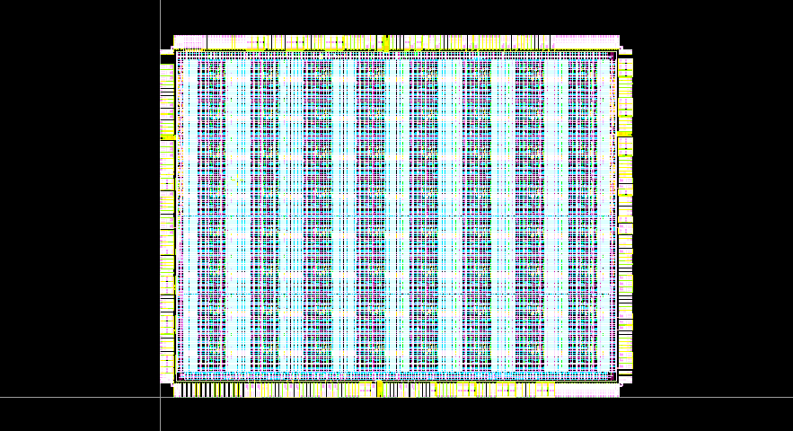
EpiphanyTM 28nm Product Announcement
a
Link Logic
IO Pads
1 Core
64 RISC cores
800 MHz Operating Frequency
100 GFLOPS
< 2Watt Max Chip Power
25mW & 0.12mm² per core
Up to 70 GFLOPS/Watt
2MB On-Chip SRAM
Only 10.0 mm² silicon area
Scale to 1000’s of cores on chip
In Fab, available Q1,2012

Slide 4
Hold on...the title said 1024 cores!
a
We can build it any time!
Waiting for sponsor/customer
LEGO approach to design
No global timing paths
Guaranteed by design
Generate any array in 1 day
~130 mm² silicon area
1024 Cores
1 Core

Slide 5
EpiphanyTM Single Chip Performance Scaling
On-demand scaling from 0.25W to 64 Watt

Slide 6
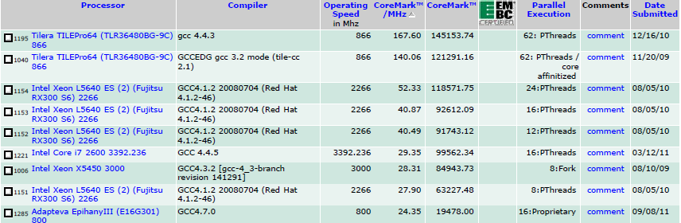
Epiphany, Server Performance Without the Power Drain
20-100W
2W!!

Slide 7
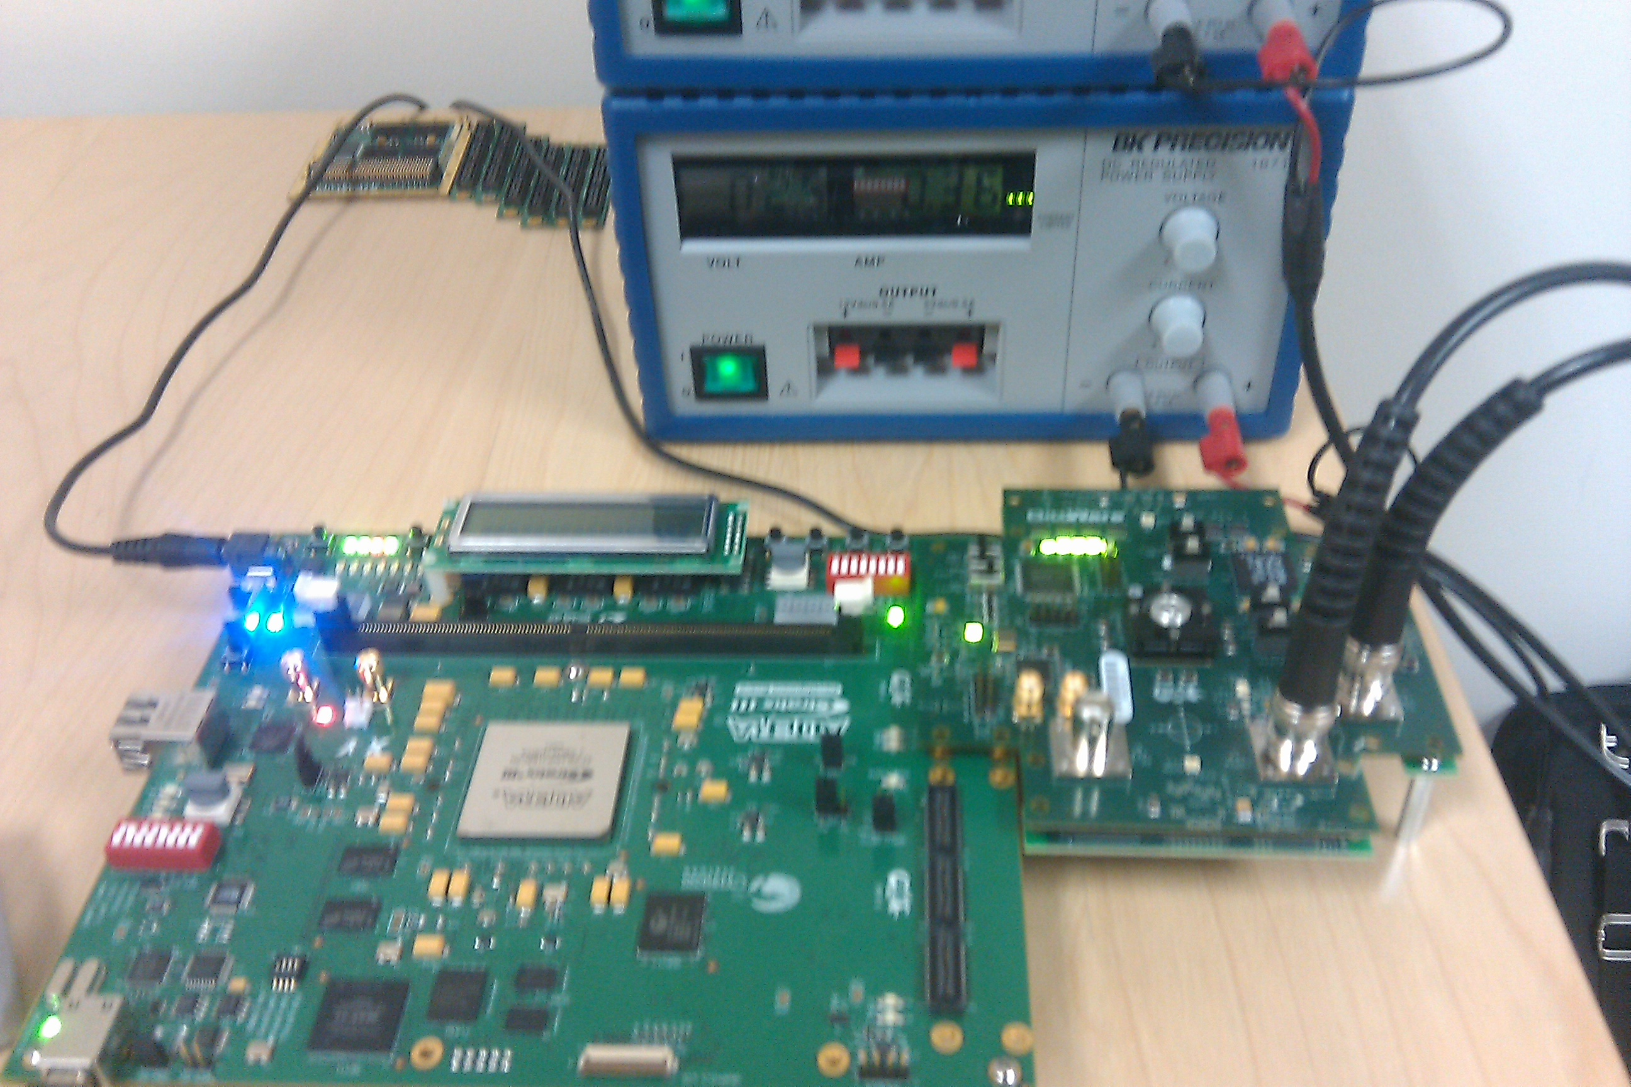
Energy Efficiency Lab Measurements

Slide 8
What this means for Embedded Systems
10x-50x boost in energy efficiency
Put the #1 Supercomputer of ~1995 in a smartphone
Make a solar powered 1 PFLOP supercomputer
Put processing closer to the sensor
Prototype real time real time systems entirely with floating point and C/C++

Slide 9
Summary
Currently providing easy to use development kits based on 65nm platform
Soon sampling the world’s most energy efficiency processors in 28nm
Looking for collaborators that can quickly demonstrate real time applications running on the Epiphany Multicore Architecture
Reached profitability in August 2011, we’re here to stay!

