Slide 1

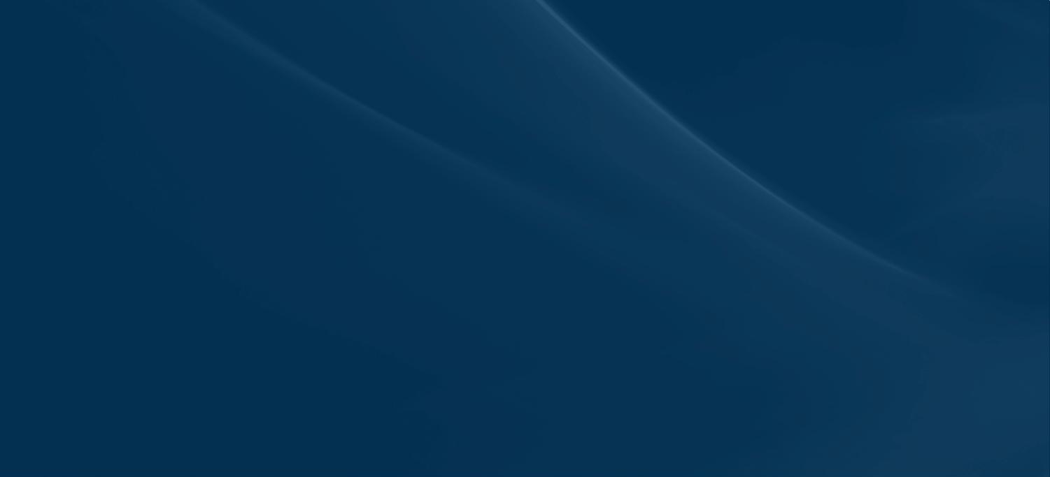
An Open Architecture/Open Business Model Solution for High Performance Multi-Level Collaborative Environment
Kent Lindell
High Performance Embedded Computing Workshop  September 21-22, 2011
RCC-2825(1)

Slide 2
SNAP Overview
Secure Network Architecture and Processing (SNAP) improves mission effectiveness by providing a cost effective, open architecture, high-assurance, multi-level, labeled, network solution ideal for high performance environments
General Dynamics’ SNAP
Open Architecture Solution
Fully programmable
High assurance secure solution
Reduced Size, Weight and Power (SWaP)
Reduced upgrade and certification costs
High performance and low latency
Allows migration to IP-based solutions
Dynamic and flexible security polices
Evolutionary approach minimizes up front investment
Notes:
Notes level one
Notes level two
Notes level three
Notes level four

Slide 3
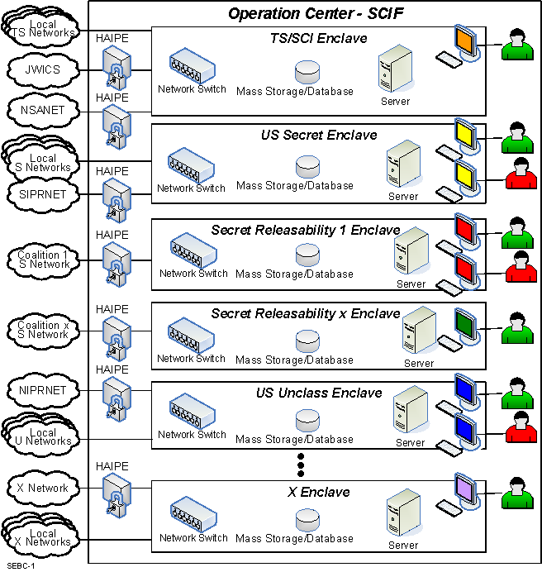
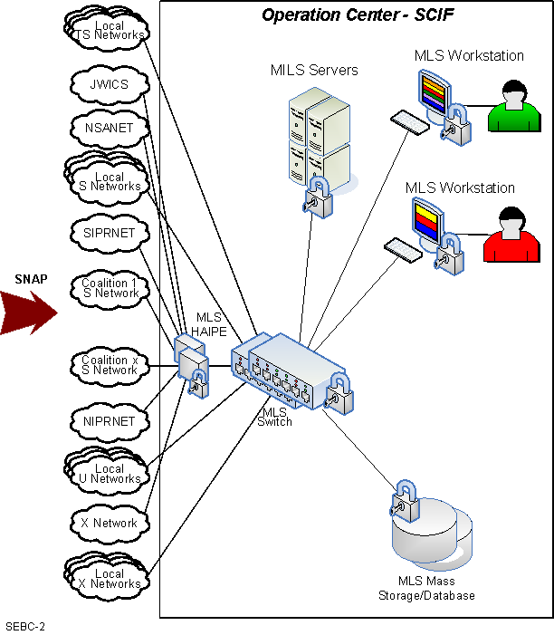
Security Segregation Enables a Cost Effective IA Infrastructure
SNAP IA Architecture Changes the Security Paradigm The Security Policy Can Now Enable a Mission vs. Limit a Mission
Notes:
Notes level one
Notes level two
Notes level three
Notes level four

Slide 4
Security Segregation Enables a Cost Effective IA Infrastructure
COTS/NDI base cards provide basic functionality
High Assurance functions provided by separate composable, loosely coupled HW & SW elements. Coupling to COTS occurs over open interfaces
Allows evolutionary, scalable approach and minimizes recertification costs
Can add / upgrade processing elements with mitigated impact to deployed systems
Firewall & NIPS
MLS
NIC
MLS
HAIPE
Black Router
& Link
Controller
Single Level Processor
MLS Switch Wrapper
MLS
NIC
Control
Interface
Single Level Network
Switch
MLS
NIC
MLS
NIC
MILS & MLS
Processing
MLS
NIC
I/O Mezz
Secure
MLS
Storage
I/O Module
Security
Mgr
COTS/NDI
High Assurance (HA)
Platform Customized
Notes:
Notes level one
Notes level two
Notes level three
Notes level four

