Slide 1
Android Application for Language ID*
Pedro Torres-Carrasquillo Robert A. Ford Joel C. Acevedo-Aviles
* This work is sponsored by the Department of the Air Force under Air Force Contract #FA8721-05-C-0002. Opinions, interpretations, conclusions and recommendations are those of the author and are not necessarily endorsed by the United States Government.
Notes:
Title slide with authors and disclaimer

Slide 2
Outline
Motivation
Automatic Language Identification (LID)
SmartPhone Implementation
System Performance
Conclusions and Future Work
Demo
Notes:
Talk outline

Slide 3

Motivation
Any unplanned interaction with someone who does not speak our language requires an interpreter
Language identification is needed first
Recent example in San Diego Harbor (March 27, 2011)
  26-foot sailboat capsized
  First responders did not
  recognize language
  “…investigators had to bring in interpreters to speak to them, San Diego Fire-Rescue spokesman Maurice Luque said. He did not know what language they spoke.”
Notes:
Motivation. Why and where could you need language identification.

Slide 4
Applications
Language-based data filtering
Pre-processing for automated speech applications such as machine translation and speech recognition
Requesting human interpreters for emergency situations
Our focus is to develop a Smartphone application that addresses the latter scenario (i.e. routing language service requests in emergency situations)
Notes:
Continuing from the previous slide. Gets into specific applications for language identification.

Slide 5
Project Goals
Implement a LID system on an Android based Smartphone
Evaluate tradeoffs between computational complexity and performance across several phones
Evaluate performance of in-phone LID system with field testing
Develop a prototype application that integrates existing Smartphone capabilities with LID to quickly and efficiently route language service requests
Notes:
Describes what the goal of the project is and what we want to accomplish.

Slide 6
Automatic Language Identification (LID)
Automatic language identification is the process of determining the language being spoken in a speech utterance without human intervention
Closed-set identification
  Prior knowledge of all classes
Open set identification
  Out of set class
Arabic
Arabic
Which language is this?
Which language is this?
?
?
?
?
English
?
English
?
?
?
?
?
?
?
Focus: Closed-set ID
Farsi
Farsi
?
?
None of the above
Notes:
Definition slide for language id and the two main scenarios where you can be using this technology.

Slide 7
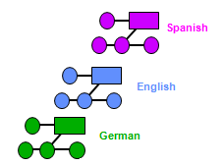
  LID System
  Architecture
Language identification task: Find messages spoken in a target language
Training
Spanish
Feature
Extraction
Training
Algorithm
English
German
Training speech utterances
in known languages
Set of models:
one model per language
Recognition
Feature
Extraction
Recognition
Algorithm
It’s German!
Speech utterance
in unknown language
Recognition Output
Notes:
Architecture for LID system and the general concepts of training the system and testing the system.

Slide 8
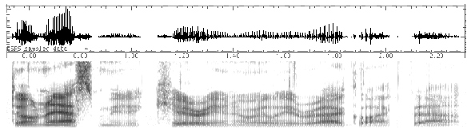
  LID System
  Feature Processing
10ms
...
Feature
Vectors
3.4
3.6
2.1
0.0
-0.3
0.1
0.2
3.4
3.6
2.1
0.0
-0.3
0.1
0.2
.
.
.
.
.
.
-0.1
3.4
3.6
2.1
.
.
.
0.1
3.4
3.6
2.1
.
.
.
.
.
.
.
.
.
.
0.2
Short-time
Spectral
Magnitude
Cepstral
Analysis
Channel
Compensation
Deltas
Spectral Analysis
  Generate frequency component information through Short-Time Fourier Transform
Cepstral Analysis
  Separates frequency information that is characteristic of a language from what is
  common across all languages considered (7 features)
Channel Compensation
  Reduces the effects of differences across channels (landline vs cell phone)
Deltas
  Encode temporal variation of Cepstral features by computing the differences among
  neighboring frames

Slide 9
  LID System
  Gaussian Mixture Modeling
Gaussian Mixture Model (GMM)
  Almost any continuous probability distribution can be approximated by a linear combination of Gaussians
Each language is modeled as a probability distribution over the feature variables
Variance
Mixture Weight
Mean

Slide 10
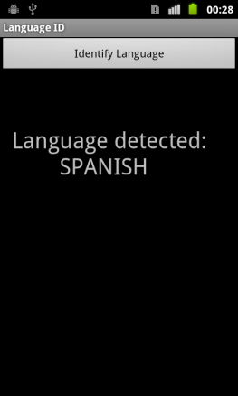
Android LID System Architecture
Processing
Java
(Android SDK)
Results Processing/
Display
Audio Capture
Standard wave file (PCM)
16 bits/sample
8kHz sample rate
NDK (JNI)
LID System (C⁺⁺)
As the user speaks, streaming audio is sent to the LID component for processing
The LID system consists of previously developed technology by the HLT group at Lincoln Laboratory (C++)
Android’s Native Development Kit (NDK) allow us to make use of C++ native code
Notes:
Description of the Android LID system architecture and how the code and wrappers for the code were developed.

Slide 11
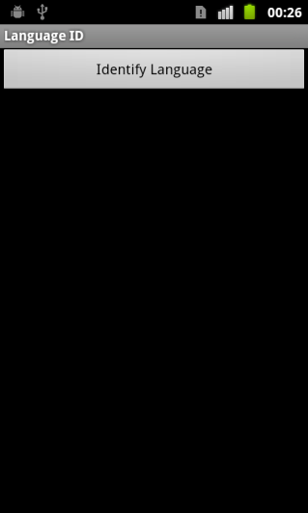
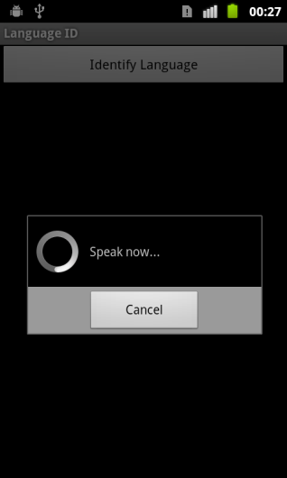

Android Screenshots/Demo
User speaks
for up to 30s
Detected language
is displayed
Main screen
User presses button
When enough
speech captured
App starts capturing user’s speech and does not stop until final decision is displayed
  When a minimum of audio is captured, it is processed
    Minimum audio is a system parameter; currently 7-seconds
  A score is generated for each language
If language score > preset threshold
  Decision is displayed, otherwise
  Score all audio captured until this point
Notes:
Screenshots for the phone application.

Slide 12
System performance versus model complexity
Computer Simulation
Five-Language task: Arabic, Cantonese, English, Mandarin, Spanish
Test sample nominal length: 30s
Task: closed-set ID
Notes:
Evaluation of the system via computer simulation. Presents the tradeoff between time and accuracy performance.

Slide 13
SmartPhone configurations
Multiple phones were evaluated
  Older platform (HTC Magic)
  Newer (Atrix)
 | HTC Magic | Samsung Nexus S | HTC Sensation | LG G2x, Motorola Atrix
CPU | Qualcomm MSM7200A | Hummingbird | Qualcomm MSM 8x60 | Tegra 2
Processor design | ARM 11 | Cortex A8 | Scorpion | Cortex A9
Clock | 528 MHz | 1 GHz | 1.2 GHz | 1 GHz
Process | 90 nm | 45 nm | 45 nm | 40 nm
Out of Order Execution | no | no | partial | yes
Year introduced | 2009 | 2011 | 2011 | 2011
Relative performance | 1 | 6 | 16 | 18

Slide 14
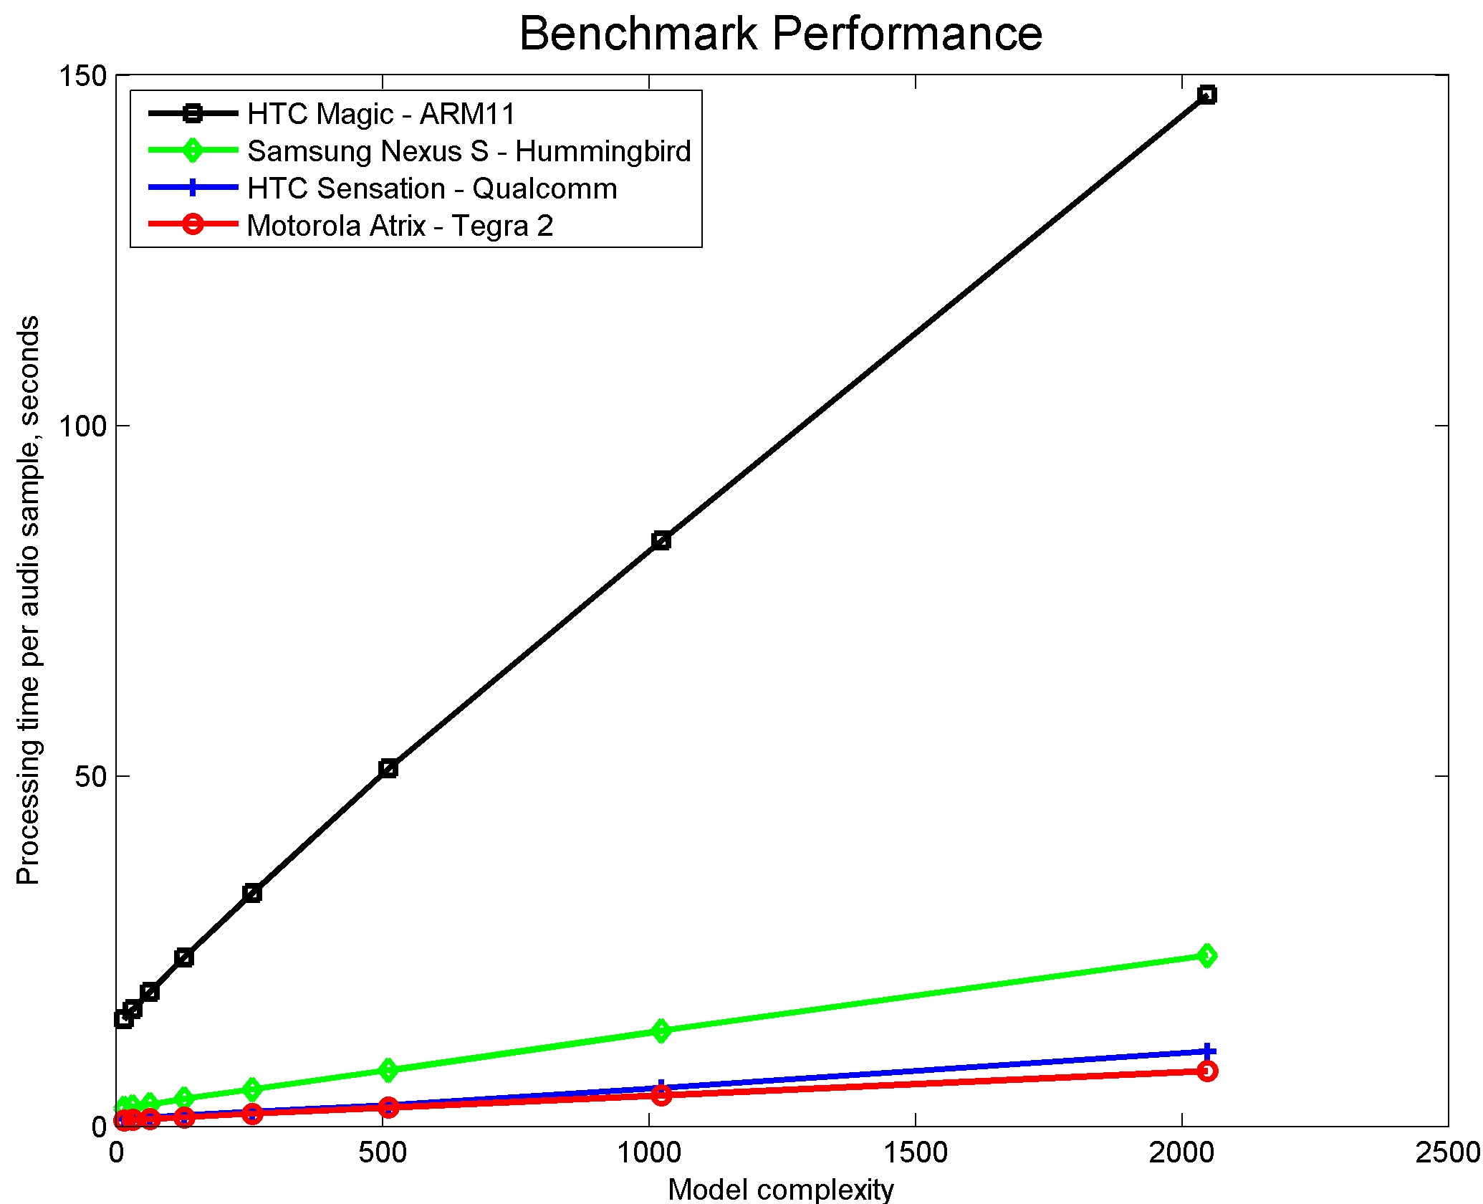
Average execution time versus model order
In-SmartPhone Evaluation
Task: 5-language closed-set Id
Test sample average duration: 30s
Averaged over 4 test samples
Notes:
Comparison of the LID system performance on various smartphones based on Android platform.

Slide 15
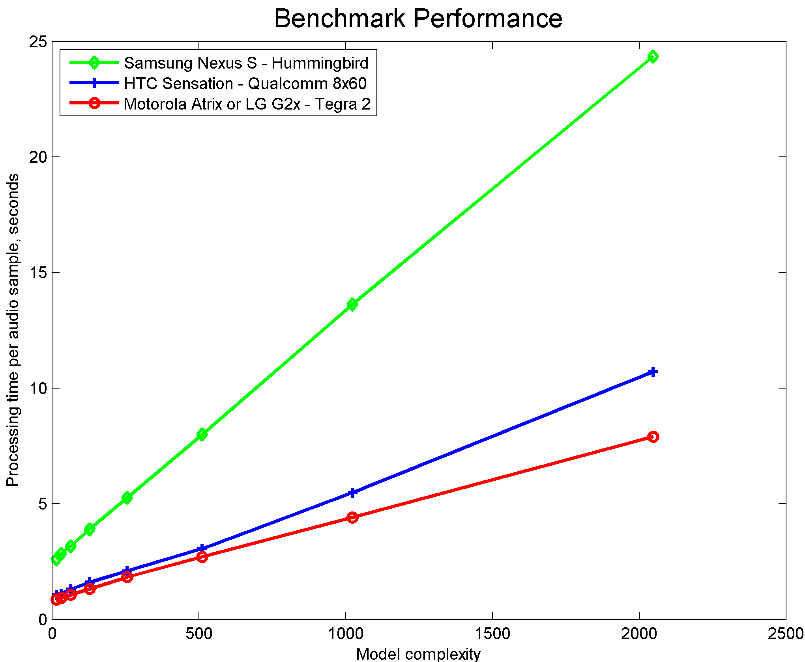
Average execution time versus model order
In-SmartPhone Evaluation
Task: 5-language closed-set Id
Test sample average duration: 30s
Averaged over 4 test samples
Notes:
Comparison of the LID system performance on various smartphones based on Android platform.

Slide 16
Average execution time for different tasks
In-SmartPhone Evaluation
Comparison in execution time between 5 and 50-language task
Fixed model complexity 2048
30-sec samples
Small overhead in computation since in both cases the language independent model is scored and takes most of the processing time
Phone | 5 Languages | 50 Languages
Nexus S (Hummingbird) | 16.9s | 21s
Motorola Atrix | 7.9s | 9s
HTC | 10.7s | 11s
Droid X2 | 5.2s | 8.6s
LGE G2X | 7.9s | 9s

Slide 17
System performance
Benchmark Classification Error Rate: 9.1%
  Computer LID system
  Development Set
In-phone evaluation
  Classification Error Rate: ~20%
  7 languages
    Arabic, Mandarin, Vietnamese, Hindi, Russian, Spanish, Turkish
  Half of captured segments < 10s
Potential issue with mismatch between 30s system training and amount of speech provided by users
Notes:
Presents the tradeoff between time and accuracy performance while the system is evaluated in the phone.

Slide 18
System performance
Impact of test segment duration
Matched system
  Train and test samples of same duration
Mismatched system
  Trained on full sample length
Speech (s) | Classification error rate (%)
6 | 28.1
12 | 16.8
18 | 10.2
24 | 9.4
30 | 9.2
Full sample | 9.1
Speech (s) | Classification error rate (%)
6 | 29.8
12 | 17.6
18 | 12.6
24 | 10.3
30 | 9.3
Full sample | 9.1

Slide 19
Conclusions and Summary
State of the art LID technology has been implemented in Android platform
Successful evaluation conducted over multiple handsets
  Newer handset perform in real time
Additional data is needed to support more in-phone testing
Notes:
Conclusions and summary including achievement of the main goals and what needs further testing.

Slide 20
Future Work
Implementation of robustness techniques to enhance mismatch between training data and telephone
Can performance be improved by using multiple systems in combination?
Is current speech activity detection aggressive enough?
Use speech time instead of audio time
Compensate for shorter durations
  Likely main current source of mismatch
Evaluate power consumption/battery life for field use
Study the open-set problem
Leverage current implementation to extend to speaker identification
Notes:
A general take on future work. Including extending the application to other scenarios, additional algorithms and leveraging to speaker identification.

