Slide 1
Graphics Processor Clusters for High Speed Backpropagation
2011 High Performance Embedded Computing Workshop
22 September 2011
Daniel P. Campbell, Thomas M. Benson, Daniel A. Cook
dan.campbell@gtri.gatech.edu

Slide 2
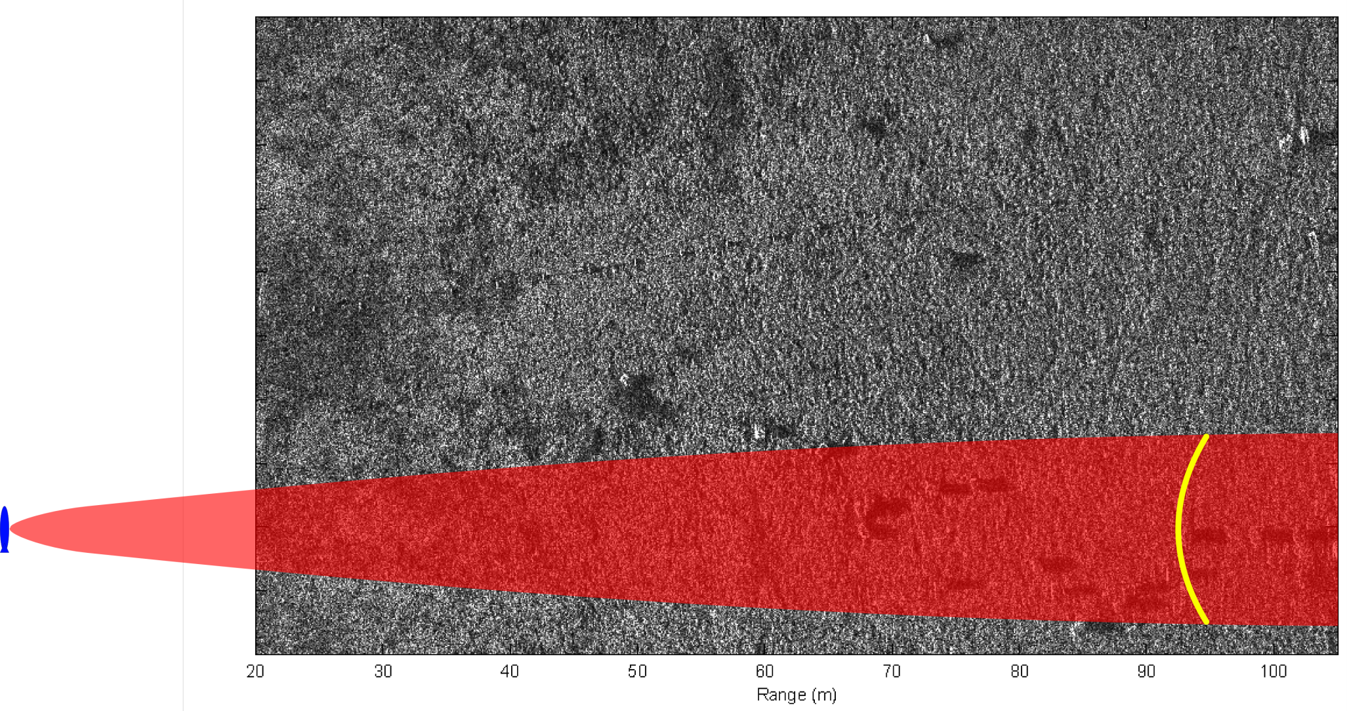
Sonar Imaging via Backpropagation
Forward Travel
As the sonar passes by the scene, it transmits pulses and records returns.
Each output pixel is computed by returns from the pulses for which it is within the beamwidth (shown in red). A typical integration path is shown in yellow.
Notes:
Fix this image. Flip the yellow around, add another beam with intersecting yellow

Slide 3
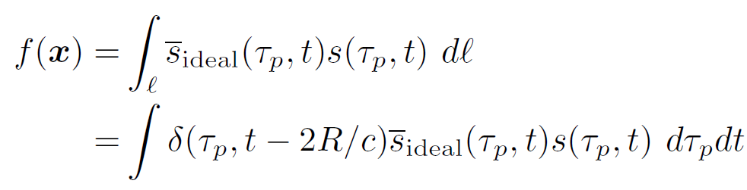
Backpropagation
Backpropagation
Backpropagation is the simplest synthetic aperture image reconstruction algorithm
for each output pixel:
  Find all pings containing reflections from that location on the ground
  Find recorded samples at each round-trip range
  Inner product with expected reflection
  Sum all of these data points
end

Slide 4
Backpropagation – Practical Advantages
Procedure
  Attempt to fly a perfectly straight line
  Compensate for unwanted motion
  Form image using Fourier-based method backpropagation
  Register and interpolate image onto map coordinates
Algorithmic simplicity
  Easier to code and troubleshoot
  Less accumulated numerical error
Flexibility
  Can image directly onto map coordinates without postprocessing
Expanded operating envelope
  Can image in adverse environmental conditions during maneuvers

Slide 5
Sonar vs. Radar
Synthetic Aperture Sonar/Radar
Typical SAS range/resolution: 100m/3cm
Typical SAR range/resolution: 10km/0.3m
SAS and SAR are mathematically equivalent, allowing (a lot of) the same code to be used for both
  The sensor is in continual motion, so it moves while the signal travels to and from the ground
Light travels 200,000 times faster than sound, so SAR processing can be accelerated by assuming the platform is effectively stationary during each pulse.

Slide 6
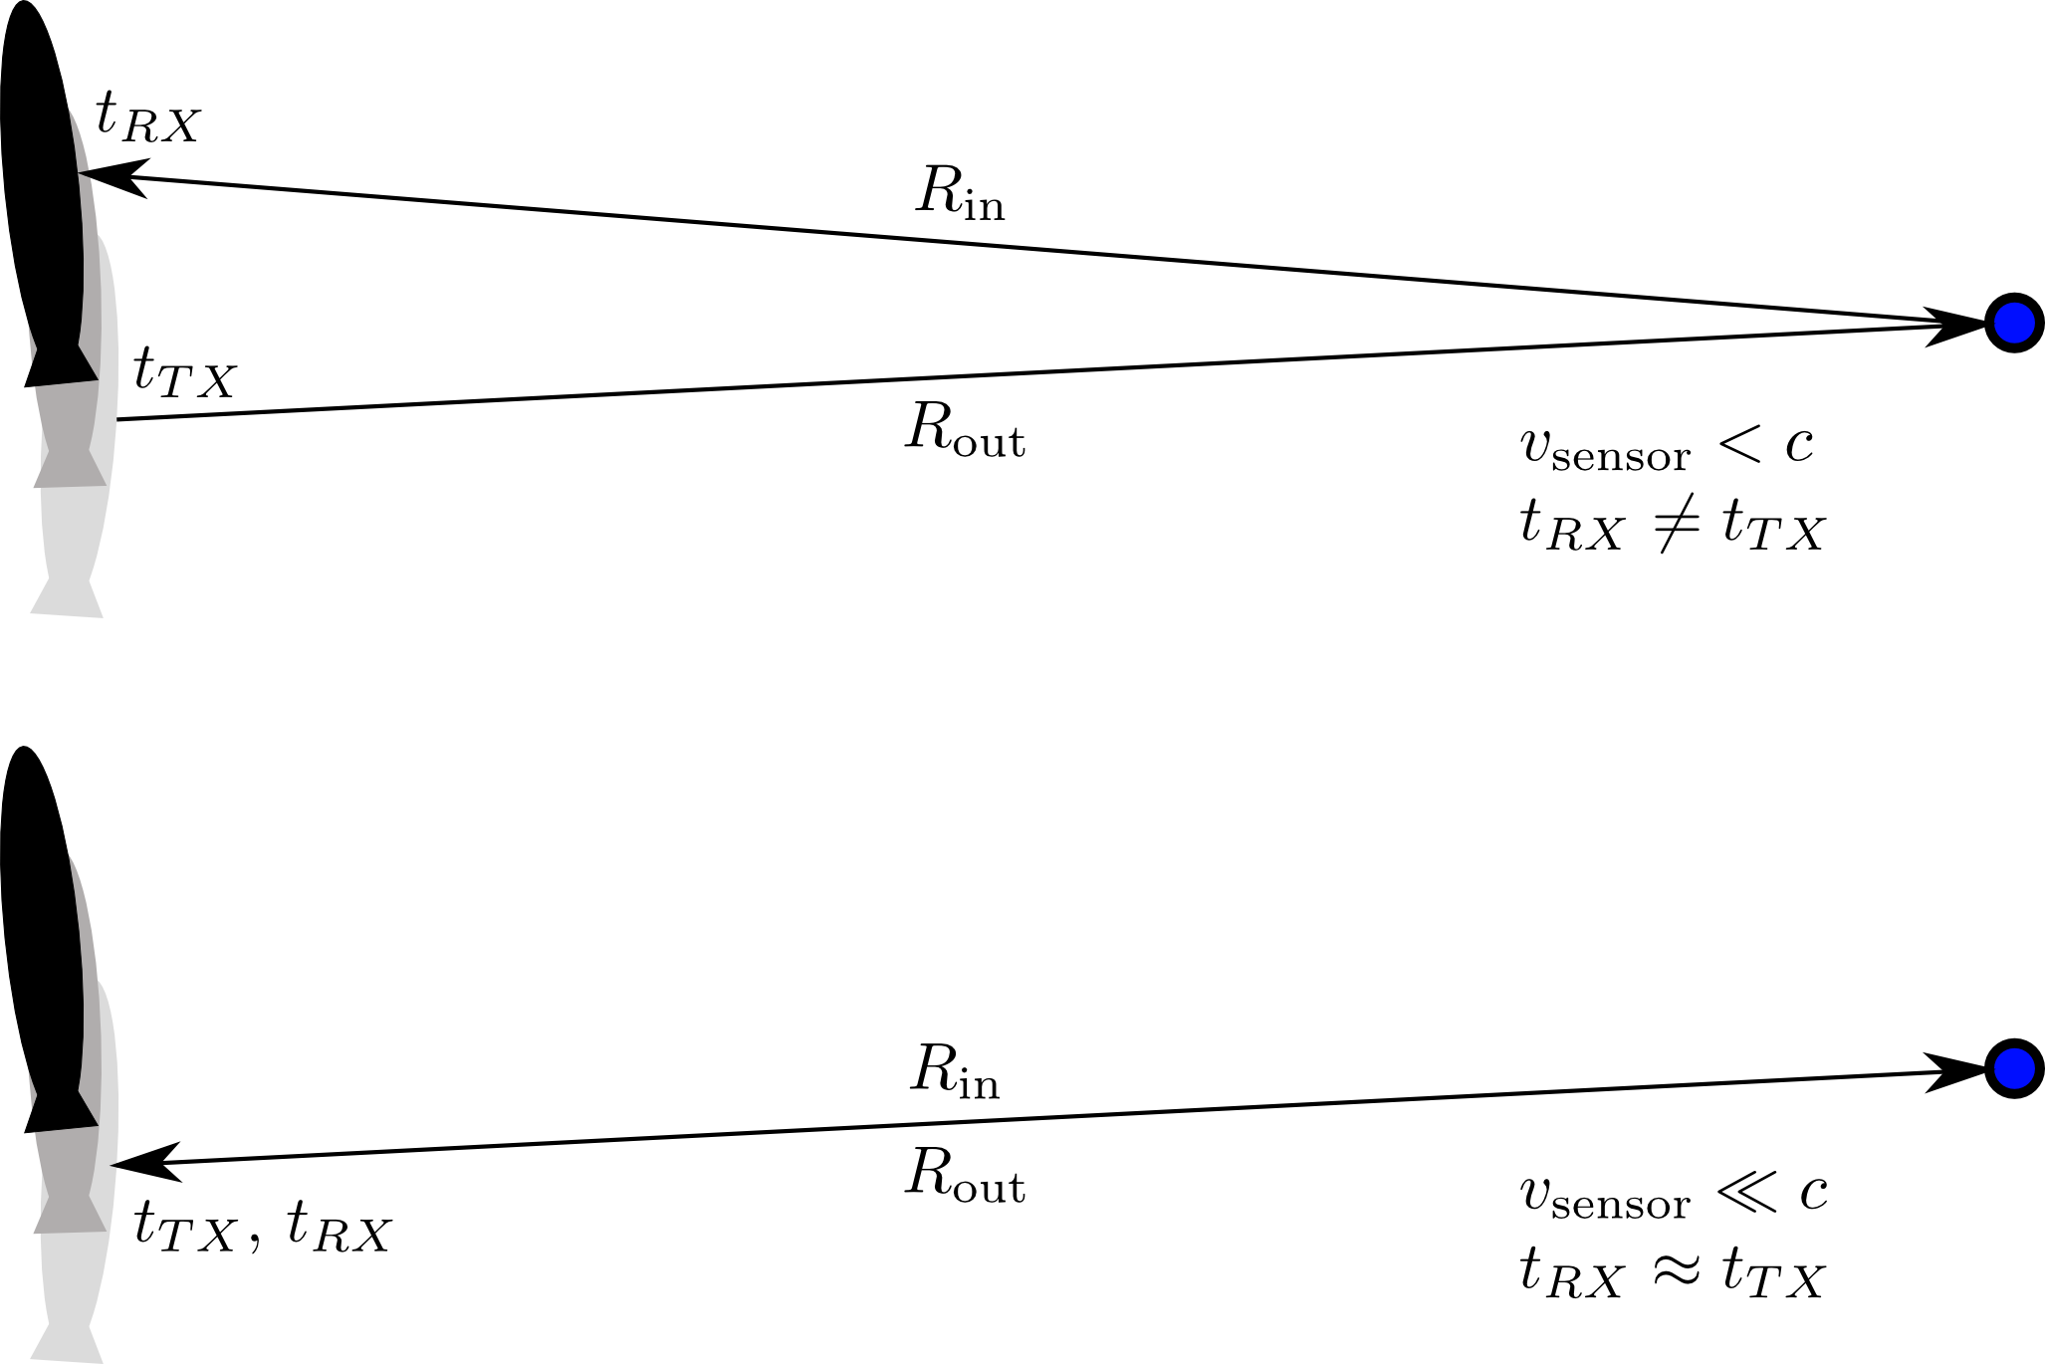
Sonar vs. Radar
Sonar vs. Radar
In general, the sensor is at a different position by the time the signal is received (above). If the propagation is very fast (i.e., speed of light), then the platform can be considered motionless between transmit and receive

Slide 7
Advantages of Backpropagation
FFT-based reconstruction techniques exist
  Require either linear or circular collections
  Only modest deviations can be compensated
  Requires extra steps to get georeferenced imagery
  Images only onto planar surface
Backpropagation is far more expensive, but is the most accurate approach
  No constraints on collection path: image during maneuvers
  Directly image onto any map coordinates desired
  Image onto height-varying surfaces

Slide 8
Minimum FLOPs
Minimum FLOPs per Pixel per Ping
Not needed for Radar
Range out 9
Estimated r/t time 1
Beam Check 5
Final receiver position 65
  Final platform orientation 6
  Construct platform final R 35
  Apply R 15
  Add platform motion 9
Range In 9
Range->Bin 2
Sample & Interpolate 9
Correlate with ideal reflector 9
Accumulate 2
Total 111

Slide 9
GPU Backpropagation
GPU Backpropagation
  GTRI SAR/S Toolbox, MATLAB Based
    Multiple image formations
    Backpropagation too slow
  GPU Accelerated plug-in to MATLAB toolbox
  CUDA/C++
  One output pixel per thread
  Stream groups of pulses to GPU memory
  One kernel invocation per pulse group

Slide 10
Single-Node Optimization Considerations
Direct Optimization Considerations
  Textures for clamped, interpolated sampling
  2-D blocks for range (thus cache) coherency
  Careful control of register spills
    Shared memory for (some) local variables
    Reduced precision transcendentals
  Recalculate versus lookup
  Limit index arithmetic
  Careful use of L2 cache versus shared memory
  Eliminate partially dead code
  Peak throughput: 6.47 billion pixel*ping/second

Slide 11
Baseline Scaling
Baseline Scaling
Node:
1 or 2 Tesla C2050
2x Xeon 5660/24GB RAM
DDR Infiniband

Slide 12
Baseline Scaling
Baseline Scaling
Node:
1 or 2 Tesla C2050
2x Xeon 5660/24GB RAM
DDR Infiniband

Slide 13
Final Test Platform
Direct Optimization Considerations
  Keeneland Initial Deployment
  120 Nodes
    3 Tesla C2070
    QDR Infiniband
    2 6-core Westmere
  201 Tflops GNE
  http://keeneland.gatech.edu/

Slide 14
Gigapixel & Large Cluster Considerations
Direct Optimization Considerations
  Full image too big for single GPU memory
  Full input too big for single GPU memory
  Number of pings not used by large groups of pixels quite large
  Load imbalance constraining at high GPU count
  Kernel, PCI-E, and MPI serialized
  Volume of input data not used by a given pixel quite large

Slide 15
Gigapixel & Large Cluster Considerations
Direct Optimization Considerations
  Full image too big for single GPU memory
  Full input too big for single GPU memory
  Number of pings not used by large groups of pixels quite large
  Load imbalance constraining at high GPU count
  Kernel, PCI-E, and MPI serialized
  Volume of input data not used by a given pixel quite large

Slide 16
Performance Drivers
Baseline Scaling
Keeneland ID
32768/3
Notes:
Update this slide with final numbers once obtained

Slide 17
Gigapixel & Large Cluster Considerations
Direct Optimization Considerations
  Full image too big for single GPU memory
  Full input too big for single GPU memory
  Number of pings not used by large groups of pixels quite large
  Load imbalance constraining at high GPU count
  Kernel, PCI-E, and MPI serialized
  Volume of input data not used by a given pixel quite large

Slide 18
Gigapixel & Large Cluster Considerations
Direct Optimization Considerations
  Full image too big for single GPU memory
  Full input too big for single GPU memory
  Number of pings not used by large groups of pixels quite large
  Load imbalance constraining at high GPU count
  Kernel, PCI-E, and MPI serialized
  Volume of input data not used by a given pixel quite large

Slide 19
Achieved Performance
Baseline Scaling
Keeneland ID
32768/1
Notes:
Update this slide with final speed #s once obtained

Slide 20
Achieved Performance
Baseline Scaling
Keeneland ID
32768/3
Notes:
Update this slide with final speed #s once obtained

Slide 21
Achieved Performance
Baseline Scaling
Keeneland ID
Notes:
Update this slide with final speed #s once obtained

Slide 22
Achieved Performance
Baseline Scaling
Keeneland ID
Notes:
Update this slide with final speed #s once obtained

Slide 23
Future Work
Future Work
  MPI Culling
  Improve tuning for SAR
  Preconditioning data reduction
  Improve error handling, edge cases, etc.
  Cloud service

