Slide 1


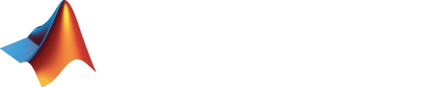
Accelerating Bit Error Rate Simulation in MATLAB using Graphics Processors
High-Performance Embedded Computing Workshop (HPEC 2011)
22 September 2011
James Lebak
Brian Fanous
Nick Moore
© 2011 The MathWorks, Inc.
1

Slide 2
Outline
Application Area
MATLAB Tools
DVB-S.2 Subset benchmark
DVB-S Subset benchmark
Conclusions

Slide 3
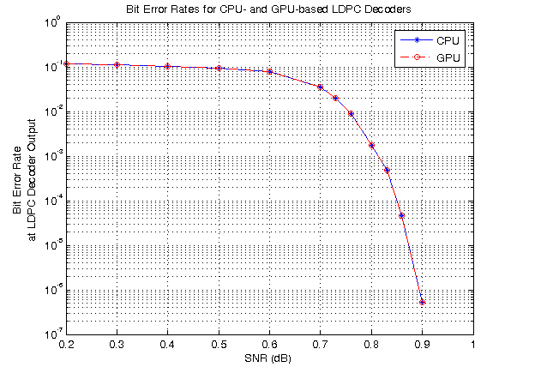
Bit Error Rate Simulation
Begin with a model of a communications system
Vary the signal-to-noise ratio
Calculate bit error rate through Monte Carlo simulation
Obtain a curve like that at the right
Expensive (millions of trials, days of simulation)

Slide 4
Example System Model Digital Video Broadcast Standard, Second Generation (DVB-S.2)
Transmitter Model
Modulator
and
Interleaver
Data In
BCH
Encoder
LDPC
Encoder
Channel
Model
Receiver Model
Demodulator
and Deinterleaver
Data Out
BCH
Decoder
LDPC
Decoder
LDPC = Low-Density Parity Check
Simulation Goal: Verify transmitter and receiver achieve a given bit error rate in the presence of noise introduced by the channel model
Notes:
Red boxes have been ported to be GPU System objects.
DVB-S.2 (Digital Video Broadcasting, 2nd generation). Used by Dish Networks, etc.

Slide 5
Outline
Application Area
MATLAB Tools
DVB-S.2 Subset benchmark
DVB-S Subset benchmark
Conclusions

Slide 6
System Objects
System objects allow design of dynamic systems in MATLAB
Represent dynamic systems
Algorithms with input values and states that change over time
Optimized for iterative execution
One-time checking of parameter values, input arguments
Data streaming between objects
Many algorithms implemented in C++ for speed
Support for automatic C code generation
Notes:
System objects extend MATLAB to represent dynamic systems. I’ve mentioned “dynamic systems” a number of times now – these are algorithms with input values and internal states that change over time. Such systems typically require more than a simple “y equals function of x” computation. They typically have one-time initialization code, repetitive calls to output computations, periodic reset tasks, and termination code, to name a few. They update and maintain internal states of the System over time. System objects define and encapsulate all these tasks and states within its model of a dynamic system.
(click) This task decomposition leads to one reason System objects are highly efficient for iterative execution or processing streaming data in MATLAB: parameter values and input arguments are validated once, during the first iteration of the object. After that, these time-consuming validation and error-checks are replaced by simpler, more efficient internal checks as needed during subsequent loop iterations. We’re finding faster execution in many systems. Also, System objects support automatic code generation, so C-code execution performance is always available. We’ll talk more about code generation later in this presentation.
(click) They help overcome system complexity by providing a common interface for implementing these algorithms, regardless of the algorithm you choose. Once you’ve learned how to work with one System object, you’ve learned how to work with every System object.
(click) System objects can be used in both MATLAB and Simulink. “MATLAB teams” and “Simulink teams” can share the same algorithm and leverage each other’s work. For example, you are able to develop algorithms in MATLAB and re-use them in Simulink when your project requirements demand Simulink features such as hybrid system simulation, physical modeling, and graphical block diagrams.

Slide 7
System Object Receiver Model
%***Receiver Object Creation ***
hDemod = comm.PSKDemodulator(demodulatorArgs{:});
hDeintrlv = comm.BlockDeinterleaver(dvb.InterleaveOrder);
hDec = comm.LDPCDecoder(decoderArgs{:});
{'ModulationOrder', 2^dvb.BitsPerSymbol, ...
'BitOutput', true, ...
'PhaseOffset', dvb.PhaseOffset, ...
'SymbolMapping', 'Custom', ...
'CustomSymbolMapping', dvb.SymbolMapping, ...
'DecisionMethod', 'Approximate log-likelihood ratio', ...
'Variance', dvb.NoiseVar}
%***Receiver Model Execution***%
demodOut = step(hDemod, chanOut);
dexlvrOut = step(hDeintrlv, demodOut);
ldpcdecOut = step(hDec, dexlvrOut);

Slide 8
Graphics Processing Unit (GPU) Acceleration in MATLAB
Level of control
Required effort
Parallel options
Minimal
None
Use GPU arrays with MATLAB built-in functions
Some
Straightforward
Execute custom functions on elements of GPU arrays
Extensive
Involved
Create kernels from existing CUDA code and PTX files
Requirements
Parallel Computing Toolbox
NVIDIA GPU with Compute Capability 1.3 or greater

Slide 9
LDPC Decoder
Check nodes
(32400 nodes)
f_{j}
f0
f1
f2
f3
f4
q_{ij}
LDPC Decoder was implemented using custom CUDA kernels in MATLAB release R2011a
r_{ji}
c_{i}
~226,000 edges
c0
c1
c2
c3
c4
c5
c6
c7
c8
c9
Received word
(64800 nodes)
LDPC Decoder Algorithm
for ii=1:maxIterations,
Update all r messages (in parallel)
Update all q messages (in parallel)
end
form hard/soft decision (in parallel)
Iteratively determine message bits that best satisfy system constraints
Notes:
rji is Log of ratio fj check is satisfied, given received bit i is 0/1 give info not from ci
Qij is Log of ratio Pr(ci = 1/0| received bit & info not from fj)

Slide 10
GPU-Accelerated Receiver Model
%***Receiver Object Creation ***
hDemod = comm.PSKDemodulator(demodulatorArgs{:});
hDeintrlv = comm.BlockDeinterleaver(dvb.InterleaveOrder);
hDec = comm.gpu.LDPCDecoder(decoderArgs{:});
%***Receiver Model Execution***%
demodOut = step(hDemod, chanOut);
dexlvrOut = step(hDeintrlv, demodOut);
ldpcdecOut = step(hDec, dexlvrOut);
Minimal code changes to use GPU System Object
GPU System object is 20x faster than original System object
Overall system simulation is 5x faster

Slide 11
Outline
Application Area
MATLAB Tools
DVB-S.2 Subset benchmark
DVB-S Subset benchmark
Conclusions

Slide 12
DVB-S.2 Subset Benchmark Digital Video Broadcast Standard, Second Generation (DVB-S.2)
Transmitter Model
Modulator
and
Interleaver
Data In
BCH
Encoder
LDPC
Encoder
Channel
Model
Receiver Model
Demodulator
and Deinterleaver
Data Out
BCH
Decoder
LDPC
Decoder
Subset benchmark (can execute entirely on GPU)
New objects implemented using MATLAB for faster development
Notes:
Red boxes have been ported to be GPU System objects.
DVB-S.2 (Digital Video Broadcasting, 2nd generation). Used by Dish Networks, etc.

Slide 13
Using GPU System objects
GPU System objects are drop-in replacements for standard System objects
Normal MATLAB arrays in ➔ normal MATLAB arrays out
Requires two data transfers
%***Receiver Object Creation ***
hDemod = comm.gpu.PSKDemodulator(demodulatorArgs{:});
hDeintrlv = comm.gpu.BlockDeinterleaver(dvb.InterleaveOrder);
hDec = comm.gpu.LDPCDecoder(decoderArgs{:});
%***Receiver Model Execution***%
demodOut = step(hDemod, chanOut);
dexlvrOut = step(hDeintrlv, demodOut);
ldpcdecOut = step(hDec, dexlvrOut);

Slide 14
Using GPU System objects
GPU System objects are drop-in replacements for standard System objects
Normal MATLAB arrays in ➔ normal MATLAB arrays out
Requires two data transfers
GPU System objects also accept GPUArrays as inputs
In this case the output is also a GPU Array
Avoids data transfer overhead
%***Receiver Object Creation ***
hDemod = comm.gpu.PSKDemodulator(demodulatorArgs{:});
hDeintrlv = comm.gpu.BlockDeinterleaver(dvb.InterleaveOrder);
hDec = comm.gpu.LDPCDecoder(decoderArgs{:});
%***Receiver Model Execution***%
demodOut = step(hDemod, gpuArray(chanOut));
dexlvrOut = step(hDeintrlv, demodOut);
ldpcdecOut = gather(step(hDec, dexlvrOut));

Slide 15
DVB-S.2 Subset Benchmarks Using GPUArray
Baseline: speed of subset with all objects on the CPU
Using GPUArray objects as inputs accelerates both versions of the benchmark
Using the GPU-accelerated LDPC provides a large performance boost
Adding GPU-accelerated versions of other objects slows down the simulation
Benchmark Machine Specs
CPU: 2.5 GHz Intel Core 2 Quad
GPU: NVIDIA Tesla C1060
Windows 7
MATLAB R2011b

Slide 16
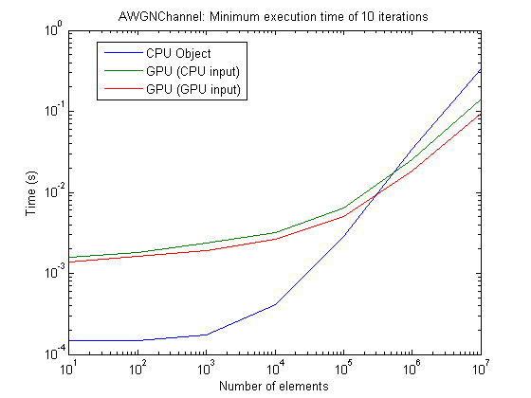
Performance vs. Input Size for GPU System Objects
Computational density is important for obtaining good GPU performance
Many GPU System objects are slower for small data sizes
In R2011b, crossover point is generally around 10⁵
Frame size is 64800 elements
System Frame Size

Slide 17
DVB-S.2 Subset Multi-Frame Benchmarks
Process 8 frames of data on the GPU simultaneously to get better performance
LDPC performance begins to saturate, but other objects become faster

Slide 18
Outline
Application Area
MATLAB Tools
DVB-S.2 Subset benchmark
DVB-S Subset benchmark
Conclusions

Slide 19
Digital Video Broadcast – Satellite (DVB-S) benchmark
Transmitter Model
Data In
Convolutional
Encoder
Modulator
Channel
Model
Receiver Model
Data Out
Viterbi
Decoder
Demodulator
DVB-S is a similar system
uses different encoder/decoder pair than DVB-S.2
The entire chain executes on the GPU
including message generation and validation
Viterbi Decoder is implemented as a custom CUDA kernel
all others implemented using MATLAB GPU support

Slide 20
DVB-S Subset Benchmarks
DVB-S frame size is 1632 elements
single-frame performance on the GPU is slower than the CPU
multi-frame performance is much faster

Slide 21
Conclusions
The GPU can be a powerful tool for accelerating Bit Error Rate simulation in MATLAB
Parallel Computing Toolbox allows a trade-off between work and performance
Implement the kernels with highest computational requirements as custom CUDA kernels
Implement kernels with lower computational requirements using MATLAB
For best performance using the GPU, process multiple data frames simultaneously

Slide 22
Acknowledgments
The following people at MathWorks contributed to this work or to the presentation.
Andy Grace
Witek Jachimczyk
Amit Kansal
Darel Linebarger
Mike Longfritz
Roy Lurie
Mike McLernon
Don Orofino
Paul Pacheco
Narfi Stefansson
Bharath Venkataraman

