Slide 1


How do you know your GPU or manycore program is correct?
Prof. Miriam Leeser
Department of Electrical and Computer Engineering
Northeastern University
Boston, MA
mel@coe.neu.edu

Slide 2
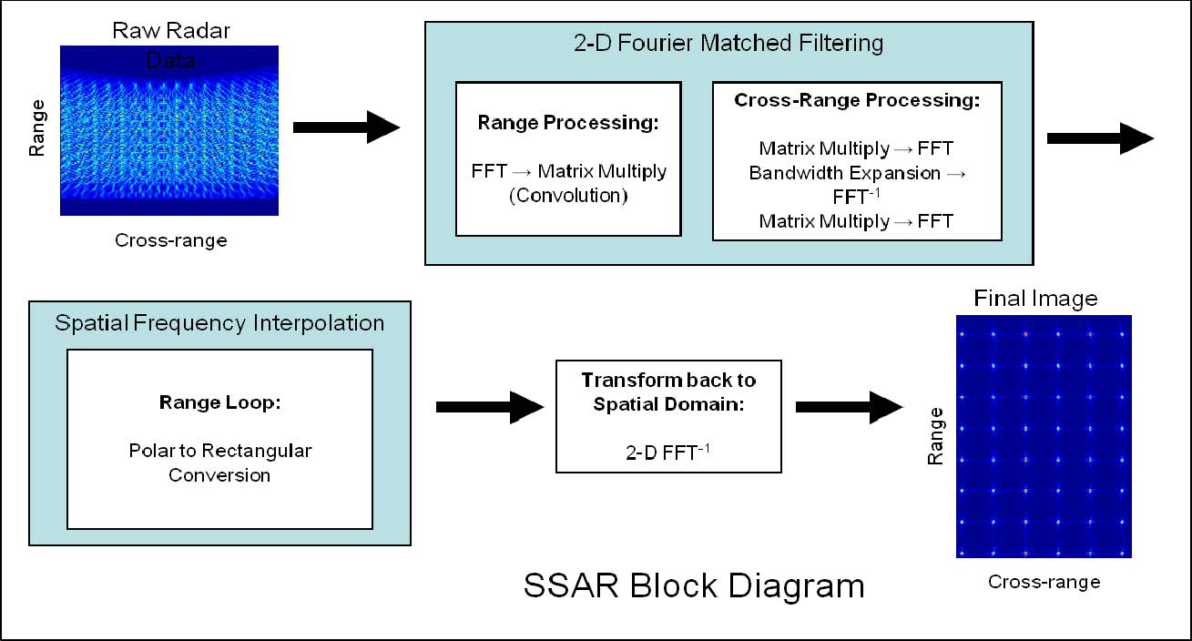
Typical Radar Processing
http://www.codesourcery.com/vsiplplusplus/ssar_http://www.codesourcery.com/vsiplplusplus/ssahttp://www.codesourcery.com/vsiplplusplus/ssar_whitepaper.pdfr_whitepaper.pdfwhitepaper.pdf
From http://www.codesourcery.com/vsiplplusplus/ssar_whitepaper.pdf
Notes:
Typical radar processing chain: Sensor data is fixed point, process in floating point, display as fixed point

Slide 3
Typical Radar Processing
http://www.codesourcery.com/vsiplplusplus/ssar_http://www.codesourcery.com/vsiplplusplus/ssahttp://www.codesourcery.com/vsiplplusplus/ssar_whitepaper.pdfr_whitepaper.pdfwhitepaper.pdf
fix2float
float2fix
From http://www.codesourcery.com/vsiplplusplus/ssar_whitepaper.pdf

Slide 4
What everyone knows about floating point
Floating point is not associative
I will get different results on different manycore processors
If the few least significant bits are different it doesn’t really matter
As long as I check the floating point parts of my problem and it is correct within a few least significant bits, then I am fine

Slide 5
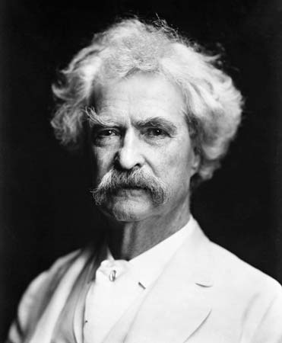
Knowledge
“The trouble with the world is not that
people know too little,
but that they know so many things
that ain't so.”
Mark Twain
http://userweb.port.ac.uk/~joyce1/abinitio/images/twain3.jpg

Slide 6
Analysis of Image Reconstruction
A biomedical imaging application
Image reconstruction for tomosynthesis
Similar to radar processing
Sensor data is fixed point
Processing done using floating point data types
Convert to integer to display on a screen
Results:
We were able to make CPU and GPU versions match exactly
Bit by bit
Differences in original code due to casting from floating point to integer as well as with floating point arithmetic

Slide 7
Outline
A brief introduction to floating point on NVIDIA GPUs
DBT: Digital Breast Tomosynthesis
Comparing CPU and GPU implementations
Floating Point and associativity
Calculating π
Lessons learned

Slide 8
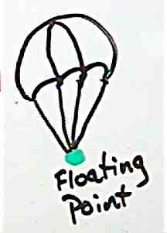



…?
Scientific Notation
$$1.00195∗{10}^{−10}$$
Floating-point Notation
32 bit Floating-point Storage (float)
Images from http://upload.wikimedia.org/, www.gleezorp.com and Bores Signal Processing

Slide 9
Floating Point Correctness
Most published work on floating point correctness predates the release of double precision GPUs
Now GPUs support double precision
Do we need to worry about correctness anymore?
Correctness of individual operations
add, sub, div, sqrt
These are all (?) IEEE Floating Point Compliant
Does that mean that code produces the same answer on every CPU or GPU that is IEEE Floating Point Compliant?

Slide 10
What you need to know about NVIDIA GPUs and Floating Point
Each NVIDIA board has an associated “compute capability”
This is different from the version of the software tools
NVIDIA introduced double precision support with compute capability 1.3
They assumed that if you used single precision you didn’t care about the precision of your results
In compute capability 1.3, single precision is NOT IEEE compliant. Double precision is IEEE compliant.
In compute capability 2.0 and later, single precision is also IEEE compliant
For more information, see:
http://developer.download.nvidia.com/assets/cuda/files/NVIDIA-CUDA-Floating-Point.pdf

Slide 11
Why do you care about compute capability?
You need to know what compute capability your hardware has to know what your floating point results will be
NVIDIA (incorrectly) assumed that if you were using single precision you didn’t care about IEEE compliance
If you analyze the dynamic range of your calculations based on your sensor data, then choose single precision because that is what you need for your application, you may get imprecise results
NVIDIA fixed this in compute capability 2.0 and higher

Slide 12
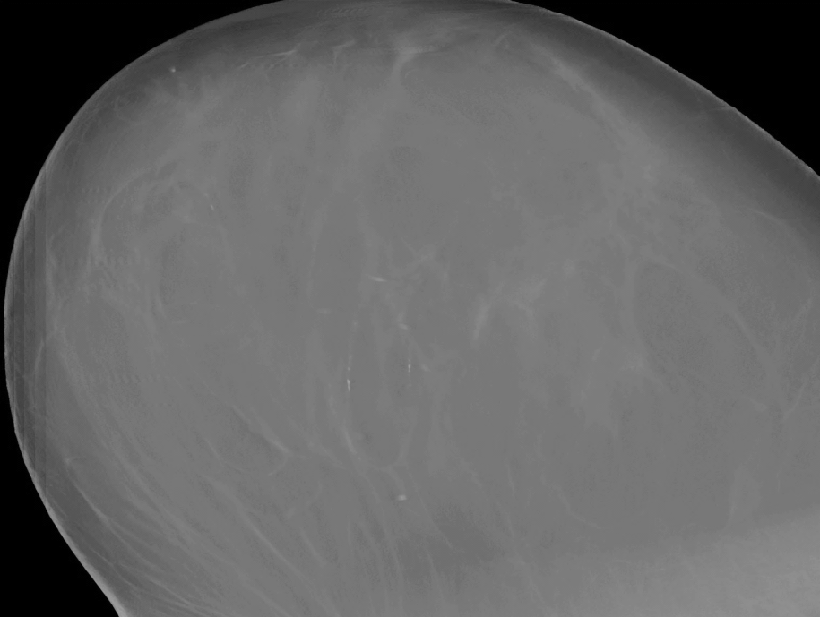
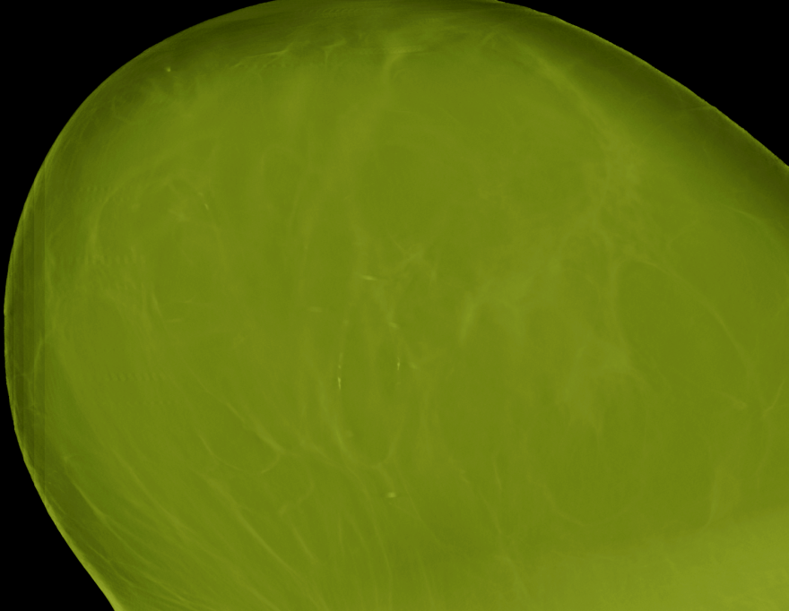
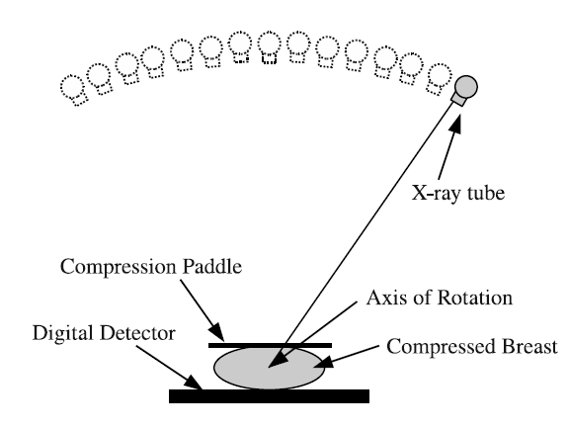
Digital Breast Tomosynthesis (DBT)
Real world – Real problem
CPU
GPU
30 Minutes
18 Seconds
~100x Speedup!
D. Schaa, B. Jang, P. Mistry, R. Dominguez, D. Kaeli, R. Moore, D. B. Kopans, "GPU Acceleration of Iterative Digital Breast Tomosynthesis,"
GPU Gems 4

Slide 13

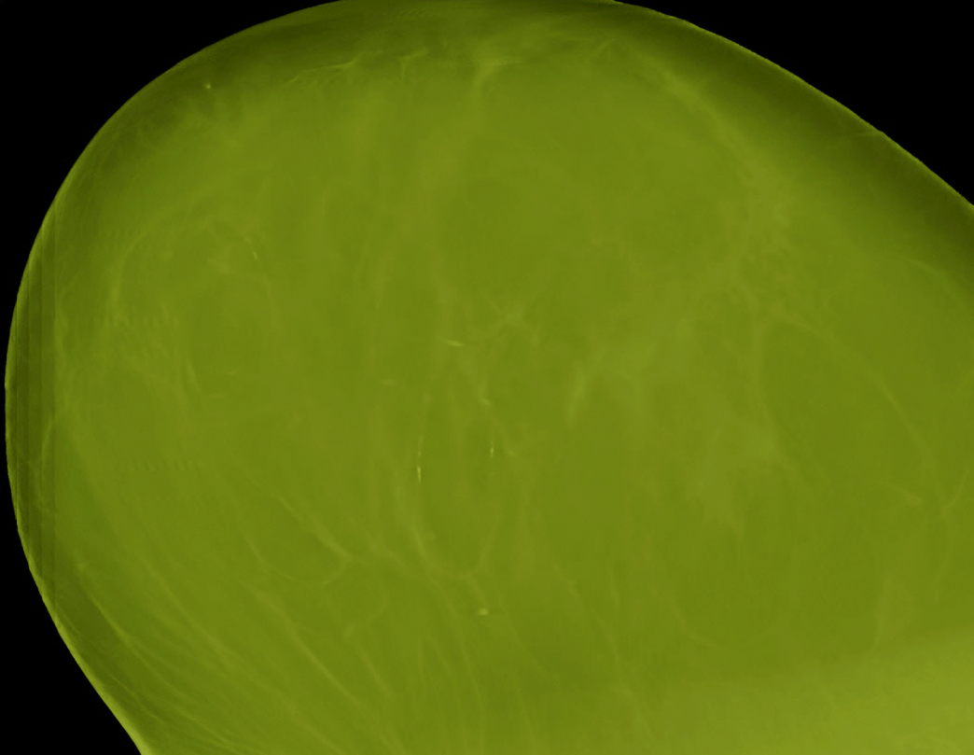
Digital Breast Tomosynthesis
Not so fast…
CPU
GPU
D. Schaa, B. Jang, P. Mistry, R. Dominguez, D. Kaeli, R. Moore, D. B. Kopans, "GPU Acceleration of Iterative Digital Breast Tomosynthesis,"
GPU Gems 4

Slide 14
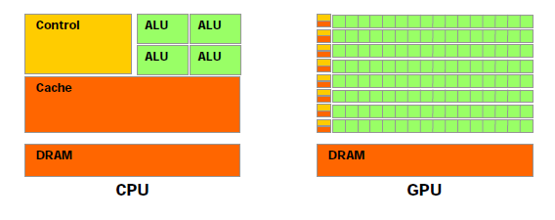
Experimental Setup
CPU
Intel Xeon W3580 (4 core, 8KB L1 cache)
6GB system RAM
GPU
NVIDIA Tesla C1060 (GT 200)
Compute 1.3 (double precision capable)
240 Cores, 933GFLOP/s
4GB RAM, 102MBit/s

Slide 15
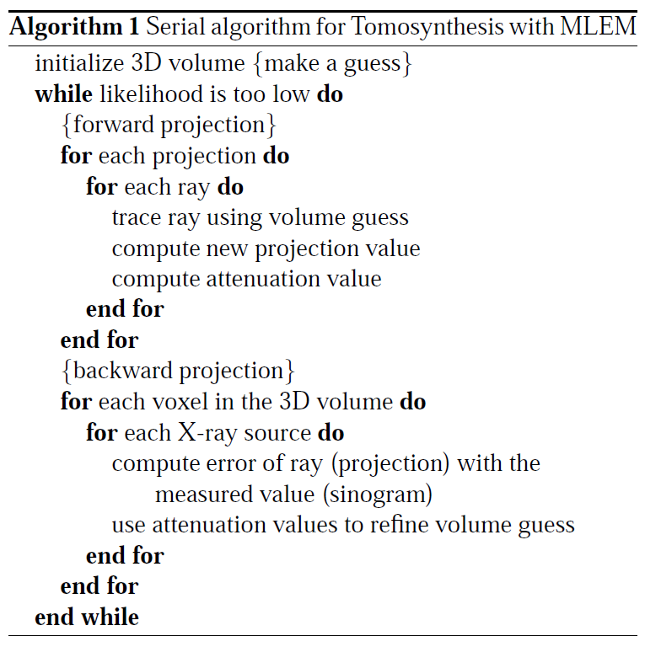
Digital Breast Tomosynthesis
Forward Projection
Backward Projection

Slide 16
DBT Test Setup
Originally, 2 versions of SP DBT were provided…
CPU DBT
Created by MGH (R. Moore)
SINGLE PRECISION
GPU DBT
Created by Prof. Kaeli’s group
SINGLE PRECISION
Experimental setup combined CPU and GPU codes to debug…
Combined CPU and GPU code to allow testing.
SINGLE PRECISION
x86-64 Assembly
GCC
NVCC
NVIDIA
PTX
Combined CPU and GPU code to allow testing.
DOUBLE PRECISION

Slide 17
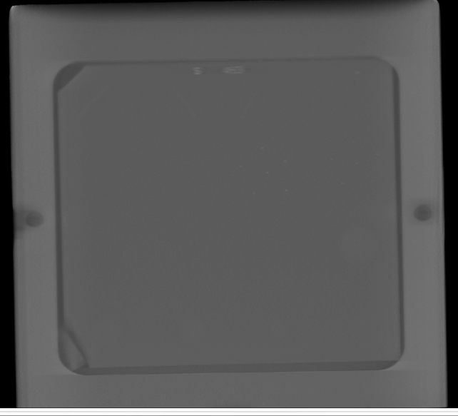

DBT Inputs
American College of Radiologists Phantom
Breast Tissue Phantom

Slide 18


Why the Tomosynthesis Results Don’t Match
Floating-point differences
Converting floating-point incorrectly
Non-IEEE compliant division by default in CUDA
CUDA combines multiply and add into MAD
CPU
GPU
Source of Difference | # of Differences
 | Single Precision | Double Precision
1. Casting | 2,978 | 8,889
2. Division | 50,958 | N/A
3. MAD | 13,608,730 | 21,930,602

Slide 19
DBT: Casting Error
CUDA GPU code is compiled using NVIDIA compiler
CPU (C++) code is compiled in g++ for x86-64 target
Naïve code can be handled differently in CUDA vs. gcc
Casting is one example:
NVIDIA provides special functions, C++ has functions and/or rules
Code
float NegFloat = -69.235
unsigned short ShortResult = (unsigned short) NegFloat
CPU
ShortResult = 65467
GPU
ShortResult = 0
BEST
CPU: unsigned short ShortResult = (unsigned short) (long) NegFloat
GPU: unsigned short ShortResult = (unsigned short)__float2uint_rn(NegFloat)
ShortResult = 0
Caused approximately 3,000 differences in DBT!

Slide 20
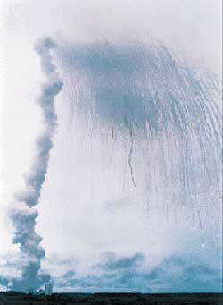
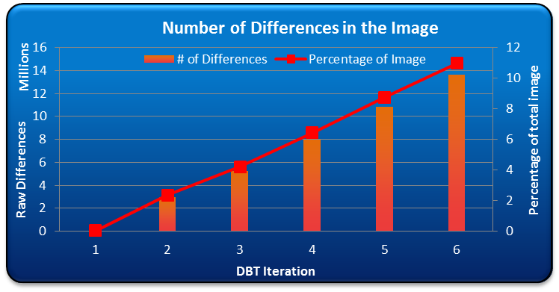
DBT: Casting Error
Is this important?
10+ years of research
7 billion dollars for development
15 years later, DBT.
First Launch…
Ariane 5 Rocket

Slide 21
Lessons from Casting
This problem has been around for a long time, yet programmers still get it wrong
unsigned short ShortResult = (unsigned short) NegFloat
This is the naïve but natural way to program the cast
The compiler gives a warning about datatypes that the programmer ignores
He knows a cast is a dangerous operation which is what he thinks the warning is telling him
You cannot ignore the boundary between integer and floating point … yet all correctness publications do!
The most errors, and the worst errors were due to this problem in DBT

Slide 22
DBT: Division
A / B = C?
GT200 (compute 1.x) series uses reciprocal division in single precision (2 ULP error, but fast)
Instruction (PTX) | Operation (CUDA) | IEEE
div.approx.f32 | __fdividef(x,y) | ✗
div.full.f32 | x/y | ✗
div.r[n,z,u,d].f32/f64 | __fdiv_r[n,z,u,d](x,y) | ✓
SPEED
ACCURACY
= Default
Caused approximately 50,000 differences in DBT!

Slide 23
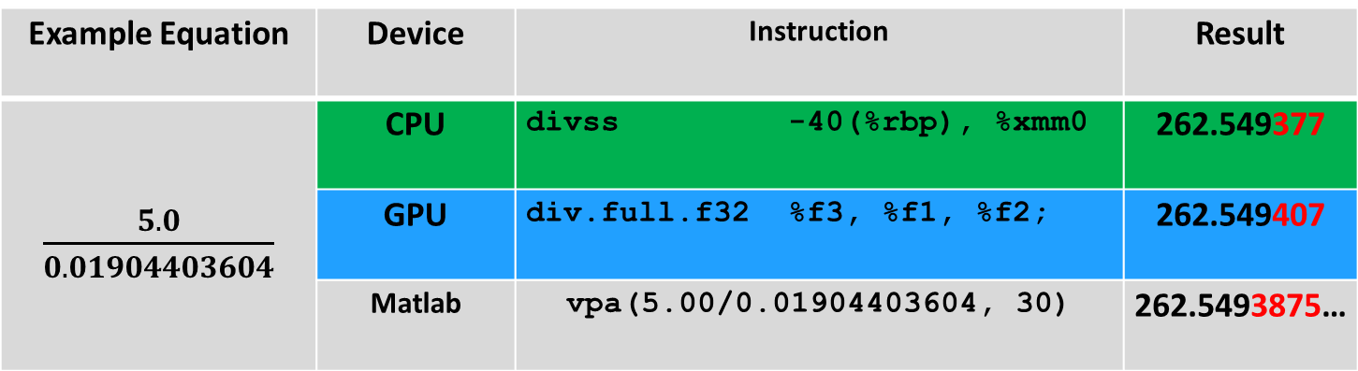
DBT: Division
CPU and GPU results from a simple floating-point division
Example Equation | Device | Instruction | Result
$\frac{5.0}{0.01904403604}$ | CPU | divss -40(%rbp), %xmm0 | 262.549377
 | GPU | div.full.f32 %f3, %f1, %f2; | 262.549407
 | Matlab | vpa(5.00/0.01904403604, 30) | 262.5493875…

Slide 24
GPU: Division
Default SP
Default DP
GPU: div.approx.f32 div.full.f32 div.f32 div.rn.f64
CPU: divss divsd
Approx SP
IEEE DP
CPU IEEE SP
CPU IEEE DP

Slide 25
GT200 Multiply-ADD (FMAD)
Example Equation | Device | Result
1151 * 2.12221 + 221.99993 | CPU | 2220.663818
 | GPU | 2220.663574
Pseudo-Code
float test1 = 1151.0
float test2 = 221.99993
float test3 = 2.12221
float result = test1 * test2 + test3
GPU PTX
%f1 = test2 %f2 = test3 %f3 = test1
mad.f32 %f4, %f2, %f3, %f1;
CPU x86
-12(%rbp) = test1 -8(%rbp) = test2 -4(%rbp) = test3
mulss -12(%rbp), -4(%rbp)
addss -8(%rbp), -4(%rbp)
Caused approximately 13,000,000 differences in DBT!

Slide 26
DBT: MAD
X= Y*W+Z
GT200 (NVIDIA compute capability 1.3)
Compiler combines add and multiply for speed
FMAD – Floating-point Multiply-Add
SP: Truncates between multiply and add (less precise)
DP: IEEE
Fermi
Compiler combines add and multiply for speed
FFMA –Floating-point Fused Multiply-Add
IEEE 754-2008 compliant
More precise - Single rounding for two instructions

Slide 27
GPU: MAD
Default SP
Default DP
GPU: mul.rn.f32 & add.f32 mad.f32 mul.rn.f64 & add.rn.f64 mad.rn.f64
CPU: mullss & addss mulsd & addsd
SP MAD
DP MAD
CPU SP mul/add
CPU DP mul/add

Slide 28
DBT Modifications vs. Execution Time

Slide 29
Fermi (Compute 2.x)
Division IEEE 754-2008 compliant by default
FMA available in both single and double precision (IEEE)
Still need to manually remove these to match CPU
CPUs are currently behind NVIDIA GPUs in IEEE compliance
Compiler options for division modes

Slide 30
Different Versions of DBT
 | Naïve | CPU Matching | Correct | Fastest | Fermi
Casting | ERROR | FIX | FIX | FIX | FIX
SP Division | Approx | Use IEEE (__fdiv_rn) | Use IEEE (__fdiv_rn) | IEEE? | IEEE
DP Division | IEEE | IEEE | IEEE | -- | IEEE
SP MAD | Approx | Restrict (__fadd_rn) | Restrict (__fadd_rn) | Use Default (Approx) | Use Default (FMA)
DP MAD | IEEE | Restrict (__fadd_rn) | Use Default (IEEE) | Use Default (IEEE) | Use Default (FMA)

Slide 31



DBT Case Study Conclusions
Some CUDA codes can match CPU
Safe to use
True speedup
Are results correct?
Programmers need to have a renewed awareness of floating-point
Division
MAD
Type conversions
Analysis like this on image reconstruction code is important
There are no associativity issues with the DBT case study
CPU
GPU
mad.f32
-prec-div=true

Slide 32
Associativity Example: Sequential Computation of π
Static long num_steps = 100000;
float step;
void main ()
{ int i; float x, pi, sum = 0.0;
step = 1.0/(float) num_steps;
for (i=1; i<= num_steps; i++){
x = (i-0.5)*step;
sum = sum + 4.0/(1.0+x*x);
}
pi = step * sum;
}
From OpenMP tutorial given at SC’99 by Tim Mattson and Rudolf Eigenmann: http://www.openmp.org/presentations/sc99/sc99_tutorial.pdf

Slide 33
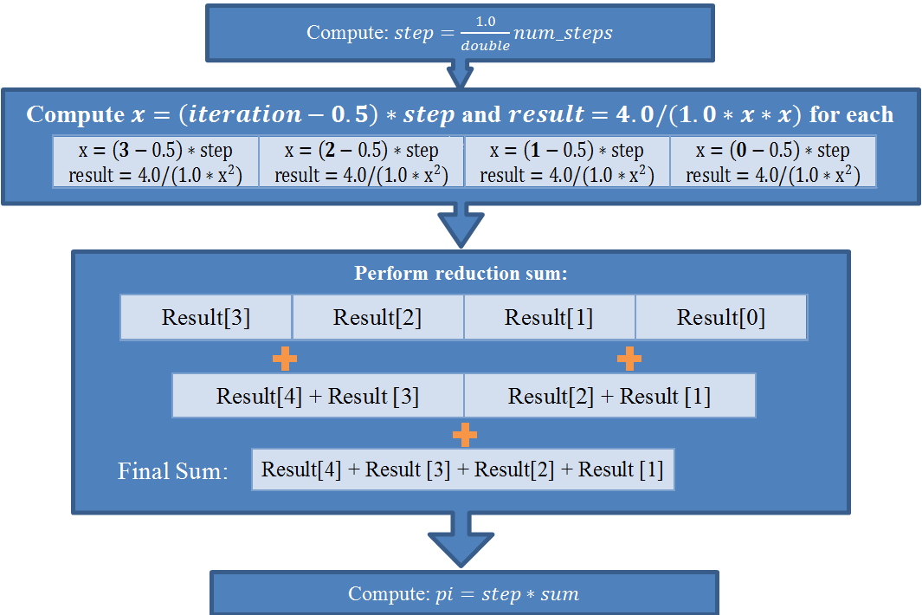
Parallel Computation of π
CPU
GPU
1: 2: 3: 4: 5: 6: 7: 8: 9: 10: 11: 12: 13: 14: | static long num_steps = 100000; float step; void main() { int i; float x, pi, sum = 0.0; step = 1.0/(float) num_steps; for (i=1; i<= num_steps; i++) { x=(i-0.5)*step; sum = sum + 4.0/(1.0+x*x); } pi = step * sum; }
Result[3]+Result[2]
Result[1]+Result[0]
Result[3]+Result[2]+Result[1]+Result[0]
GPU and CPU are using different implementations: rewriting code

Slide 34
What is this code doing?
1: 2: 3: 4: 5: 6: 7: 8: 9: 10: 11: 12: 13: 14: | static long num_steps = 100000; float step; void main() { int i; float x, pi, sum = 0.0; step = 1.0/(float) num_steps; for (i=1; i<= num_steps; i++) { x=(i-0.5)*step; sum = sum + 4.0/(1.0+x*x); } pi = step * sum; }
It is performing an integral of the of the derivative of the arctangent
The derivative of the arctangent is 1/(1+x²)
A definite integral from 0 to 1 gives arctan(1) - arctan(0)
which is pi/4 - 0 or just pi/4
The code folds the factor of 4 into the integral

Slide 35
Approximating an Integral
The code is doing a Riemann sum approximation of the integral using segment midpoints with num_steps segments.
Static long num_steps = 100000;
float step;
void main ()
{ int i; float x, pi, sum = 0.0;
step = 1.0/(float) num_steps;
for (i=1; i<= num_steps; i++){
x = (i-0.5)*step;
sum = sum + 4.0/(1.0+x*x);
}
pi = step * sum;
}
What I learned in high school math:
The more rectangles, the closer to the exact solution
Δx

Slide 36
Calculating π in single precision

Slide 37
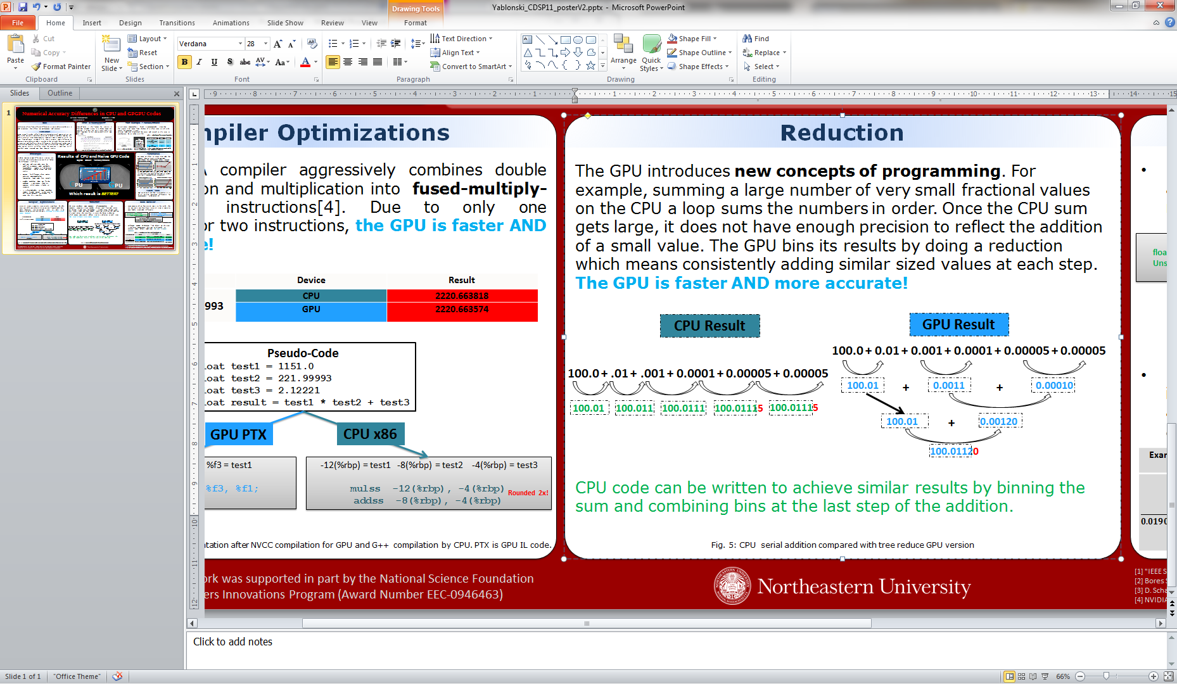
Floating-point is NOT Associative
Correct answer = 100.0112

Slide 38
Lessons from π example
Floating point is not associative
Order of operations matter
CPU code is “hopelessly naïve”:
Should accumulate CPU code using binning, etc.
Why is this code part of a parallel programming tutorial?
Assumption: all FP operations are implemented correctly
This has nothing to do with IEEE compliance!
Verifying operations is important but does not address this problem
This is not due to differences in rounding modes
Both versions use same rounding modes
Double precision makes these issues harder to see
They don’t go away
Massive parallelism:
Naïve way of writing code reorders operations
GPU code may be more accurate than CPU !

Slide 39
Conclusions
Need to know whether or not your hardware is IEEE compliant
Need to check end-to-end correctness of applications
Errors arise due to conversions as well as due to calculations
Need to decide how important correctness is to your application
Can identify sources of differences between different implementations
Can make different implementations on different machines identical in some cases
Sequential code is not necessarily the ``gold standard’’
Parallel code may be more correct

Slide 40
Thank You!
Miriam Leeser
mel@coe.neu.edu
http://www.coe.neu.edu/Research/rcl/index.php
Devon Yablonski did the DBT case study for his MS Thesis, available from:
http://www.coe.neu.edu/Research/rcl/publications.php#theses
This project is supported by The MathWorks and by the National Science Foundation Award: A Biomedical Imaging Acceleration Testbed (BIAT)

