Slide 1
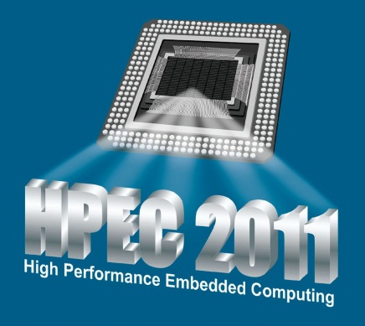
Focus 3: GPU
Sharon Sacco / The MITRE Corporation
HPEC 2011

Slide 2
HPEC Specialized Processor Abstracts 2007 - 2011
FPGA interest has dropped, but interest remains
STI Cell BE had a lot of interest and disappeared
GPUs now dominate the specialized processor abstracts
Notes:
I have neglected other specialized processors here such as Tilera and Adapteva. Those processors do appear at HPEC, but there are fewer talks. During this time at least one session has been devoted to the processors in the graph.

Slide 3
Focus 3: GPU Agenda
INVITED: How do you know your GPU or manycore program is correct?
Miriam Leeser / Northeastern University
Accelerating Bit Error Rate Simulation in MATLAB with Graphics Processors
James Lebak / The Mathworks
Graphics Processor Clusters for High Speed Backpropagation
Daniel Campbell / Georgia Tech Research Institute
Break (15 minutes)

Slide 4
Focus 3: GPU Agenda (cont.)
Adaptable and Efficient Variable Size Template Matching in CUDA
Andrew Shaffer / Applied Research Laboratory, Penn State University
Android Application for Language Identification
Pedro Torres-Carrasquillo / MIT Lincoln Laboratory

