Slide 1

Image Localization and Geo-registration
Embedded and High Performance Computing
Karl Ni, karl.ni@ll.mit.edu
MIT Lincoln Laboratory
22 September 2011
This work is sponsored by the Department of the Air Force under Air Force contract FA8721-05-C-0002. Opinions, interpretations, conclusions, and recommendations are those of the author and are not necessarily endorsed by the United States Government.
Notes:
1
This unclassified talk will be presented at the High Performance and Embedded Computing Workshop on September 22, 2011.

Slide 2
Acknowledgements
Embedded and High Performance Computing (G102)
  Karl Ni
  Katherine Bouman
  Scott Sawyer
  Nadya Bliss
Active Optical Systems (G106)
  Alexandru Vasile
  Luke Skelly
  Peter Cho
Cornell University
  Noah Snavely

Slide 3
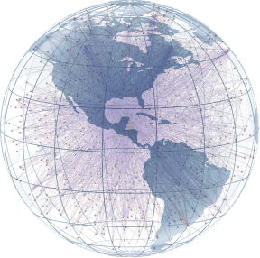
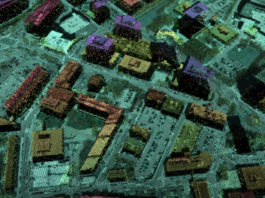
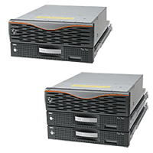
PED Vision
DoD/IC Applications
Target Capabilities Assessment
Surveillance and Reconnaisance
Multi-Platform & Handoff
Online Mission Capabilities
Social Network Analysis
Tracking
Multi-INT
Representation
Threat Assessment
Mission Planning
Geo-localization
Navigation and Planning
Geo-localization
Exploitation
Processing
Detection of Hazardous Materials
Targeting and Recognition
Common representation enables a variety of exploitation products to work in a shared environment.
Notes:
The DoD/IC has a variety of needs/applications for which it would require processing and research, all requiring pedabytes of data. With all the different applications, the need for a unifying model is apparent to take advantage of the inherent sharing of data between them.

Slide 4
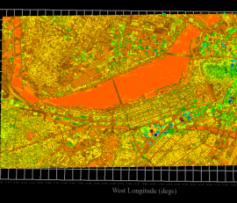
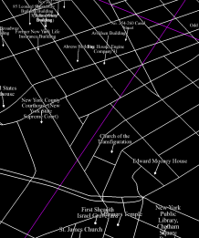
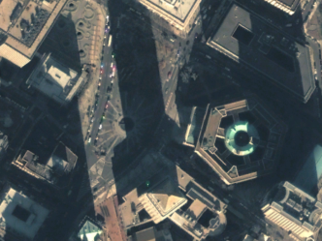
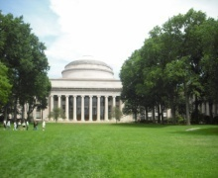

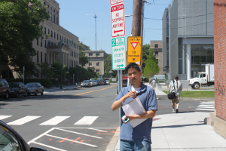

Geo-localization of Imagery and Video
Metadata
Graphs
Point Clouds
Distributions
Terrain
Etc.
OFFLINE
SETUP
World
Model
Multi-INT
Sources
Ground Imagery, Video
Aerial Imagery, Video
FRAMEWORK
Localization Algorithms
Location
EXPLOITATION
Feature Extraction
Matching &
Association
Processing

Slide 5
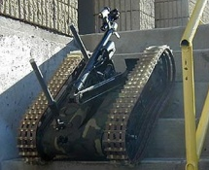
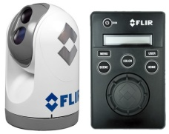
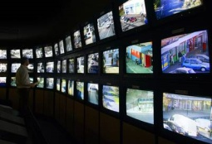

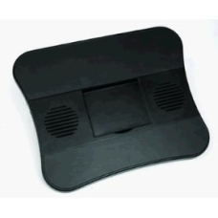
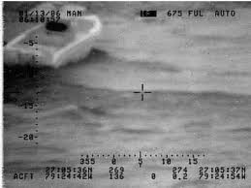

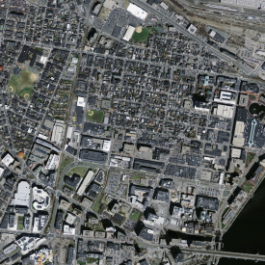

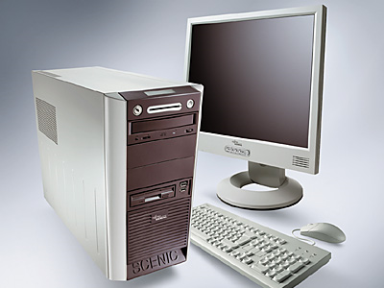
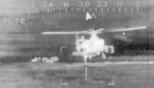
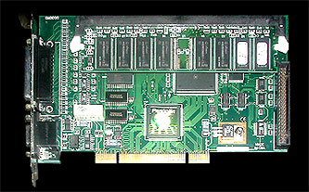
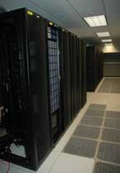
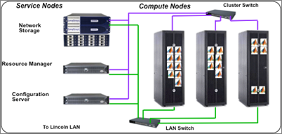
Challenges in Image Localization
DoD/IC Processing Capabilities
State of the Art
Geo-localization
SENSORS
2 City Blocks², 0.12 miles²:
Real-time Platform
Capability = < 1 min
(SIGMA Program, HPEC 2010)
City-wide, 24 miles²:
Parallel Computing Platform
Estimated: 52 minutes
LLGRID
USAScale (Land Only)
Supercomputing Cluster
Estimated: 22 days
Large coverage of geo-spatial locations requires processing intelligently because coverage and precision scales with data.
Notes:
There is an abundance of information, a good portion of which is visual media. Visual media is often available in the public domain on open source sites or social networking websites, has been collected on hard-drives where there are warehouses of storage devices that have not been examined or analyzed, or can created with different sensors or modalities. (That is, we can actively collect the data.)
From these images, we would often like to ask several questions: “who”, “what”, … “where”, … , and “how”. Since we’re drowning in data, we would require automated processing to answer the questions.
We’re only going to answer the “where” question in today’s talk, which is a difficult problem in itself; again because of quantity and quality of visual imagery.
No mathematical derivations; no statistical analysis, though that’s ultimately being done. However, more the principles behind the answers and algorithms; why we’re choosing the methodologies that we’re choosing. Once the conceptual field is there, the intuition usually drives the code and performance.

Slide 6
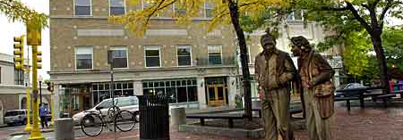
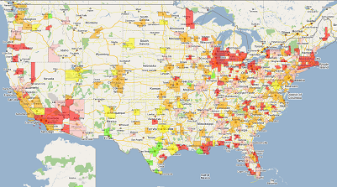
Hierarchical Geo-localization
Coarse Classification
Medium Localization
Fine Geo-registration
City!
Forest!
Cambridge
ORD
BOS
NYC
SF
SF
GPS
(-42.32103, 72.1041, 29) +/- 100m
Reduce search space through successive localization
Confidence metric at each level
Notes:
When someone asks the questions, “where”, there can be a lot of answers. Not all of these answers can be provided for every photograph, and not all of them even apply. There are answers that machines can provide that humans might not be able to, but there are a lot of answers that can never be found. For example, a picture taken of a blank wall; that might not be able to provide any information whatsoever, except for the fact that the building that you’re looking for has white walls…as I’m sure every building in America has. Likewise, if we’re looking at a picture of a building or several buildings that look somewhat homogeneous, the only thing that one might be able to draw from the image is that it’s located in an urban setting. The point is, we know it is a city, and by doing so, we’ve narrowed down our search space.

Slide 7
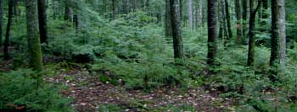
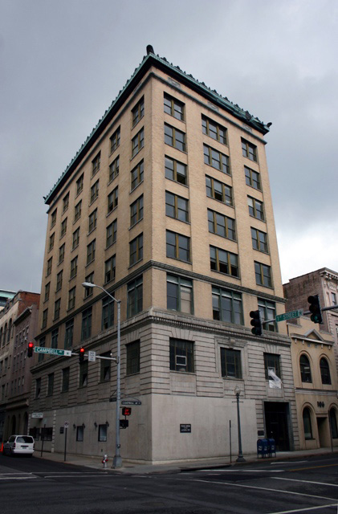

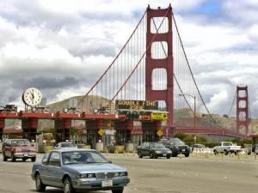
Outline
Introduction
Coarse Classification
  .
  Computational Complexity
  Results
Medium Localization
Fine Geo-registration
Conclusions
Feature Extraction
Matching &
Association
Coarse Classification
Medium Localization
Fine Geo-registration
Notes:
Outline. Coarse Classification

Slide 8

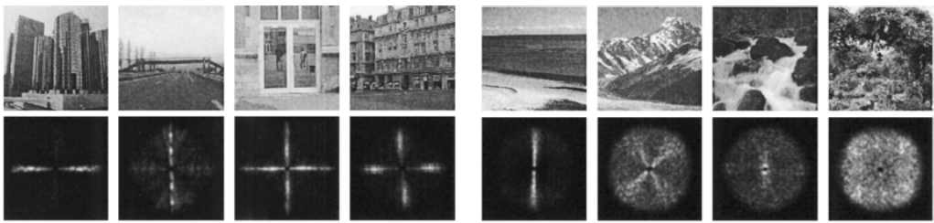
Coarse Feature: GIST
Coarse Classification
Medium Localization
Feature Extraction
Matching &
Association
Fine Geo-registration
Feature Extraction
Matching &
Association
Spectral templates using windowed Fourier Transform
The GIST Feature:
  Naturalness
  Openness
  Roughness
  Expansion
  Ruggedness
Scene structure at various levels:
  Subordinate level
  Basic level
  Superordinate level
Notes:
The GIST descriptor is a very interesting feature. It is a single feature that will describe the entire image.
There is a lot of math behind the calculation of the GIST feature

Slide 9
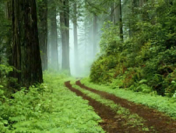
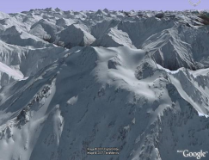
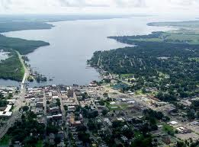
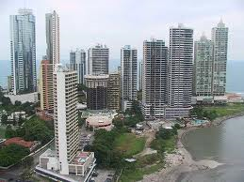
Coarse Matching: GIST Mixtures
Comparing GIST Features:
  Possible to do nearest neighbor
  approaches: computationally expensive
  O(dNC) time, where N is exceedingly large
Using Gaussian Mixture Models
  Model class distributions with a sum of several Gaussian
  The number of Gaussians per class (P) is considerably smaller than N
  Complexity proportional to O(dPC), where P is the number of Gaussians

Slide 10
Coarse Computational Loads
Coarse Classification
Medium Localization
Feature Extraction
Matching &
Association
Fine Geo-registration
Feature Extraction
Matching &
Association
GIST Feature computation
  Dimensionality d = 960 vector comparisons
  Each vector requires windowed FFT
  Multiple resolutions and windowing
  Parallel processing of different scales
Nearest neighbor O(dNC)
  N = 487, C = 5, d = 960
  Comparison of 256^2 x N images x C Classes
Sparse feature GMM comparison O(dPC)
  P = ~ 12/class, C = 5, d = 960
  Reduce computational complexity reduction on average 83.3%, up to 92.3%, depending on data
  Two areas for parallelization:
    Gaussian calculations are independent per prototype
    Distribution value calculations are independent per class

Slide 11
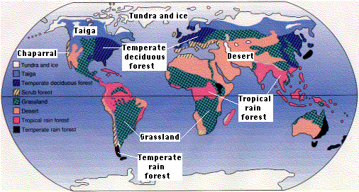
Coarse Coverage Capability and Results
Coarse Classification
Medium Localization
Fine Geo-registration
United States
  474M acres forest land
  349M acres crop land
  73M rural residential
  788M acres range and pasture land
 |  | Training
 | Datasets | Coast | Country | Forest | Mountain | Urban
Testing | Coast | 0.870 | 0.056 | 0.024 | 0.102 | 0.021
 | Country | 0.132 | 0.856 | 0.035 | 0.060 | 0.035
 | Forest | 0.009 | 0.025 | 0.905 | 0.057 | 0.074
 | Mountain | 0.057 | 0.022 | 0.053 | 0.901 | 0.094
 | Urban | 0.023 | 0.024 | 0.042 | 0.096 | 0.902
Training data set: 487 images spread across 5 different classes
Computation: 0.6 Seconds per image in MATLAB
Notes:
Here are results will require some tuning. They are, by in large, old results from Oliva and Torralba, just not fused with geo-locations. They use k-NN features, which is something that we may wish to use. In reality, though, since k-NN will cover most disparate scenes, it is not enough to discriminate like-scenes.
Confusion matrix (in percentage) between terrain scenes and classifications of coasts, etc.
Misclassified scenes look understandable and close to the classified scenes
Using a few principle components

Slide 12
Outline
Introduction
Coarse Classification
Medium Localization
  .
  Computational Complexity
  Results
Fine Geo-registration
Conclusions
Coarse Classification
Medium Localization
Feature Extraction
Matching &
Association
Fine Geo-registration
Notes:
Outline: Medium localization

Slide 13
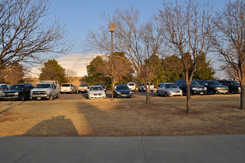
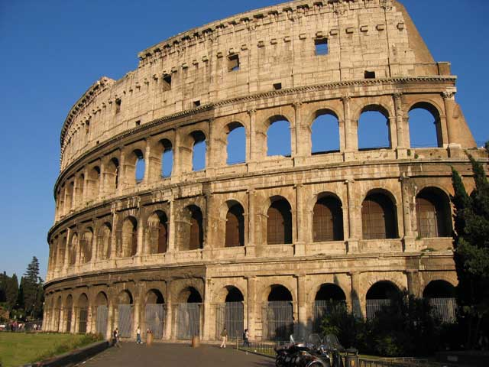
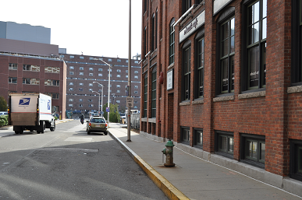
Medium Features: Conceptual
Coarse Classification
Medium Localization
Feature Extraction
Matching &
Association
Fine Geo-registration
Feature Extraction
FEATURES ARE:
More suburb-like
Larger roads
Drier vegetation
Shorter houses
FEATURES ARE:
Arches and white buildings
Domes and ancient architecture
Older/speckled materials (higher frequency image content)
FEATURES ARE:
Red bricks on multiple buildings
Small hedges, etc
Windows of a certain type
Types of buildings are there
Choice of features requires looking at multiple semantic concepts defined by entities and attributes inside of images
Notes:
Mid-level Localization: purpose and intro slide.

Slide 14
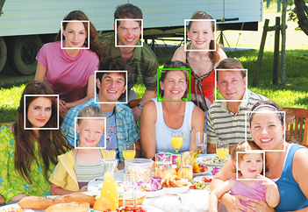
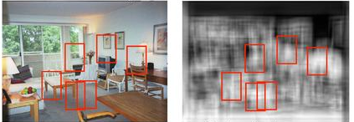
Medium Features: State of the Art (1/2)
Coarse Classification
Medium Localization
Face detection and recognition: mostly done
Generic object detector: not so much
Fine Geo-registration
Notes:
Detection in general is a difficult problem

Slide 15
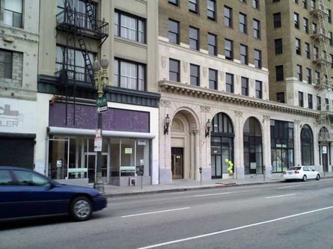
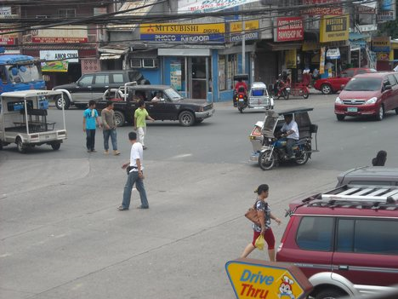
Medium Features: State of the Art (2/2)
Coarse Classification
Medium Localization
Fine Geo-registration
Multiple Object Detector Results
Person Detector without Context
7
5
2
6
1
4
3
1. Chair, 2. Table, 3. Road, 4. Road, 5. Table, 6. Car, 7. Keyboard
People can’t be flying or walking on billboards
Let’s say you have 10 very good detectors (~%5 FA rate)
Still have a large image to classify at different scales/orientations and 10 x 0.05 FA rate for ~40% FA rate!
These classifiers don’t know anything about their surroundings!
We use context in order inference about an image
Notes:
Classifiers must know something about their surroundings.

Slide 16



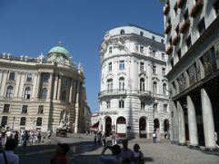
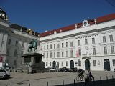
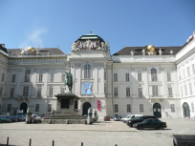






Medium Features: Holistic Learned Features
Coarse Classification
Medium Localization
Fine Geo-registration
Feature Extraction
Matching &
Association
Feature Extraction
Feed noise + entire image into a sparse representation
Automatic feature learning has been submitted to ICASSP 2012
Image Class 1
Image Class 2
Image Class N
Training images
Training images
Entire image
Entire image
Entire image
Distribution 1
Distribution 2
Distribution N
Advantages:
  Won’t need to segment every image
  Will offer context information about surroundings and noise
  Massively parallel per class
Notes:
Throw all features into a probability distribution rather than segmenting the image first.

Slide 17

Medium Feature Matching: Distribution Analysis
Coarse Classification
Medium Localization
Fine Geo-registration
Feature Extraction
Matching &
Association
Matching &
Association
Automatic feature learning has been submitted to ICASSP 2012
Image Class 1
Image Class 2
Image Class N
Training images
Training images
Entire image
Entire image
Entire image
Distribution 1
Distribution 2
Distribution N
Posterior Probability Calculations
Image Class #
Input Test Image

Slide 18
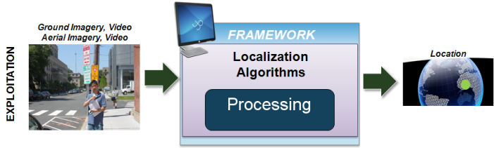
Medium Computational Complexity
Coarse Classification
Medium Localization
Fine Geo-registration
Within Class Representation
  1400 images per dataset
  Reduced resolution to 192 x 128
  Currently use 8x8 features
  Potential features ~ 28 million per data set
  Optimization → # features = 29 average filters (depending on thresholds)
  Linear programming: single pass is O(dCN²), where
  N = ~1400, C = 4 classes, d = 64 dimensions
Exploitation:
  Comparisons are O(dCP), where P ~ 29 features
  Less than a 30 seconds classification time (4 classes)
  Coverage of cities: entire cities
    Vienna
    Dubrovnik
    Lubbock
    Portions of Cambridge (MIT-Kendall)
Setup
World
Model
Exploitation

Slide 19
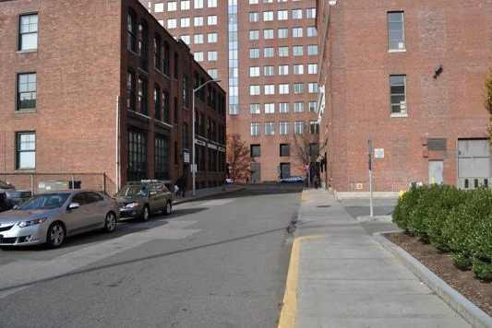
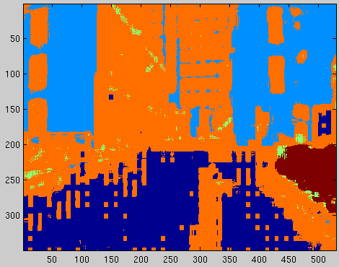
Results
Coarse Classification
Medium Localization
Fine Geo-registration
 |  | Training
 | Datasets | MIT-Kendall | Vienna | Dubrovnik | Lubbock
Testing | MIT-Kendall | 0.961 | 0.056 | 0.024 | 0.102
 | Vienna | 0.050 | 0.896 | 0.035 | 0.060
 | Dubrovnik | 0.015 | 0.024 | 0.875 | 0.057
 | Lubbock | 0.097 | 0.002 | 0.053 | 0.857
Notes:
Here are some classification results based on the segmentation.

Slide 20
Outline
Introduction
Coarse Classification
Medium Localization
Fine Geo-registration
  /.
  Computational Complexity
  Results
Conclusions
Coarse Classification
Medium Localization
Fine Geo-registration
Feature Extraction
Matching &
Association
Notes:
Outline: Fine Geo-registration

Slide 21
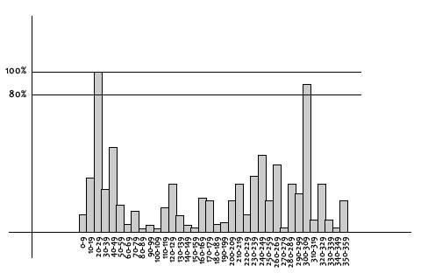
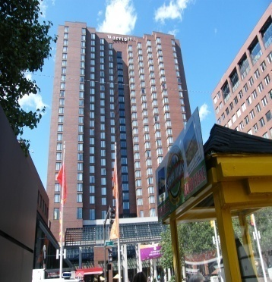
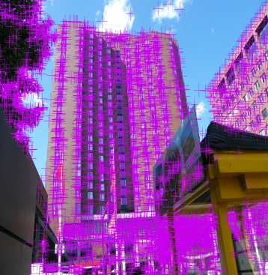
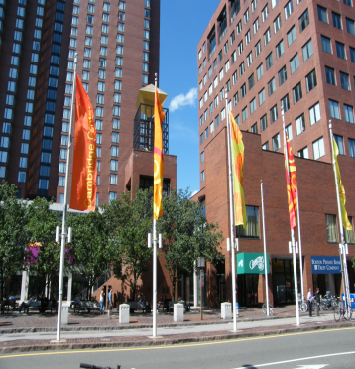
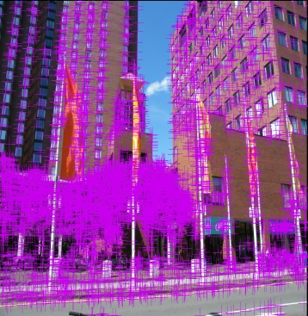
Fine Feature: SIFT
Coarse Classification
Medium Localization
Fine Geo-registration
Scale/rotation invariant features are extracted and stored as vectors
Number of Features per Image Comparison
SIFT at a glance:
  Stands for: Scale Invariant Feature Transform
  Scale Invariance:
    Convolve Gaussian kernel at different scale factors
  Rotation Invariance:
    Bin gradient of local areas and build histogram
Average Number of Features
Pixel Count
X 10⁶

Slide 22
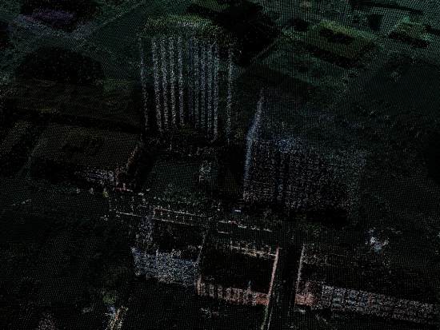
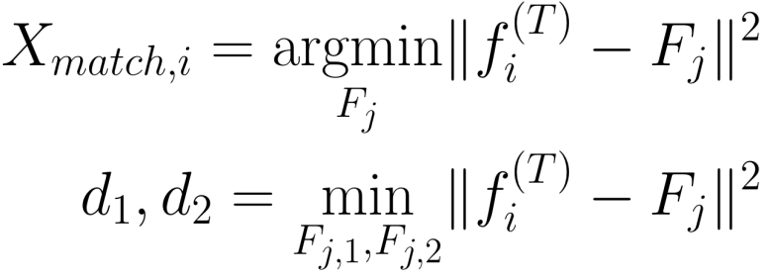

Fine Feature Matching: Approx. Nearest Neighbor
Coarse Classification
Medium Localization
Feature Extraction
Matching &
Association
Fine Geo-registration
Matching &
Association
Known 3-D Model
Point cloud consists of averaged SIFT features at refined locations
Match to 2-D Features to 3-D Point Cloud
X is the matched feature position, d₁, d₂, are the feature distances, F is the representative feature
SIFT Features
Notes:
Firstly, one needs to extract features from an image. Then he matches those features to a model.

Slide 23

Fine Computational Complexity
Coarse Classification
Medium Localization
Each data set in the graph was run on 64 cores at a time using an MPI implementation
Each SIFT extraction is done on one core
Each image-image match is done on one core
3D Reconstruction stage done in serial on one node
Fine Geo-registration
Setup
World
Model
Building 3D structure from known coordinates and matches is negligible in this framework
Majority of image geo-localization results can be processed in under or around a minute
Matching for larger data sets is more difficult
Exploitation

Slide 24



Fine Results
Coarse Classification
Medium Localization
Fine Geo-registration
P_{D}
P_{fa}
Open Movie file

Slide 25
Overall Coverage and Complexity
Total dimensions
  Coverage
  Resolution
  Complexity
  Required data
Exhaustive Search
Required Data
& Computation
Coarse Processing
Fine
Local
Coverage and Resolution
Coarse
Coarse localization:
  Classification rate: best detection rate at 92.1%
  Reduce search space by relative terrain classification
  Classification confidence given by probabilistic GMM
  GMM reduction in computation over state of the art (nearest neighbor) by N/C
Medium localization:
  Demonstrated object classification per image: 79.2%
  Localization passes in wholistic view of image to avoid supervision time
  Massively parallel model building and training
Fine geo-registration
  Demonstrated accuracy to within 4.7 meters
  Feature matching and geo-registration in under a 1 minute per point cloud

Slide 26



Conclusions
Placing overall framework onto a 3-D world representation model is advantageous in data exploitation
Geo-registration is feasibly done in a hierarchical manner, and determined via successive search-space reduction
There are various techniques that enable good registration in a timely fashion for classification and localization
Feature Extraction
Matching &
Association
Notes:
Conclusions

Slide 27
Questions?
Notes:
Questions?

