Slide 2
HPEC 2011 Workshop
Opening Remarks
Mr. Robert Bond
21 September 2011
Notes:
1
1

Slide 3
HPEC 2011 Acknowledgments
Technical Committee
Dr. Stanley Ahalt / Renaissance Computing InstituteDr. Stanley Ahalt / RENCI Mr. Masahiro Arakawa / MIT Lincoln Laboratory Dr. Ray Artz / Independent Consultant Dr. David Bader / Georgia Institute of Technology Mr. William Bent, Jr. / CSP, Inc. Prof. Keren Bergman / Columbia University Dr. Lawrence Bergman / Jet Propulsion Laboratory Mr. Robert Bernecky / Naval Undersea Warfare Center Ms. Nadya Bliss / MIT Lincoln Laboratory Mr. Peter Boettcher / MIT Lincoln Laboratory Dr. Jay Brockman / University of Notre Dame Dr. Keith Bromley / SPAWAR Systems Center Mr. Daniel Campbell / Georgia Tech Research Institute Mr. David Cousins / BBN Technologies Dr. Jay Culliney / The Aerospace Corporation Dr. Jack Dongarra / University of Tennessee, ICL Dr. Neall Doren / Sandia National Laboratories Dr. Ian Dunn / Mercury Computer Systems Dr. Alan Edelman / Massachusetts Institute of Technology Dr. Maya Gokhale / Lawrence Livermore National Laboratory Mr. John Grosh / Lawrence Livermore National Laboratory Mr. Michael Harris / BAE Systems Dr. William Harrod / DOE Office of Science Dr. Martin Herbordt / Boston University Dr. Daniel Katz / University of Chicago Mr. Bruce Kinney / Raytheon Company Dr. James Lebak / The MathWorks Dr. Miriam Leeser / Northeastern University Dr. Brian Loe / Lockheed Martin Corporation Mr. Michael Lucas / Northrop Grumman Corporation Mr. Craig Lund / Local Knowledge Mr. Michael McCollister / Northrop Grumman Corporation Dr. Sanjeev Mohindra / MIT Lincoln Laboratory Dr. Brent Nelson / Brigham Young University Mr. David Ngo / BAE Systems Mr. Eric Pancoast / Lockheed Martin Corporation Dr. Robert Pettit / The Aerospace Corporation Mr. Frank Pietryka / Raytheon Company Dr. Viktor Prasanna / University of Southern California Dr. Albert Reuther / MIT Lincoln Laboratory Dr. John Reynders / Johnson & Johnson Dr. Mark Richards / Georgia Institute of Technology Dr. Martin Rinard / Massachusetts Institute of Technology Dr. Sharon Sacco / The MITRE Corporation Mr. Craig Sather / The Aerospace Corporation Dr. Philip Sementilli / Raytheon Company Dr. Anthony Skjellum / University of Alabama at Birmingham Dr. Hendrik Spaanenburg / Heterogeneous Computing, LLC Mr. Brian Sroka / The MITRE Corporation Dr. Jeffrey Vetter / Oak Ridge National Laboratory Mr. Dan Wells / The Boeing Company
Sponsors
Air Force Research Laboratory
Air Force Rapid Capabilities Office
High Performance Computing Modernization Office
Advisory Committee
Dr. Richard Games / The MITRE Corporation
Dr. Richard Linderman / Air Force Research Laboratory
Dr. David Martinez / MIT Lincoln Laboratory
Workshop Office Support
Ms. Joan Meehan-Dion
Ms. Lori Tsoulas
Administrative Support
Ms. Carragh Callahan
Ms. Shawna Morgan-O’Connor
Ms. Terry Retherford
Ms. Loretta Wesley
Technical Support
Mr. John Bilodeau
Contract Support
Ms. Linda Litchfield
Mr. John Dreyer
Document Production
Ms. Jesslyn Wicklund
Ms. Patricia Maguire
Print Shop
Projectionists
Mr. Tom Burbine
Mr. Don Gaudette
Mr. Mike Imbeault
Security
Ms. Renee Gylfphe
Ms. Roslyn Wesley
Mr. Thomas Zech
Reception Staff
Security Officers
Special Services
Mr. James Armao
Mr. Richard Gabriele
Mr. Steve Milley
Corporate Chefs
Mr. James Iannone
Food Service Staff

Slide 4
2011 HPEC Workshop Administrative Information
Unclassified Sessions and a U.S. Only Session
Workshop is being videotaped
No smoking inside the Laboratory
Lunch and refreshments are provided
Wireless devices that include embedded cameras or recording devices are restricted. Please see the Registration Desk for storage
Badges
100% Picture ID check is required each day
Picked up at the Security Desk each morning and returned before you leave
May not be taken outside the facility
Unclassified Proceedings will be available on the web
Please provide any necessary updates on the Contact Information form that is provided in your Attendee Package and leave at the Registration Desk
Please provide your completed Workshop questionnaire to the Registration Desk

Slide 5
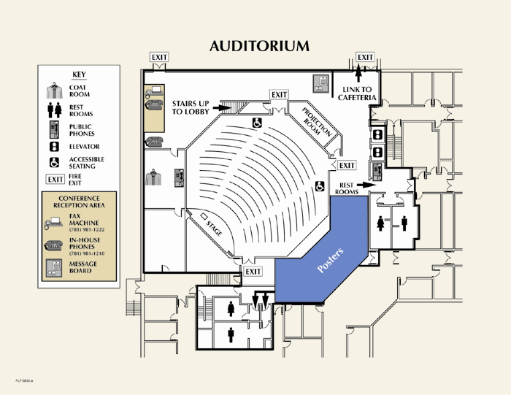
Auditorium
PLF-3050.ppt
Notes:
1
1

Slide 6
Unescorted Area
Lincoln Laboratory is a secure facility. Access to any other portion of the facility requires continuous escort by a white-badged employee.

Slide 7
Focus Sessions in S2-180

Slide 8
Agenda Highlights
Day 1
Wednesday
21 September
Mission Keynote Address – Dr. Mark Maybury / U.S. Air Force
Technology Keynote Address – Prof. Anant Agarwal / MIT CSAIL
Session 1: Embedded Exascale Processing Focus 1: Open Systems
Poster / Demo A: Research and Applications
Session 2: Graph and Network Processing Focus 2: Secure and Power Efficient Computing
Reception and Banquet (Burlington Marriott)
Banquet Presentation – Dr. Thomas Sterling / Indiana University
Title: The HPC Paradigm Shift 2020: HPEC Victim or Victor?
Day 2
Thursday
22 September
2012 Prenote – Mr. John Goodhue / Massachusetts Green High Performance
Computing Center
Session 3: Silicon Focus 3: GPU
Poster / Demo B:Technologies and Systems
Session 4: Awards Session
Panel: Will Security Impact Using COTS for HPEC

Slide 9
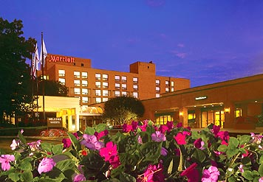
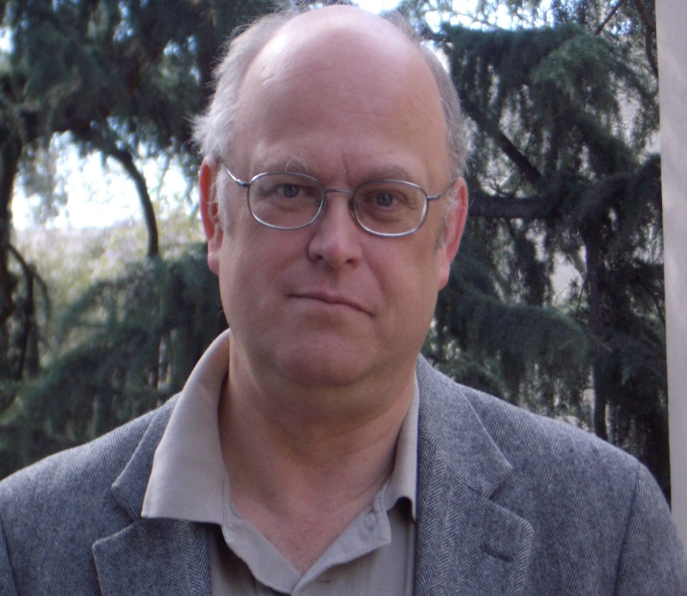
Banquet Speaker
Thomas Sterling, Ph.D
Title: The HPC Paradigm Shift 2020: HPEC Victim or Victor?
Place: Burlington Marriott
Date: Wednesday, 21 Sept 2011
Time: 1800 – Reception
1830 – Speaker
1900 – Banquet
REPLACE PHOTO

Slide 10
IEEE HPEC High Performance Extreme Computing
Charter: “To serve as the premier conference in the world on the confluence of HPC and Embedded Computing”
Goals
Migrate core of HPEC Workshop to an annual New England-focused IEEE conference
Foster fuller participation by academic and industrial community
Expand HPEC to include emerging Holyoke supercomputing community
Program
11-12 September 2012, Westin in Waltham
Academic track and demo night
Sub-Topics
Architectures
Data Intensive Computing
Embedded & Power Efficient Computing
Cyber Security
HPC (Power Efficient & Green)
Massive Databases
Convergence of mobile/cloud computing
Notes:
1
1

