Slide 1
The Angstrom Project: The Angstrom Project: Building 1000-Core Computer Systems Anant Agarwal CSAIL, MIT

Slide 2
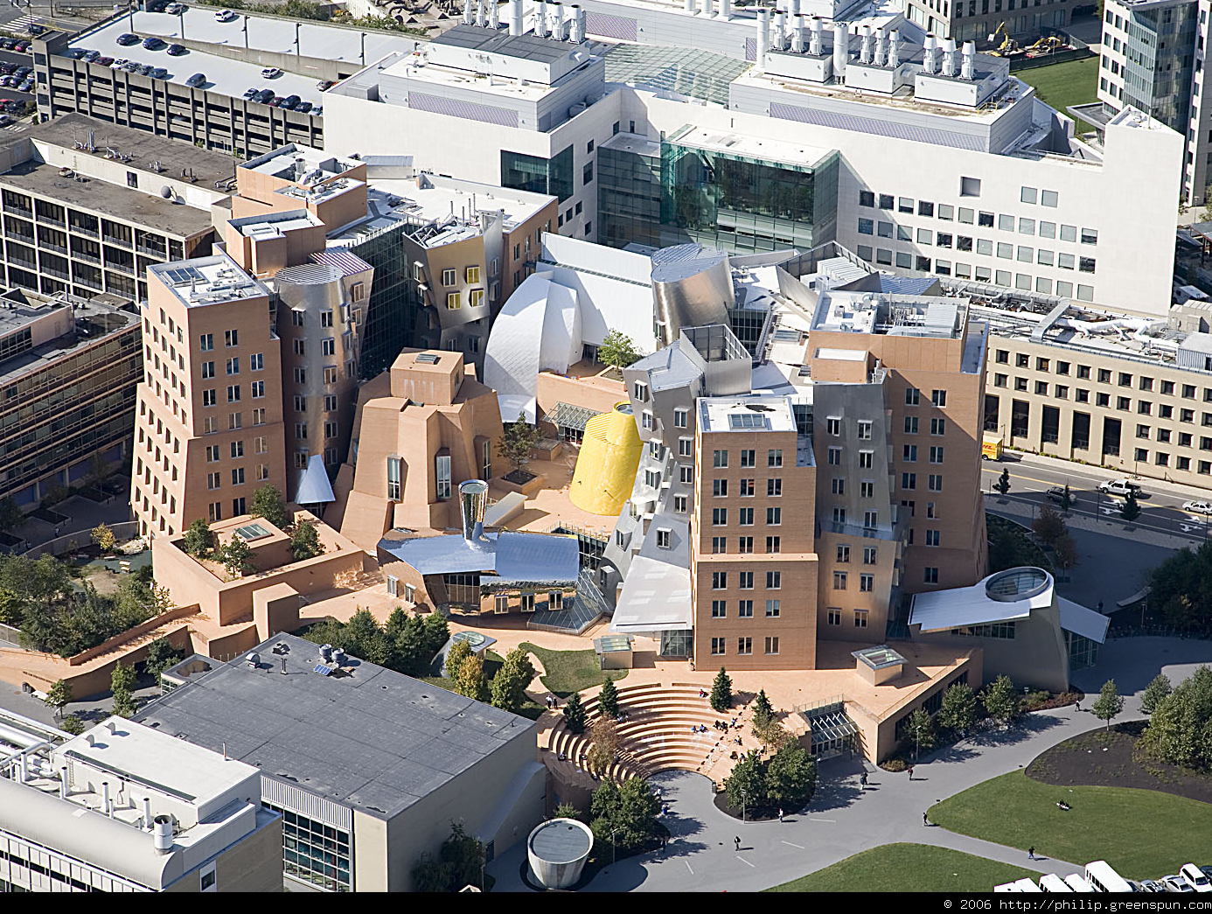



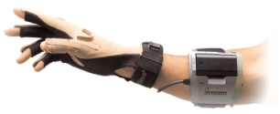
MIT’s largest laboratory with ~1000 members
AI & Robotics:
Intelligence Initiative
Medical decision making
Machine Learning
Autonomous vehicles
Robot locomotion & control
Systems:
Parallel and distributed systems
Wireless protocols and coding
Mobile and mesh networks
Relational databases
Security & recovery
Medical Telepresence
Theory:
Theory of distributed systems
Cryptography & Information Security
Mechanism Design
Quantum Information Science
Computational Biology
eDRAM
Cache
PEP core
WDM
Hub
Compute
Core
Mesh
Router
Architecture & Programming:
Manycore architectures
Organic or self-aware computing
Languages for scalable computing
Reconfigurable HW, Rapid Prototyping
Provably Reliable Software
Program analysis
Human/Computer Interactions:
Spoken language systems
Graphics, Vision, Image processing
Natural language understanding
Gesture-based interfaces
Web automation
Crowd sourcing
Stata Center

Slide 3







Project Angstrom:
Building 1000-Core Processor Systems
Observe
Applications
Dynamic Graph
Streaming Sensor
Chess
HPC
Prog. Model
Heartbeats
Goals met?
Goals
Algorithmic Choice
Sketches
Goals
Heartrate
Constraints
Energy-Budget
Security-Level
SEEC Application API
Perf. Models
Compiler
Peta-
Bricks
ZetaBricks
Autotuning
Compiler
Heartbeats and Adaptive Tuners
Partner Core Software
Cntrl Sys
Learner
Runtimes
Decide
Act
Smart Locks
Observe
OS
Self Aware Factored OS – SEFOS
Decide
Act
Energy
Perf. Events
HW-Config
Locality
Security-Level
SEEC Architecture API
eDRAM
Cache
Partner
Compute
Core
WDM
Hub
emesh
Router
Notes:
3
3
3

Slide 4
Challenges to Exascale Computing: The 3 P’s
Programmability
Programmability
Programmability
Performance
Performance
Performance
Power Efficiency
Power Efficiency
Power Efficiency
Programmability
Performance
Power Efficiency
Easy to get two of three, hard to get all three

Slide 5
“Flopping ALUs” are Energy Efficient
Big FLOPS
Low Energy
But are about as programmable as a paperweight

Slide 6
How to Get All Three
2. SEEC technology
Programmability
Performance and scalability
1. Fully distributed tiled architecture
Power Efficiency

Slide 7
Fully Factored Angstrom Chip Design – Yields Energy Efficiency and Scalability
Ultra-low power SRAM cell
1000 cores
5TFLOPS 1.5GHz
50W (50mW/tile)
Core:
32KB L1i
64KB L1D
256KB L2
1MB eDRAM
Cache
eDRAM
PEP core
Compute
Core
WDM
Hub
Mesh
Router
Broadcast
network using WDM optical
Electrical
express
mesh
network
Distribute everything so things are close by
_{No large central structures}

Slide 8
What Core to Use
_{10W/core to 50mW per core!}
_{You don’t}
_{Start with embedded tile core}
_{Go from 300mW to 50mW}

Slide 9
Tiled Approach is Power Efficient and Scalable
DDR2 Memory Controller 0
DDR2 Memory Controller 1
PCIe 0
MAC
PHY
XAUI
MAC
PHY 0
PROCESSOR
CACHE
Reg File
L2 CACHE
P2
P1
P0
L1I
L1D
Serdes
ITLB
DTLB
Serdes
2D DMA
UART, HPI
JTAG, I2C,
SPI
GbE 0
MDN
TDN
UDN
STN
IDN
SWITCH
Flexible IO
GbE 1
PCIe 1
MAC
PHY
Flexible IO
Example: TilePro64
200Gbps memory BW
40Gbps I/O
150GOPS
20W
XAUI
MAC
PHY 1
Serdes
Serdes
DDR2 Memory Controller 3
DDR2 Memory Controller 2

Slide 10
2. SEEC: A New Computational Model
Self-Aware Execution (SEEC) – a computing paradigm in which systems observe their runtime behavior, learn, and take actions to meet desired goals
Observe
User indicates performance or energy goals and provides alternatives of how to do things
System hardware and software manage everything else (e.g., locality, resilience), meeting goals by adapting to changing conditions
Heartbeats
Goals met?
Perf. Models
Cntrl Sys
Learner
Decide
Act

Slide 11
2. SEEC – Self Aware Computational Model
Heartrate lower than user goal
Power is manageable
Increase core frequency
heartrate
App 1
App 2
App 3
goals
Factored
Operating
System
Analysis &
Optimization
Engine
Observe
Scheduler
Memory
Manager
File
System
Perf. Models
Learner
Decide
Act
power, temp
voltage, freq
App 2
Cache
Cache
Cache
Cache
App 1
Disk
Cache
Partner core
Partner core
App 3
Partner core
Core
Core
DRAM
Computers should become more like humans
www.youtube.com/user/HeartbeatsAPI
Notes:
11

Slide 12
Why SEEC? Programming is Becoming very Hard
mini-SAR frontend
Mini-SAR app has many configurations in existing or future machines
# threads/stage
Thread mapping → cores
Core frequencies and voltage
Memory controller mapping
Layout of threads and cores
Cache management
What if something breaks – I lose a core!
Measured range of 0.07 - 0.7 pulses/sec/watt for various configurations (10X range) – 10X in energy efficiency on the table!
Programmer can easily make bad choices in configuration
Best configuration can also change with input
Communication and cache variability
SEEC technology achieved 90% of optimal with minimal programmer effort
12

Slide 13
Roles in the SEEC Model
 | Application Developer | Systems Developer | SEEC System Infrastructure
 | Express application goals and progress (e.g. frames/ second) |  | Read goals and performance
 |  |  | Determine how to adapt (e.g. How to speed up the application)
 |  | Provide a set of actions and a callback function (e.g. allocation of cores to process) | Initiate actions based on results of decision phase
Observe
Decide
Act
The decision engine is key to enabling SEEC
13
13
Notes:
13

Slide 14

ODA Control Loop
A control theory for Sefos
Observe
Heartbeats API
User can dial in desired behavior
Decide
Act
Control system
Learning engine
Heuristic models
System Parameters
Cores
Memory
Power
14
Notes:
14
14

Slide 15

H.264 Video Encode: Procedural
Open Movie file
15

Slide 16

H.264 Video Encode: Self-Aware using Heartbeats plus Heuristic Approach
16
Open Movie file

Slide 17
Minimizing Power in a Self-Aware System
Time (s)
0
2
4
6
8
10
12
14
16
80
70
180
Performance
Power
60
170
Performance (Frame/s)
50
Power (W)
160
40
30
Performance goal
150
20
140
10
0
130
50
150
250
350
450
Time (Heartbeat)
Notes:
17

Slide 18
Multiple Applications
bodytrack
x264
SEEC allocates cores to bodytrack
SEEC removes cores from x264
Clock drops 2.4-1.6GHz
w/o SEEC app misses goals
w/o SEEC app exceeds goals
SEEC adjusts algorithm to meet goals
18
Notes:
18

Slide 19
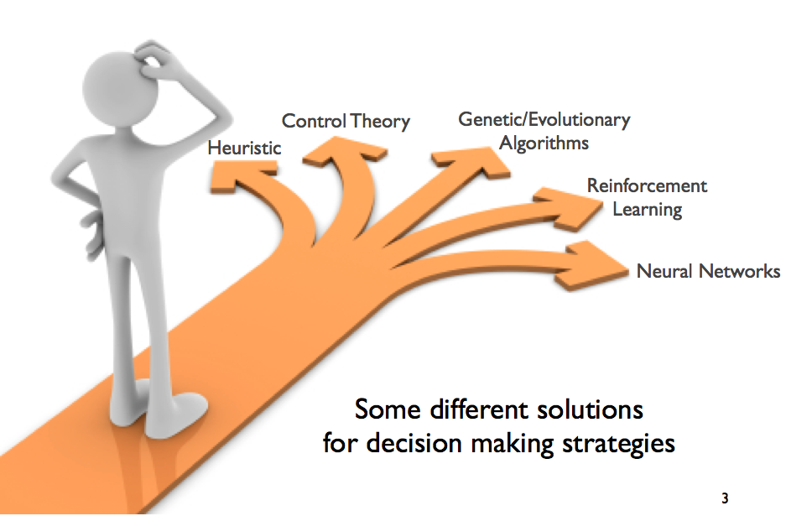
Decision Making Strategies
19

Slide 20
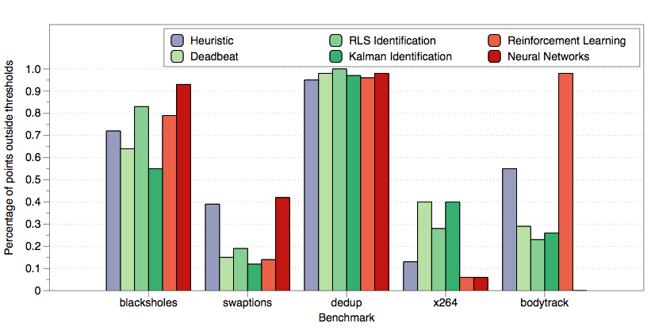
Decision Making Strategies Comparison of Different Approaches
*(lower is better)
WDP: measures the percentage of data points that are not in the desired performance interval
20

Slide 21
Summary
Angstrom project is approaching the computing problem with two key ideas
Create a fully distributed architecture
Create a fundamentally new computational model – SEEC
Angstrom approach has the potential to solve the power efficiency, performance and programmability challenges
SEEC approach is showing promise as a new way of building computer ystems
21

