Slide 1
23 September 2010
Using Graphics Processors to Accelerate Synthetic Aperture Sonar Imaging via Backpropagation
2010 High Performance Embedded Computing Workshop
Daniel P. Campbell, Daniel A. Cook
dan.campbell@gtri.gatech.edu

Slide 2
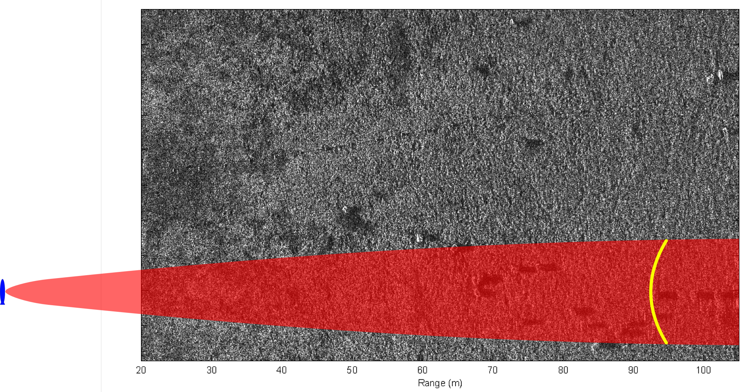
Sonar Imaging via Backpropagation
Forward Travel
As the sonar passes by the scene, it transmits pulses and records returns.
Each output pixel is computed by returns from the pulses for which it is within the beamwidth (shown in red). A typical integration path is shown in yellow.

Slide 3
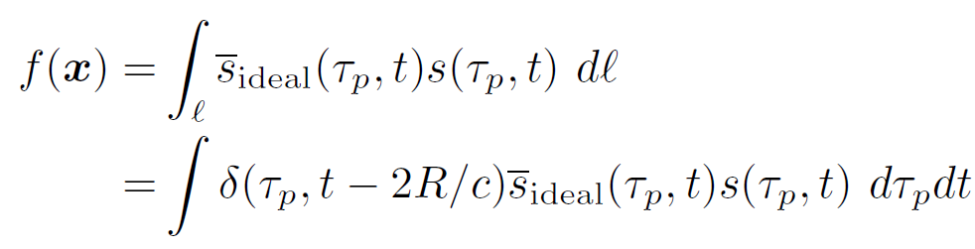
Backpropagation
Backpropagation is the simplest synthetic aperture image reconstruction algorithm
for each output pixel:
Find all pulses containing reflections from that location on the ground
Find recorded samples at each round-trip range
Inner product with expected reflection
Sum all of these data points
end

Slide 4
Backpropagation – Practical Advantages
Procedure
Attempt to fly a perfectly straight line
Compensate for unwanted motion
Form image using Fourier-based method backpropagation
Register and interpolate image onto map coordinates
Algorithmic simplicity
Easier to code and troubleshoot
Less accumulated numerical error
Flexibility
Can image directly onto map coordinates without the need for postprocessing (including bathymetric maps)
Expanded operating envelope
Can form imagery in adverse environmental conditions and during maneuvers

Slide 5
Sonar vs. Radar
Typical SAS range/resolution: 100m/3cm
Typical SAR range/resolution: 10km/0.3m
SAS and SAR are mathematically equivalent, allowing the same code to be used for both
The sensor is in continual motion, so it moves while the signal travels to and from the ground
Light travels 200,000 times faster than sound, so SAR processing can be accelerated by assuming the platform is effectively stationary for each pulse.

Slide 6
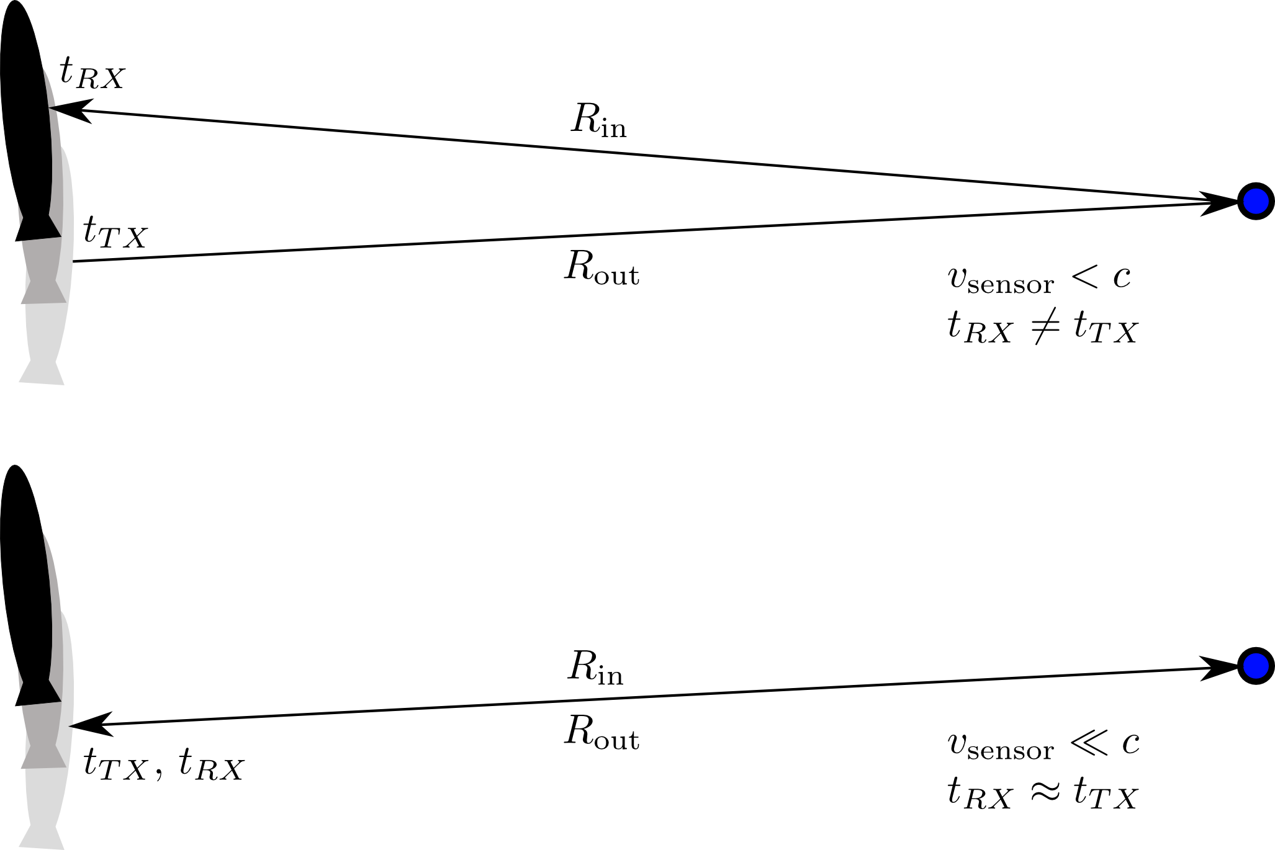
Sonar vs. Radar
In general, the sensor is at a different position by the time the signal is received (above). If the propagation is very fast (i.e., speed of light), then the platform can be considered motionless between transmit and receive (below).

Slide 7
Advantages of Backpropagation
FFT-based reconstruction techniques exist
Require either linear or circular collections
Only modest deviations can be compensated
Requires extra steps to get georeferenced imagery
Backpropagation is far more expensive, but is the most accurate approach
No constraints on collection geometry: can image during maneuvers
Directly produces imagery located on any map coordinates desired

Slide 8
Minimum FLOPs
Range out 9
Estimated r/t time 1
Beam Check 5
Final receiver position 65
Final platform orientation 6
Construct platform final R 35
Apply R 15
Add platform motion 9
Range In 9
Range->Bin 2
Sample & Interpolate 9
Correlate with ideal reflector 9
Accumulate 2
Total 111
Not needed for Radar

Slide 9
GPU Backpropagation
GTRI SAR/S Toolbox, MATLAB Based
Multiple image formations
Backpropagation too slow
GPU Accelerated plug-in to MATLAB toolbox
CUDA/C++
One output pixel per thread
Stream groups of pulses to GPU memory
Kernel invocation per pulse group

Slide 10
Direct Optimization Considerations
Textures for clamped, interpolated sampling
2-D blocks for range (thus cache) coherency
Careful control of register spills
Shared memory for (some) local variables
Reduced precision transcendentals
Recalculate versus lookup
Limit index arithmetic

Slide 11
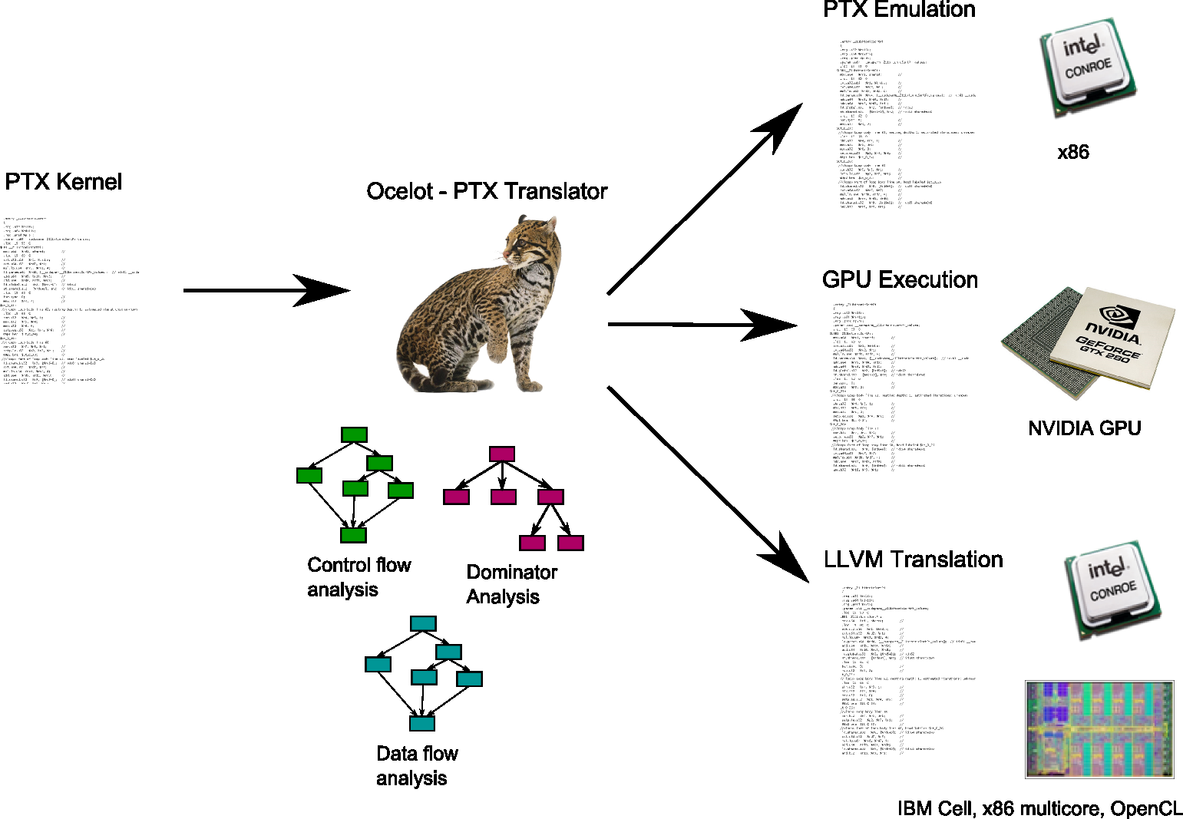
GPU Ocelot
Courtesy, Computer Architecture and Systems Laboratory, Georgia Tech
http://www.ece.gatech.edu/research/labs/casl/index.html
G. Diamos, A. Kerr, S. Yalamanchili, and N. Clark, “Ocelot: A Dynamic Optimizing Compiler for Bulk Synchronous Applications in Heterogeneous Systems,” IEEE/ACM International Conference on Parallel Architectures and Compilation Techniques, September 2010.

Slide 12

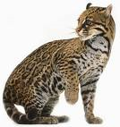
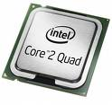

Productivity Tools for Hybrid Systems
Debugging
Memory race detection
Bounds checks
Profiling/Performance Tuning
Alignment behavior
Control flow behavior
Inter-thread data flow
Integration with Front-End profiling tools
GLIMPSES (S. Pande)
Ocelot Dynamic Execution Infrastructure

Slide 13
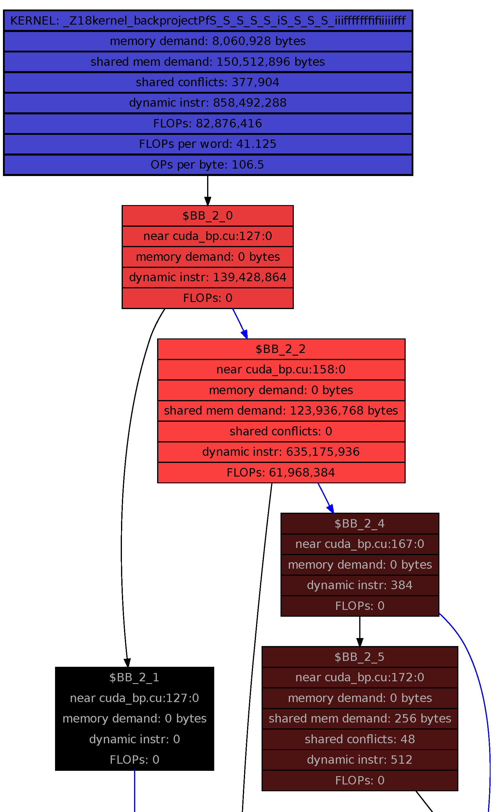
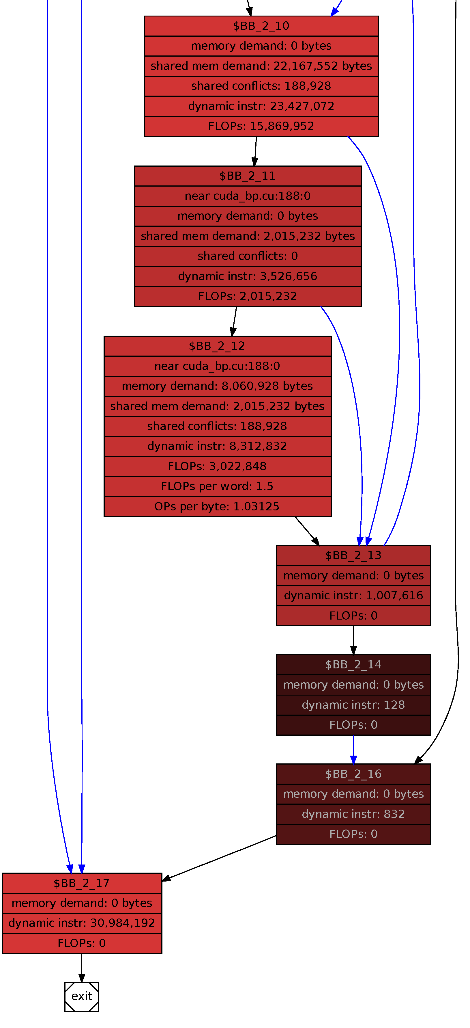
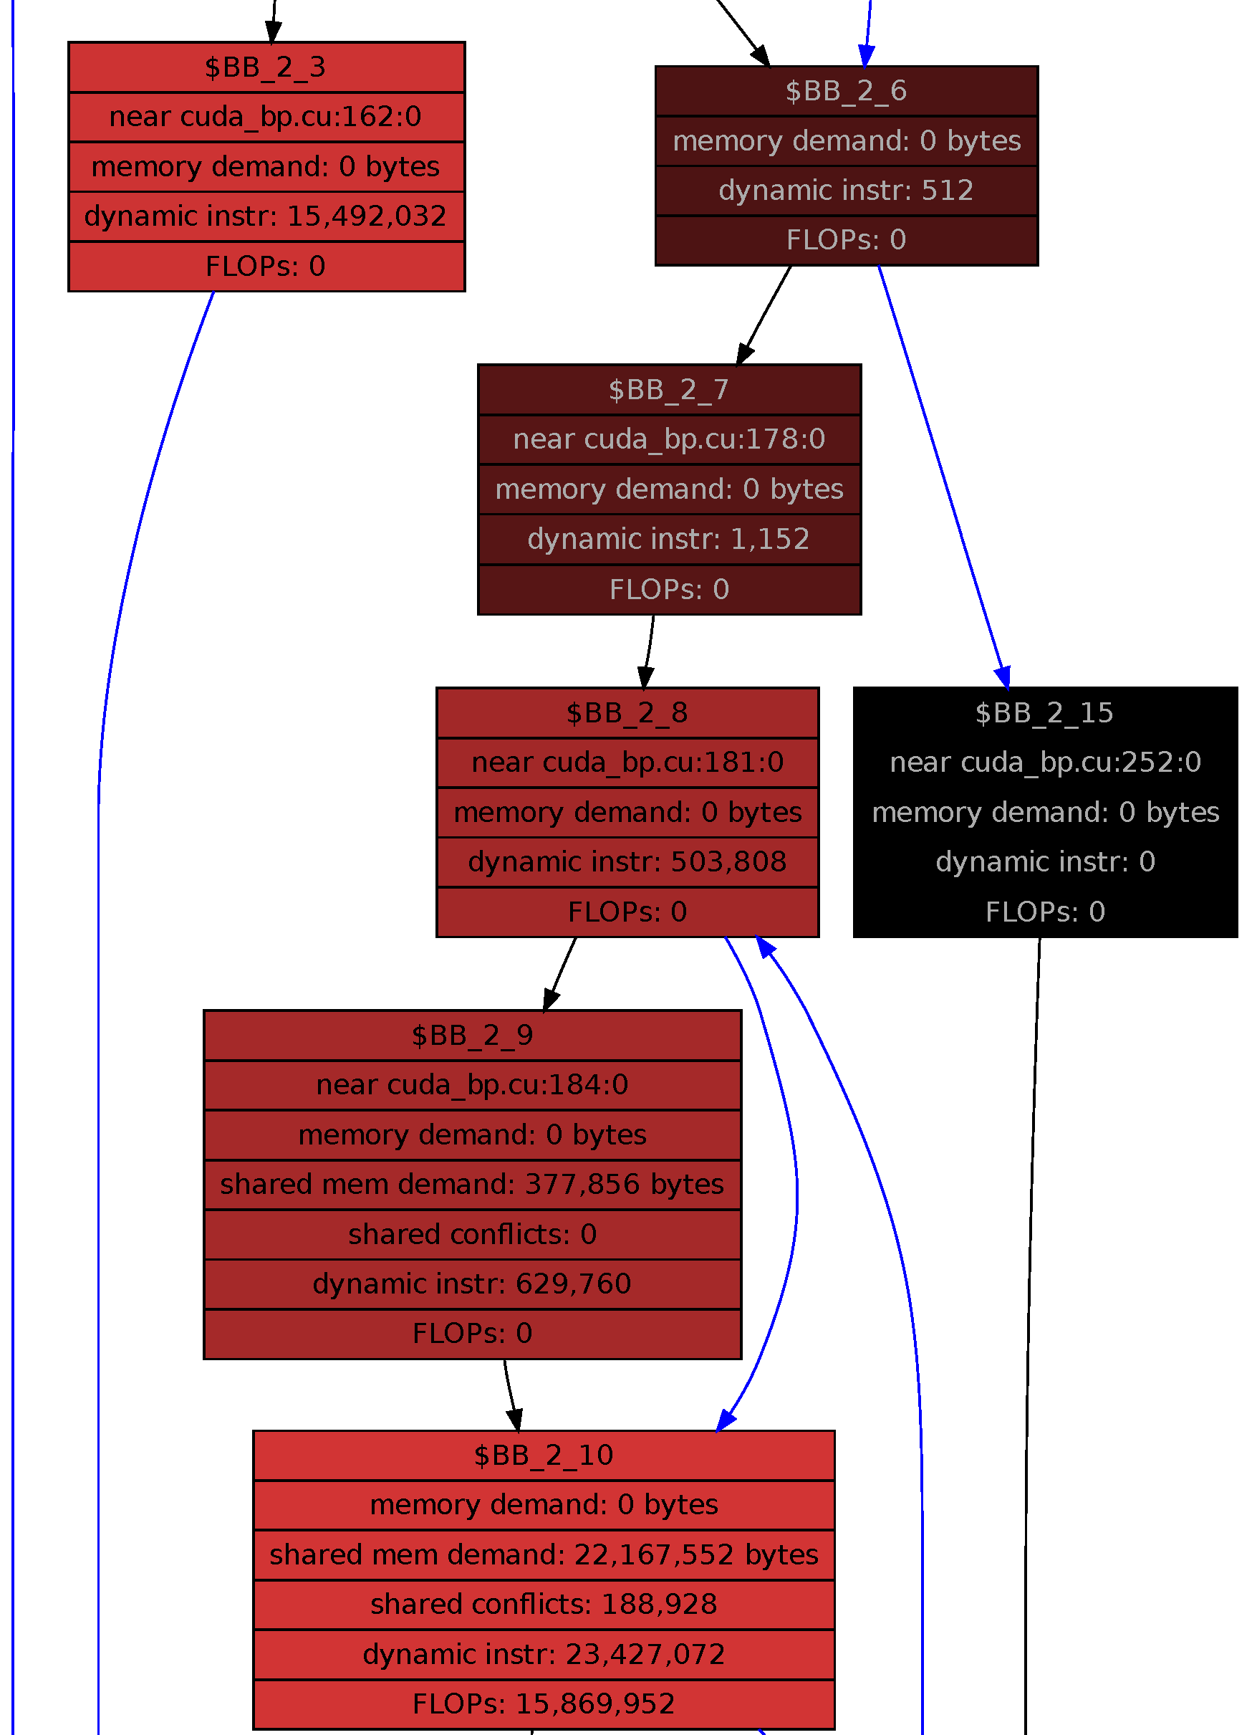
Ocelot data

Slide 14
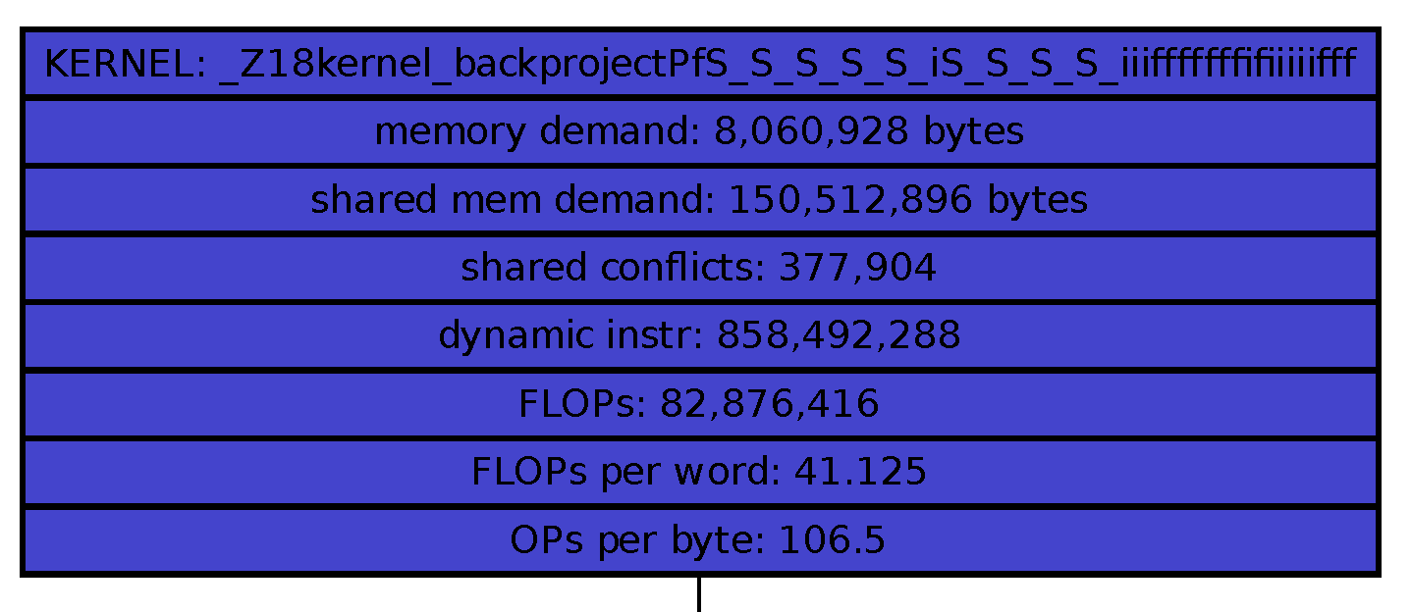
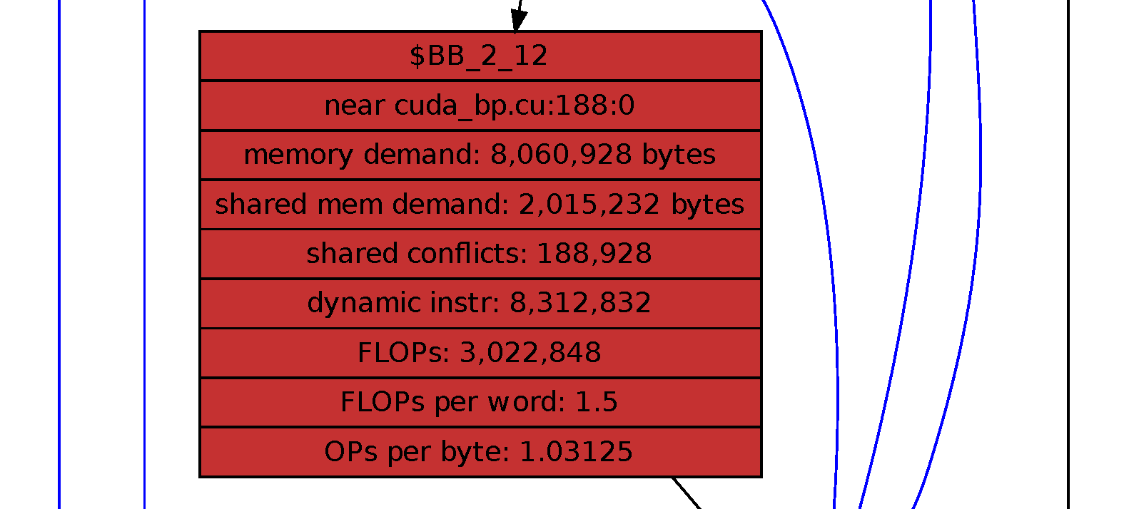
Ocelot Findings
82.25 FLOPS per pixel*pulse, too high
a = calc1();
b = calc2();
if (a<constant) {…
25% Speedup
Did not expect any!
tyx = ThreadIdx.x * BLOCK
+ ThreadIdx.y;
share[tyx] = foo;
5% Speedup

Slide 15
Performance versus Image Size

Slide 16
Strong Scaling Results

Slide 17
Performance – Alternate Configurations
Configuration | Run time (s) | pp/s | FLOPS/pp | FLOPS/s
SAS | 14.78 | 4.13E+9
Stop & Hop | 12.82 | 4.76E+9
Ignore Beam | 22.81 | 2.67E+9 | 111 | 296.73E+9
SAR (S&H+IB) | 16.52 | 3.69E+9 | 32 | 118.12E+9
3936 x 3936 Image from 3936 pulses
Alternate configurations not optimized
GTX 480

Slide 18
Future Work
Further optimization
Reoptimize for Fermi
Tune for multi-GPU
Multi-node
Improve error handling, edge cases, etc.
Backpropagation server

