Slide 1
Development of a Component-Based Framework using VSIPL++
HPEC
September 15-16 2010
Alan Ward
Systems Engineer

Slide 2
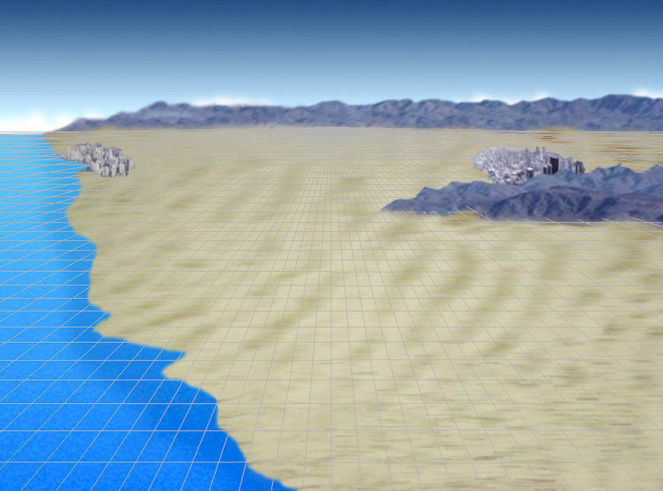
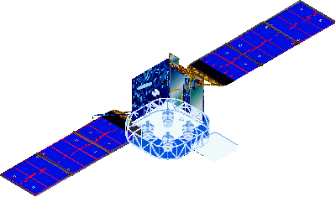


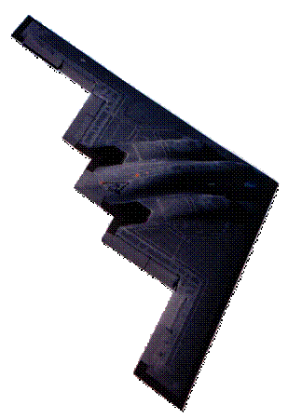


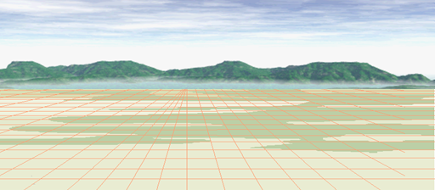

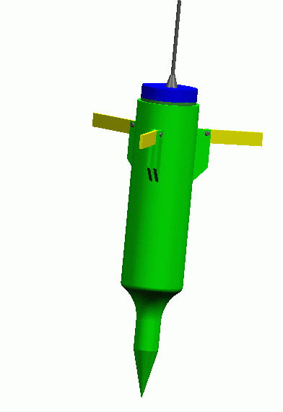
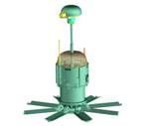


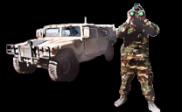
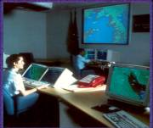

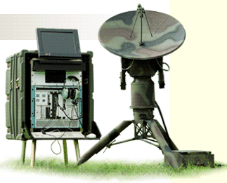
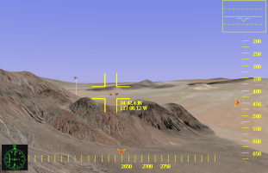
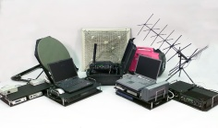
Our Data Sharing Challenge
Current State: Lots of Data, Little Sharing/Interoperability
Desirable Traits:
Sensors as Discoverable Nodes
Processing is scalable
Service Oriented Mission Apps
Security (AT & IA)
OPEN Standards Based
Performance & QoS based
Discoverable Sensor
Capabilities
Netted Situational Awareness
Access to UGS
Strike
Access to Special OPs
ISR

Slide 3
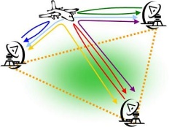

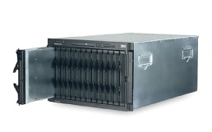
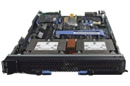
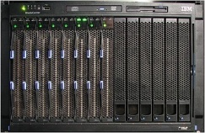
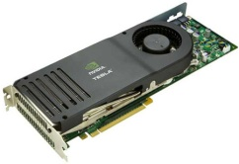
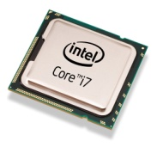
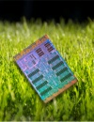
Data Sharing Between Solution Classes
Want to share data products both within and between different solution classes
Requires data products to be represented in a standard and modularized format
Net-centric
Systems of Systems
Multi-static, swarming
Global Information Grid
Platform
Vehicles
Sensor fusion
UAVs
Aircraft
Processor
Inside single sensor
Embedded
Node
Inside single sensor
Data Products
We are creating an infrastructure to facilitate the transfer of data products between applications in the same and different Classes

Slide 4
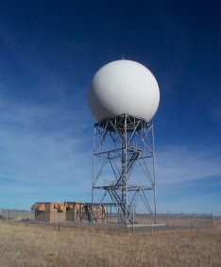
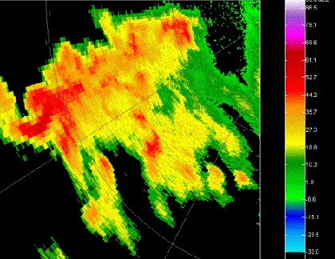
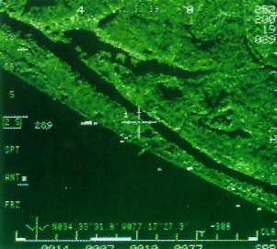
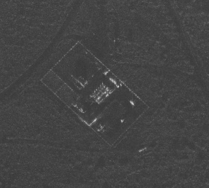
Legacy Design Pattern: Stove Pipes
Sensors produce data in their own world – not shared with other platforms or systems.
Leads to redundancy and waste in systems, inefficiencies, and increased cost and
development time.
Data
Data
Data

Slide 5
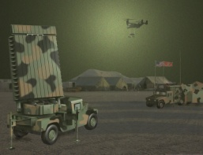
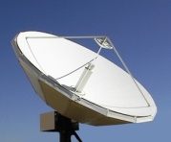
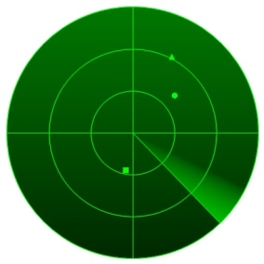
Enabling Data Distribution and Interoperability
The data products in the embedded space are defined using the VSIPL++ data model.
Sensors have typically been designed to produce data for a specific platform or system, but their data is often useful to other platforms as well.
Data can be utilized by different
nodes, processors, and platforms
Data
Sensors generate data
The same data can be interpreted in different ways
For use with different systems
Come see our poster for details!

