Slide 1
Performance Scalability on Embedded Many-Core Processors
Michael Champigny
Research Scientist
Advanced Computing Solutions
Mercury Computer Systems
2010 HPEC Workshop
September 15, 2010

Slide 2
Outline
Motivation
Single-chip parallelism and convergence
Variability challenges
Dynamic scheduling
Task Parallelism
Load balancing
Work stealing
Runtime design
Parallel runtime
Scalability study
Data structure considerations

Slide 3
Many-Core in Embedded HPC
Large scale parallel chip multiprocessors are here
Power efficient
Small form factors
e.g., Tilera TILEPro64
Convergence is inevitable for many workloads
Multi-board solutions became multi-socket solutions
…and multi-socket solutions will become single-socket solutions
e.g., ISR tasks will share a processor
Software is a growing challenge
How do I scale my algorithms and applications?
…without rewriting them?
…and improve productivity?

Slide 4
Sources of Variability
Chip multiprocessors introduce variability to workloads
cc-NUMA
Memory hierarchies and block sizes
Asymmetries in processing elements due to
Thermal conditions
Process variation
Faults
Workloads themselves are increasingly data-driven
Data dependencies lead to processor stalls
Complex state machines, branching, pointer chasing
Convergence compounds the problem
Adversarial behavior of software components sharing resources

Slide 5
Importance of Load Balancing
Mapping algorithms to physical resources is painful
Requires significant analysis on a particular architecture
Doesn’t translate well to different architectures
Mapping must be revisited as processing elements increase
Static partitioning is no longer effective for many problems
Variability due to convergence and data-driven applications
Processing resources are not optimally utilized
e.g., Processor cores can become idle while work remains
Load balancing must be performed dynamically
Language
Compiler
Runtime

Slide 6
Task Parallelism & Cache-Oblivious Algorithms
Load balancing requires small units of work to fill idle “gaps”
Fine-grained task parallelism
Exposing all fine-grained parallelism at once is problematic
Excessive memory pressure
Cache-oblivious algorithms have proven low cache complexity
Minimize number of memory transactions
Scale well unmodified on any cache-coherent parallel architecture
Based on divide-and-conquer method of algorithm design
Tasks only subdivided on demand when a processor idles
Tasks create subtasks recursively until a cutoff
Leaf tasks fit in private caches of all processors

Slide 7
Scheduling Tasks on Many-Cores
Runtime schedulers assign tasks to processing resources
Greedy: make decisions only when required (i.e., idle processor)
Ensure maximum utilization of available computes
Have knowledge of instantaneous system state
Scheduler must be highly optimized for use by many threads
Limit sharing of data structures to ensure scalability
Any overhead in scheduler will impact algorithm performance
Work-stealing based schedulers are provably efficient
Provide dynamic load balancing capability
Idle cores look for work to “steal” from other cores
Employ heuristics to improve locality and cache reuse

Slide 8
Designing a Parallel Runtime for Many-Core
Re-architected our dynamic scheduler for many-core
Chimera Parallel Programming Platform
Expose parallelism in C/C++ code incrementally using C++ compiler
Ported to several many-core architectures from different vendors
Insights gained improved general performance scalability
Affinity-based work-stealing policy optimized for cc-NUMA
Virtual NUMA topology used to improve data locality
Core data structures adapt to current runtime conditions
Tasks are grouped into NUMA-friendly clusters to amortize steal cost
Dynamic load balancing across OpenCL and CUDA supported devices
No performance penalty for low numbers of cores (i.e., multi-core)

Slide 9
Work-Stealing Scheduling Basics
Cores operate on local tasks (i.e., work) until they run out
A core operating on local work is in the work state
When a core becomes idle it looks for work at a victim core
This operation is called stealing and the perpetrator is labeled a thief
This cycle is repeated until work is found or no more work exists
A thief looking for work is in the idle state
When all cores are idle the system reaches quiescent state
Basic principles of optimizing a work-stealing scheduler
Keep cores in work state for as long as possible
This is good for locality as local work stays in private caches
Stealing is expensive so attempt to minimize it and to amortize cost
Stealing larger-grained work is preferable
Choose your victim wisely
Stealing from NUMA neighbor is preferable

Slide 10
Work-Stealing Implications on Scheduler Design
Work-stealing algorithm leads to many design decisions
What criteria to apply to choose a victim?
How to store pending work (i.e., tasks)?
What to do when system enters quiescent state?
How much work to steal?
Distribute work (i.e., load sharing)?
Periodically rebalance work?
Actively monitor/sample the runtime state?

Slide 11
Example: Victim Selection Policy on Many-Core
Victim selection policy
When a core becomes idle which core do I try to steal from?
Several choice are available
Randomized order
Linear order
NUMA order
We found NUMA ordering provided better scalability
Benefits became more pronounced with larger numbers of cores

Slide 12
Optimal Amount of Tasks to Steal
When work is stolen how much do we take from the victim?
If we take too much
…victim will begin looking for work too soon
If we don’t take enough
…thief begins looking for work too soon
We conducted an empirical study to determine the best strategy
Intuitively, stealing half the available work should be optimal

Slide 13
Impact of Steal Amount Policy on Data Structures
Steal a single task at a time
Implemented with any linear structure (i.e., dynamic array)
Allows for concurrent operation at both ends
…without locks in some cases
Steal a block of tasks at a time
Implemented with a linear structure of blocks
Each block contains at most a fixed number of tasks
Can lead to load imbalance in some situations
If few tasks exist in system one core could own them all
Steal a fraction of available tasks at a time
We picked 0.5 as the fraction to steal
Data structure is a more complex list of trees

Slide 14
Empirical Study of Steal Amount on Many-Core
Determine steal amount policy impact on performance scalability
Scalability defined as ratio of single core to P core latency
Run experiment on existing many-core embedded processor
Tilera TILEPro64 using 56 cores
GNU compiler 4.4.3
SMP Linux 2.6.26
Used Mercury Chimera as parallel runtime platform
Modify existing industry standard benchmarks for task parallelism
Barcelona OpenMP Task Suite 1.1
MIT Cilk 5.4.6
Best-of-10 latency used for scalability calculation

Slide 15
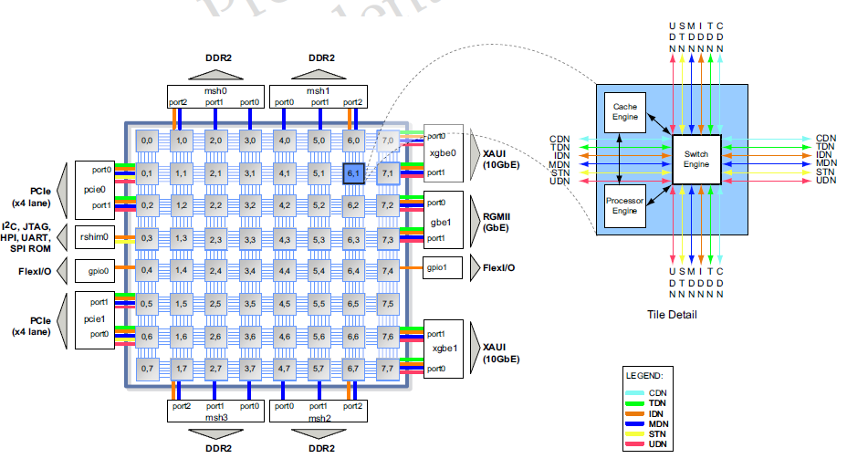
Tilera TILEPro64 Processor Architecture

Slide 16
Tilera TILEPro64 Processor Features
Processing
64 tiles arranged in 8 × 8 grid @ 23W
866 MHz clock
32-bit VLIW ISA with 64-bit instruction bundles (3 ops/cycle)
Communication
iMesh 2D on-chip interconnect fabric
1 cycle latency per tile-tile hop
Memory
Dynamic Distributed Cache
Aggregates L2 caches into coherent 4 Mbytes L3 cache
5.6 Mbytes combined on-chip cache

Slide 17
Task Parallel Benchmarks
Benchmark | Source | Domain | Cutoff | Description
FFT | BOTS | Spectral | 128 | 1M point, FFTW generated
Fibonacci | BOTS | Micro | 10 | Compute 45th number
Heat | Cilk | Solver | 512 | Diffusion, 16M point mesh
MatrixMult | Cilk | Dense Linear | 16 | 512×512 square matrices
NQueens | BOTS | Search | 3 | 13×13 chessboard
PartialLU | Cilk | Dense Linear | 32 | 1M point matrix
SparseLU | BOTS | Sparse Linear | 20 | 2K×2K sparse matrix
Sort | BOTS | Sort | 2048, 20 | 20M 4-byte integers
StrassenMult | BOTS | Dense Linear | 64, 3 | 1M point matrices

Slide 18
Example: FFT Twiddle Factor Generator (Serial)
void fft_twiddle_gen (int i, int i1, COMPLEX* in,
COMPLEX* out, COMPLEX* W, int n, int nW, int r, int m)
{
if (i == (i1 – 1))
fft_twiddle_gen1 (in+i, out+i, W, r, m, n, nW*i,
nW*m);
else {
int i2 = (i + i1) / 2;
fft_twiddle_gen (i, i2, in, out, W, n, nW, r, m);
fft_twiddle_gen (i2, i1, in, out, W, n, nW, r, m);
}
}

Slide 19
Example: FFT Twiddle Factor Generator (OpenMP)
void fft_twiddle_gen (int i, int i1, COMPLEX* in,
COMPLEX* out, COMPLEX* W, int n, int nW, int r, int m)
{
if (i == (i1 – 1))
fft_twiddle_gen1 (in+i, out+i, W, r, m, n, nW*i,
nW*m);
else {
int i2 = (i + i1) / 2;
#pragma omp task untied
fft_twiddle_gen (i, i2, in, out, W, n, nW, r, m);
#pragma omp task untied
fft_twiddle_gen (i2, i1, in, out, W, n, nW, r, m);
#pragma omp taskwait
}
}

Slide 20
Example: FFT Twiddle Factor Generator (Chimera)
void fft_twiddle_gen parallel (int i, int i1,
COMPLEX* in, COMPLEX* out, COMPLEX* W, int n, int nW,
int r, int m)
{
if (i == (i1 – 1))
fft_twiddle_gen1 (in+i, out+i, W, r, m, n, nW*i,nW*m);
else join {
int i2 = (i + i1) / 2;
fork (fft_twiddle_gen, i, i2, in, out, W, n, nW,r,m);
fork (fft_twiddle_gen, i2, i1, in, out, W, n,nW,r,m);
}
}

Slide 21
BOTS: Fibonacci

Slide 22
BOTS: Fast Fourier Transform

Slide 23
Cilk: Matrix-Matrix Multiply

Slide 24
BOTS: Strassen Matrix-Matrix Multiply

Slide 25
BOTS: Sparse LU Factorization

Slide 26
Cilk: Partial Pivoting LU Decomposition

Slide 27
Cilk: Heat

Slide 28
BOTS: N-Queens

Slide 29
BOTS: Sort

Slide 30
Conclusions
Popular choice of stealing a single task at a time is suboptimal
Choosing a fraction of available tasks led to improved scalability
Popular choice of randomized victim selection is suboptimal
We found NUMA ordering improved scalability slightly
Cache-oblivious algorithms are a good fit for many-core platforms
Many implementations available in literature
Scale well across a wide range of processors
…but research continues and questions remain
What about 1000s of cores?
How far can we scale algorithms on cc-NUMA architectures?

Slide 31
Questions?
Michael Champigny
mchampig@mc.com
Thank you!

