Slide 1
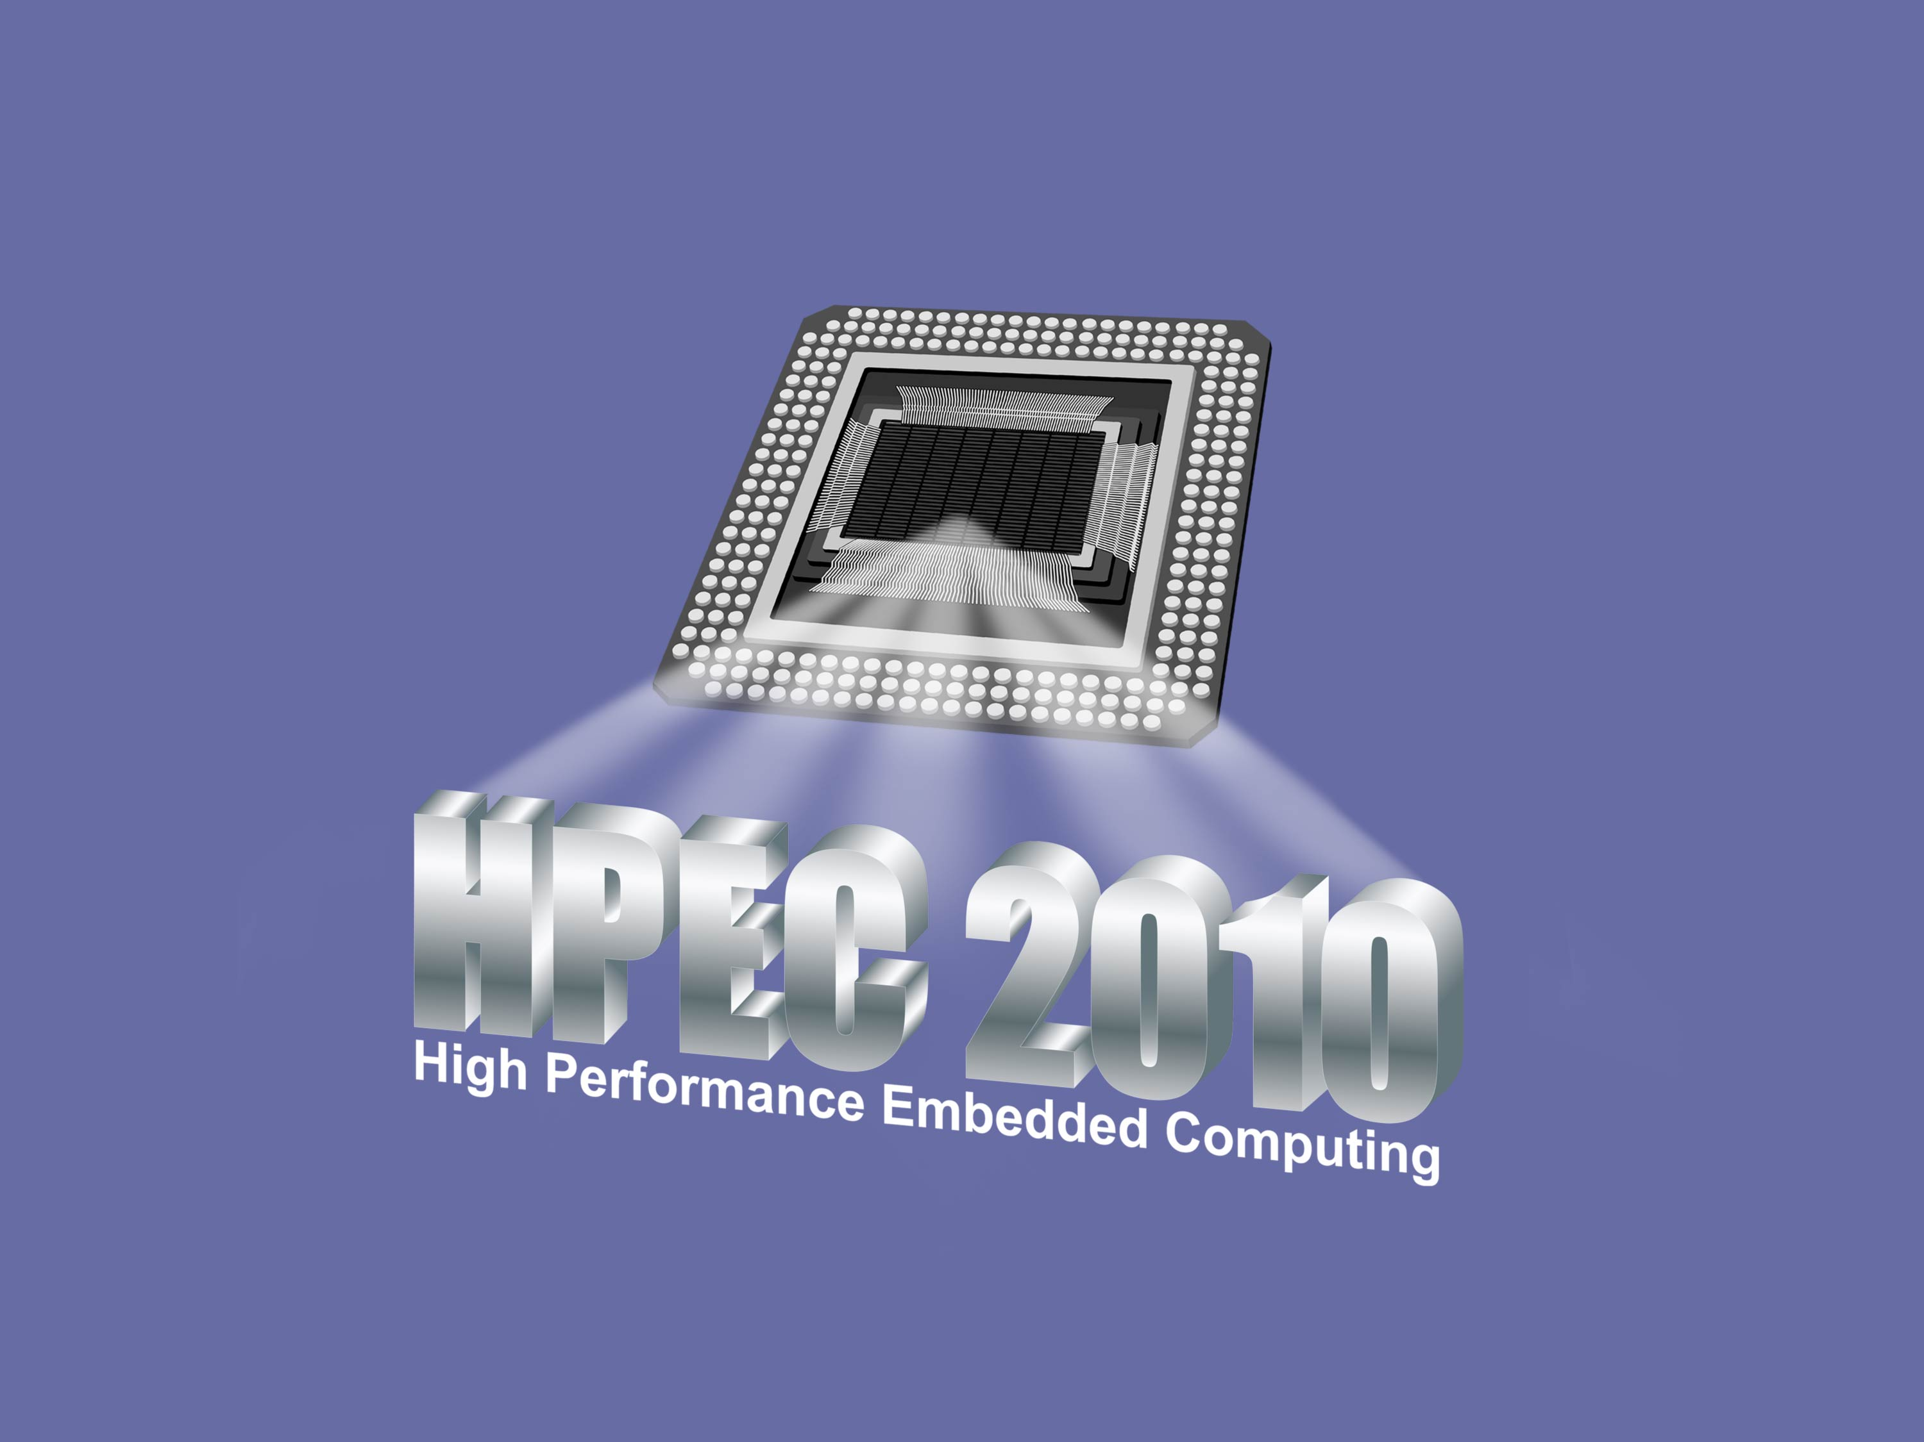

Slide 2
HPEC 2010 Acknowledgments
Technical Committee
Dr. Stanley Ahalt / RENCI Mr. Masahiro Arakawa / MIT Lincoln Laboratory Dr. Ray Artz / Independent Consultant Dr. David Bader / Georgia Institute of Technology Mr. William Bent, Jr. / CSP, Inc. Prof. Keren Bergman / Columbia University Dr. Lawrence Bergman / Jet Propulsion Laboratory Mr. Robert Bernecky / Naval Undersea Warfare Center Ms. Nadya Bliss / MIT Lincoln Laboratory Mr. Peter Boettcher / MIT Lincoln Laboratory Dr. Jay Brockman / University of Notre Dame Dr. Keith Bromley / SPAWAR Systems Center Mr. Daniel Campbell / Georgia Tech Research Institute Mr. David Cousins / BBN Technologies Dr. Jay Culliney / The Aerospace Corporation Dr. Jack Dongarra / University of Tennessee, ICL Dr. Neall Doren / Sandia National Laboratories Dr. Ian Dunn / Mercury Computer Systems Dr. Alan Edelman / Massachusetts Institute of Technology Dr. Maya Gokhale / Lawrence Livermore National Laboratory Mr. John Grosh / Lawrence Livermore National Laboratory Mr. Michael Harris / BAE Systems Dr. William Harrod / DARPA / TCTO Dr. Martin Herbordt / Boston University Dr. Daniel Katz / University of Chicago Mr. Bruce Kinney / Raytheon Company Dr. James Lebak / The MathWorks Dr. Miriam Leeser / Northeastern University Dr. Richard Linderman / Air Force Research Laboratory Dr. Brian Loe / Lockheed Martin Corporation Mr. Michael Lucas / Northrop Grumman Corporation Mr. Craig Lund / Local Knowledge Mr. Michael McCollister / Northrop Grumman Corporation Dr. Sanjeev Mohindra / MIT Lincoln Laboratory Dr. Brent Nelson / Brigham Young University Mr. David Ngo / BAE Systems Mr. Eric Pancoast / Lockheed Martin Corporation Dr. Robert Pettit / The Aerospace Corporation Mr. Frank Pietryka / Raytheon Company Dr. Viktor Prasanna / University of Southern California Dr. Albert Reuther / MIT Lincoln Laboratory Dr. John Reynders / Johnson & Johnson Dr. Mark Richards / Georgia Institute of Technology Dr. Martin Rinard / Massachusetts Institute of Technology Dr. Sharon Sacco / The MITRE Corporation Mr. Craig Sather / The Aerospace Corporation Dr. Philip Sementilli / Raytheon Company Dr. Anthony Skjellum / University of Alabama at Birmingham Dr. Hendrik Spaanenburg / Heterogeneous Computing, LLC Mr. Brian Sroka / The MITRE Corporation Dr. Jeffrey Vetter / Oak Ridge National Laboratory Mr. Dan Wells / The Boeing Company
Sponsors
Defense Advanced Research Projects Agency
Air Force Research Laboratory
Air Force Rapid Capabilities Office
High Performance Computing Modernization Office
Advisory Committee
Dr. Robert Shin / MIT Lincoln Laboratory
Dr. Richard Games / MITRE
Workshop Office Support
Ms. Kathleen Cable
Ms. Carragh Callahan
Ms. Joan Napoli
Ms. Ellen Oehme
Ms. Terry Retherford
Ms. Lori Tsoulas
Ms. Janet Quinn
Technical Support
Mr. Troy McLean
Mr. Igor Marchenko
Document Production
Mr. Michael Burke
Ms. Patricia Maguire
Ms. Linda Litchfield
Mr. James Caruso
Projectionists
Mr. Tom Burbine
Mr. Don Gaudette
Mr. Mike Imbeault
Security
Ms. Renee Gylfphe
Ms. Roslyn Wesley
Mr. Thomas Zech
Reception Staff
Security Officers
Special Services
Mr. James Armao
Mr. Richard Gabriele
Mr. Hugo Volpe
Corporate Chefs
Mr. James Iannone
Food Service Staff
Audience
All of you attending!
Notes:
1
1

Slide 3
2010 HPEC Workshop Administrative Information
Unclassified Sessions and a U.S. Only Session
Workshop is being videotaped
No smoking inside the Laboratory
Lunch and refreshments are provided
Wireless devices that include embedded cameras or recording devices are restricted. Please see the Registration Desk for storage
Badges
100% Picture ID check is required each day
Picked up at the Security Desk each morning and returned before you leave
May not be taken outside the facility
Unclassified Proceedings will be available on the web
Provide any necessary updates on the Contact Information form that is provided in your Attendee Package and leave it at the Registration Desk
Please provide your completed Workshop questionnaire to the Registration Desk
NEW

Slide 4
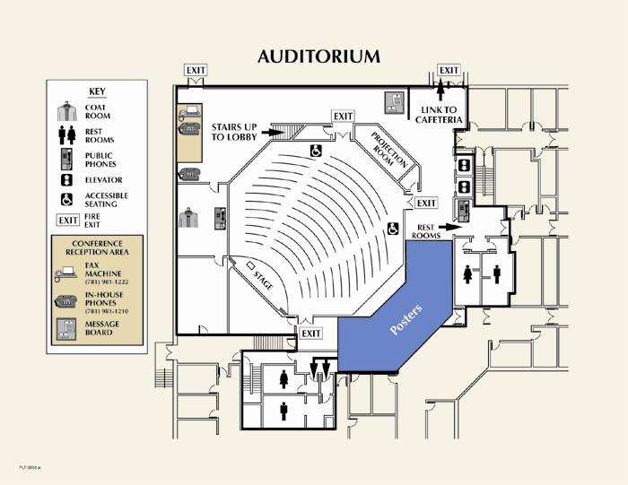
Auditorium
PLF-3050.ppt
Notes:
1
1

Slide 5
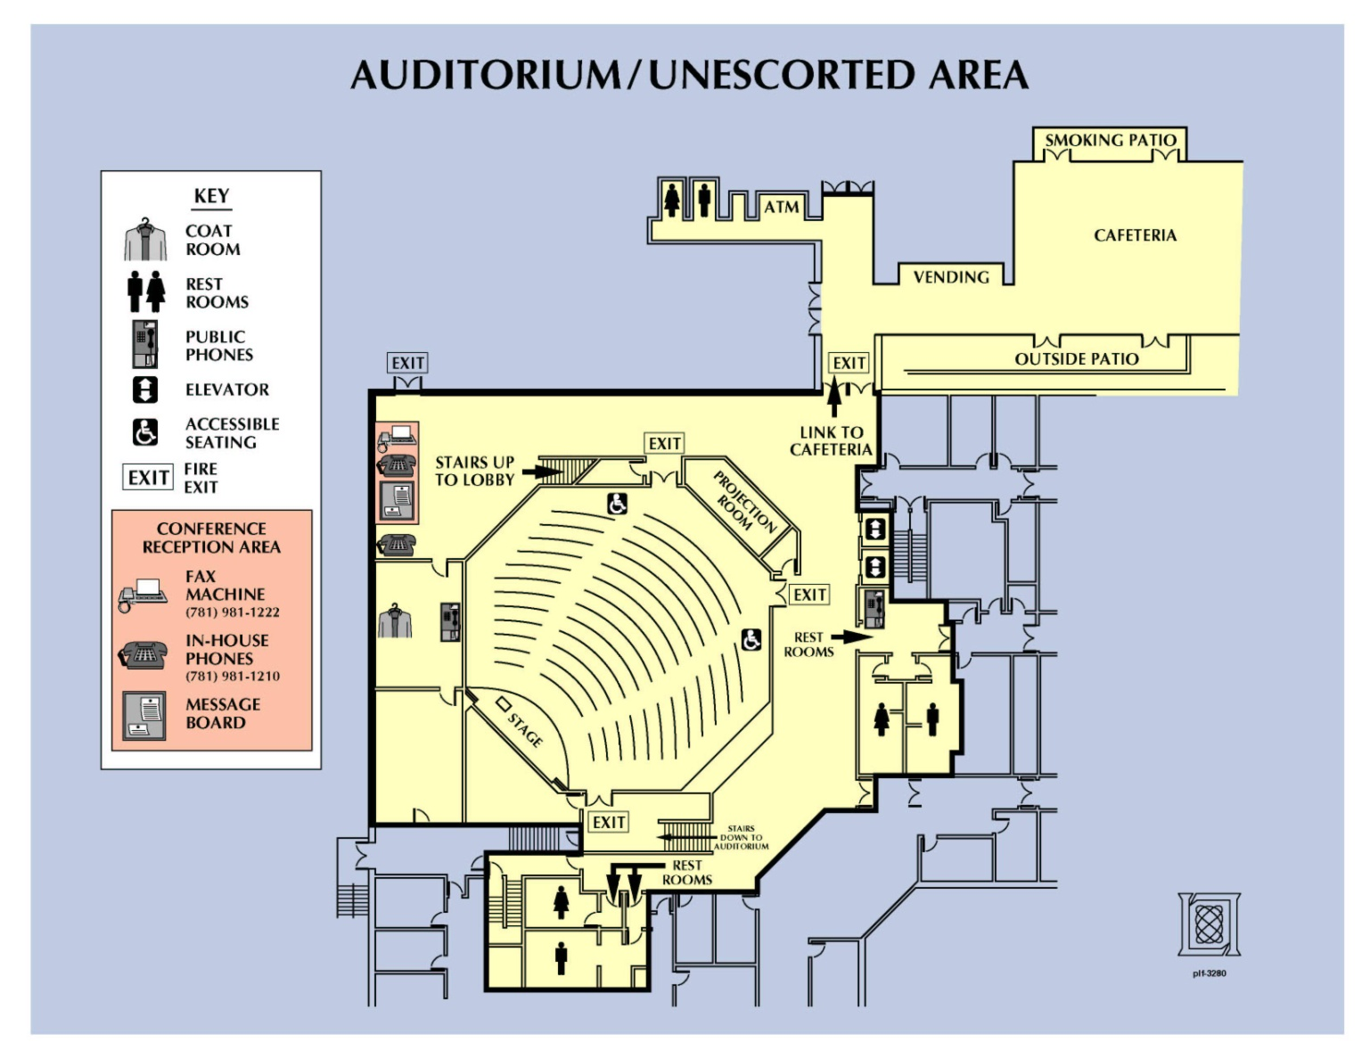
Unescorted Area
Lincoln Laboratory is a secure facility. Access to any other portion of the facility requires continuous escort by a white-badged employee.

Slide 6
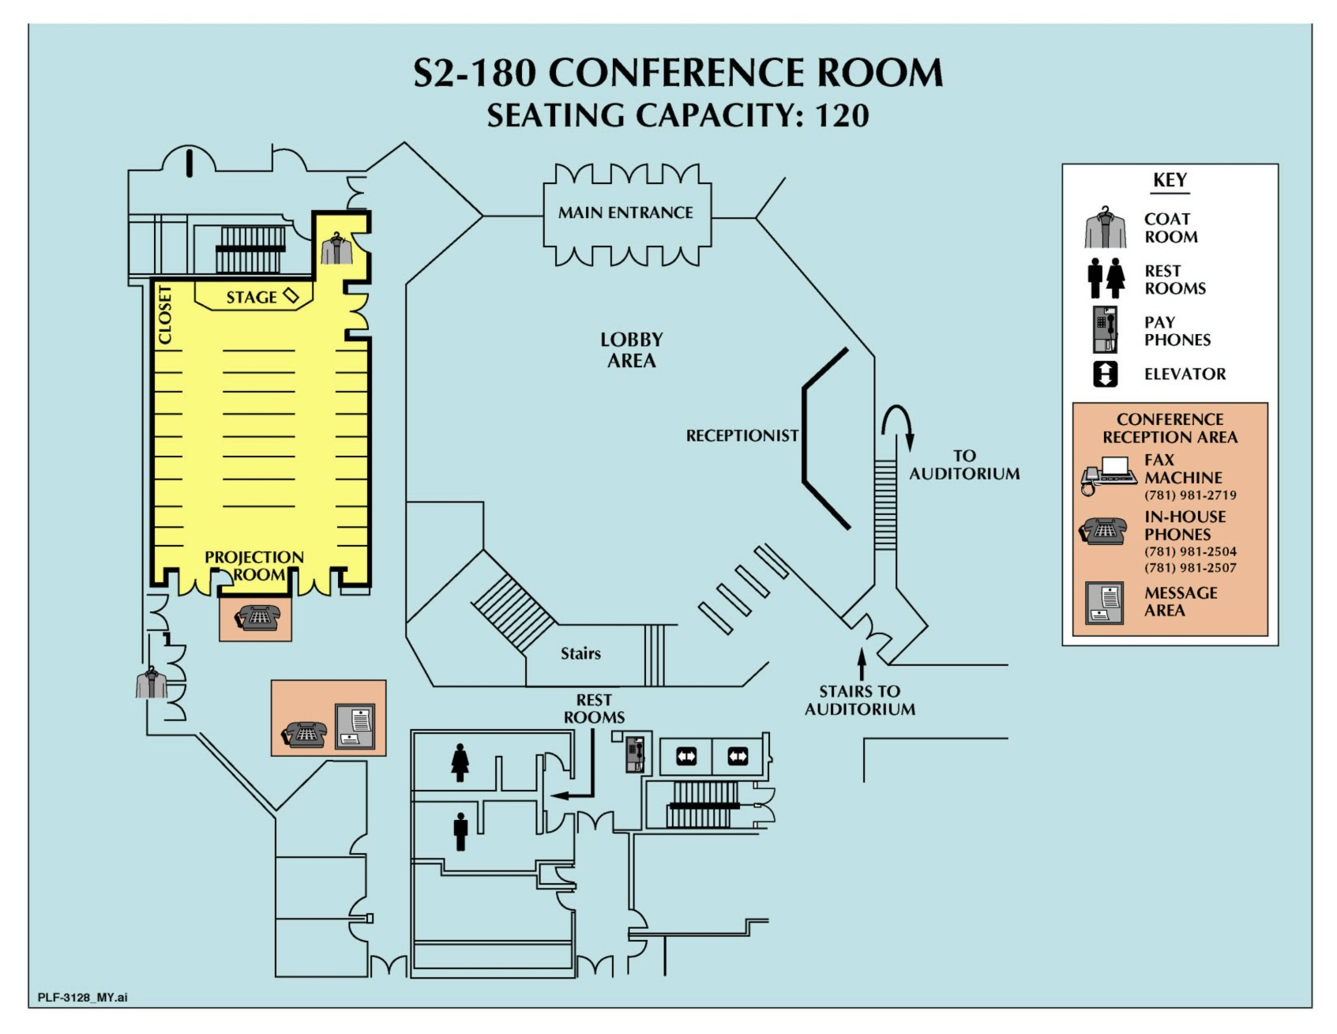
Focus Sessions in S2-180

Slide 7
Agenda Highlights
Day 1
Wednesday
15 September
Mission Keynote Address – Dr. Peter Lee / DARPA TCTO
Session 1: GPU Focus 1: Novel Technologies Poster / Demo A: GPU Technologies and Applications
Session 2: Many Core Processors Focus 2: U.S. Only & Networked Computing
Reception and Banquet (Burlington Marriott)
Banquet Presentation – Professor Rahul Sarpeshkar / MIT
Title: Analog and Bio-inspired Computation
Day 2
Thursday
16 September
Technology Keynote Address – Mr. Robert Bond / MIT Lincoln Laboratory
Session 3: Cloud Computing Focus 3: GPU Frameworks
Poster / Demo B: Cloud Technologies and Applications
Session 4: Awards Session
Panel: ISR Clouds

Slide 8
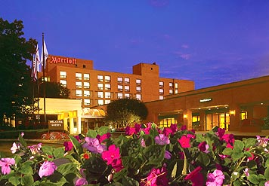
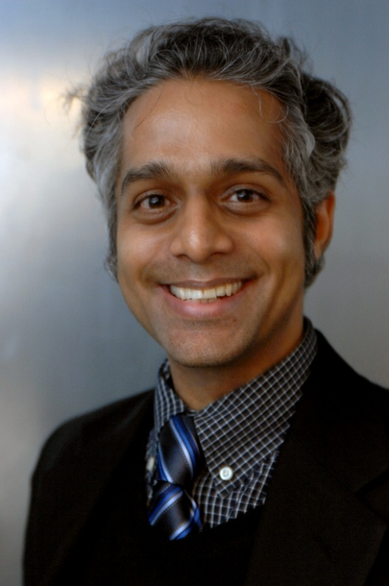
Banquet Speaker
Professor Rahul Sarpeshkar
Title: Analog and Bio-inspired Computation
Place: Burlington Marriott
Date: Wednesday, 15 Sept 2010
Time: 1800 – Reception
1830 – Speaker
1900 – Banquet
Notes:
James C. Anderson, JCA@LL.MIT.EDU, 6/16/08; public-domain info. from http://en.wikipedia.org/wiki/Richard_Stallman

