Slide 1
A Fault Tolerant Gaussian Elimination Solver for the Cell Broadband Engine
James Geraci
Lead Researcher
Square Enix Co., Ltd.
Research and Development Division

Slide 2
Introduction to Square Enix Group
Square Enix Group is a Japanese entertainment content/service developer and publisher.
Best known for following video game franchises.
FINAL FANTASY, DRAGON QUEST (SQUARE ENIX)
Tomb Raider (EIDOS)
Space Invaders (TAITO)
Approximately 3000 employees*1 and ¥135.6 billion*2 ($1.5 billion) in sales. *1 As of March 31, 2009 *2 FY2008
Develop for Nintendo DS, PSP, Xbox 360, Playstation 3, Wii, PC, iPhone, cell phones, etc….

Slide 3
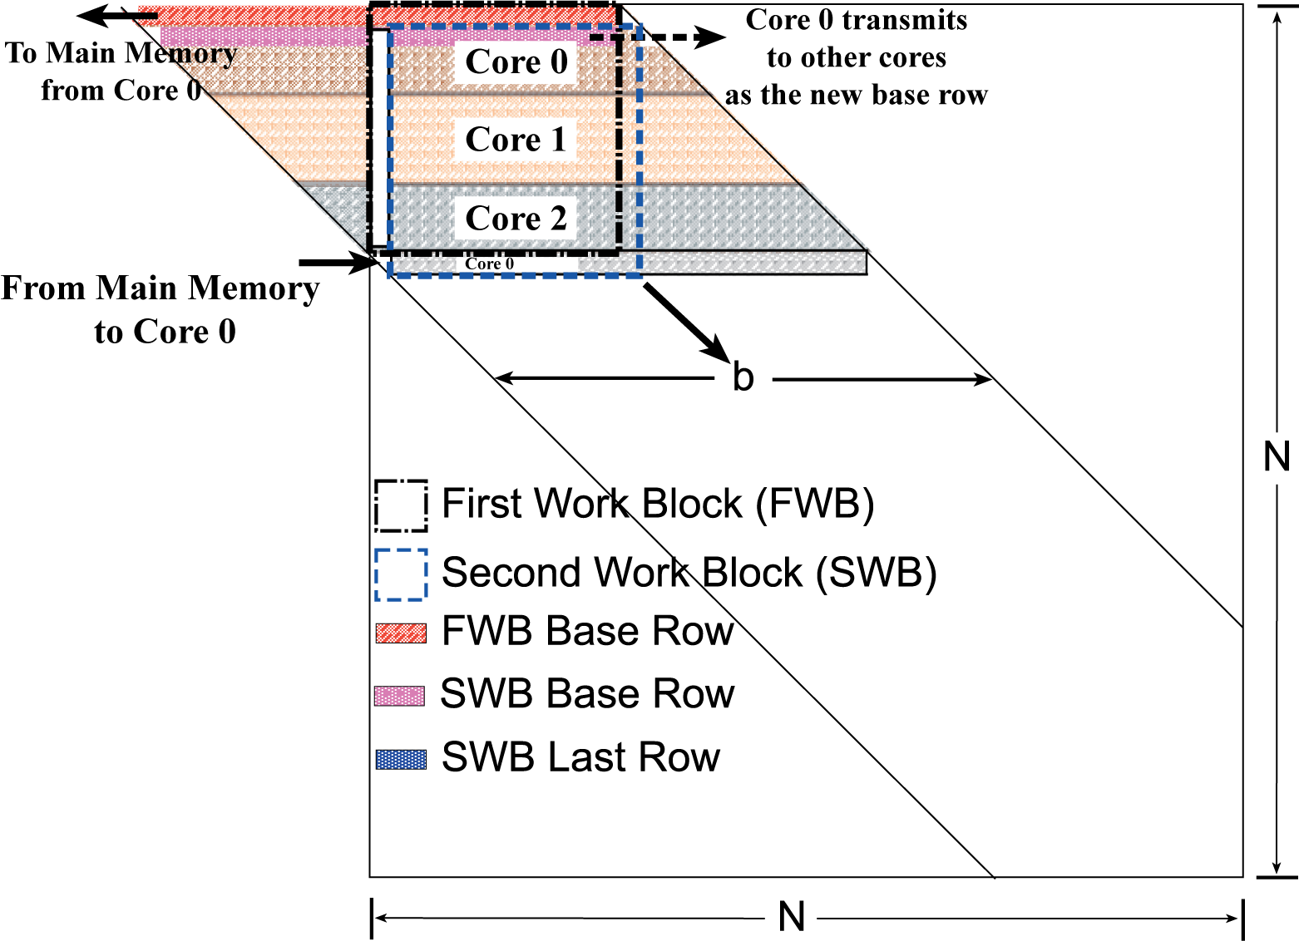
Fault tolerant Gaussian elimination
Fault tolerance idea is to back
up on-chip data into main memory
at checkpoints.
The algorithm’s natural serialization points
are used as checkpoints.
When a fault occurs, backed up data is used
to redistribute workload among remaining
cores.

Slide 4
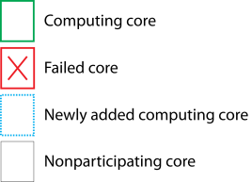
Fault Tolerance Capabilities
Fault Tolerance:
Core failures lead
to redistribution
of workload among
remaining cores
Addition of Cores:
Cores are added and
rows are dynamically
redistributed
Fault Tolerance
with Replacement:
N failed cores
are replaced
with M new cores

