Slide 1

Optimizing An Innovative SAR Post-Processing Algorithm for Multi-Core Processors
Peter Carlston,
Embedded Computing Division
Intel Corporation
Dave Murray,
N.A. Software Ltd.
1
Intel Proprietary

Slide 2
Legal Disclaimer
INFORMATION IN THIS DOCUMENT IS PROVIDED IN CONNECTION WITH INTEL® PRODUCTS. NO LICENSE, EXPRESS OR IMPLIED, BY ESTOPPEL OR OTHERWISE, TO ANY INTELLECTUAL PROPERTY RIGHTS IS GRANTED BY THIS DOCUMENT. EXCEPT AS PROVIDED IN INTEL'S TERMS AND CONDITIONS OF SALE FOR SUCH PRODUCTS, INTEL ASSUMES NO LIABILITY WHATSOEVER, AND INTEL DISCLAIMS ANY EXPRESS OR IMPLIED WARRANTY, RELATING TO SALE AND/OR USE OF INTEL PRODUCTS INCLUDING LIABILITY OR WARRANTIES RELATING TO FITNESS FOR A PARTICULAR PURPOSE, MERCHANTABILITY, OR INFRINGEMENT OF ANY PATENT, COPYRIGHT OR OTHER INTELLECTUAL PROPERTY RIGHT.
UNLESS OTHERWISE AGREED IN WRITING BY INTEL, THE INTEL PRODUCTS ARE NOT DESIGNED NOR INTENDED FOR ANY APPLICATION IN WHICH THE FAILURE OF THE INTEL PRODUCT COULD CREATE A SITUATION WHERE PERSONAL INJURY OR DEATH MAY OCCUR.
Intel may make changes to specifications and product descriptions at any time, without notice. Designers must not rely on the absence or characteristics of any features or instructions marked "reserved" or "undefined." Intel reserves these for future definition and shall have no responsibility whatsoever for conflicts or incompatibilities arising from future changes to them. The information here is subject to change without notice. Do not finalize a design with this information.
The products described in this document may contain design defects or errors known as errata which may cause the product to deviate from published specifications. Current characterized errata are available on request.
Contact your local Intel sales office or your distributor to obtain the latest specifications and before placing your product order.
Copies of documents which have an order number and are referenced in this document, or other Intel literature, may be obtained by calling 1-800-548-4725, or by visiting Intel's Web Site.
Performance tests and ratings are measured using specific computer systems and/or components and reflect the approximate performance of Intel products as measured by those tests. Any difference in system hardware or software design or configuration may affect actual performance. Buyers should consult other sources of information to evaluate the performance of systems or components they are considering purchasing. For more information on performance tests and on the performance of Intel products, visit Intel Performance Benchmark Limitations
All information provided related to future Intel products and plans is preliminary and subject to change at any time, without notice. All dates provided are subject to change without notice. Intel may make changes to specifications and product descriptions at any time, without notice.
Intel, Intel logo, Intel Core, and Xeon are trademarks or registered trademarks of Intel Corporation or its subsidiaries in the United States and other countries.
64-bit computing on Intel architecture requires a computer system with a processor, chipset, BIOS, operating system, device drivers and applications enabled for Intel® 64 architecture. Performance will vary depending on your hardware and software configurations. Consult with your system vendor for more information.
The code names Tigertown, Dunnington, and Nehalem, resented in this document are only for use by Intel to identify products, technologies, or services in development, that have not been made commercially available to the public, i.e., announced, launched or shipped. They are not "commercial" names for products or services and are not intended to function as trademarks.
* Other names and brands may be claimed as the property of others.
Other vendors are listed by Intel as a convenience to Intel's general customer base, but Intel does not make any representations or warranties whatsoever regarding quality, reliability, functionality, or compatibility of these devices. This list and/or these devices may be subject to change without notice.
Copyright © 2009, Intel Corporation. All rights reserved.
2
Intel Proprietary

Slide 3


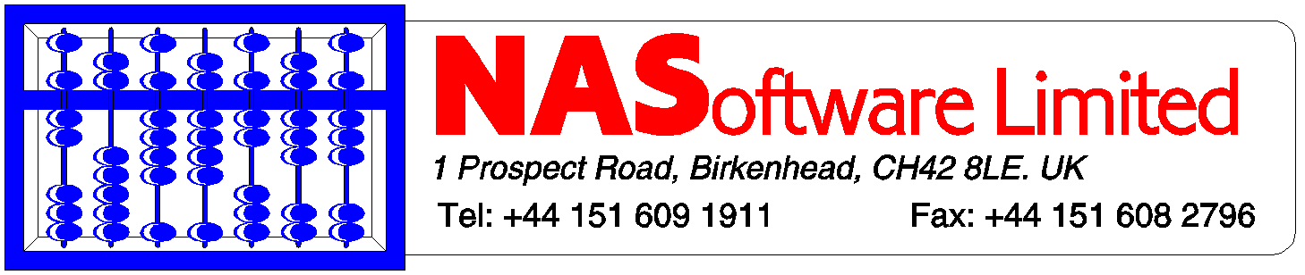
Optimizing SARMTI for Multi-Core Processors
A major US defense contractor asked NA Software, Ltd*. and Intel’s Embedded Computing Division to multi-thread and evaluate an innovative SAR post-processing algorithm
    “SARMTI” developed by Dr. Chris Oliver, CBE, of InfoSAR*
    Identifies slow-/fast-moving targets from existing SAR data – no need for MTI radar
Goals:
  Phase 1: How will the original, serial algorithm scale across multiple processor cores when it is multi-threaded?
  Phase 2: Can moving targets be detected, motions derived, and objects registered on a background SAR image in near real-time?
Intel® and the Intel logo are registered trademarks of Intel Corporation in the United States and other countries
* Other names and brands may be claimed as the property of others
3
Intel® and the Intel logo are registered trademarks of Intel Corporation in the United States and other countries
* Other names and brands may be claimed as the property of others

Slide 4
Existing SAR and MTI Algorithms
SAR
  Excellent along-track resolution -- ~1m
  Moving targets degrade result
MTI
  Poor along-track resolution >100m
  Good at identifying fast moving targets, but slow targets and ground clutter degrade result
  Current “integrated” systems switch between SAR and MTI – require human analysis, several passes
Existing SAR and MTI algorithms are both sub-optimal
4

Slide 5


New SARMTI Algorithm from
InfoSAR*
Moving Target
Position
Actual
SAR calc.
SARMTI calc.
o
Existing SAR:
Moving targets are both shifted and blurred
•
o
o
o
o
o
After SARMTI applied to same SAR data: Targets detected (red circles) in correct positions within one SAR resolution cell
Corresponding motions are also derived
Across-track acceleration and along-track velocity in addition to across-track velocity measured in typical MTI systems
o
o
o
o
o
5
* Other names and brands may be claimed as the property of others

Slide 6
Multi-Threading: Round 1
PPC code ported to IA
Gnu* ‘gprof’ used to determine time spent in each function (“hot spots”)
Multi-threaded compression and detection phases
Restructured calls to most used target detection functions
  Only a few calls—all in initial stage
Round 1 gprof Results
Time % | Operation
30.48 | DETECTION.
53.07 | FFTW Calls
11.22 | OTHER COMPRESSION.
2.04 | DATA EXTRACTION
96.81 % | Total
6
* Other names and brands may be claimed as the property of others

Slide 7
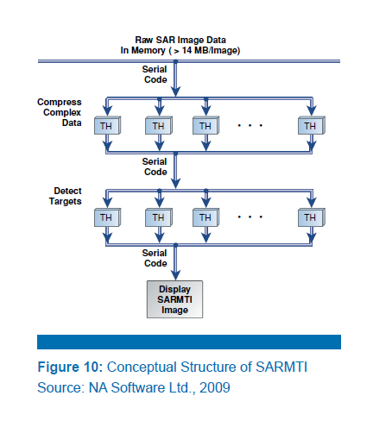
SARMTI: Multi-Threaded Structure
Raw SAR image (>14MBytes) loaded into memory
Serial processing for set-up, synchronization and image display)
Data tiles processed independently on each core (thread)
    Avoid ‘cache thrash’: Be careful to use localized memory for each thread
    Processor (Core) Affinity vs letting Linux dynamically place each process on least-loaded core
      Load very balanced load either way. Went with Linux* for maximum portability
7
Intel® and the Intel logo are registered trademarks of Intel Corporation in the United States and other countries
* Other names and brands may be claimed as the property of others
Notes:
MP X7460, each with 6 cores running at 2.66 GHz,

Slide 8
Test Scenarios
Test Scenario | Description
run_sarmti_test1 | Uniform background with no targets
run_sarmti_test2 | Uniformed background with 10 moving targets
run_sarmti_test3 | Structured background with no targets
run_sarmti_test4 | Structured background with 10 moving targets
8
Intel® and the Intel logo are registered trademarks of Intel Corporation in the United States and other countries
* Other names and brands may be claimed as the property of others

Slide 9
Compilers: Gnu vs Intel® C++ Compiler for Linux*
gcc: Gave better results on FFTW* libraries
  FFTW libraries developed and optimized using gcc
But overall SARMTI had very similar processing times with either compiler
Compiler Option | Scenario 1 | Scenario 2 | Scenario 3 | Scenario 4
SARMTI code = gcc FFTW code = gcc | 7.74 secs | 9.9 secs | 7.4 secs | 13.9 secs
SARMTI code = icc FFTW code = gcc | 7.86 secs | 10.1 secs | 7.5 secs | 14.1 secs
SARMTI code = icc FFTW code = icc | 10.25 secs | 13.4 secs | 9.7 secs | 18.9 secs
SARMTI code = gcc FFTW code = icc | 9.75 secs | 13.1 secs | 9.3 secs | 18.5 secs
9
Intel® and the Intel logo are registered trademarks of Intel Corporation in the United States and other countries
* Other names and brands may be claimed as the property of others

Slide 10
Multi-Threading: Round 2
‘gprof’ rerun – remaining ‘hot spots’:
  54% FFTW Calls
  26% Target detection
  13% Data compression
  2.5% Data Extraction
FFTW Library replaced by Intel® Math Kernel Library
  Vector Math functions
  “fftw wrappers”
 | Scenario 1 | Scenario 2 | Scenario 3 | Scenario 4
C vector code time | 6.9 secs | 9.3 secs | 6.9 secs | 12.8 secs
MKL Vector Library time | 6.4 secs | 8.5 secs | 6.1 secs | 11.8 secs
MKL library speed up | 7.2% | 8.5% | 11.6% | 7.8%
MKL FFT Speed up | 10.8% | 6.1% | 6.8% | 7.9%
Total MKL Speed up | 18.0% | 14.7% | 18.4% | 15.7%
Note: Timings are for a 4x 4C “Tigertown” processor system, but MKL speed-up percentages
on “Dunnington” and “Nehalem” systems are similar
10
Intel® and the Intel logo are registered trademarks of Intel Corporation in the United States and other countries
* Other names and brands may be claimed as the property of others

Slide 11
Threaded Performance Speed-Up: 4x
“Tigertown” Processor System
– 16 Physical Cores, 16 HW Threads per system
Test Case | Intel® Xeon® Processor | Serial Time (sec) | ThreadedTime | Speed Up 0T→16T
 |  |  | 16 Cores
1 | 4x TGR | 85 | 6.4 | 13.3X
2 | 4x TGR | 120 | 8.5 | 14.1
3 | 4x TGR | 104 | 6.1 | 17.0
4 | 4x TGR | 166 | 11.8 | 14.1
Serial to 16-Thread Speed Up: 13-17X -- Approaches # of Cores
4x Intel® Xeon® L7345 Processors (“Tigertown”) 4 Cores each @ 1.86 GHz each; 8MB L2 Shared Cache; 1 Thread/Core (See configuration information in Backup)
11
Intel® and the Intel logo are registered trademarks of Intel Corporation in the United States and other countries
* Other names and brands may be claimed as the property of others
Notes:
MP X7460, each with 6 cores running at 2.66 GHz,

Slide 12
Threaded Performance Speed-Up: 4X
“Dunnington” Processor System
-- 24 physical cores, 24 HW Threads
Test Case | Intel® Xeon® Processor | Serial Time (sec) | Time (seconds) per Hardware Cores/Threads |  |  |  |  |  | Total Speed Up 0→ 24T | Speed Up 1→24T
 |  |  | 1 | 2 | 4 | 8 | 16 | 24
1 | 4x DUN | 85.4 | 37.0 | 18.8 | 9.9 | 4.9 | 3.6 | 2.2 | 38.8X | 16.8X
2 | 4x DUN | 120.2 | 47.9 | 24.6 | 12.9 | 6.7 | 4.8 | 3.1 | 38.8X | 15.5X
3 | 4x DUN | 104 | 35.6 | 18.3 | 9.6 | 4.8 | 3.5 | 2.1 | 49.5X | 17.0X
4 | 4x DUN | 166.2 | 67.1 | 33.9 | 17.8 | 9.6 | 6.6 | 4.4 | 37.8X | 15.3X
Single Threaded to Multi-Threaded Speed Up: 37-49X
1 Thread to 24 Thread Speed Up: 15-17X
4x Intel® Xeon® MP X7460 Processors (“Dunnington”) 6 Cores each @ 2.686 GHz,
16 MB Shared L2 Cache 1 Thread/Core (See configuration information in Backup)
Note that “Dunningtons” are pin-compatible with “Tigertowns”
12
Intel® and the Intel logo are registered trademarks of Intel Corporation in the United States and other countries
* Other names and brands may be claimed as the property of others

Slide 13
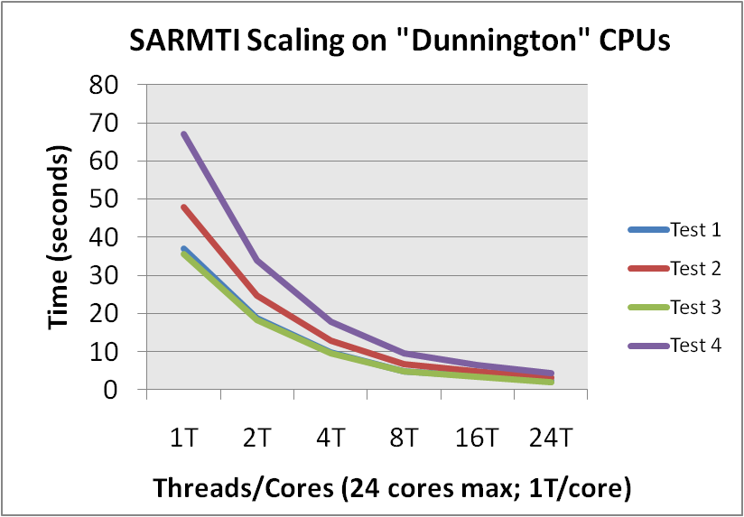
Performance Scaling/Core: 4x 6 Core “Dunnington”
Intel processors’ large L2 caches are a major factor in the high performance of this application/workload
Gain % slows > 8 threads, but is still significant overall
  Different portions of the algorithm use differently sized data sets, whose sizes change dynamically as the geometry changes. Some of the data sets do not thread as efficiently across 16 or 24 cores
13
Intel® and the Intel logo are registered trademarks of Intel Corporation in the United States and other countries
* Other names and brands may be claimed as the property of others

Slide 14
Threaded Performance Speed-Up: 2x
“Nehalem” Processor System
– 8 Physical Cores, 16 HW Threads
Test Case | Intel® Xeon® Processor | Time (seconds) per Hardware Cores/Threads |  |  |  |  |  | Speed Up 1T→8 T | Speed Up 1T→16T
 |  | 1 | 2 | 4 | 8 | 16 | 24
1 | 2x NHL | 29.04 | 15.28 | 7.87 | 4.77 | 4.26 | 4.19 | 6.1X | 6.8X
2 | 2x NHL | 36.93 | 19.29 | 10.04 | 6.31 | 5.4 | 5.61 | 5.8X | 6.8X
3 | 2x NHL | 27.95 | 14.69 | 7.57 | 4.43 | 4.03 | 4.16 | 6.3X | 6.9X
4 | 2x NHL | 53.5 | 27.45 | 14.15 | 7.5 | 7.4 | 7.73 | 7.1X | 7.2X
1 Thread to 8 Thread Speed Up: 6-7X
Very Little Gain From Second HW Thread/Core
24 thread time worse because some cores are running > 2 threads
2x Intel® Xeon® DP X5570 Processors (“Nehalem-EP”) 4 Cores each @ 2.93 GHz,
2 Threads/Core (See Configuration information in Backup)
14
Intel® and the Intel logo are registered trademarks of Intel Corporation in the United States and other countries
* Other names and brands may be claimed as the property of others

Slide 15
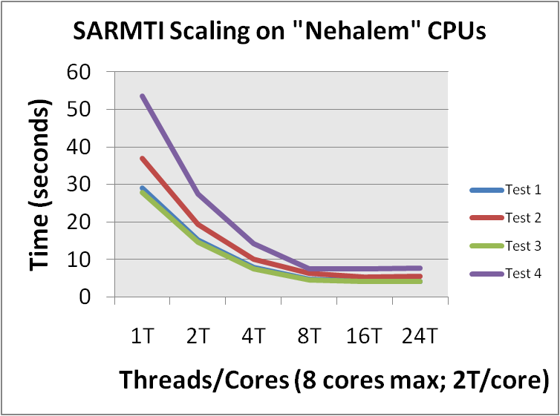
Threaded performance speed up: 2x
4 Core “Nehalem”
Intel processors’ large L3 caches are a major factor in the high performance of this application/workload
Some of the data sets do not thread efficiently across 16 or 24 cores. Timings for 24 threads are slightly higher because max HW threads on this system is 16
15
Intel® and the Intel logo are registered trademarks of Intel Corporation in the United States and other countries
* Other names and brands may be claimed as the property of others

Slide 16
Performance / SWAP Comparison
CPU | Test 4 Time (seconds) |  |  | Processor Maximum Thermal Design Power | Deltas
 |  |  |  |  | Core Speed | 8T Time | 16T Time | 24T Time | Max TDP | System Size
 | 8T | 16T | 24T
Tigertown |  | 11.8 |  | 4X 50 = 200W
Nehalem | 7.5 | 7.4 |  | 2x 95 = 190W | 63% faster |  | 63% faster |  | 5% cooler | 75% smaller
Dunnington | 9.6 | 6.6 | 4.4 | 4x 130 = 520W
Nehalem | 7.5 | 7.4 | 7.73 | 2x 95 = 190W | 9% faster | 22% faster | 11% slower | 44% slower | 273% cooler | 75% smaller
Nehalem | 4x Forthcoming
4-socket Dunnington system: fastest overall time
Nehalem microarchtecture far more efficient core for core
16
Intel® and the Intel logo are registered trademarks of Intel Corporation in the United States and other countries
* Other names and brands may be claimed as the property of others
Notes:
MP X7460, each with 6 cores running at 2.66 GHz,

Slide 17
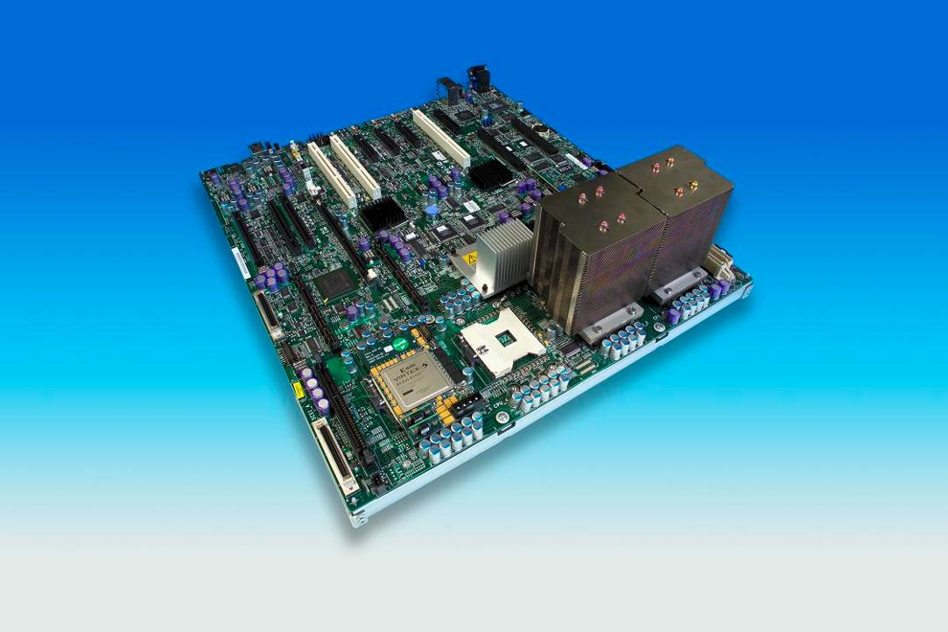
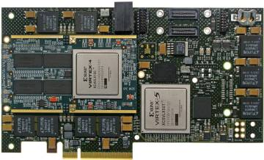
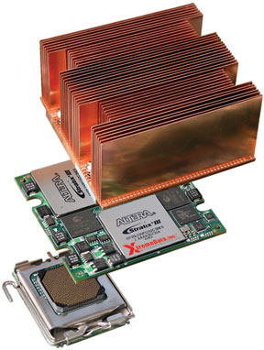
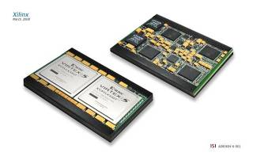

Tightly Coupled FPGA accelerators – Front Side (Processor) Bus
Phase 2 Study
Offload FFTs and other parts of SARMTI to FPGA(s)
  Xilinx* FPGAs/Nallatech* PCIe and In-Socket Accelerator Modules
  Altera* FPGAs/XtremeData* In-Socket Accelerator Modules
Demonstrate effectiveness of Intel® QuickAssist Acceleration Abstraction Layer (AAL)
Loosely Coupled FPGA accelerators -- PCIe
Results: <1s times achievable
17
Intel® and the Intel logo are registered trademarks of Intel Corporation in the United States and other countries
* Other names and brands may be claimed as the property of others
Notes:
XDI is currently shipping Altera-based modules
Nallatech is currently shipping Xilinx-based modules

Slide 18
Intel® QuickAssist Acceleration Abstraction Layer
Low level software runtime layer
Service Oriented Architecture (SOA)
  Publish/Request service model: database of acceleration functions
  Virtualizes accelerators: multiple calls operate seamlessly
  Implements system-wide resource aggregation and sharing policies
Abstracts hardware details from application
  Optimizes memory interaction between accelerators and operating system
  Provides dynamic interface binding to acceleration packages
  Dynamically reconfigures FPGAs
Handles all types of accelerated workloads
  Data parallel and/or task parallel
  Asynchronous programming model: optimized for concurrent task processing
  Very large to small data sets; streaming data
Designed to be compatible with existing software development frameworks
Intel® and the Intel logo are registered trademarks of Intel Corporation in the United States and other countries
* Other names and brands may be claimed as the property of others
Notes:
9/17/2009
18
AAL defines a set of platform services that facilitate the integration of accelerators into Intel® platforms
- It is not compiler or language extensions
It does this by defining common service level APIs that:
Define a common programming model
e.g.
How data is presented to/from the accelerator (e.g., workspace optimized for zero copy transfers)
Policies for memory management & exception handling
Message exchange (e.g., async callbacks)
Independent of the acceleration workload
Appropriate for a large variety of usage models and use cases across a spectrum of markets
We expect that AAL will not be used in isolation.
Must compatible with thing like MPI, OpenMP, Quantlib, .NET etc…

Slide 19
AAL Conceptual Model
Digital Signal Processing Application(s)
Domain Accelerator Libraries
(Intel® Performance Primitives, FPGAlib, etc.)
AAL Service API
Acceleration Abstraction
Service Layer
AFU
Proxy
AFU
Proxy
AFU
Proxy
Physical Interconnect
Protocol
WS₀
WS₁
WS₂
WS₃
WS₄
System
Memory
Accelerator
Module 0
FSB-FPGAs
Accelerator
Module 1
PCIe-FPGAs
Physical
Interconnect Protocol
AFU 0
AFU 1
Accelerator
Module2
QPI-FPGAs
AFU 2
Accelerator
Module 3
CPU DSP
Libraries
AFU 3
Accelerator
Module 4…
….
AFU 4
Accelerator
Module 4…
….
Accelerator
Module 4…
….
AFU: Acceleration Functional Unit
WS: Workspace in coherent, shared
system memory
Under Investigation
Intel Plan of Record
19
Intel® and the Intel logo are registered trademarks of Intel Corporation in the United States and other countries
* Other names and brands may be claimed as the property of others
Notes:
As Figure 1 shows, the AAL does not define domain-specific libraries or functions. Instead, it provides consistent interfaces that existing libraries and frameworks can use to interface to hardware accelerator modules. Developers can use the programming languages, libraries, and software development environments they already know.
AAL provides platform level services for basic system operations such as discovery, binding, transport, and exception handling. AAL also provides services for the use of shared system memory as an efficient means of passing data between the host and accelerator. Unnecessary memory-to-memory copies are eliminated and memory is efficiently mapped between the virtual address space used by the host CPU and the physical address space used by the FPGA accelerator.
The AAL has two major components: a common Unified Accelerator Interface (UAI) and Accelerator Abstraction Services (AAS). These provide access to the algorithms that enable accelerated performance encryption, very large Fast-Fourier Transforms (FFTs), complex FIR filtering, and so on - without the need for application programmers to delve into the minutiae of a specific accelerator's architecture.
19

Slide 20
Backup
20
Intel Proprietary

Slide 21
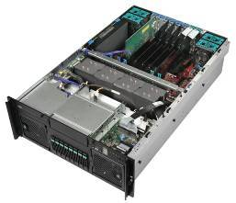
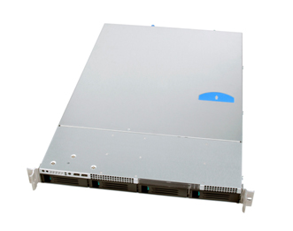
SARMTI POC Configurations
Intel® SFC4UR “Foxcove” 4-processor system --4U Rack Mount Server
  Four Intel Xeon® Processors L7345 (“Tigerton”) – 4 cores each @ 1.86 GHz; 8MB L2 cache 50W Max Thermal Design Power each
  Four Intel Xeon Processors MP X7460, 6 cores each @ 2.66 GHz, (“Dunnington”); 16MB L3 cache. 130W Max Thermal Design Power
  1066 MHz Front Side Bus
  16 MB 667-MHz FBDIMMs
Fedora* release 8 (Werewolf*) for x86_64 architecture (Linux* 2.6.23 kernel)
gcc 4.1.2, flags: -O3 –Xt –ip –fno_alias –fargument-noalias
Intel Math Kernel Library version 10.0
Intel® SR1625 “Petrof Bay 2-processor server – 1U Rack Mount Server
2 x Intel® Xeon Processors X5570 (“Nehalem-EP”) 4 cores each @ 2.93 GHz; QPI: 6.4 G transfers per second, 8M L2 Cache per processor 95W Max Thermal Design Power per processor
12 MB 1333MHz Registered ECC DDR3
SCSI HARDDRIVE Seagate 146GB Savio 10k RPM SAS 2.5in SFF
NUMA Optimized [Enabled] in BIOS
Frequency scaling off: /sbin/service cpuspeed stop
Centos 5.3 el5_x86_64 (RHEL) (Linux* 2.6.18 kernel)
gcc 4.1.2, flags: -O3 –Xt –ip –fno_alias –fargument-noalias
Intel Math Kernel Library version 10.2
Intel Integrated Performance Primitives 6.1
Intel® QuickAssist Technology Accelerator Abstraction Layer White Paper:
http://download.intel.com/technology/platforms/quickassist/quickassist_aal_whitepaper.pdf
21
Intel® and the Intel logo are registered trademarks of Intel Corporation in the United States and other countries
* Other names and brands may be claimed as the property of others

