Slide 1
Modeling Singular Valued Decomposition (SVD) Techniques using Parallel Programming with pMATLAB
Miguel Goenaga (Presenter)
Carlos J. González,
Inerys Otero
Juan Valera
Domingo Rodríguez, Advisor
University of Puerto Rico at Mayaguez
HPEC 2009
September 22, 2009

Slide 2
Problem Formulation
This work seeks the decomposition of a circulant matrix with circulant blocks using pMATLAB for filtering operations on hyperspectral images.
Previous Work
Singular value decomposition transform with and FFT-based algorithm on the Connection Machine CM5 [1].
Kronecker products and SVD approximations in image restoration [2].
Effective algorithms with circulant-block matrices [3].
Solution Approach
Given a circulant block matrix A, it is desirable to solve for the following proposition [1]:
The SVD of an N²-by-N² circulant block matrix A is formulated according to [1]:
HPEC 2009

Slide 3
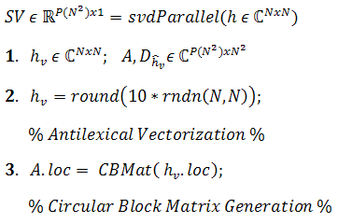
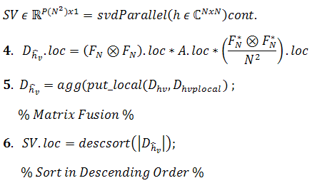
Implementation Results
Mathematical Model Approach
A Kronecker product commutation property from [4] was used to arrive at the model:
The following transformation was obtained:
The modeling formulation for SVD computation is presented as follows :
Computational Parallel Pseudo-Algorithm
HPEC 2009

Slide 4
Performance Results
pMATLAB Contributions:
Parallelized calculation of the circulant matrix with circulant blocks.
Parallelized matrix multiplications and the use of Kronecker products.
References:
[1] Cao-Huu, T. and Evequoz, C. “Singular value decomposition transform with and FFT-based algorithm on the Connection Machine CM5,” Electrical and Computer Engineering Canadian Conference, CCECE, vol. 2, pp.1046-1049, Sept. 5-8, 1995.
[2] Kamm, J. and Nagy, J. “Kronecker product and SVD approximations in the image restoration”, Linear Algebra and its Applications, vol. 284, iss. 1-3, pp. 177-192, November 15, 1998.
Figure 1: Execution time comparison between SVDs using a serial algorithm and the pMATLAB environment with Np=2 and Np=4.
[3] Rjasanow, S. “Effective Algorithms With Circulant-Block Matrices,” Linear algebra and its applications, vol. 202, pp. 55-69, 1994.
[4] Van Loan, C. F. “The ubiquitous Kronecker product,” Journal of Computational and Applied Mathematics, vol. 123, iss. 1-2, pp. 85-100, November 2000.
HPEC 2009

