Slide 1



Low Power Silicon Microphotonic Communications for Embedded Systems
Michael R. Watts
Anthony L. Lentine, Douglas C. Trotter, William A. Zortman,
Ralph W. Young, G. Robertson, David Campbell, Subhash Shinde, and Rex Kay
High Performance Embedded Computing (HPEC) Workshop
MIT Lincoln Labs
September 22nd, 2009
Sandia National Labs, Albuquerque NM
Applied Photonic Microsystems
Sandia is a multiprogram laboratory operated by Sandia Corporation, a Lockheed Martin Company,
for the United States Department of Energy’s National Nuclear Security Administration
under contract DE-AC04-94AL85000.

Slide 2
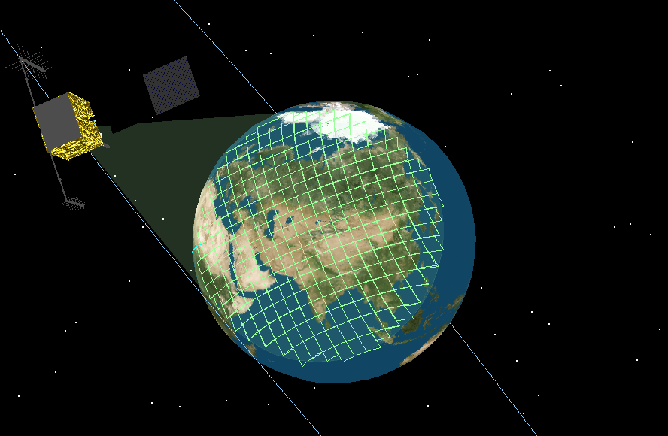
Motivation: Sandia FPA Development
“See everything, everywhere, always, and do it fast”
Develop new focal plane array (FPA) architectures and key enabling technologies in preparation for the future production of advanced very large, high pixel count, very high sample rate FPAs for full earth persistent monitoring, fast event detection and national security missions.
Emphasis on preserving transient information of interest while suppressing an enormous volume of background data
Sandia’s remote sensing systems are not used for imaging, but rather for transient signal detection, recording, and processing
Notes:
2

Slide 3
Why are Large FPAs Important
Wide Field of View ➔ Large Focal Plane Array
High Resolution ➔ High Pixel Density

Slide 4
Large Arrays Through 3D Stacking
Signal Processing Utilized to Decimate the Data

Slide 5
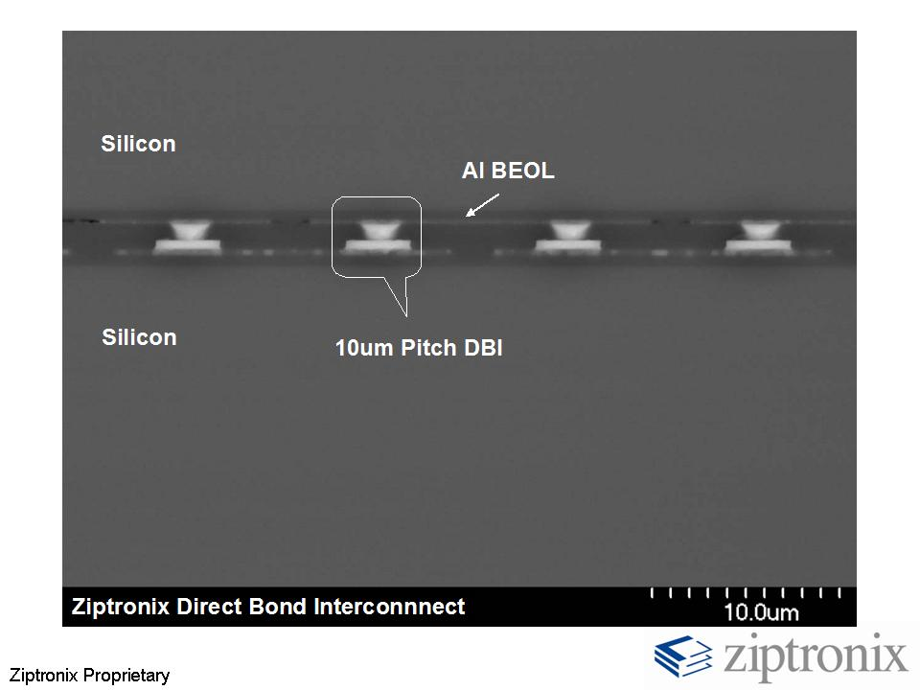
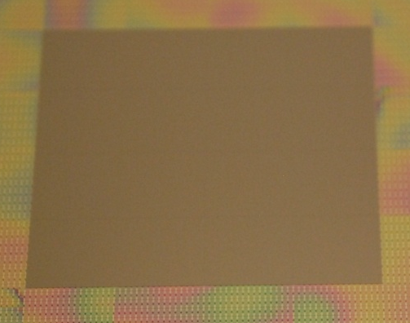
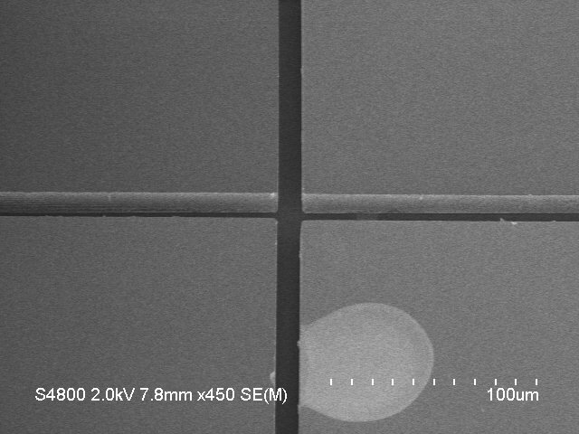
The Tiling Process
Tiled Assembly before Planarization
Large Wafer Saw Gaps are visible
Planarize
Wafer saw
Precision Bosch Etch
Direct Bond Interface
Oxide-Oxide Bonds Form Interface
Precision Bosch Etch Tiles
10um +/2um gaps

Slide 6
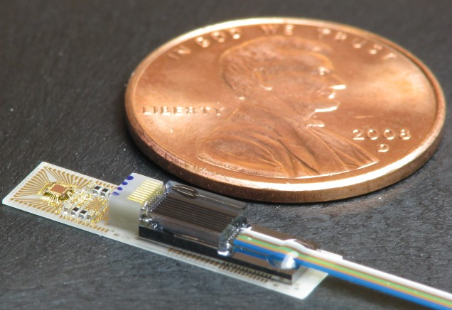
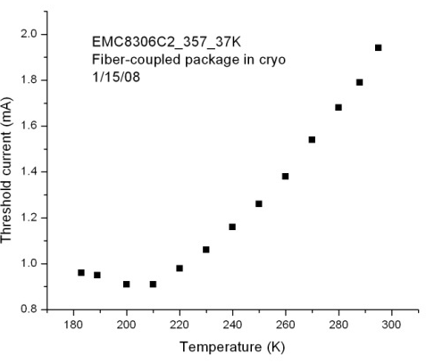
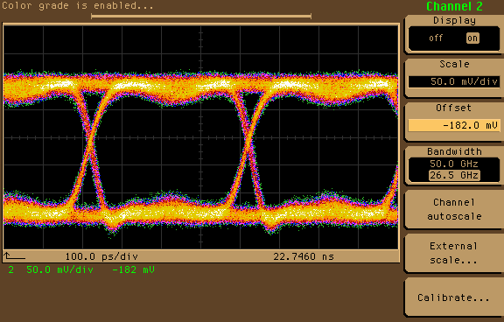
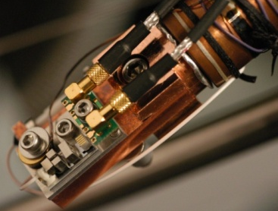
Off-Chip Optical Communications
Optical Communications (D. Serkland, G. Keeler et al., Sandia)
  VCSEL-Based Communications Optimized to Operate at 200K
  Mux/Driver function demonstrated at 4.5mW/channel at 3Gb/s, considerably lower than commercial results
  (Note: Result does not include clock recovery)
Cold Probe

Slide 7
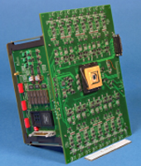
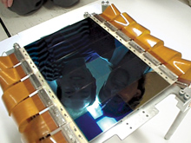
Large, High-Speed Imaging Arrays?
Sandia’s systems do not image, but rather look for transient signal detection so much of the data can be reduced, solution is managable
Imagers: Large, High-Speed Imaging Arrays (Ex. from MIT Lincoln Labs)
Canada-France-Hawaii-Telescope: 100M Pixels
High Speed Camera: 2MFrames/sec, 16k Pixels

Slide 8
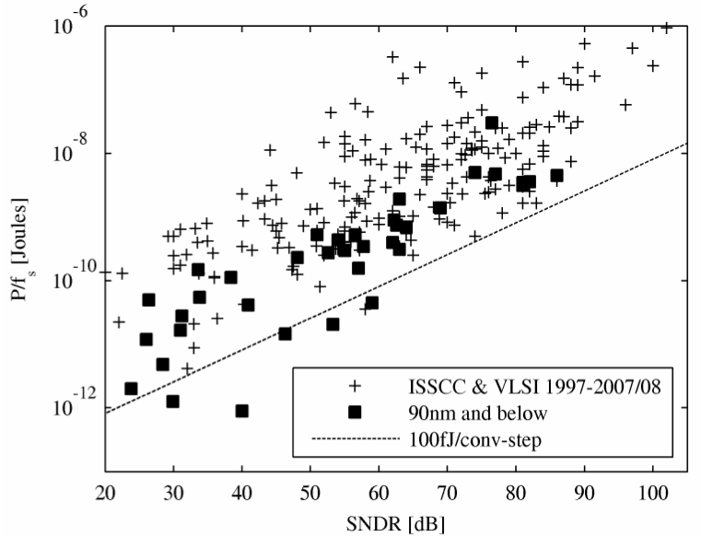
Limits to Large, High-Speed Imagers
Assume: 100MPixel@100kFrames/sec @10-bits ➔ 100Tb/s
Analog-to-Digital Converter Power: 100fJ/bit, trending down (10W@100Tb/s)
Communications Power: Electrical and traditional optical communications consume ~30-to-40pJ/bit. At 100Tb/s ➔ 3-to-4kW of power
Communications Bandwidth: At 10Gb/s/line ➔ 10,000 lines
Consider weight, thermal conductance, EMI, etc.
B. Murmann, “A/D Converter Trends: Power Dissipation,
Scaling and Digitally Assisted Architectures”

Slide 9
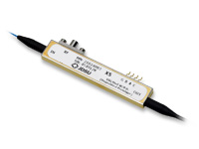
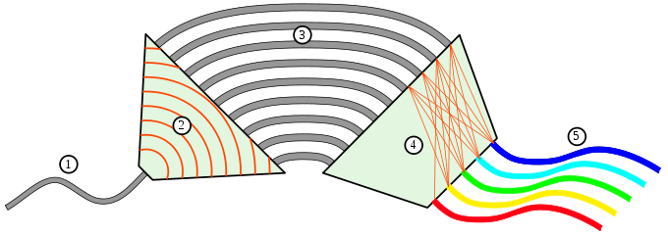
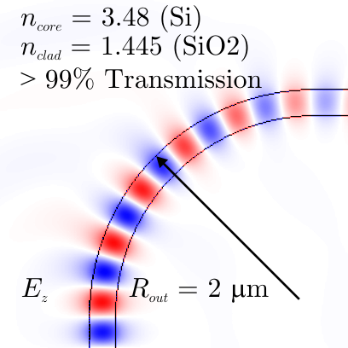
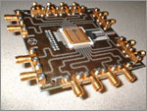
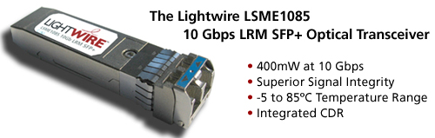
Silicon Photonics
Telecom Networks: Achieve terabit/s data-rates down a single fiber, but
are constructed of high-power, macroscopic components . . .
λ₁, λ₂, . . . λ_{N}
Silicon Enables High Index Contrast (Metallic-like) → Tight Confinement
  Sharp, Low-Loss Bends → Large Free-Spectral-Range (Tb/s/fiber)
  Dense Integration (shrinking PLCs by a factor of 1-Million)
  Ultra-compact resonators → low power consumption
  Photonics can be directly, or nearly directly with CMOS
Luxtera

Slide 10
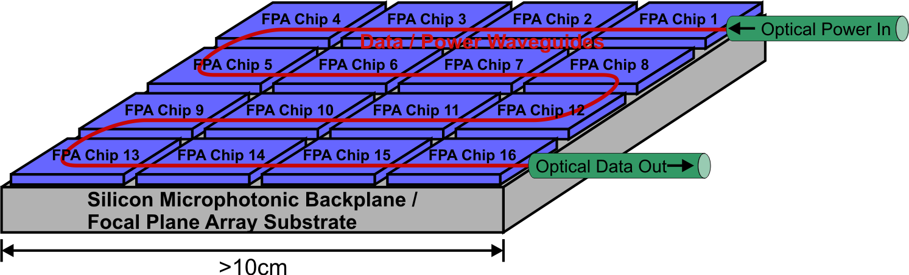
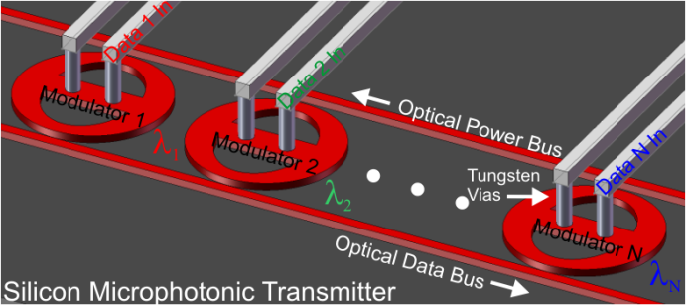
Consider: Silicon Optical Backplane
Solution: A Silicon Microphotonic Backplane
  Communications Power: 100-Tb/s @1pJ/bit (100W)
  Bandwidth Density: 1 WDM silica fiber carries as much info. as 100 metal lines
  Electromagnetic Interference: Eliminated, direct connections from optics to CMOS
  Optical Packaging: Direct leverage of mature and scalable electronic packaging

Slide 11
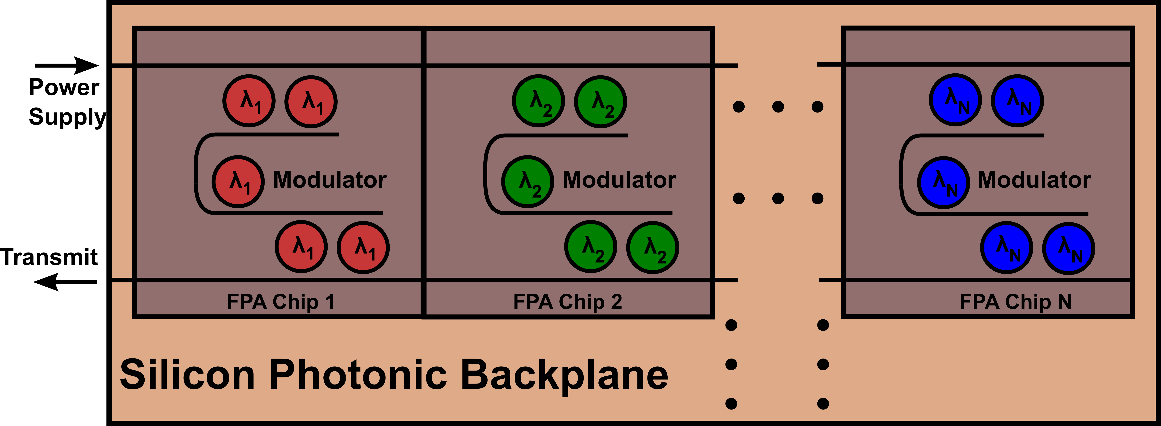
Silicon Photonic Backplane: In Detail
Components
Wavelength Division Multiplexing (WDM) / Filtering
Low Power Modulators
Fabrication / Temperature Invariant Performance
Low-Loss Waveguides
Low Power Detectors (for receive-side)
For Space Applications, Radiation Hard CMOS

Slide 12
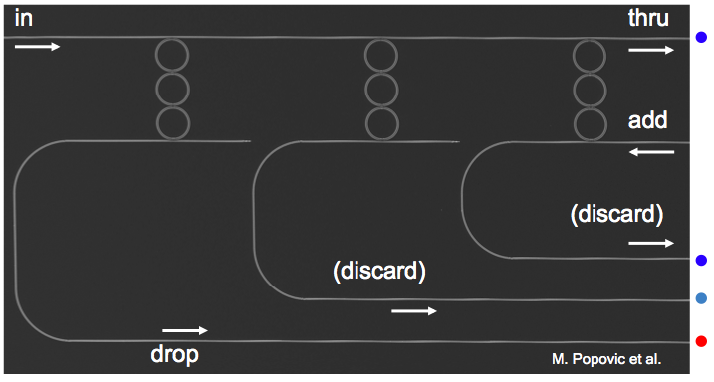
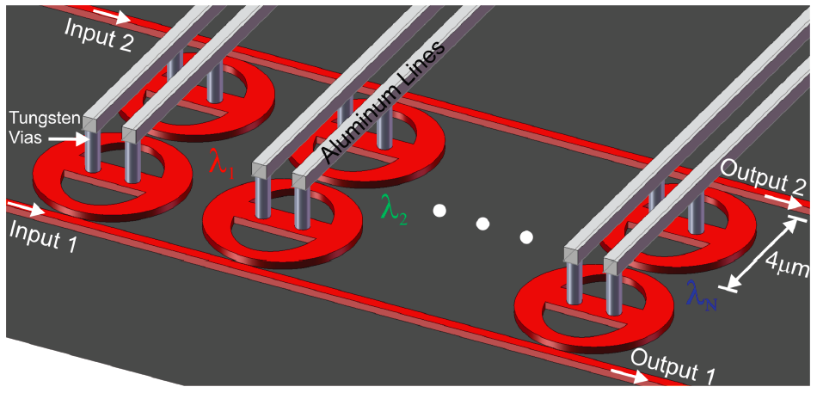
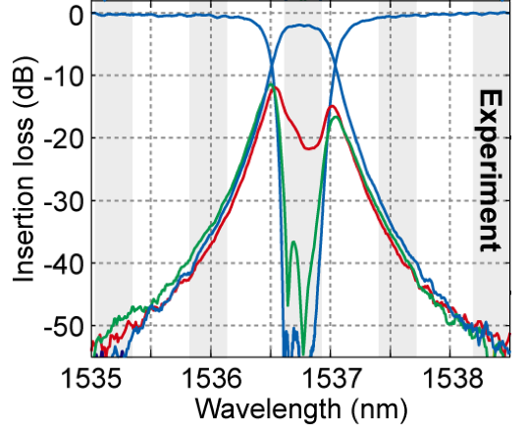
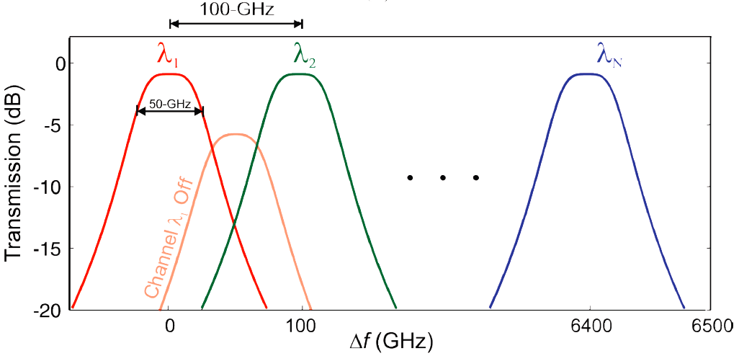
WDM Filtering: High-Order Microrings
High Order Microring Filters in Si/SiN
MIT Work, Haus, Ippen, Smith, Kaertner Groups

Slide 13
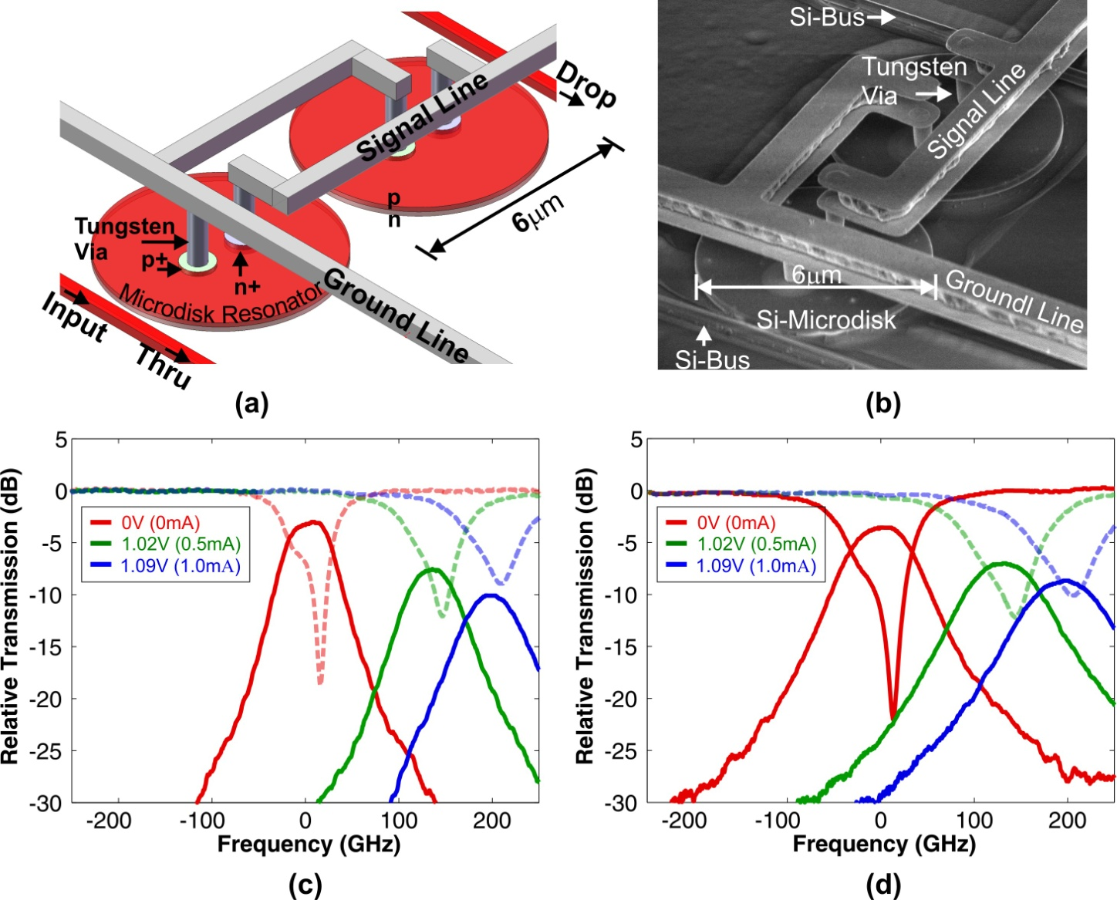
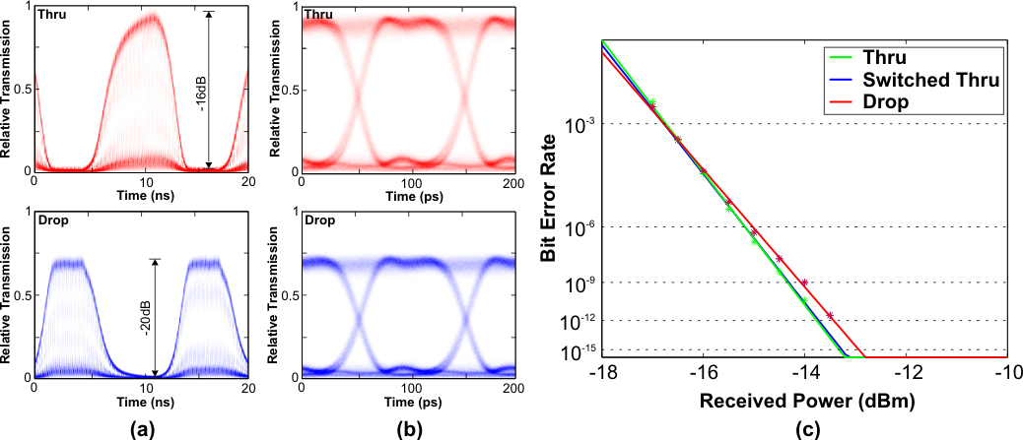
WDM Filtering: High-Speed WDM Switch
Switch Results
  Data switched error-free (BER<10⁻¹²) with little power with ~2ns rise time
  Power penalty measured to be <0.4dB in Drop Port and <0.1dB in Thru Port
  Driven with ~0.6V (~1V due to reflection), so CMOS compatible
M. R. Watts et al., OFC Postdeadline Presentation (Feb. 2008)

Slide 14
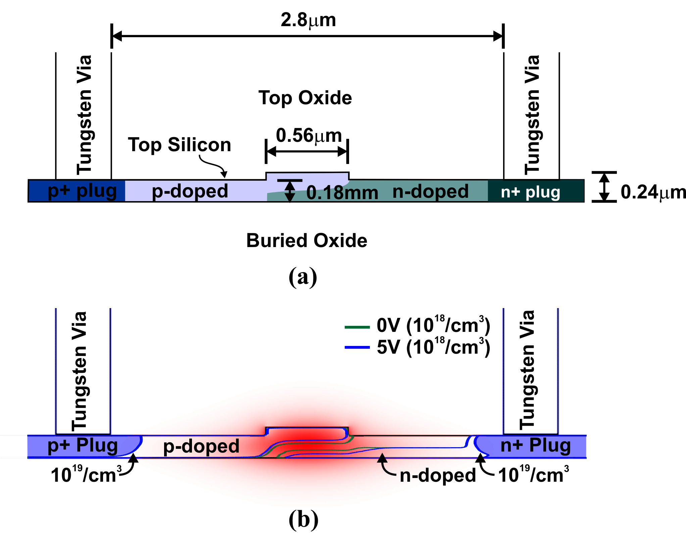
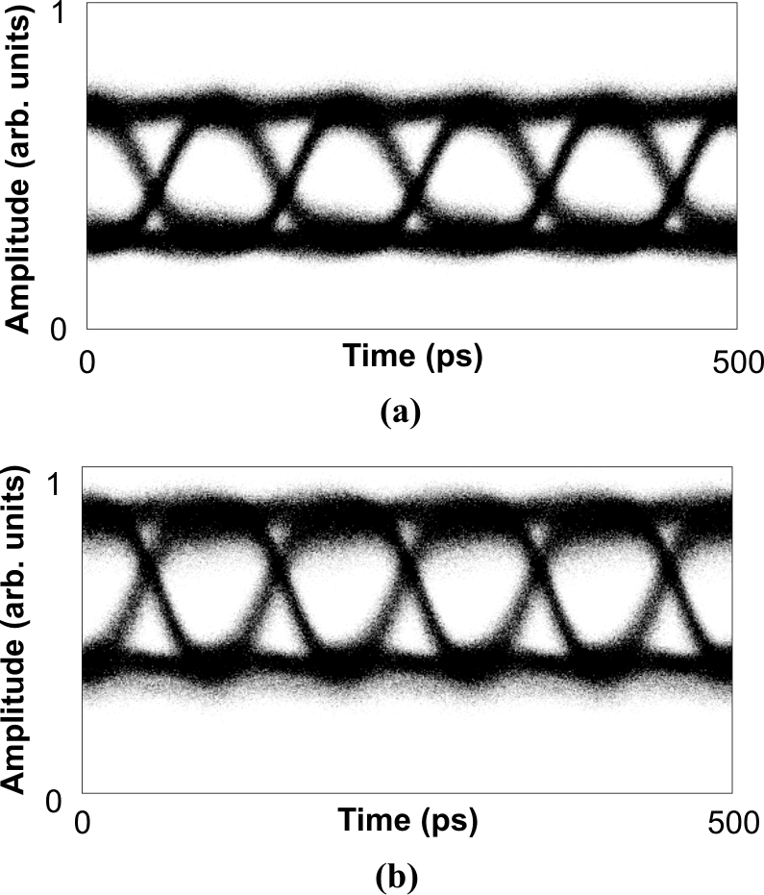
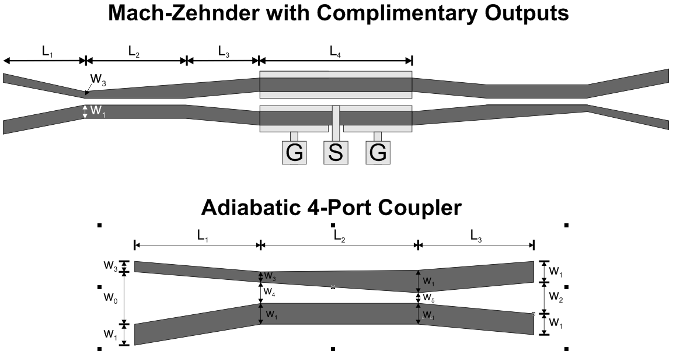
Modulators: Silicon Mach-Zehnder
Works well, but consumes ~10pJ/bit

Slide 15
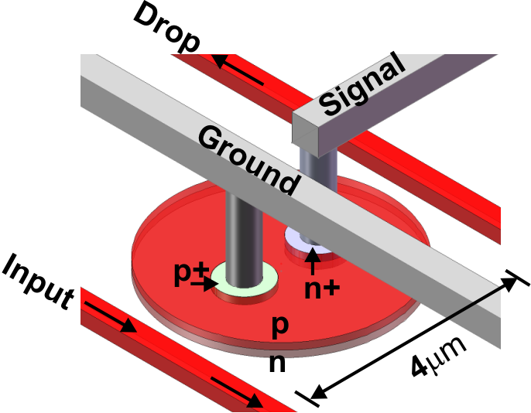
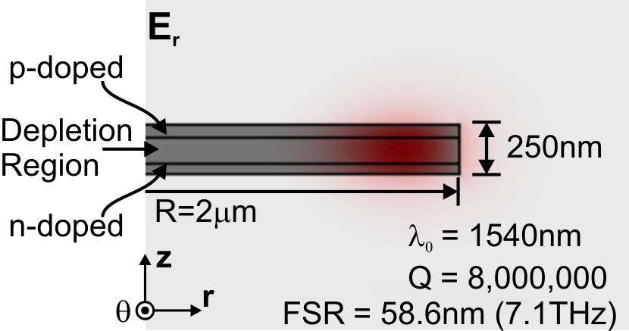
Modulators: Resonant Microdisks
Vertical P-N Junction
TE₁₁ Cylindrical Mode
Vertical P-N Junction Resonant Modulator
  Resonant modulator multiplies up the small silicon free-carrier effect
  Power consumption is simply f×CV²/4, and the capacitance is small
  Small devices, no pre-emphasis → fast / low power

Slide 16
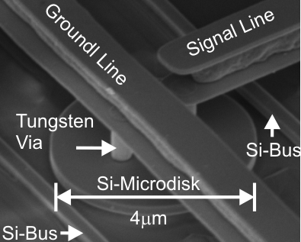
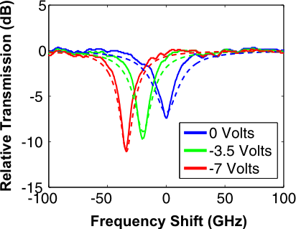
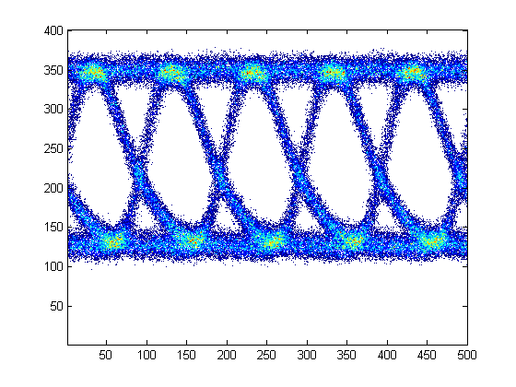
Modulators: Microdisk Demonstration
SEM of the Microdisk
Frequency Shift vs. Reverse Bias
Dashed Lines → Simulations
Eye Diagram (10Gb/s)
Vertical Junction Reverse-Biased Results
  35-GHz freq. shift demo'ed, >70-GHz possible
  Achieved a BER<10⁻¹³ at 10Gb/s
  CMOS compatible drive (3.3V)
  No pre-emphasis or equalization
  Measured energy/bit 85fJ

Slide 17
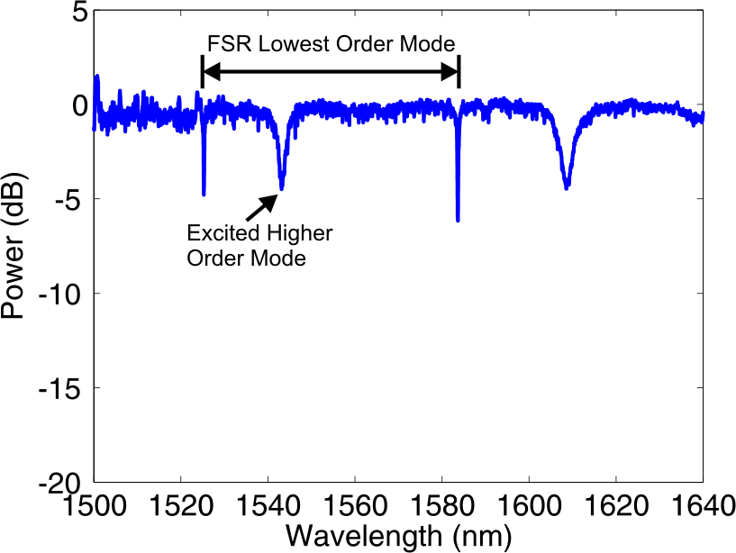
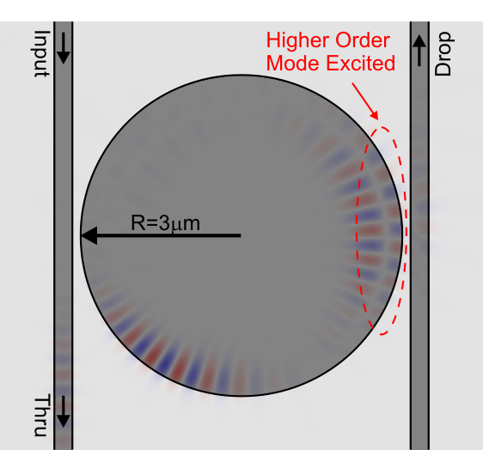
Challenge: Limited Free-Spectral Range
  Microdisks propagate higher order modes corrupting FSR and limiting the available line bandwidth.
  Can be fixed with a microring, but . . .

Slide 18
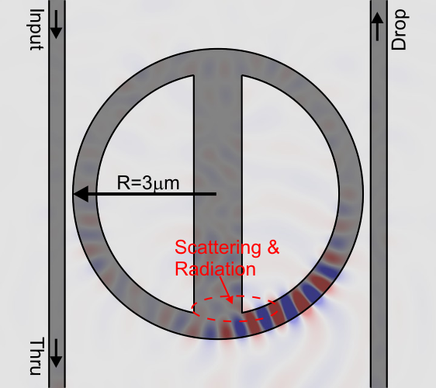
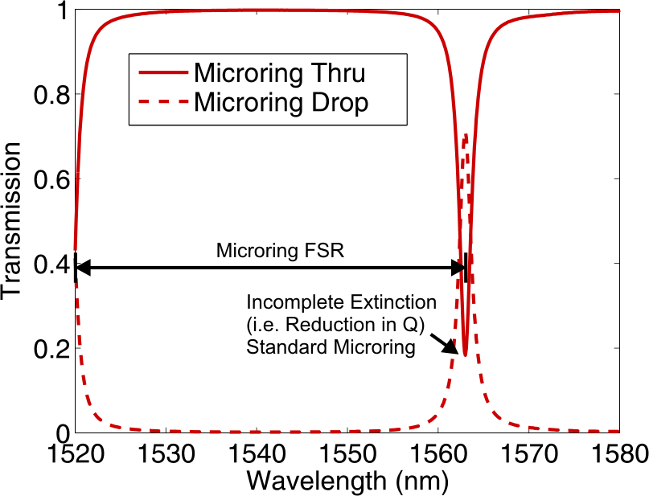

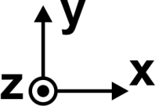
Directly Contact a Microring?
Results
  Microrings enable a recovery of the full Free Spectral Range
  However, the contact leads to scattering and a reduction in Q
  Can we modify the ring geometry to enable contact without loss?

Slide 19
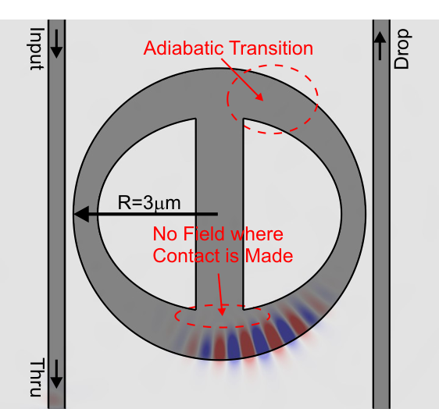
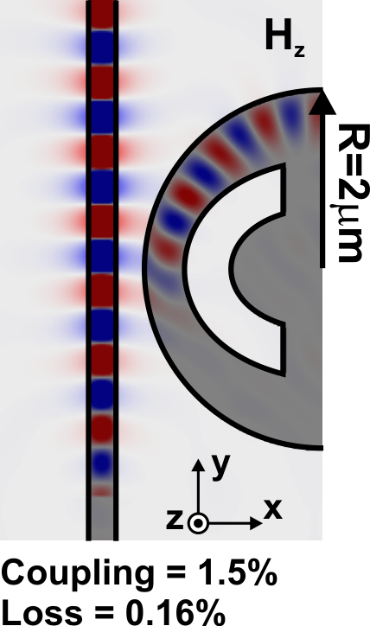
Adiabatic Resonant Microrings (ARMs)
Approach / Results
  Adiabatic Resonant Microrings (ARMs) enable contact without radiation
  Essentially, a cross between a ring and a disk
  Recovers the full Free-Spectral-Range (FSR)

Slide 20
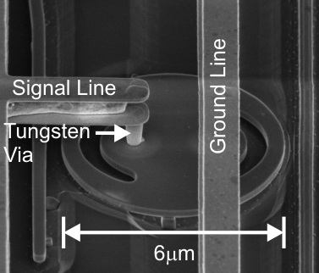
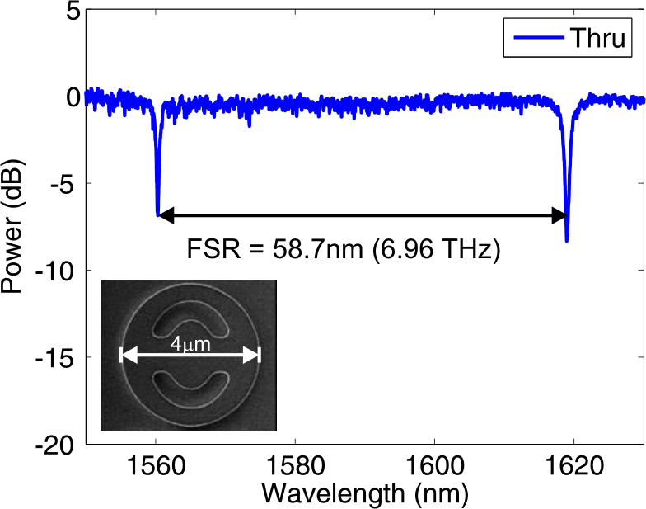
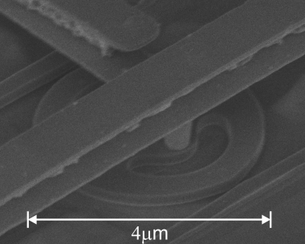

A Large Free-Spectral-Range (FSR)
7-Terhertz Free-Spectral-Range Means
  70 WDM Channels at a 100-GHz spacing
  140 WDM Channels at a 50-GHz spacing
  At 10Gb/s this corresponds to 700Gb/s
  and 1.4Tb/s data rates/fiber

Slide 21
Silicon Photonic Backplane: In Detail
Components
Wavelength Division Multiplexing (WDM) / Filtering
Low Power Modulators
Fabrication / Temperature Invariant Performance
Low-Loss Waveguides
Low Power Detectors (for receive-side)
For Space Applications, Radiation Hard CMOS

Slide 22
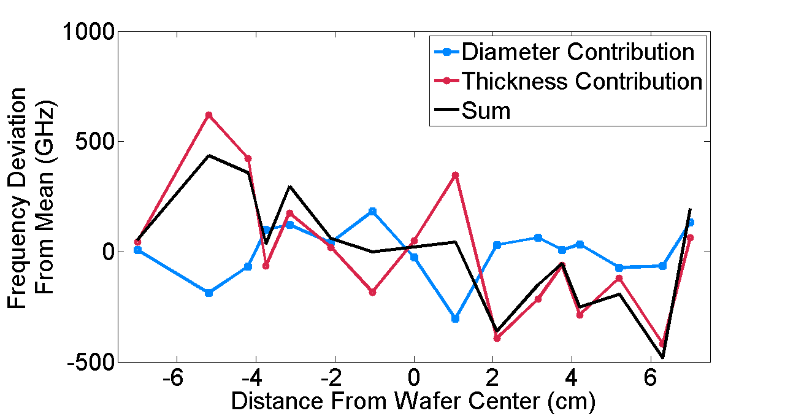
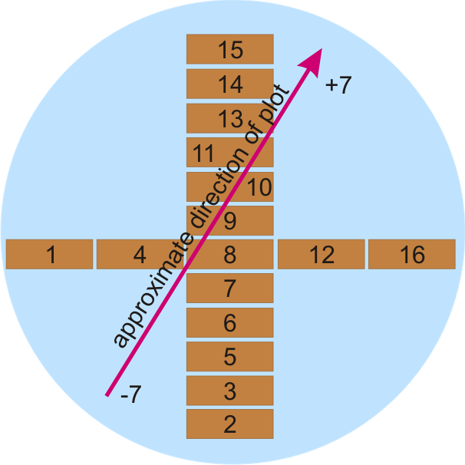
Resonant Frequency Variations
Measured Resonant Frequencies
Wafer Map Measured Devices
SOI
Components
Total variations on the order of ~1THz
Variations can be reduced to ~100GHz with tighter tolerances on layer thickness, but probably not less . . .

Slide 23
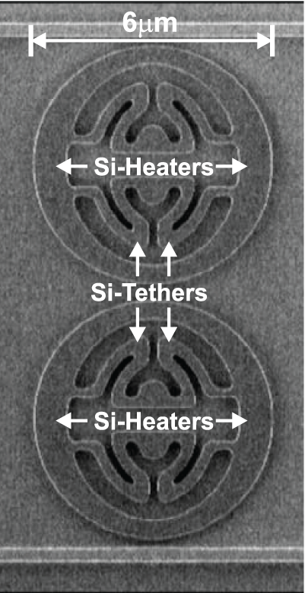
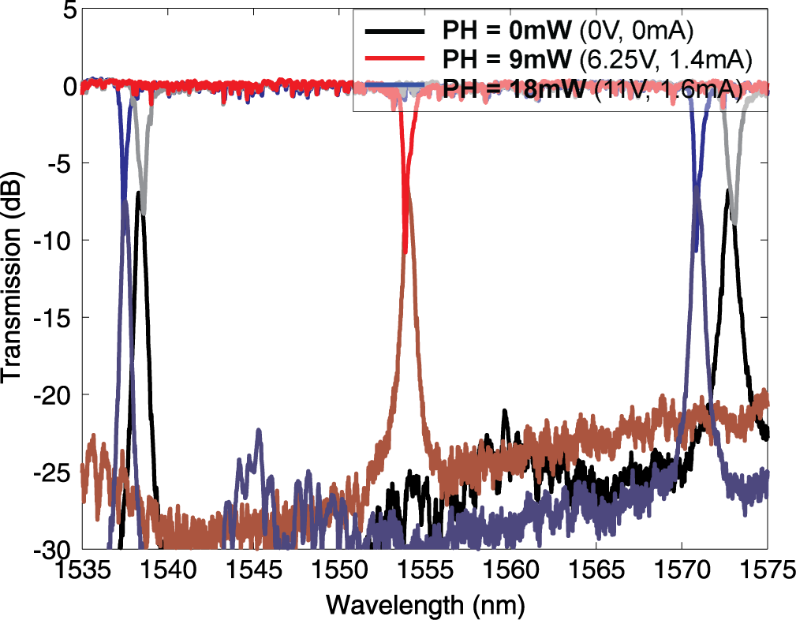
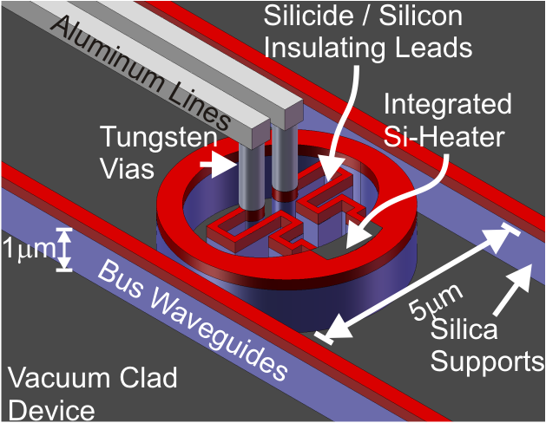
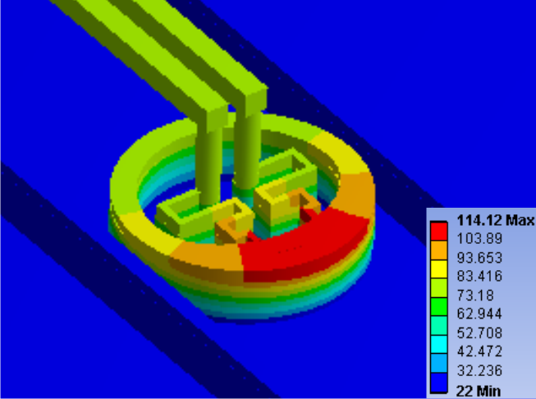
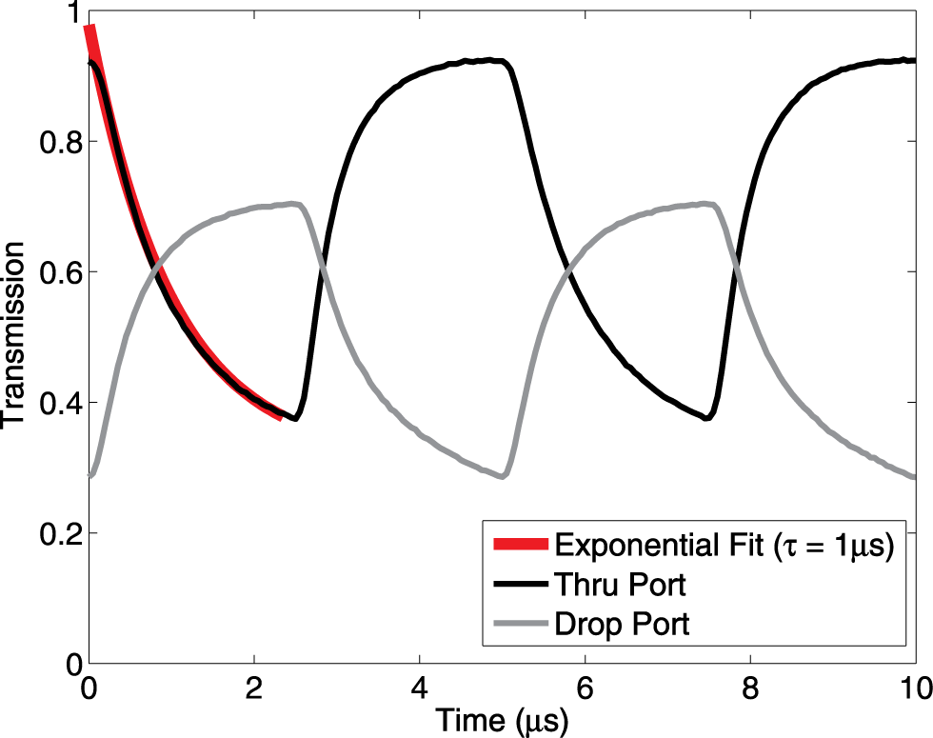
Ultralow Power Thermal Control
1st C-Band thermally tuned microring
Lowest-power thermal tuning (4.4μW/GHz)
50μW/°C, a 20°C range at 200fJ/bit (@10Gb/s)
If 5 rings are used in the network, then 1pJ/bit,
but expect to be able to reduce power by 5X
Record, 1μs thermal time constant

Slide 24

CMOS: Electronic-Photonic Integration
2Gb/s NRZ
Direct integration of Sandia CMOS and silicon photonics, potential space-qual.
Data rate (2Gb/s) limited only by CMOS
Enables ultralow power, highly scalable, silicon photonic platform

Slide 25



Low Loss: Silicon Ridge Waveguides
Reflowed Photo Resist with
Oxidation of SOI Rib Waveguide
Q = 7.5 x 10⁶
Internal-Q = 1.4 x 10⁷
Impact: Potential for cross-wafer communication (50cm → 1dB loss)

Slide 26




Germanium Detectors
Yin, et al, (Intel), 31 GHz Germanium on Silicon Detector
Ahn, et al, (MIT), >7GHz Germanium on Silicon Detector

Slide 27

Optical Communications Power
Bit-Error Rate (Fundamental)
Receiver Performance (Tech)
P-I-N Sensitivity ~ -20dBm
APDs ~ -27dBm
Add source, heat, mod., det. ~ 0.5pJ/bit
SERDES, Clock recovery, etc. ~0.5pJ/bit
Total ~1pJ/bit or 1mW/Gb/s
 | Source Power Budget
Electrical Power | 2mW
Optical Power | -10dBm (5% efficient)
Comm. Efficiency | 200fJ/bit (0.2mW/Gb/s)
Fiber-to-Chip Losses | -3dB (1dB/connection)
Filter Drop Losses | -3dB (1dB/Drop)
Filter Thru Losses | -4dB (0.1dB/Thru)
Modulator Losses | -4dB (3dB Mod./1dB Loss)
Power at Receiver | -24dBm
f_{clock} = 10Gb/s
Results Based Shot, Johnson,
and Dark Current Noise
Require Dark Current < 100nA
1000 Photons/Bit is sufficient
Only 0.15μW/Gb/s

Slide 28

Summary
Connect to Microprocessor
Components Exist: Filters, Modulators, Detectors, Thermal, etc..
Power: Expect to get below 1pJ/bit, including electronics, or about 30X
Bandwidth: 100X increase in BW density, 100, 10Gb/s channels
Example: 100Tb/s @1pJ/bit ➔ 100W, require 100-fibers
Side Benefits: Reduced thermal conductance, EMI, packaging . . .
Challenges: ROICs, SERDES, clock recovery, etc . . .

Slide 29
Acknowledgements
FDTD Code: Christina Manolatou
Cylindrical Modesolver: Milos Popovic
Funding: Sandia LDRD and DARPA MTO (M. Haney and J. Shah)

Slide 30


Detectors: Germanium on Silicon
Germanium can be grown epitaxially on silicon with excellent results
Low dark currents (<1nA @1V)
High bandwidths (>30GHz reported)
Fabricated in production epitaxial tools
Many groups including, Intel, BAE, MIT, Cornell, Luxtera, etc. have demonstrated impressive results with Ge-on-Si detectors

Slide 31
CMOS: Microdisk Modulator Driver
Β
CMOS
Drive signal
26 fF
V_{out}
Pic Pad
Mod.
Cap.
CMOS Pad
Wirebonds
Modulator
Series R
Run on IBM-90nm CMOS

