Slide 1

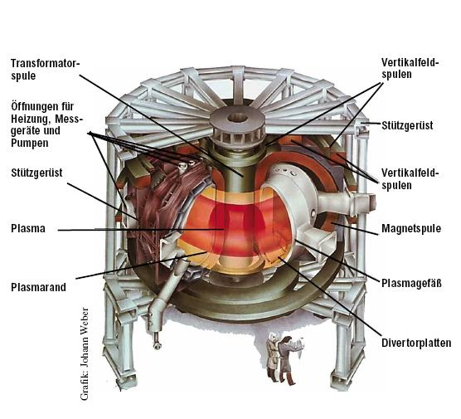
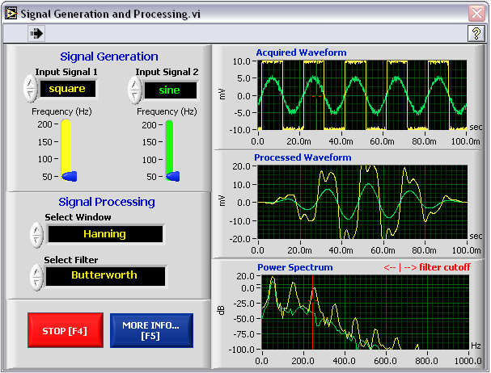
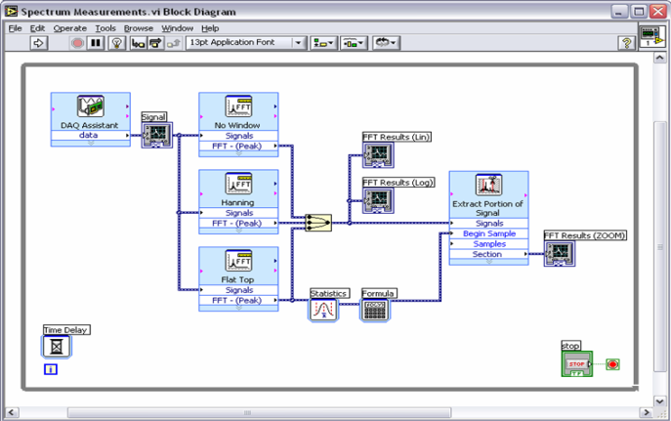
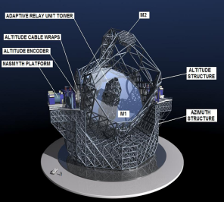

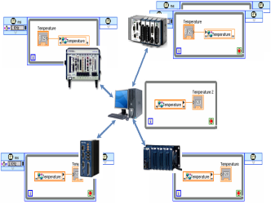
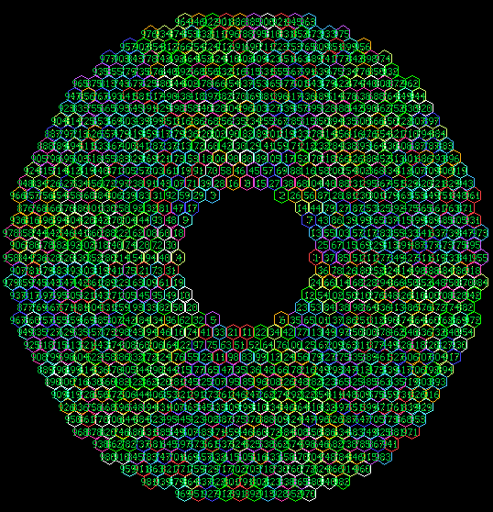
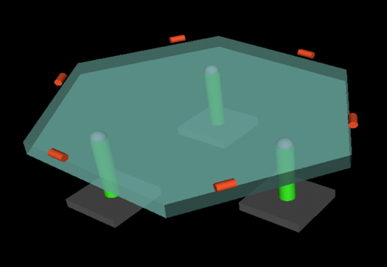
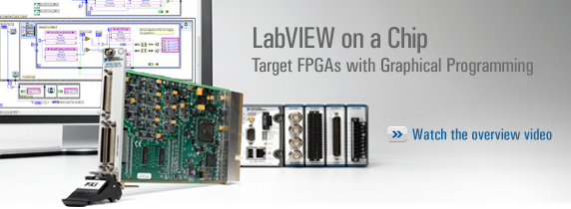
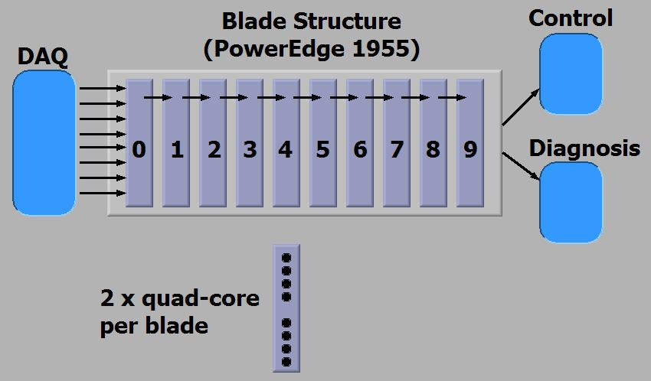

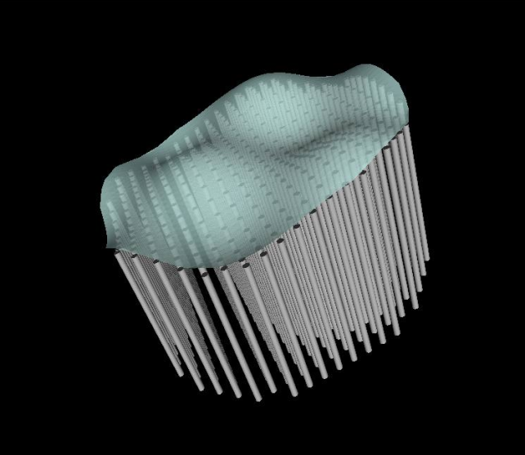


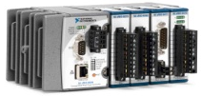

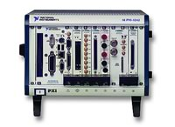

LabVIEW Real Time for High Performance Control Applications
Aljosa Vrancic, Lothar Wenzel, LabVIEW R&D, National Instruments
Case studies: Matrix-vector Multiplication & PDE Solver
Tool
Most of the basic computational algorithms for high-performance computing are designed to have the best average performance for the most general case as they are used in off-line calculations: the goal is for calculation to end in as little time as possible for an arbitrary set of inputs but each step in general does not have a strict time deadline. As a result, they do not scale well into hard real-time embedded environments that have much stricter per-iteration timing constraints, often in a 1 ms range. We found the following approach to work much better for real-time environments:
Divide algorithm into two steps:
  Off-line calculation – it is acceptable for this step to be expensive, as it is done up front
  On-line calculation – this step uses input and off-line calculation data to compute outputs deterministically
We applied this approach to matrix-vector multiplication and PDE solver problems that are at the heart of many control applications. PDEs are used to describe the system and matrix-vector multiplication is used to apply the model to sensor data in order to generate actuator data.
(Non)Linear Elliptic PDE Solver
LabVIEW Graphical Development Environment
Tokamak Fusion Reactor
Structured data flow programming
Compiled graphical development
Target desktop, mobile, industrial, and embedded
Thousands of out-of-the box mathematics and signal processing routines
Seamless connectivity to millions of I/O devices
Matrix-Vector Multiplication in real-time
Custom FPGA-based Communication Protocol
Grad-Shafranov PDE
Magnetohydrodynamics Shape Control
Application Layers
E-ELT Telescope
Currently: 3-12 ms, 39x63 grid
Goal: 1ms
Geometry-aware algorithm:
Cast PDE into a set of equations: Mx – b = f(x)
Use iterative algorithm: x^{(n+1)} = M⁻¹{f[x^{(n)}] + b}
Reduce problem for each iteration by finding a set of points (pink) that, when calculated, exactly split the problem into two or more smaller independent sub-problems (blue and green)
Calculate the exact solution for the points using corresponding rows of M⁻¹
Repeat for each sub-problem
Layer 1
ESO (European Southern Observatory)
Five mirrors (M1 through M5)
National Instruments involvement:
Data Acquisition
M1 – 42m primary segmented mirror
M4 – adaptive mirror
Off-line calculations
Data distribution
CPU affinity feature for cache control (keep fixed data in cache)
Read sensor data, distribute across CPUs (machines). Collate and update outputs
Program FPGA
Call dll
Network topology: ring
Network speed: up to 110 MB/s (cable dependent)
Configurable: RX and TX parameters, data sink, data source, data recombine
Development time: 2 weeks
Distributed
Real-Time
FPGA
E-ELT Telescope: M1 Mirror
Throughput/Latency for 80MB/s network setup
Calculating the exact solution for these grid points splits grid into two independent sections of smaller size
Graph representation of solution grid points
Layer 2
984 hexagonal segments
6 sensors/3 actuators per segment
1 ms control cycle
Math tricks to reduce problem to 3k x 3k symmetric matrix by 3k vector multiplication
New multiplication algorithm needed
750 μs (worst case)
Dell T7400 (2x2.6GHz 12MB L2 Quad Core Xeon)
Matrix restructured off-line in L1/L2 cache optimized sub-problems and loaded into the CPU caches
GPU (dual Tesla): 850 μs
Packet length (f32s) | Throughput (MB/s) | First byte latency per node (μs)
8 | 46 | 1
16 | 57 | 1.5
32 | 65 | 2.5
64 | 70 | 4.5
Problem:
For a 1000x1000 grid, M dimensions are
M(1,000,000 x 1,000,000)
Calculating M⁻¹ directly may be impossible
Solution:
Solve the problem for the unit boundary vector using any method (for example, iteration over smaller subsets of the problem for which M-1 can be calculated directly). Values for the solution corresponding to the pink points represent elements in the M⁻¹ rows corresponding to the unit boundary vector. Repeat the process for all unit vectors.
C code
Memory management
data alignment
Iterate over sub-problems
FPGA Block Diagram
Layer 3
Assembly code
Hand coded SSE2 assembly for solving sub-problems
L2 & L1 cache optimized
PC
PC Memory
FPGA
DMA
0
Grid points calculated with reduced set of boundary conditions
Interaction between solution grid points (represents matrix M)
L2 Cache Threshold
Receive
Block
Transmit
Block
Minimum Grid Size
Layer 4
Custom communication protocol
CPU of-load for data recombination
Fully hand-shaked, with retries
Slower nodes will gate data delivery
DMA for data access directly from memory
Matrix fits
Matrix too big
0
+
111x63 grid (6993 non-linear equations with 6993 unknowns)
7th order RHS polynomial
One iteration: < 250 μs
10⁻⁵ error: 4 iterations starting from 0s
Total time for solution: <1 ms
Dell 7400T (2x2.6GHz Quad Core Xeons)
Hold time
Packet Size
f32 ADD
Hold time
Packet Size
Retry
Linear PDE Benchmarks (μs)
LabVIEW Targets
E-ELT Telescope: M4 Mirror
Grid Size | Laplace |  |  | General Elliptic Liner PDE
 | Spectral | New Method (CPUs) |  | CPUs
 |  | 1 | 8 | 1 | 2 | 4 | 8
31x31 | 115 | 39 | 73 | 40 | 32 | 34 | 72
63x63 | 495 | 96 | 84 | 100 | 66 | 61 | 85
127x127 | 2130 | 363 | 128 | 381 | 211 | 157 | 129
255x255 | 10321 | 1498 | 296 | 6073 | 2866 | 2408 | 308
319x319 | 16594 | 2589 | 459 |  |  |  | 1416
511x511 | 45748 | 10883 | 965 | 29195 | 15171 | 13873 | 11814
Sensor
6000-9000 actuators
1ms control cycle
Math: 9k x 15k matrix by 15k vector multiplication
Both CPU bandwidth and cache size limited ➔distributed computation required
Custom FPGA-based communication protocol:
Deterministic communication
On-the-fly data recombination
Problem
Grid
Grid points calculated with full set of boundary conditions
FPGA
DSP/MPU
Boundary
Conditions
Handheld
Geometry-aware algorithm applied to a rectangular PDE grid
Vision System
Embedded Controllers
Multi-blade setup for distributed calculation
PC
Portable
Industrial Controllers (PXI)
ni.com

