Slide 1
Program Generation with Spiral: Beyond Transforms
Franz Franchetti, Daniel Mcfarlin, Frédéric de Mesmay, Hao Shen, Tomasz W. Włodarczyk, Srinivas Chellappa, Marek R. Telgarsky, Peter A. Milder, Yevgen Voronenko, Qian Yu, James C. Hoe, José M. F. Moura, Markus Püschel
Electrical and Computer Engineering
Carnegie Mellon University
This work was supported by DARPA DESA program, NSF-NGS/ITR, NSF-ACR, Mercury Inc., and Intel
Notes:
Intro: 0:00 - 0:11
Spiral: 0:11 - 0:19
Parallelism: 0:19 - 0:35
OL: 0:35 - 0:47
DPA: 0:47 - 0:53
Summary: 0:53 - 0:55
0:55 Intro
0:45 Spiral
0:36 Parallel
0:20 OL
0:08 DPPA
0:02 Summary

Slide 2
Vision Behind Spiral
Current
Future
Numerical problem
Numerical problem
human effort
algorithm selection
C program
implementation
algorithm selection
implementation
automated
compilation
compilation
automated
Computing platform
Computing platform
C code a singularity: Compiler has no access to high level information
Challenge: conquer the high abstraction level for complete automation

Slide 3
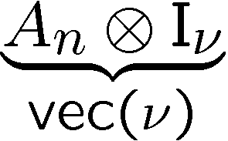
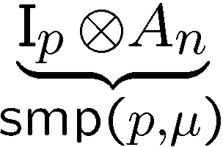
Main Idea: Program Generation
Model: common abstraction
= spaces of matching formulas
abstraction
abstraction
νp
μ
defines
rewriting
search
pick
architecture
space
algorithm
space
Architectural parameter:
Vector length,
#processors, …
optimization
Kernel:
problem size,
algorithm choice

Slide 4
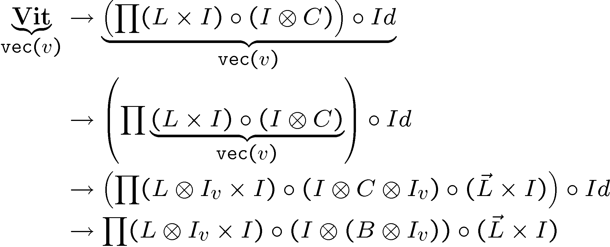
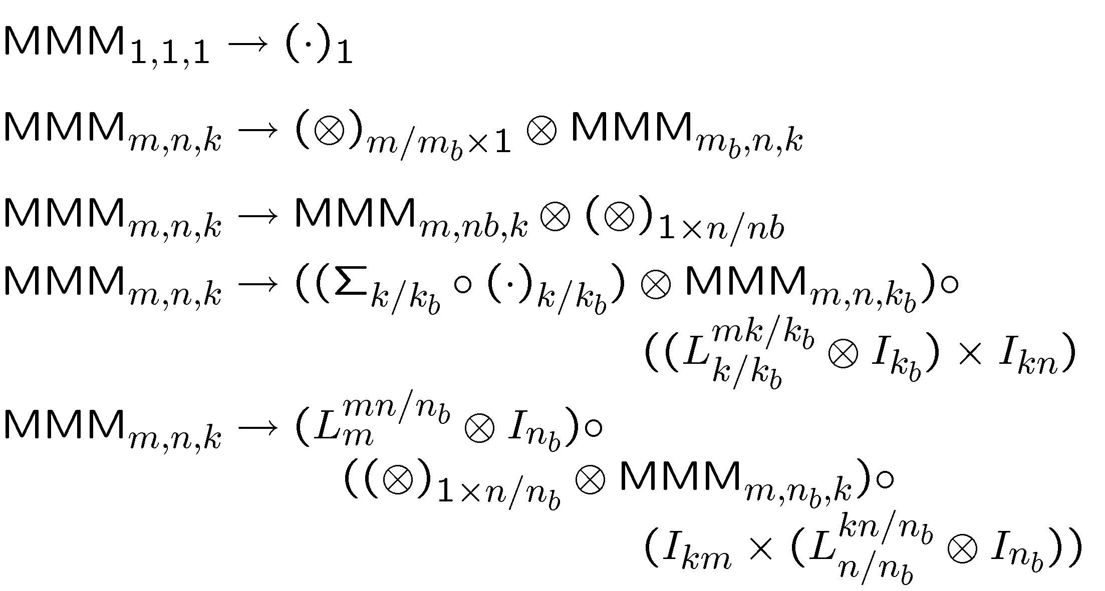
Expressing Kernels as Operator Formulas
Matrix-Matrix Multiplication
Viterbi Decoder
=
£
010001
convolutional encoder
11 10 00 01 10 01 11 00
11 10 01 01 10 10 11 00
Viterbi
decoder
010001
JPEG 2000 (Wavelet, EBCOT)
Synthetic Aperture Radar (SAR)
JPEG 2000 Compression
matched filtering
DWT
quantization
entropy coding
(EBCOT + MQ)
preprocessing
interpolation
2D iFFT

