Slide 1
Generating High-Performance General Size Linear Transform Libraries Using Spiral
Yevgen Voronenko
Franz Franchetti
Frédéric de Mesmay
Markus Püschel Carnegie Mellon University
HPEC, September 2008, Lexington, MA, USA
This work was supported by DARPA DESA program, NSF-NGS/ITR, NSF-ACR, and Intel
TexPoint fonts used in EMF.
Read the TexPoint manual before you delete this box.: AAAA

Slide 2
The Problem: Example DFT
Best code
30x
12x
Numerical recipes
Standard desktop computer
Same operations count ≈4nlog₂(n)
Similar plots can be shown for all numerical problems
2

Slide 3
DFT Plot: Analysis
Multiple threads: 2x
Vector instructions: 3x
Memory hierarchy: 5x
High performance library development = nightmare
Automation?
3

Slide 4
Idea: Textbook to Adaptive Library
Textbook FFT
?
“FFTW”
4

Slide 5
Goal: Teach Computers to Write Libraries
Input:
Transform:
Algorithm:
Hardware: 2-way SIMD + multithreaded
Key technologies:
Layered domain specific language
Algorithm manipulation via rewriting
Feedback-driven search
Result:
Full automation
Spiral
Output:
FFTW equivalent library
For general input size
Vectorized and multithreaded
Performance competitive
5

Slide 6
Contribution: General Size Library
Transform T
Spiral
DFT of size 1024
or
library for DFT of any size
dft_1024(X, Y);
Env_1 dft(1024);
dft.compute(X, Y);
Fundamentally different problems
6

Slide 7
Beyond Fourier Transform and FFTW
Cooley-Tukey FFT
“Cooley-Tukey” DCT
Overlap-save/add FIR
Spiral
Spiral
Spiral
“FFTW”
“FCTW”
“FIRW”
Fast Walsh Transform
Fast Wavelet Transform
Fast Hartley Transform
Spiral
Spiral
Spiral
“WHTW”
“FWTW”
“FHTW”
7

Slide 8
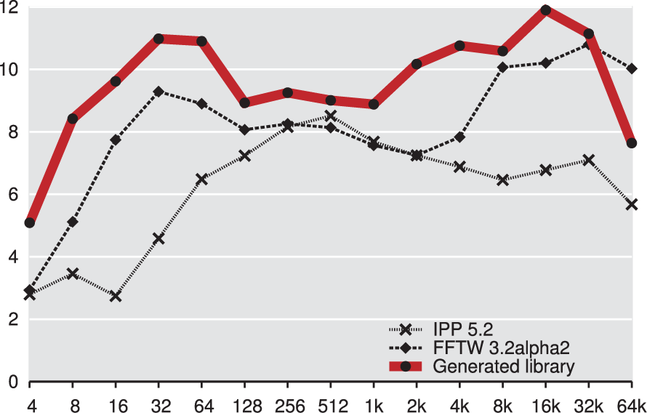
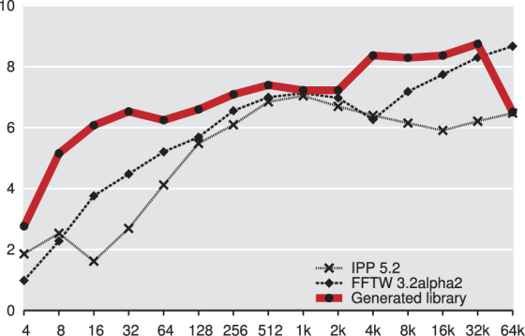
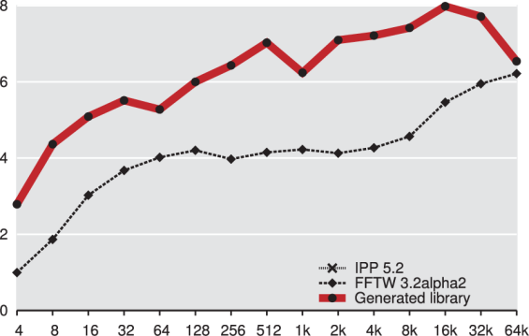
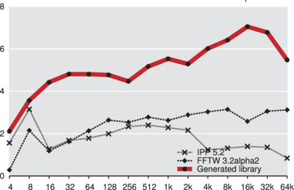
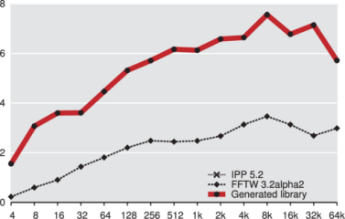
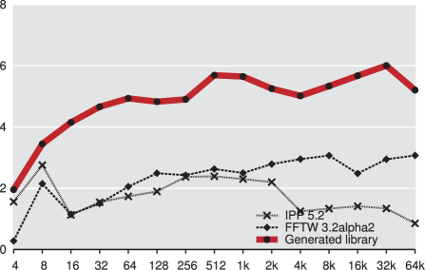
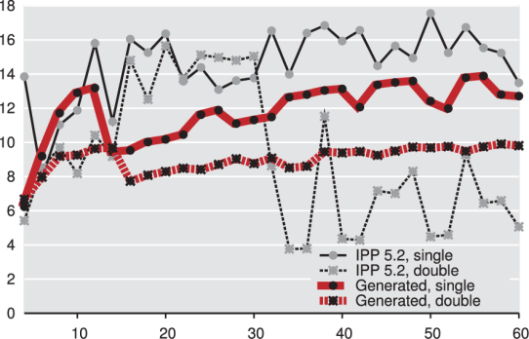
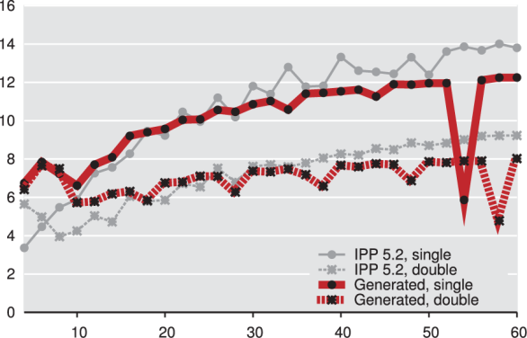
Examples of Generated Libraries
RDFT
DHT
DCT2
DCT3
DCT4
DFT
2-way vectorized, 2-threaded
Most are faster than hand-written libs
Code size: 8–120 KLOC or 0.5–5 MB
Generation time: 1–3 hours
Filter
Wavelet
Total: 300 KLOC / 13.3 MB of code generated in < 20 hours
from a few simple algorithm specs
Intel IPP library 6.0 will include Spiral generated code
8

Slide 9
Background
Library Generation
Experimental Results
Conclusions and Future Work
9

Slide 10
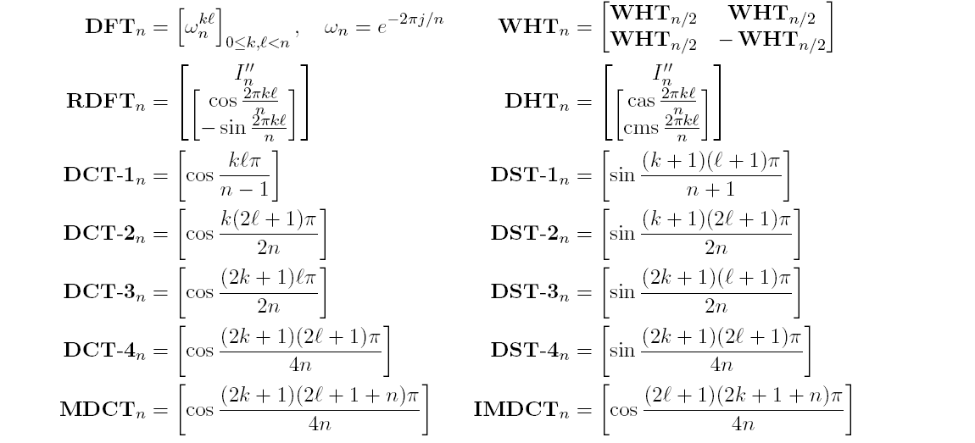
Linear Transforms
Mathematically: matrix-vector product
Examples:
Output vector
Transform matrix
Input vector
10

Slide 11
Fast Algorithms, Example: 4-point FFT
Fast algorithms = matrix factorizations
SPL = mathematical, declarative specification
Space of algorithms generated using breakdown rules
12 adds
4 mults
4 adds
1 mult
4 adds
(when multiplied with input vector x)
Fourier transform
Kronecker product
Identity
Permutation
11

Slide 12
Examples of Breakdown Rules
DFT
Cooley-Tukey
DCT
“Cooley-Tukey”
“Teach” Spiral domain knowledge of algorithms. Never obsolete.
Each rule leads to a library
12

Slide 13
Background
Library Generation
Experimental Results
Conclusions and Future Work
13

Slide 14
How Library Generation Works
Transforms +
Breakdown rules
Library Target
(FFTW, VSIPL, IPP FFT, ...)
Library Structure
Parallelization / Vectorization
Recursion Step Closure
recursion step closure
as Σ-SPL formulas
Library Implementation
Build library plan
Hot/cold partition
Generate target code
High-performance library
14

Slide 15
Breakdown Rules to Library Code
Cooley-Tukey Fast Fourier Transform (FFT)
DFT
k=4
Naive implementation
void dft(int n, cplx X[], cplx Y[]) {
k = choose_factor(n); m = n/k;
Z = permute(X)
for i=0 to k-1
dft_subvec(m, Z, Y, …)
for i=0 to n-1
Y[i] = Y[i]*T[i];
for i=0 to m-1
dft_strided(k, Y, Y, …)
}
2 extra functions needed
15
Notes:
descend example

Slide 16
Breakdown Rules to Library Code
Cooley-Tukey Fast Fourier Transform (FFT)
DFT
Naive implementation
Optimized implementation
void dft(int n, cplx X[], cplx Y[]) {
k = choose_factor(n); m = n/k;
Z = permute(X)
for i=0 to k-1
dft_subvec(m, Z, Y, …)
for i=0 to n-1
Y[i] = Y[i]*T[i];
for i=0 to m-1
dft_strided(k, Y, Y, …)
}
void dft(int n, cplx X[], cplx Y[]) {
k = choose_factor(n); m = n/k;
for i=0 to k-1
dft_strided2(m, X, Y, …)
for i=0 to m-1
dft_strided3_scaled(k, Y, Y, T, …)
}
2 extra functions needed
2 extra functions needed
16
How to discover these specialized variants automatically?
Notes:
descend example

Slide 17
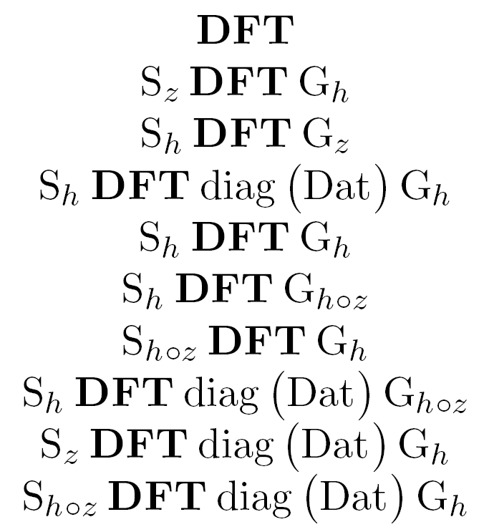
Library Structure
Input:
Breakdown rules
Output:
Recursion step closure
Σ-SPL Implementation of each recursion step
Parallelization/Vectorization
Adds additional breakdown rules
Orthogonal to the closure generation
Library Structure
Parallelization / Vectorization
Recursion Step Closure
17

Slide 18
Computing Recursion Step Closure
Input: transform T and a breakdown rule
Output: spawned recursion steps + Σ-SPL implementation
Algorithm:
Apply the breakdown rule
Convert to Σ-SPL
Apply loop merging + index simplification rules.
Extract recursion steps
Repeat until closure is reached
Parametrization (not shown) derives the independent parameter set
for each recursion step
18

Slide 19
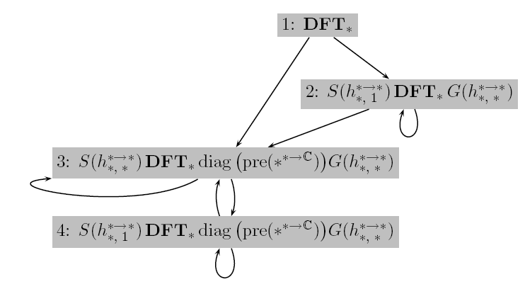
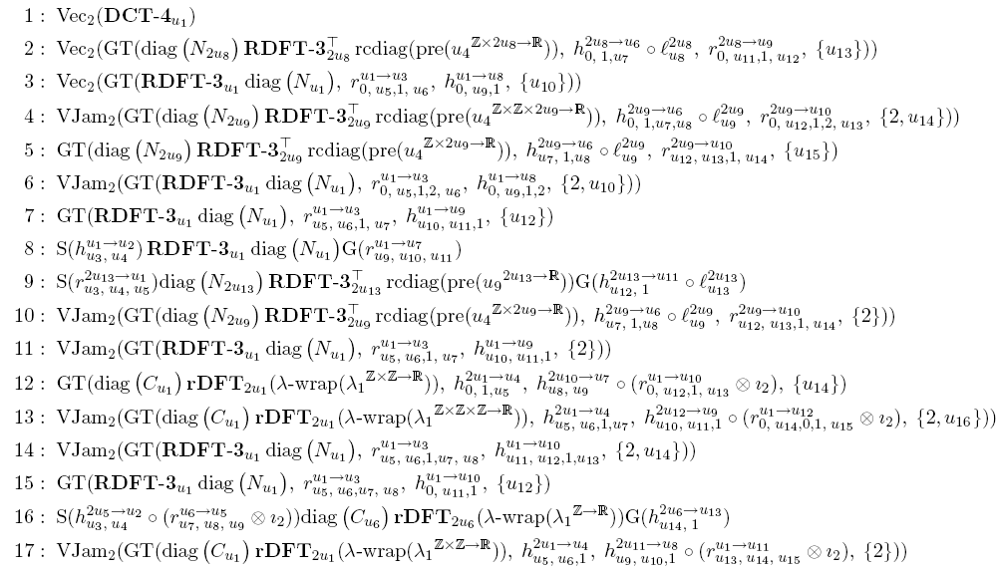
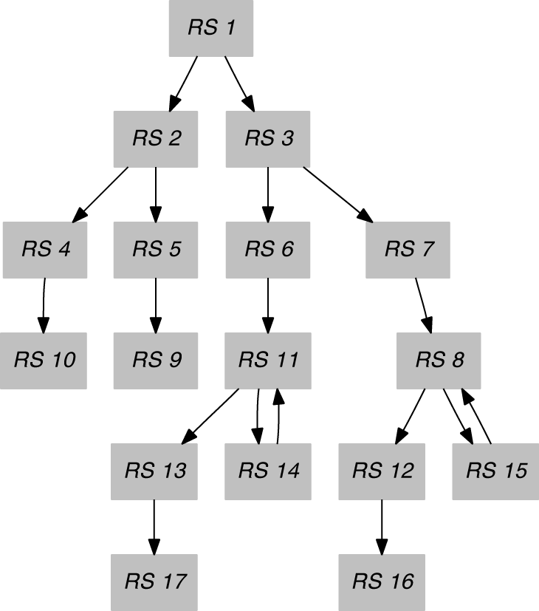
Recursion Step Closure Examples
DFT (scalar)
4 mutually recursive functions
- computed automatically
- described using Σ-SPL formulas
DCT4 (vectorized)
19
17 mutually recursive functions
Notes:
closure example

Slide 20
Base Cases
Base cases are called “codelets” in FFTW
Why needed:
Closure is converted into mutually recursive functions
Recursion must be terminated
Larger base cases eliminate overhead from recursion
How many:
In FFTW 3.2: 183 codelets for complex DFT (21 types)
147 codelets for real DFT (18 types)
In our generator: # codelet types · # recursion steps
Obtained by using standard Spiral to generate fixed size code
. . .
20

Slide 21
Library Implementation
Input:
Recursion step closure
Σ-SPL implementation of each recursion step (base cases + recursions)
Output:
High-performance library
Target language: C++, Java, etc.
Process:
Build library plan
Perform hot/cold partitioning
Generate target language code
Library Implementation
Build library plan
Hot/cold partition
Generate target code
High-performance library
21

Slide 22
Background
Library Generation
Experimental Results
Conclusions and Future Work
22

Slide 23
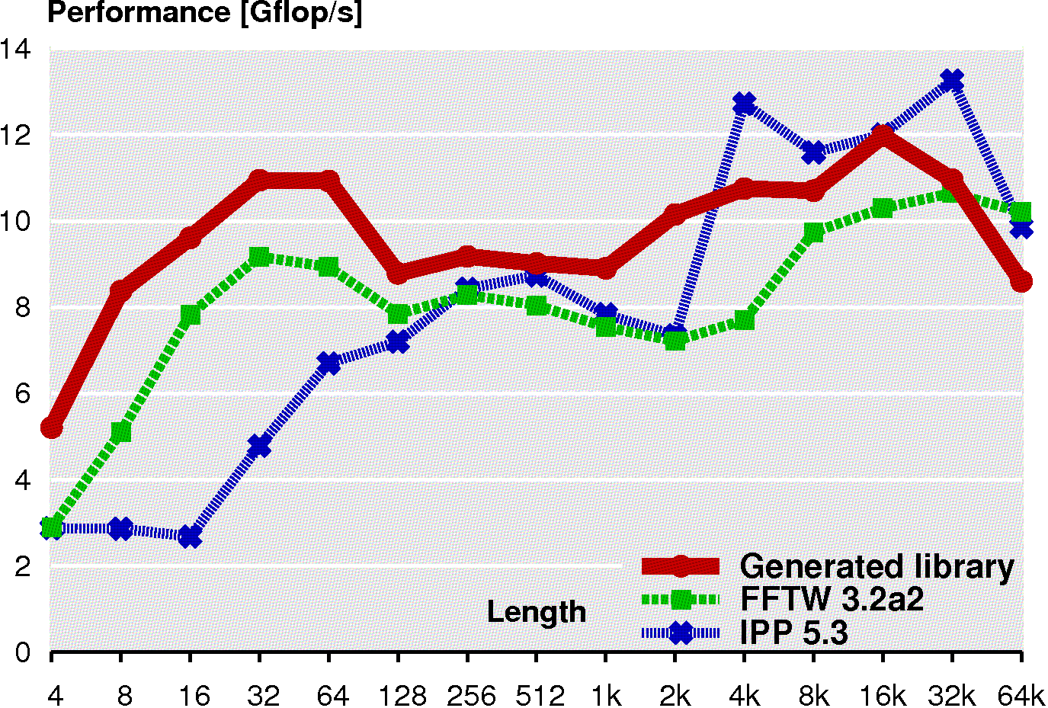
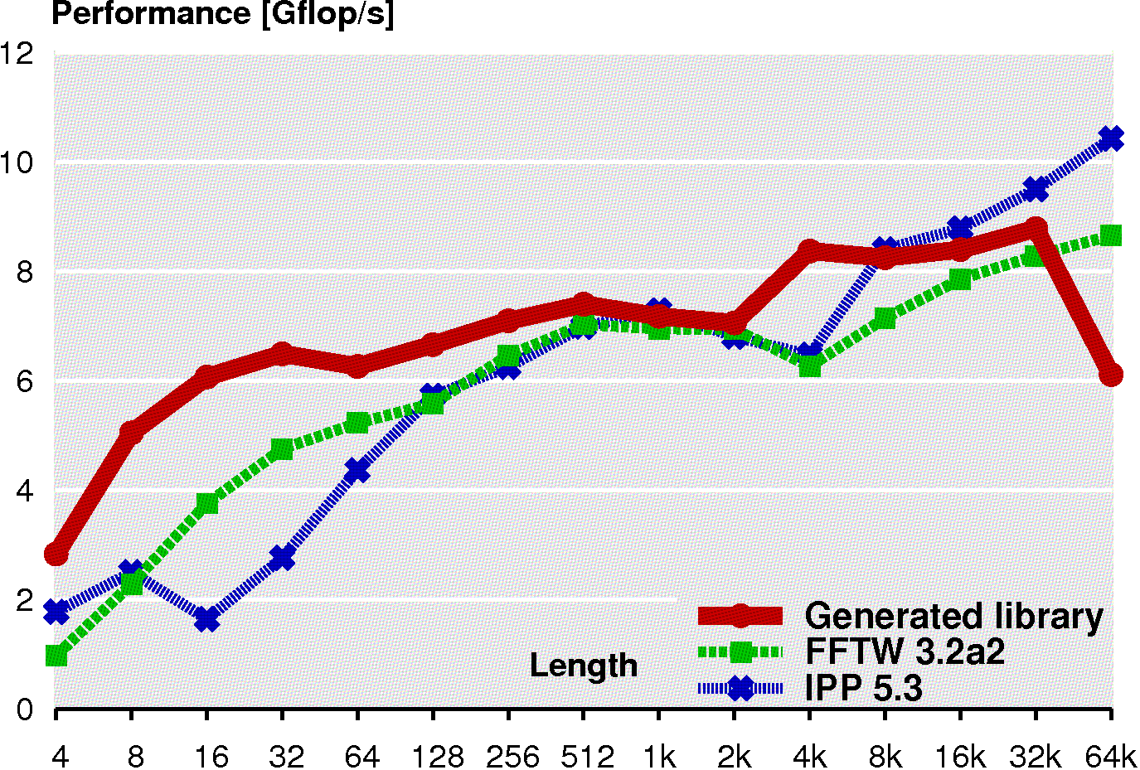
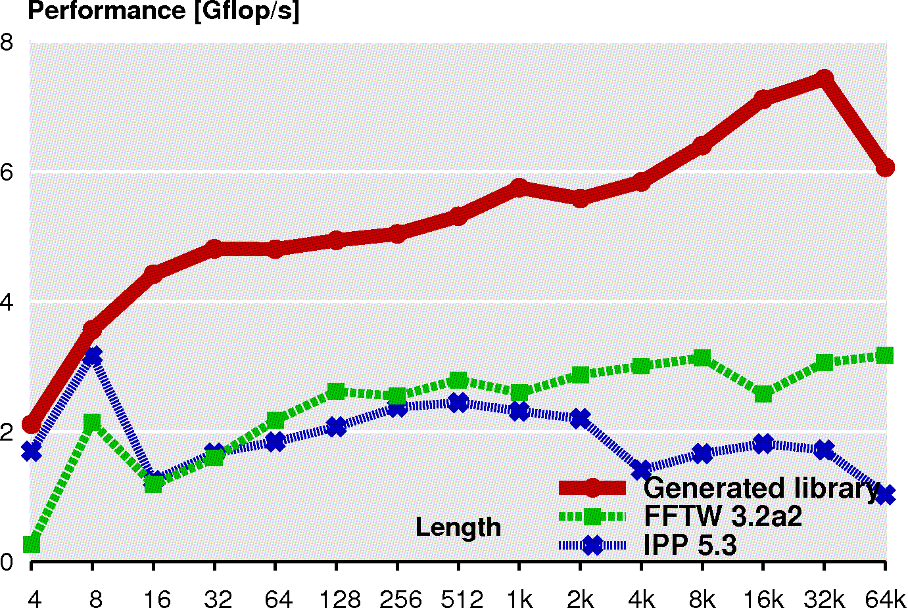
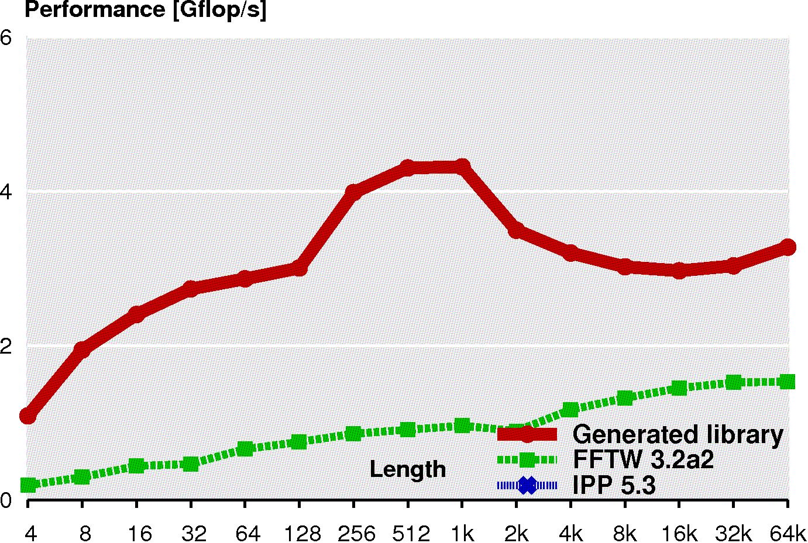
Double Precision Performance: Intel Xeon 5160 2-way vectorization, up to 2 threads
Generated library
Generated library
FFTW
Intel IPP
Complex DFT
Real DFT
Generated library
Generated library
DCT-2
WHT
23

Slide 24
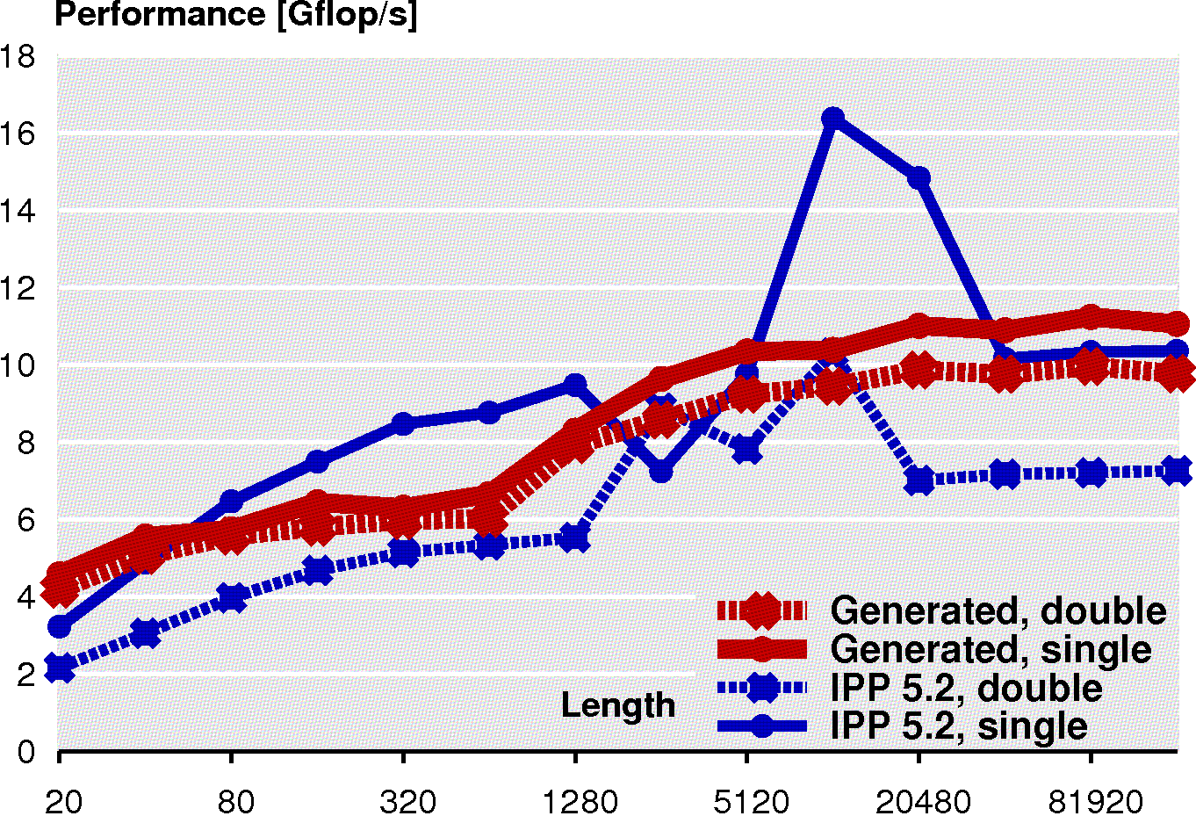
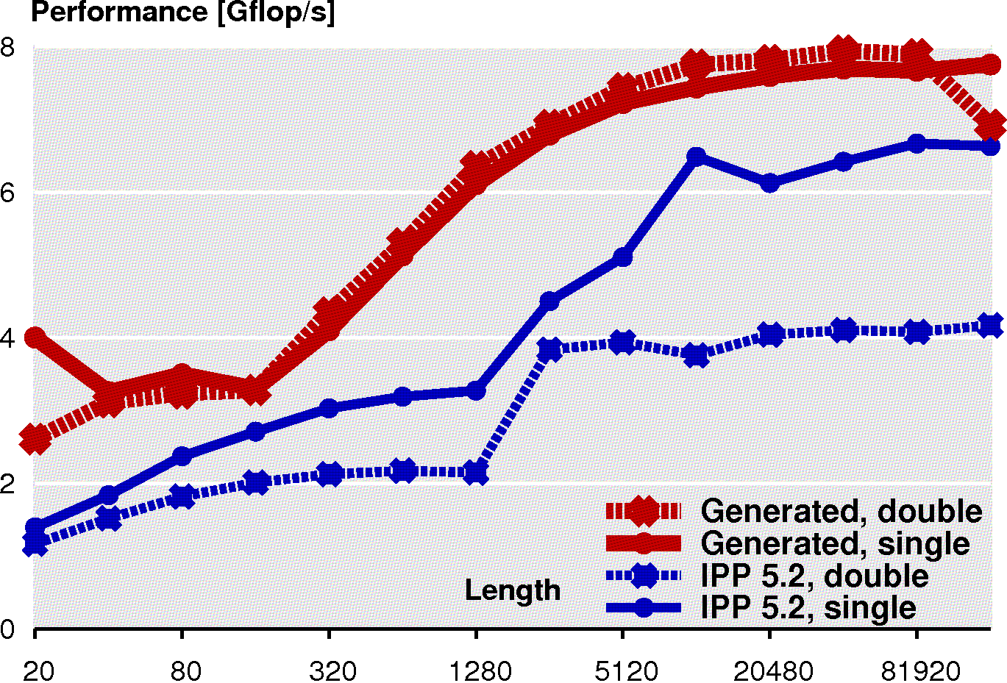
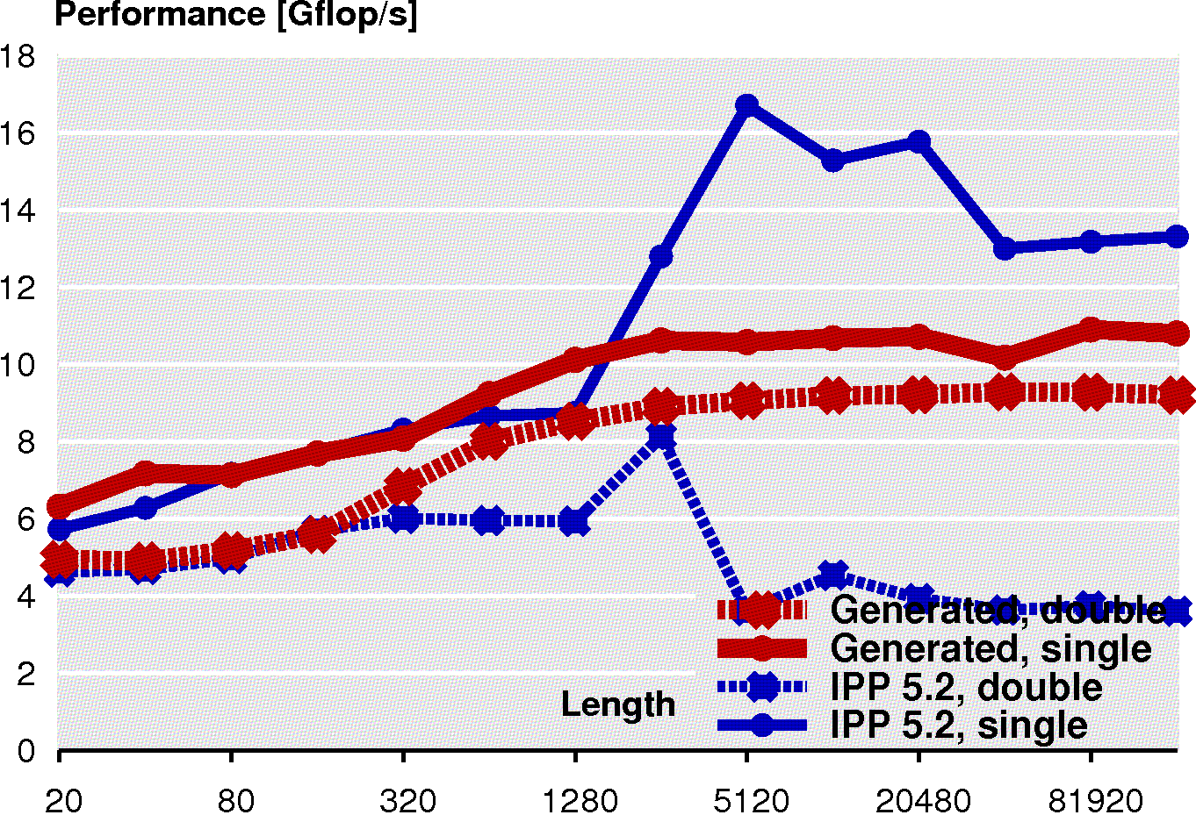
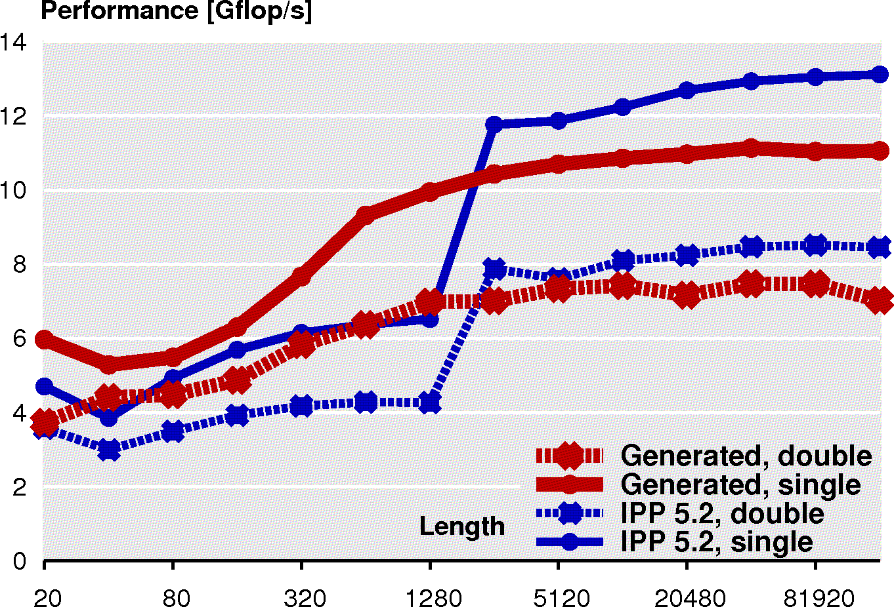
FIR Filter Performance 2- and 4-way vectorization, up to 2 threads
Generated library
Generated
library
Intel IPP
8-tap filter
8-tap wavelet
Generated
library
Generated
library
32-tap filter
32-tap wavelet
24

Slide 25
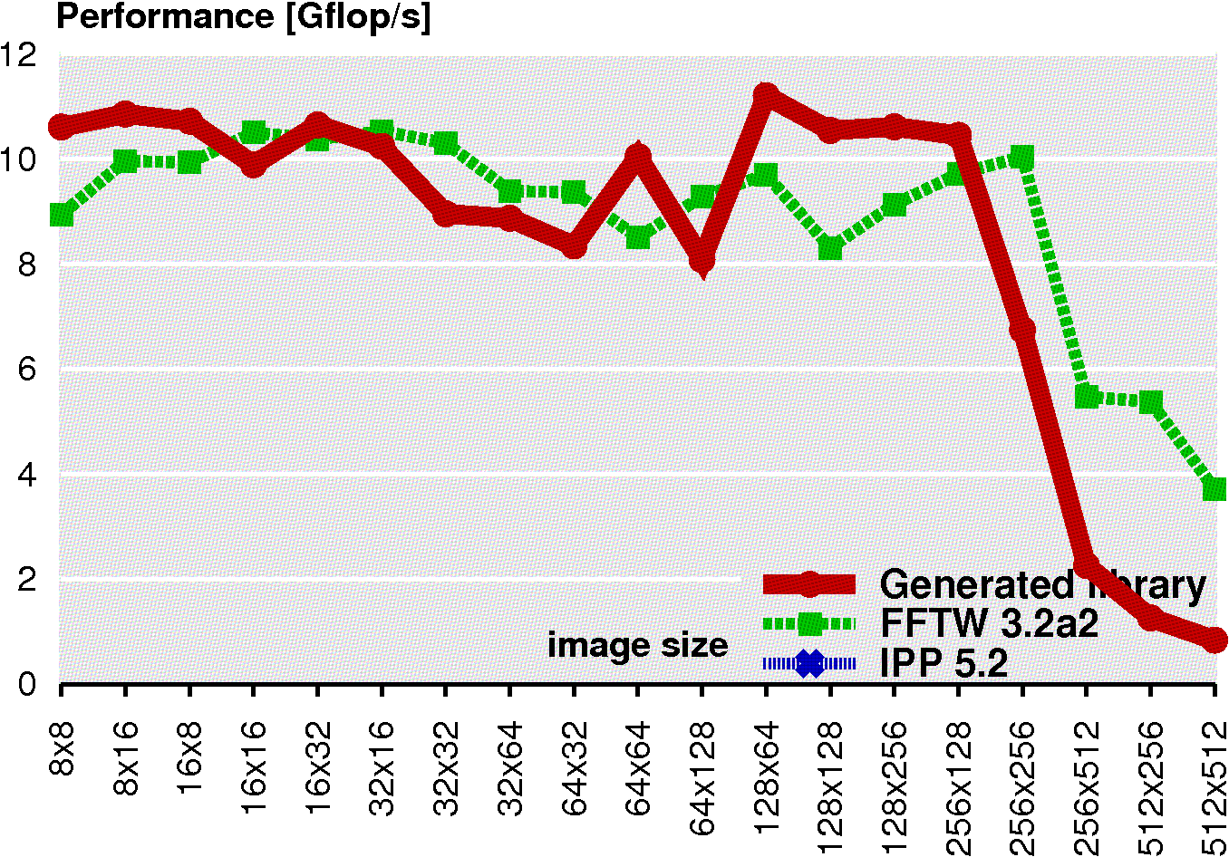
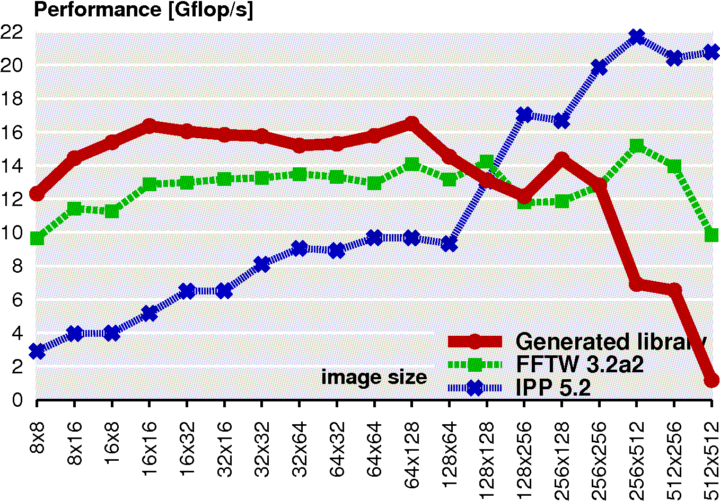
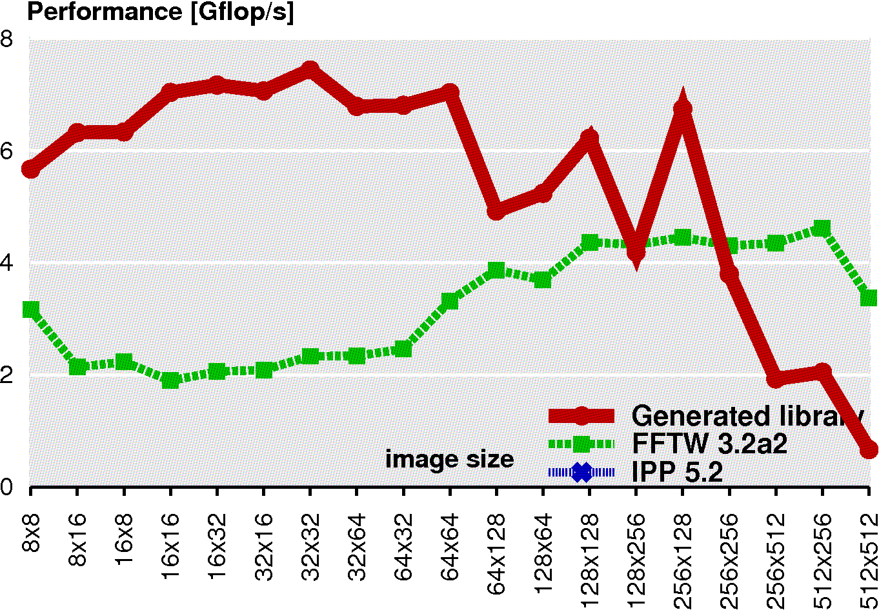
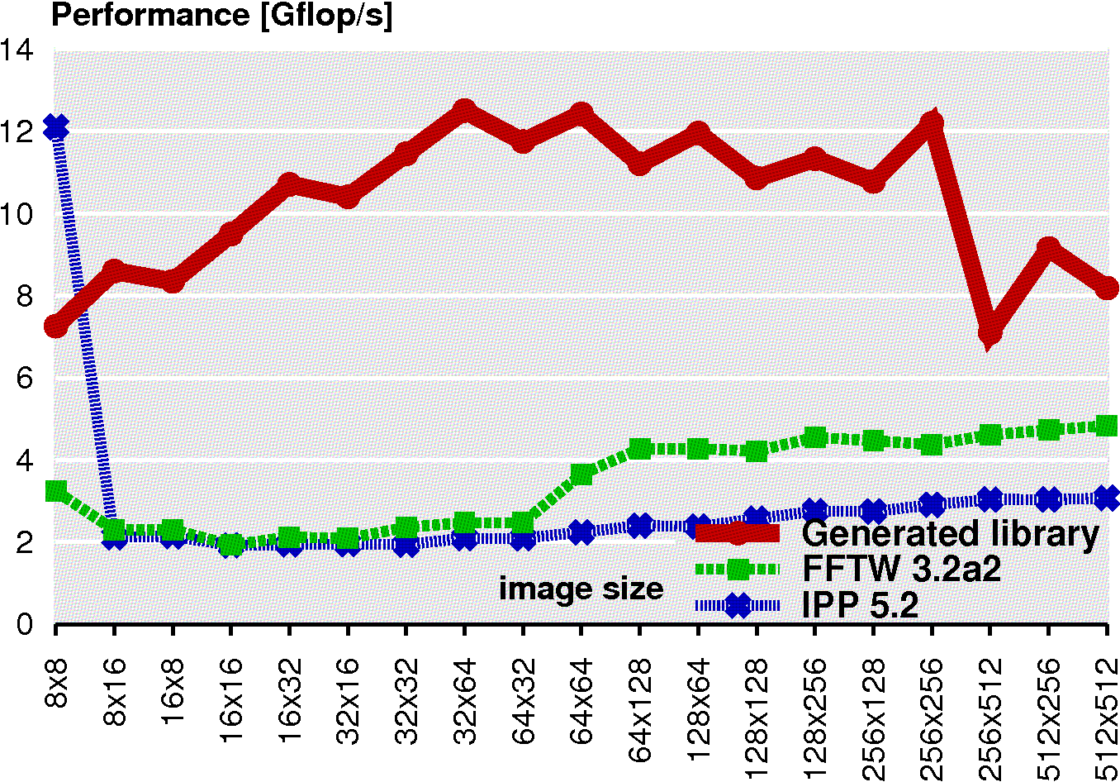
2-D Transforms Performance 2- or 4-way vectorization, up to 2 threads
Generated library
Generated library
FFTW
Intel IPP
2-D DFT double
2-D DFT single
Generated library
Generated library
2-D DCT-2 double
2-D DCT-2 single
25

Slide 26
Customization: Code Size
13 KLOC
3 KLOC
FFTW: 150 KLOC
2 KLOC
1.3 KLOC
1 KLOC
26

Slide 27
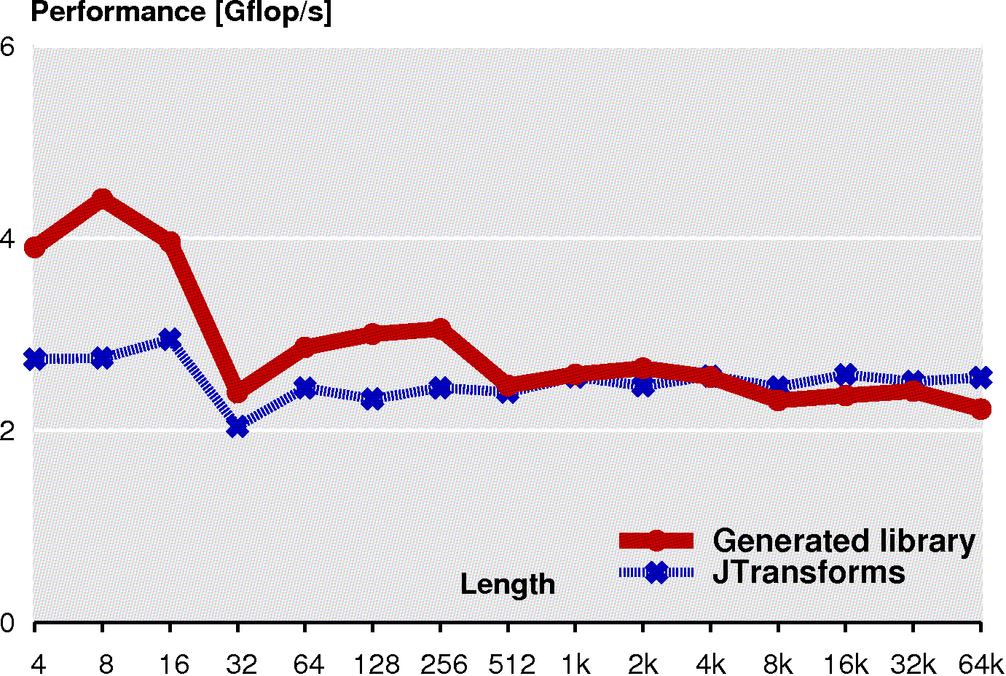
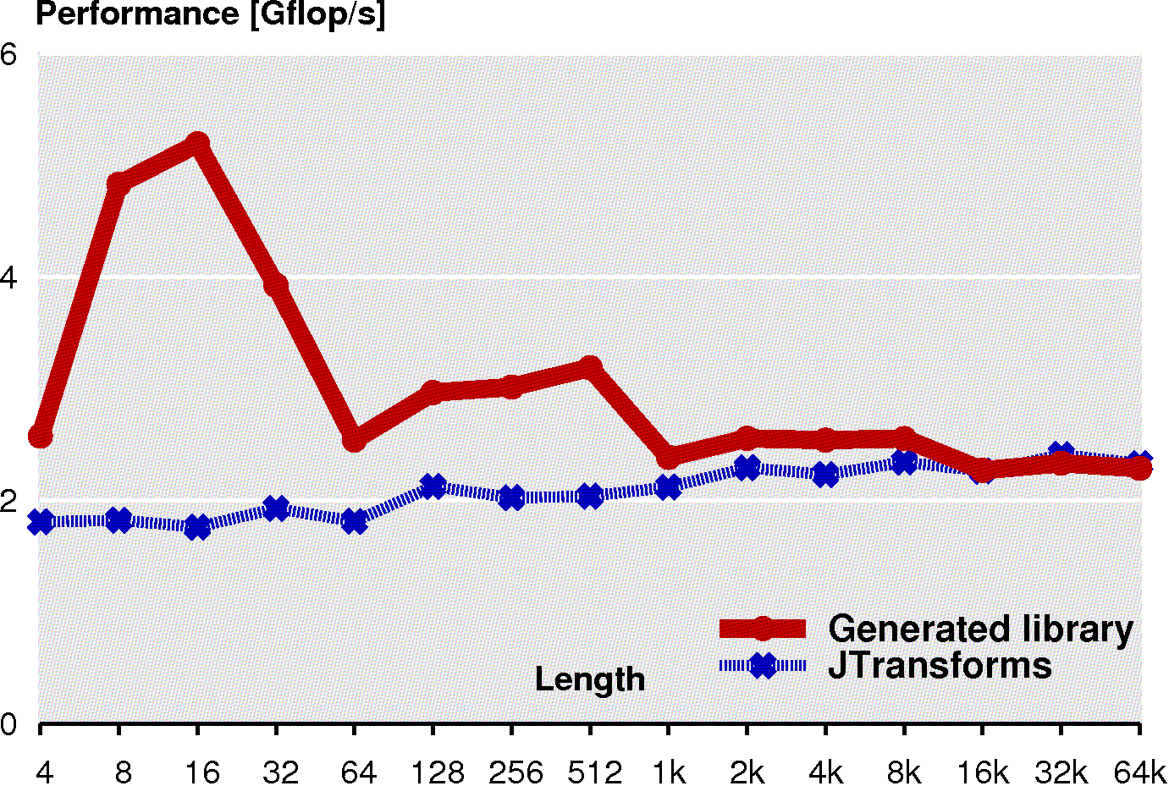
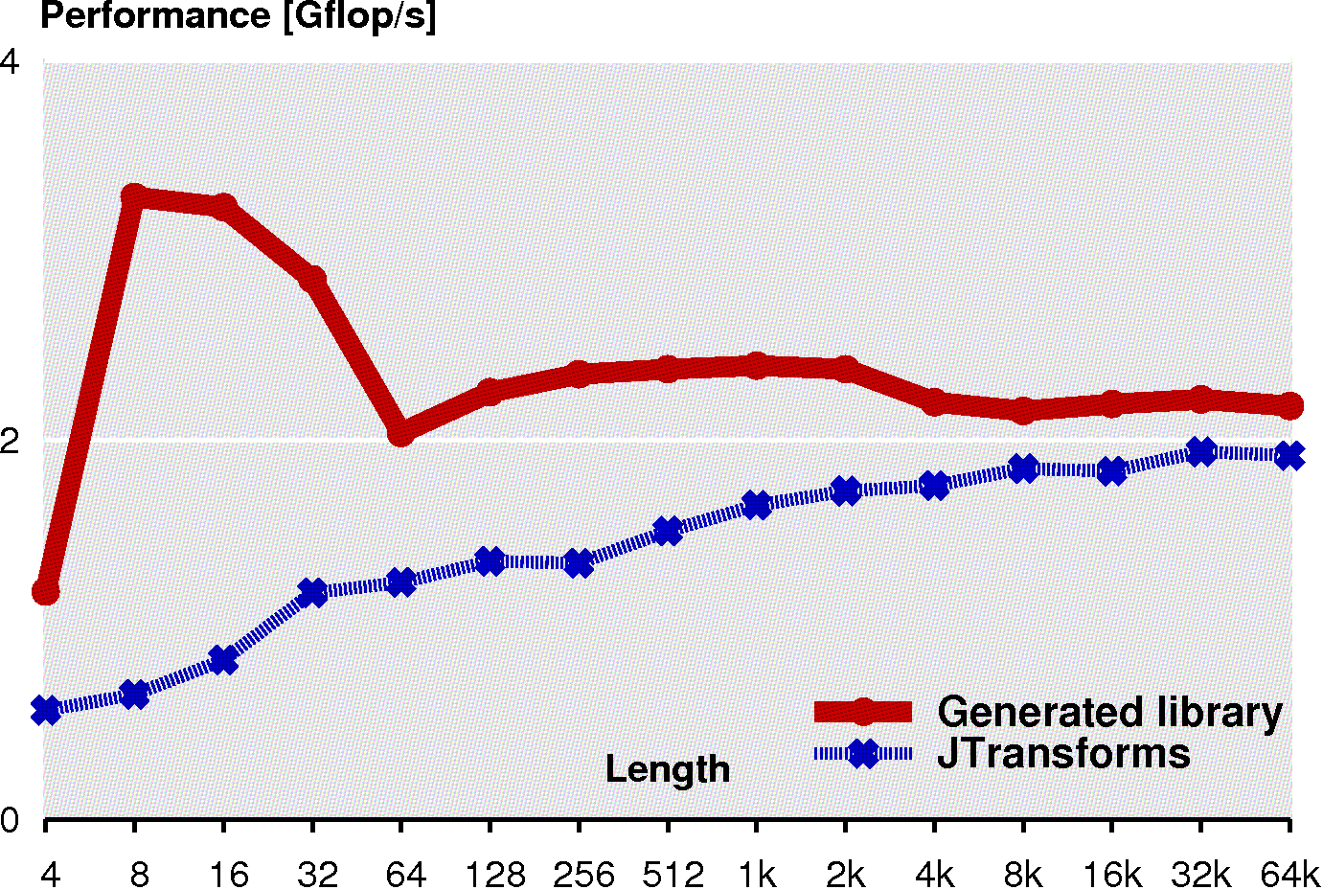
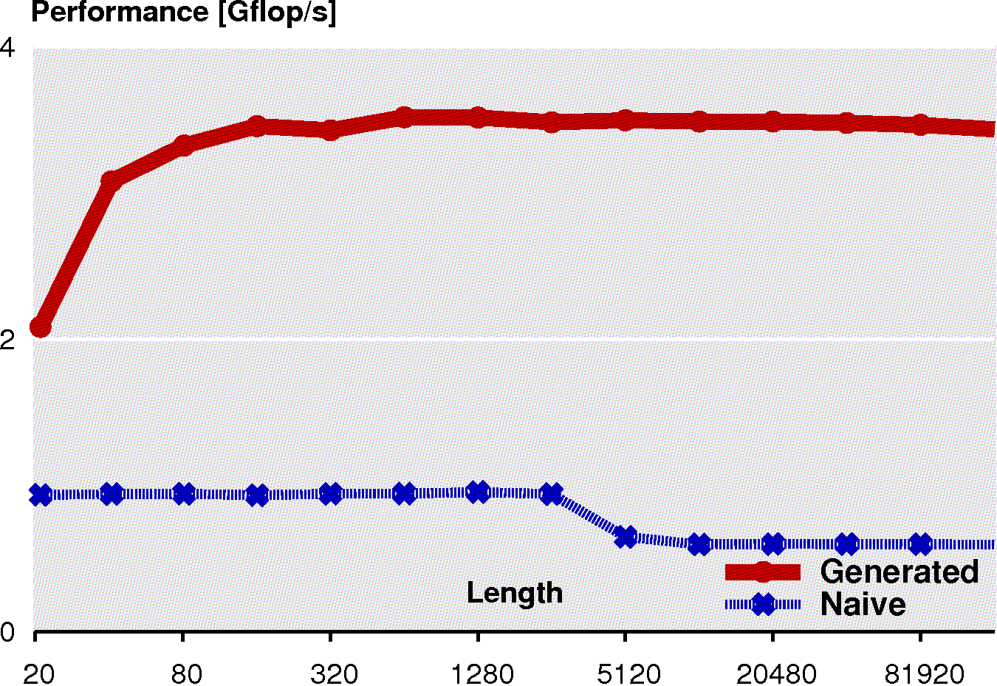
Backend Customization: Java
Generated library
Generated library
JTransforms
Complex DFT
Real DFT
Generated library
Generated library
DCT-2
FIR Filter
Portable, but only 50% of scalar C performance
27

Slide 28
Summary
FFT
Full automation: Textbook to adaptive library
Performance
SIMD
Multicore
Customization
Industry collaboration
Intel IPP 6.0 will include Spiral generated code
Spiral
“FFTW”
FIR
Spiral
“FIRW”
28

