Slide 1
Application Implementation on the Cell B.E Processor: Techniques Employed
John Freeman, Diane Brassaw, Rich Besler, Brian Few, Shelby Davis, Ben Buley
Black River Systems Company Inc.
162 Genesee St. Utica, NY 13501

Slide 2
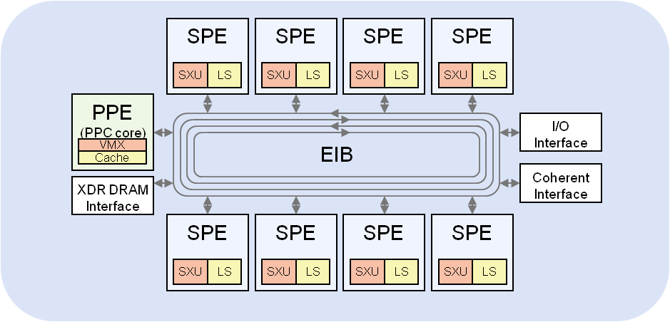
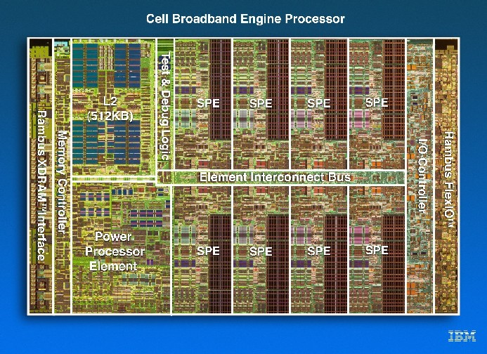
IBM Cell BE Processor
Cell BE processor boasts nine processors on a single die
1 Power® processor
8 vector processors
Computational Performance
205 GFLOPS @ 3.2 GHz
410 GOPS @ 3.2 GHZ
A high-speed data ring connects everything
205 GB/s maximum sustained bandwidth
High performance chip interfaces
25.6 GB/s XDR main memory bandwidth
Excellent Single Precision Floating Point Performance

Slide 3
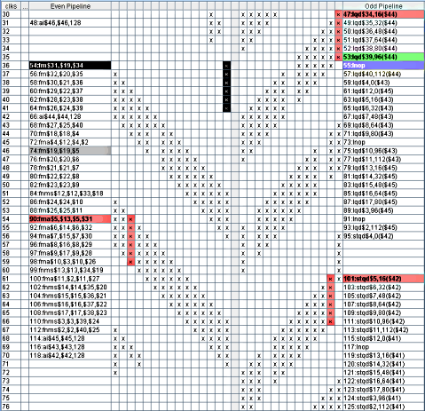
Experience, Performance, Tools & Techniques
Share Impressions and Experience From the Past ~2 Years
Development Tools and SDKs
Parallelization Techniques
Approaches for Loop Unrolling
Use of C++ templates
SPE Assembly Programming
SPE Memory Management
Performance Metrics and Tools
IBM’s ASMVis Tool
What Worked, What Didn’t and What Level of Performance was Achieved

